Slide 2



Geopolitical Shift and ESA programmes
  Europe needs to strengthen its security and resilience capabilities
  Space plays a key role because of its dual use nature
  ESA can support Member States & EU responses to the new situation
1
2
3
ESA mandated by its Member States
ESA-EU relations in preparation of EU space programme
Programmes related to ERS initiative oversubscribed by MS
Nov 2025
+
→
ERS related Programmes
EOGS
IRIS²
LEO-PNT
Notes:
MS and Council (CWG+Council 18-19 March): ESA has been mandated by its Council to prepare a new optional programme on security and resilience for CM25
EO proposing European Resilience from Space (ERS-EO)
In cooperation with EC with activities targeting “dual-use’ EO needs

Slide 3

European Resilience from Space Initiative
European Resilience from Space initiative promotes synergies and interoperability
Earth Observation
PNT
Enabler for reactive and secure space system with future‑ready technologies
Builds on 3 distinct ESA programmes IRIS² Evolution, LEO-PNT, ERS-EO
Integrates EO, connectivity, PNT, IoT, etc. for fast, secure response
Secure Connectivity

Slide 4

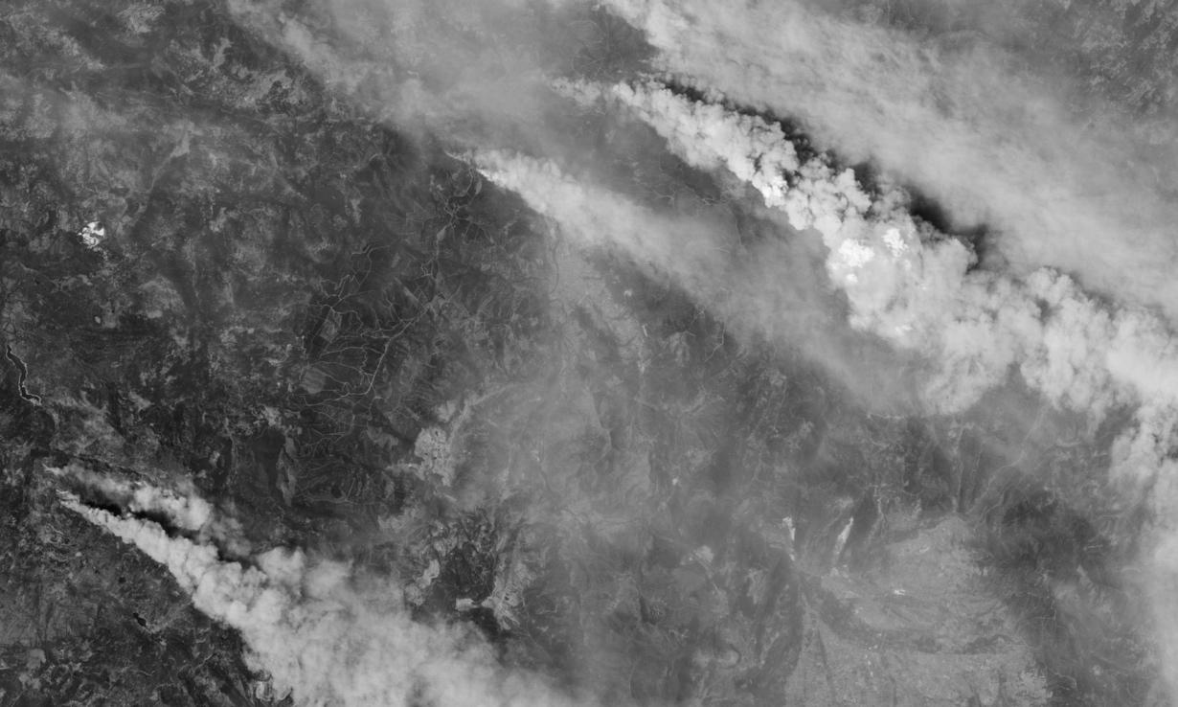

The three pillars of ERS
Connect
Observe
Navigate
Trusted Transport Layer with secure global communication links
At any time
From any location
Persistent
All-weather
Real-time
Rapid tasking
Frequent revisit
Low latency
Resilient positioning resistant against:
Jamming
Spoofing
Interference
→ An integrated system-of-systems to address critical gaps in Europe’s strategic abilities and autonomy
Notes:
Say orally: Rapid tasking / low latency is enabled thanks to the connectivity layer.

Slide 5

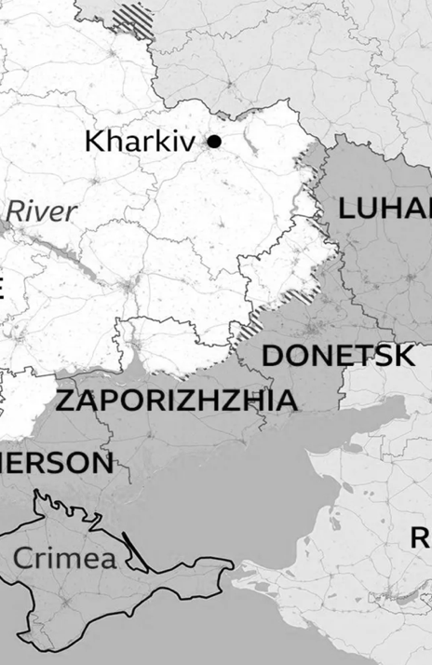
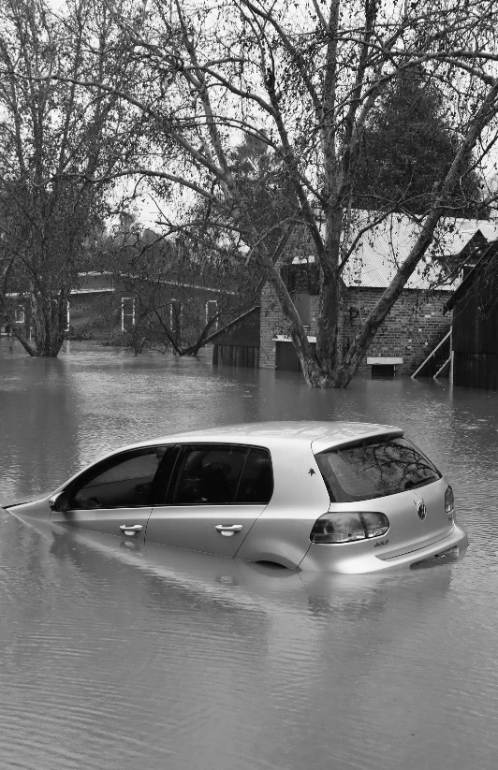



Use cases benefiting from system of system approach
Securing Europe Critical Infrastructures & Assets
Tactical support to military operations
Shaping Peace: Monitoring & Reconstruction
Environmental and Man-made Disasters Management
Surveillance to Counter Irregular Migration

Slide 6
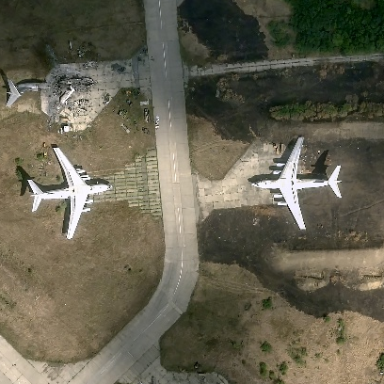
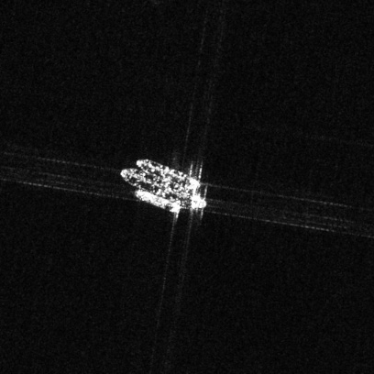
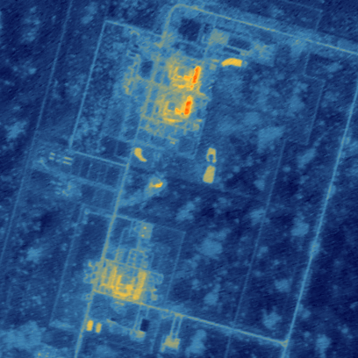

COSMO-SkyMed Image © Italian Space Agency.
Processed and distributed by e-GEOS
ERS-EO
Objectives
Enhanced situational awareness of EU & MS:
    Early detection of crisis,
    Intelligence, Surveillance, Reconnaissance,
    Geospatial support
Contribute to preparedness, support decision-making and action for security and defence
Features
ERS-EO
  EO sensors: VHR optical & radar, possibly advanced sensors
  Fast revisit capability: large EO constellations
  Guaranteed, secure and fast access to data: Global, Reactive, Reliable, Connected
  Security posture meeting both civil and military needs
Element 1
Element 2
Prepare and accelerate EU’s EOGS, based on user needs and security requirements provided by EC
Scalable, adaptable solutions integrating national and multilateral resources
6
Notes:
(cf. EU Space strategy for security and defence (2023), Niinistö report (2024), Preparedness Union Strategy (2025) and ProtectEU – Internal Security Strategy (2025)
Defence use cases:
military activity & industry monitoring
battle damage assessment
military transport & mobility
support to MS military operations & exercises
support to EU missions and operations
non-conventional weapons non-proliferation
Security Use cases:
crisis management and external action (e.g. humanitarian response)
border and maritime surveillance
civil protection (e.g. natural and man-made disasters)
homeland security (e.g. police, critical infrastructure surveillance)
economic intelligence
Strategic
Intelligence, situational awareness
Time scales weeks-months
Authenticity of information, high security level
Operative
Planification of operations, and assessment
Regional Area of Interest, time scales 12-48h
Reliablility and confidentiality
Tactical
Actionable, timely information to the local responder
Time scales of hours (from tasking to delivery)

Slide 7
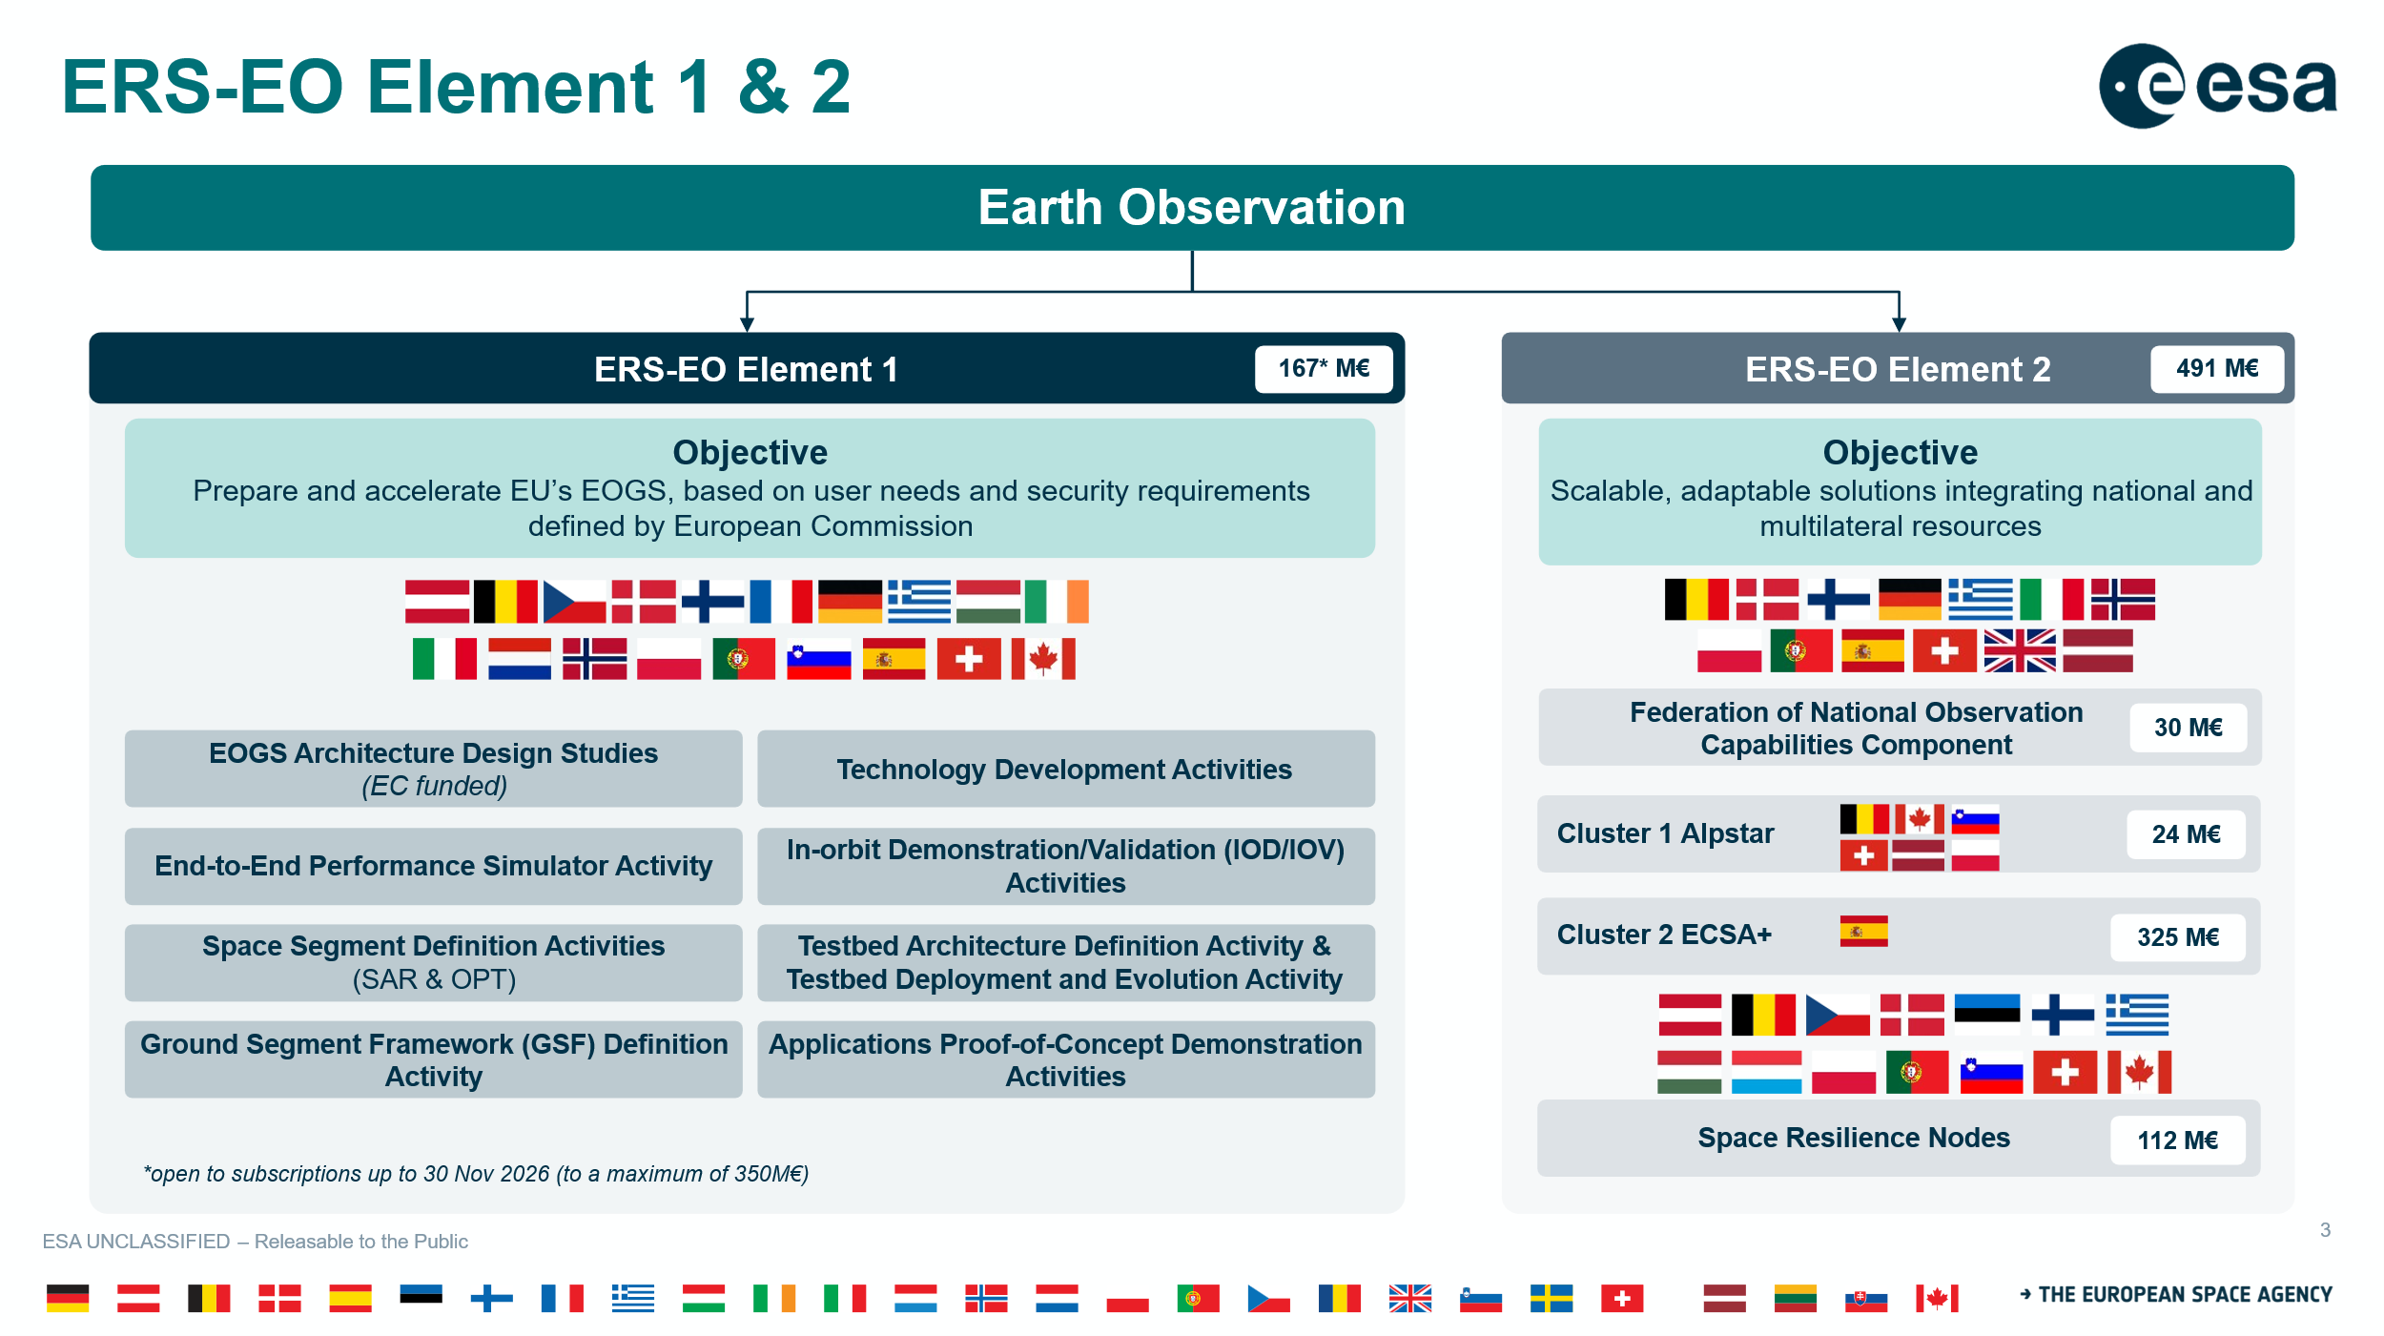























ERS-EO Element 1 & 2
Earth Observation
ERS-EO Element 1
ERS-EO Element 2
167* M€
491 M€
*67M€ temporarily allocated to Phase 2 which will be open to subscriptions in May 2026 (for 250M€)
Objective
Prepare and accelerate EU’s EOGS, based on user needs and security requirements
defined by European Commission
Objective
Scalable, adaptable solutions integrating national and multilateral resources
EOGS Architecture Design Studies
(EC funded)
Technology Development Activities
Federation of National Observation Capabilities Component
30 M€
End-to-End Performance Simulator Activity
In-orbit Demonstration/Validation (IOD/IOV) Activities
Cluster 1 Alpstar
24 M€
Space Segment Definition Activities
(SAR & OPT)
Testbed Architecture Definition Activity & Testbed Deployment and Evolution Activity
Cluster 2 ECSA+
325 M€
Ground Segment Framework (GSF) Definition Activity
Applications Proof-of-Concept Demonstration Activities
Space Resilience Nodes
112 M€

Slide 8
Introduction to EOGS
EOGS
EOGS = European Earth Observation Governmental Service
Provides secure, sovereign, high‑reliability EO capabilities for Member States
Planned under 2028-2034 Multiannual Financial Framework
USERS
USERS
USERS
Sharing Rules
SECURE PLATFORM
EOGS targets civil security and defence users
Federation Layer
EOGS Secure Platform & Federation Layer
The secure platform will provide authorised users with access to task or retrieve SBEO missions’ data from contributing and future dedicated EOGS Space Missions, obtain relevant geospatial‑intelligence products, use data‑processing and analysis tools, and securely distribute resulting data and information
Requests
Data
EOGS Space Component
EOGS-SM
Pooling Rules
GSF
MS-OWNED
ASSETS
COMMERCIAL
OPERATORS
Transport Layer
MS-owned
Assets
MS-owned
MS-owned
EOGS-SM = EOGS Space Mission
Space Segment
Constellation owned by European Commission to complement existing capabilities

Slide 9
Element 1 Coordination with EOGS preparation
User Needs
Issued by the Commission
End-to-end Performance Simulator Activity
Testbed Architecture Definition Activity
Applications PoC Demonstration Activities
Scenarios
Analyses
EOGS Architecture Design Studies*
SRD
Ground Segment Framework Definition Activity
System Requirement Document (SRD)
GSRD
MFF 2028-2034
CM28
*EC funded
PDR
Space Segment Definition Activities
SSRD
SECURE PLATFORM
Space Segment Requirements Document (SSRD)
Federation Layer
TRL6
EOGS-SM
Pooling Rules
Technology Development Activities
Ground Segment Requirement Document (GSRD)
MS-OWNED
ASSETS
COMMERCIAL
OPERATORS
Interface requirements Documents
IOD/IOV Activities
Data
CONOPS Document
TRL9

Slide 10
Users needs / security requirements for ERS-EO
SECURITY
High Level Users Needs
EOGS Risk & Threat Analysis
Performed by EUSPA in coordination with COM, EU MSs, ESA and SatCen
Started in Q4 2025 and Completed in Q1 2026
Used as reference to develop ERS-EO E1 Security Risk Assessment (ESA)
Commission High-Level User Needs (HLUN)
COM HLUN Document v2.1 dated November 2025
Document established by DG DEFIS in coordination with EU Member States, SatCen, EDA, EEAS and other relevant stakeholders
EOGS General Security Requirements
Based on the results of the EOGS RTA
Currently under COM MSs endorsement → COPERNICUS SWG AND SPC-SC.
To be used as AD for relevant ERS-EO E1 procurements
High Level military needs
Approved by EDA steering Board on 22 April 2026
Political and Security Committee High-level civil-military needs
In preparation by EEAS
Established in consultation with DG-DEFIS
To date no significant deviation on technical needs from COM HLUN v2.1
Should any relevant changes arise ESA will be promptly informed
EOGS Security Classification Guide
Based on the results of the EOGS RTA and inputs from EU MSs users
Currently under COM MSs endorsement → COPERNICUS SWG AND SPC-SC.
To be used as AD for the ERS-EO E1 Security Classification Guide (ESA)
Letter received from DEFIS.D.3/LF on 11/05/2026:
Confirms that HLUN v2.1 is fully in line with the user needs and expectations of the European Commission for the Earth Observation Governmental Service (EOGS).
Recommends that ESA proceed with the continuation of ERS-EO Element 1 activities as proposed in the Implementation Plan on the basis of HLUN v2.1
9 June: ESA SEC has:
Approved the Programme Security Instructions
Acknowledged the Security Classification Guide
Informed of the Security Sensitive Items list

Slide 11



ERS-EO timeline
ERS-EO Element 1 activities & EC Architecture Studies procurement progressing on schedule
MFF 28-34
2026
2027
2028
2029
EOGS PDR
2 activities
EOGS Architecture Design Studies (EC funded)
TEB held
PREPARE
SRR
1 activity
End-to-End Performance Simulator Activity
Kicked-off
4 activities
Space Segment Definition Activities (SAR & OPT)
EOGS
Space Component
DE-RISK
PDR
1 activity TBC
Ground Segment Framework (GSF) Definition Activity
PDR
N activities
Consolidation
Technology Development Activities
ITT issued
N activities
Consolidation
In-orbit Demonstration/Validation (IOD/IOV) Activities
TEB held
ACCELERTATE
1 activity
Testbed Architecture Definition Activity & Testbed Deployment and Evolution Activity
ITT issued
N activities
Applications Proof-of-Concept Demonstration Activities

Slide 12
2. Consolidation of the overall System Architecture
EOGS Architecture Design Studies
(EC funded)
End-to-End Performance Simulator Activity
Define the EOGS architecture, functional elements and major requirements
Assess existing national/commercial capacities and identify gaps
Produce preliminary system concepts, security architecture, CONOPS and documentation (SRD, IRDs)
Identify deployment strategy, cost ranges and programme risks
➔ ITT Closed – TEB held
Models the full tasking‑to‑delivery chain across space, ground and communications layers
Supports architectural trade‑offs and sensitivity analyses
Provides quantitative performance metrics (coverage, timeliness, responsiveness)
Supplies iterative versions aligned with the architecture and mission‑definition activities
➔ Kick-off with GMV held 16 June

Slide 13
2. Development Activities
Technology Development Activities
In-orbit Demonstration/Validation (IOD/IOV) Activities
Mature critical EOGS‑enabling technologies to TRL 6 by 2028
Focus on technologies needed for EOGS in the very short term and compatible with a maximum of potential primes
DEV-A: RF ISL
DEV-B: Optical ISL rooter
DEV-C: Security unit
DEV-D: Resilient GNSS receiver
Coordinated tightly with Space and Ground Segment Definition activities
➔ Open Competition ITT – on-going
Early validation of priority technologies to de‑risk major system choices
Four themes identified through the 2025 RFI and system‑gap analysis
Launches targeted before November 2028
➔ ITT Closed – TEB held

Slide 14
2. End‑to‑End Proof‑of‑Concept Activities
Testbed Architecture Definition Activity
& Testbed Deployment and Evolution Activity
Applications Proof-of-Concept (PoC)
Demonstration Activities
Defines a secure and scalable test framework for the integration and extensive testing of ERS‑EO applications
Provides a robust testing environment aligned with PoC‑driven technical, performance, and security requirements
Leverages advanced IT resources and relevant external data ecosystems
Deploys and evolves the testbed to support continuous PoC development, testing, and high‑performance workflows
➔ Open Competition ITT released
Demonstrates enhanced downstream applications enabled by future EOGS capabilities
Conducted with SatCen as key user and validation authority
Focuses on realistic, high‑value applications (initially critical‑infrastructure monitoring)
Covers full workflows, including data access, fusion, AI/ML processing, and information delivery
➔ Open Competition ITT intended in July 2026
Industry day
planned
on 1 July

Slide 15
2. EOGS Space Mission (EOGS-SM) Definition Activities
Space Segment Definition Activities
Ground Segment Framework (GSF)
Definition Activity
Four parallel industrial contracts: two optical, two SAR (TBC)
Mature candidate satellite designs to PDR level.
Dual‑sourcing to reduce dependency and increase resilience
Assess design space, performance, critical technologies and implementation risks
Ensure alignment with launcher compatibility, communications layer and security requirements
➔ Open Competition ITT intended for Q1 2027
Establish a modular, scalable Ground Segment architecture:
Integrate Mission Planning (MP), Flight Operations (FOS), Data Generation and Management (DGM), Security Operation Coordination (SEC) domains
Define interfaces with the Secure Platform, space‑segment designs and data‑transport layer.
Deliver operational concepts, functional chains, ICDs and PDR‑ready package
➔ Open Competition ITT intended for Q1 2027

Slide 16
Information on ERS-EO Element 2
ERS-EO Element 2
Objective
Scalable, adaptable solutions integrating national and multilateral resources
Federation of National Observation Capabilities
Cluster 1 Alpstar
Cluster 2 ECSA+
Space Resilience Nodes

Slide 17
ERS-EO timeline (Element2)
ERS-EO Element 2 activities procurement progressing on schedule
2026
2027
2028
2029
Assessment
FNOC
Simulation and definition P&S
Technical interoperability
Future Clusters phase 0
Generic Node Definition
Kicked-off
ALPSTAR
Federated Layer definition and implementation
ITT 3/07
Phase AB1 X-band SAR and ELINT
ITT 3/07
Industrial System Architect
ESCA+
Space Segment Activities (RF & OPT)
Ground Segment Activity
User needs and initial developments
ITT issued
User need harmonisation study
SRN
Specific / Generic
Generic new product development
Innovative products and services
Reference framework for SRN
Notes:
FNOC: (2026 WP)
(A) Assesment of exisiting capabilities - 6 month study Q3 2026
(B) Defining P& S governance:
(B1) Simulation campaigns support - 12 month DN, Q4 2026
(B2) FNOC Sharing and Pooling rules study, 9 month, ITT, Q1 2027
(B3) Federated access to commercial capacity 6 month, ITT, Q1 2027
(C) Preparing technical interoperability
(C1) Gap analysis and development roadmap3 contracts (DN with design authority of candidate systems), 9 month, Q1 2027
(C2) Blueprint methodology to on-board and federate NOC products
(C3) Proof of Concept of SRN Pooling and sharing architecture
(C4) Potential use of SRN for Cluster data access
(D) Initiating future clusters
(D!) phase 0 ITT, 9 month, Q4 2026

Slide 18
ERS-EO Element 2 Federation of National Observation Capabilities
Federation of National Observation Capability (FNOC) establishes an a posteriori federated system of systems, based on voluntary and modular participation, fully preserving national missions, governance frameworks and sovereignty. Activities in FNOC are targeted to allow heterogeneous national solutions to interoperate in a predictable and auditable manner.
2026 work plan main objectives: focus on the conditions for federation:
Taking stock of existing capabilities
transparent and trusted baseline of national EO systems that could be shared
Defining Pooling & Sharing governance:
identifying interested Partners per system,
Preparing technical interoperability
defining reference interface requirements, compatible with EOGS and SRNs,
Initiating future Clusters
Following Alpstar model to mature candidate ERS‑EO Clusters from 2027 onward.
selecting pilot systems (partner‑access test cases),
roadmap for future enabling developments.
simulations on representative scenarios to assess pooling mechanisms, including SPIDER/EOGS architectural concepts.
By mid-2027, FNOC will deliver a clear, shared and technically credible basis for moving from national systems to a federated European EO capability, fully aligned with EOGS, SRNs and future ERS‑EO Clusters.
Notes:
FNOC addresses the need to establish a European EO system-of-systems by leveraging
nationally owned and operated EO space and ground assets, while fully preserving national
missions, governance frameworks and sovereignty. It is conceived as a federation layer
enabling coordination and controlled access without imposing changes to national command
chains, ownership, tasking authority, security posture, classification practices or data
release rules. Participation is therefore voluntary and modular: each Participating State
determines which capabilities (e.g., acquisitions, downlink, processing, products or services)
may be made available, under which access conditions, to which Partners and for which
purposes.
Federation is achieved a posteriori for existing systems through a jointly agreed set of
governance framework elements, operational rules, reference interfaces and aligned
security postures that allow heterogeneous national solutions to interoperate in a predictable
and auditable manner.
Four tightly linked objectives:
Taking stock of existing capabilities: creating a transparent and trusted baseline of unclassified and/or dual‑use national EO systems that could be shared, including spare capacity, operational concepts and existing access arrangements.
Defining Pooling & Sharing governance: identifying interested Partners per system, using simulation on representative scenarios to derive fair and workable sharing rules, and assessing common pooling mechanisms, including SPIDER/EOGS architectural concepts.
Preparing technical interoperability: defining reference interface requirements, compatible with EOGS and SRNs, selecting pilot systems for partner‑access test cases, and establishing a roadmap for future enabling developments.
Initiating future Clusters: collecting user needs on an Alpstar‑type model, screening potential multinational projects, and framing candidate ERS‑EO Clusters for maturation from 2027 onward.

Slide 19

ERS-EO Element 2 – ALPSTAR cluster
ALPSTAR is an ESA-led, dual‑use programme within the European Resilience from Space – Earth Observation (ERS‑EO) framework whose purpose is to enable resilient, sovereign, and interoperable cooperation between the ALPSTAR Participating States in the tasking, operation and data sharing of space‑based and ground‑based sensing assets as to decrease dependence on ISR from outside Europe.
Switzerland Belgium
Poland
Slovenia
Latvia
Canada
Sharing of assets:
Ground station services
Satellites
Data

Slide 20
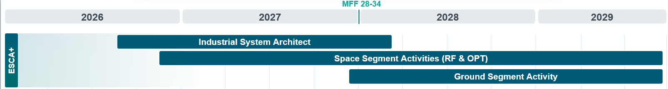
ESCA+
ESCA+ is an ESA-led, dual‑use programme within the European Resilience from Space – Earth Observation (ERS‑EO) framework and forms the Spanish Cluster of element 2, the aims of which are as follows:
Developing a mission that contributes to increasing resilience for disasters and emergencies management by reducing data delivery time to the users
    Natural disasters (volcano eruptions, flood and wildfire)
    military use cases (regional surveillance and ISR).
Giving continuity to the capabilities developed at ESCA
Ensuring interoperability with similar national, regional and European satellite systems considering the pooling and sharing mechanisms developed in the frame of the ERS-EO Programme.

Slide 21
ERS-EO Element 2 - Space Resilience Nodes
Definition: A Space Resilience Node (SRN) comprises digital (e.g. software, data), physical (e.g. hardware, facilities), and human (i.e. expertise) components to enable users to swiftly and easily access space-enabled solutions to support crisis management and civil protection.
2026 work plan main objectives:
SRN user needs and initial development: Collection of national SRN user needs through a series of feasibility studies, turning user needs into requirements, and identifying requirements that are common across SRNs, as well as consolidating existing SRNs and their service offer (building on CSS legacy projects).
Development of a reference solution for SRN and for Pooling and Sharing (P&S) across Nodes: Defining and developing a Minimum Viable Product for SRN instantiation, as well as to enable a reference architecture for Pooling & Sharing (P&S) of products across SRNs. This will entail the development of open software, interfaces, and standards, some demo use cases, as well as close coordination across SRN users and industry.
Product development and operationalisation to be offered through SRNs and via their associated P&S mechanisms.

Slide 22
Thank you

