Slide 1
Advanced AI applications in EO: fine-tuning foundation models
Dr. Lorenzo Papa, Dr. Ruben Cartuyvels, Dr. Valerio Marsocci
Internal Research Fellows, ESA ESRIN Frascati, Rome, Italy
Email: [lorenzo.papa, ruben.cartuyvels, valerio.marsocci]@esa.int

Slide 2
Outline
What are Geospatial Foundation Models?
How do we obtain a GFM?
Benchmarking GFMs
Conclusion
https://github.com/lorenzopapa5/BiDs_training_course_2025/tree/main

Slide 3
WHAT ARE GEOSPATIAL FOUNDATION MODELS?

Slide 4

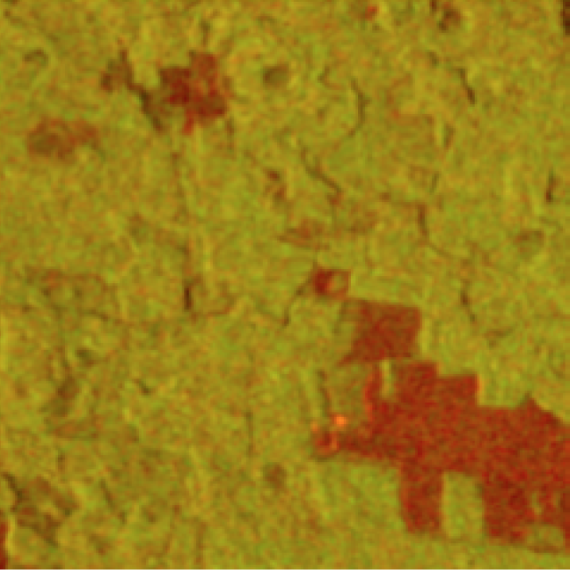
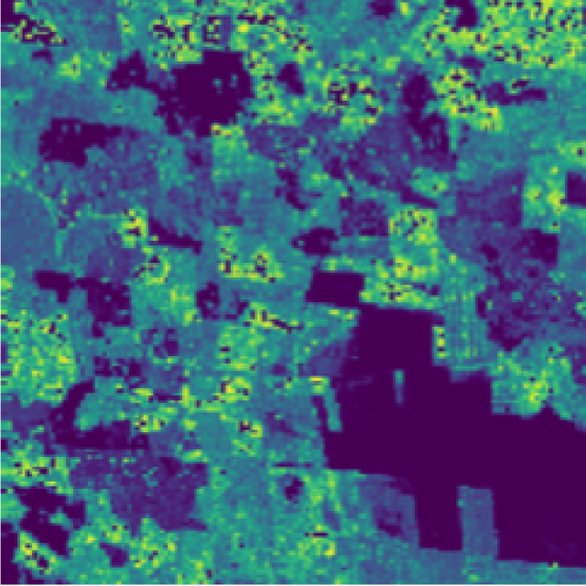
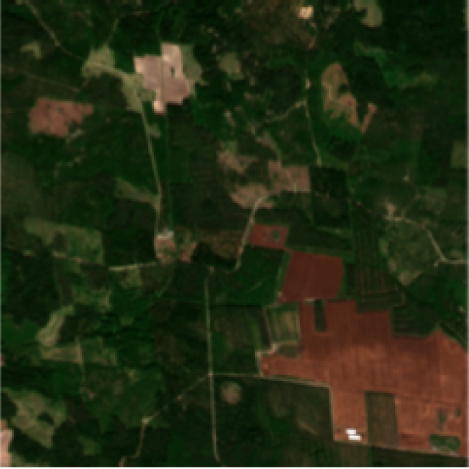
Think of a problem connected to an SDG
Notes:
Sustainable development goal e come usare immagini da satellite → vuoi stimare la biomassa (h degli alberI)

Slide 5

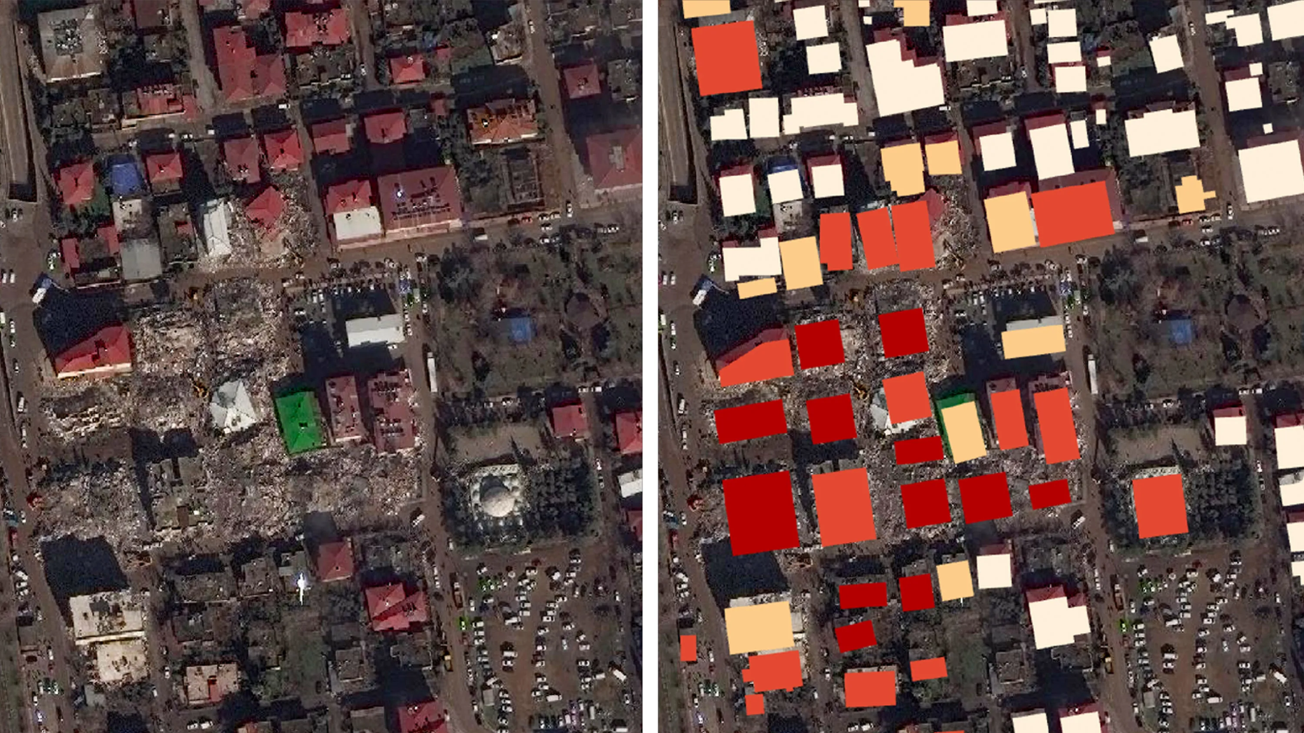
Think of another one
Notes:
Se con stesso modello altro problema? Tipo mappare I damage building? (nuovo modello? Come Lavoro su entrmabi?) nuovo satellite/task/risoluzione?

Slide 6

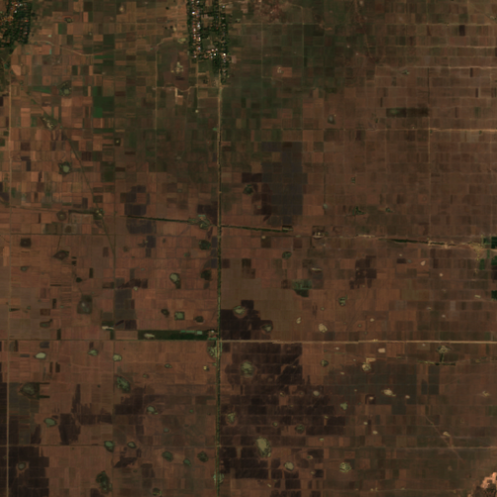
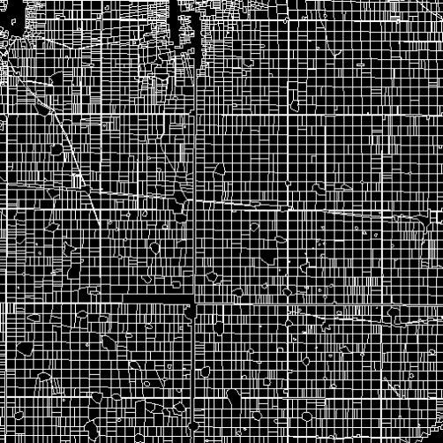
One more
Notes:
E se invece segmentazione → boundary field delimitation? Agricolture?

Slide 7
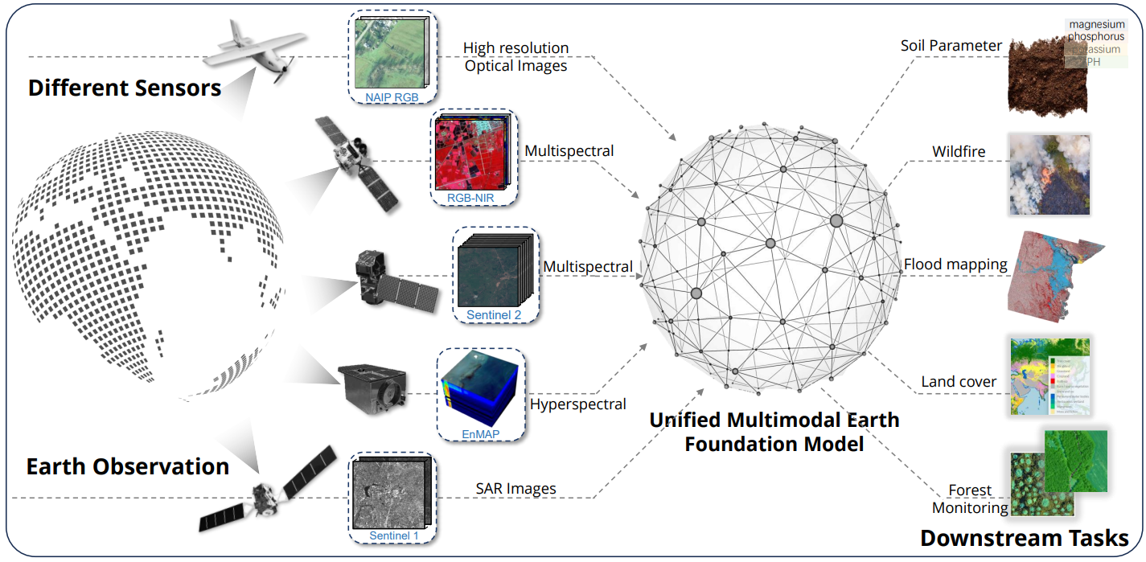
How to solve all these tasks with the same model?
Let’s use a Geospatial Foundation Model
​​​
task agnosticism
spatio-temporal awareness
sensor agnosticism
multimodality
adaptability
Source: DOFA - 2403.15356
Notes:
To do so … GFM …

Slide 8
What Are Geospatial Foundation Models?
Geospatial foundation models are large-scale AI models trained on vast amounts of diverse geospatial data
GFMs learn temporal and spatial patterns, relationships, and features across different geographic scales

Slide 9
What Are Geospatial Foundation Models?
Task Agnosticism
Not limited to a single task Can generalize across multiple geospatial applications
Enhances scalability & efficiency Reduces need for retraining and Supports diverse use cases

Slide 10
What Are Geospatial Foundation Models?
Spatio-temporal awareness
Model understands both spatial (geographic) and temporal (time-related) patterns
Essential for dynamic applications like climate monitoring, disaster response, and urban development

Slide 11
What Are Geospatial Foundation Models?
Sensor agnosticism
Model can process data from various sensors (e.g., satellite, UAV, LiDAR)
Increases versatility
Allows integration of diverse data sources

Slide 12
What Are Geospatial Foundation Models?
Multimodality
Model integrates and processes multiple types of data (e.g., imagery, text, GIS, data point)
Provides richer insights by leveraging diverse information

Slide 13
What Are Geospatial Foundation Models?
Adaptability
Model can be easily fine-tuned or adjusted for different tasks or datasets
Reduces the need for retraining from scratch, saving time and resources

Slide 14
DEVELOPING GEOSPATIAL FOUNDATION MODELS

Slide 15
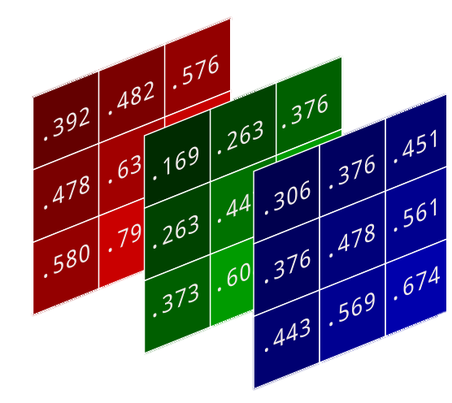
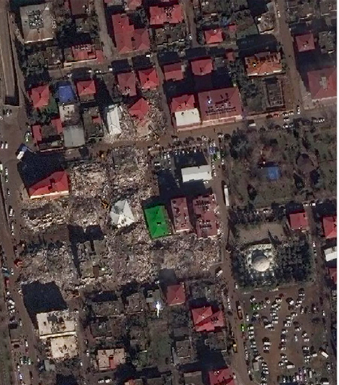
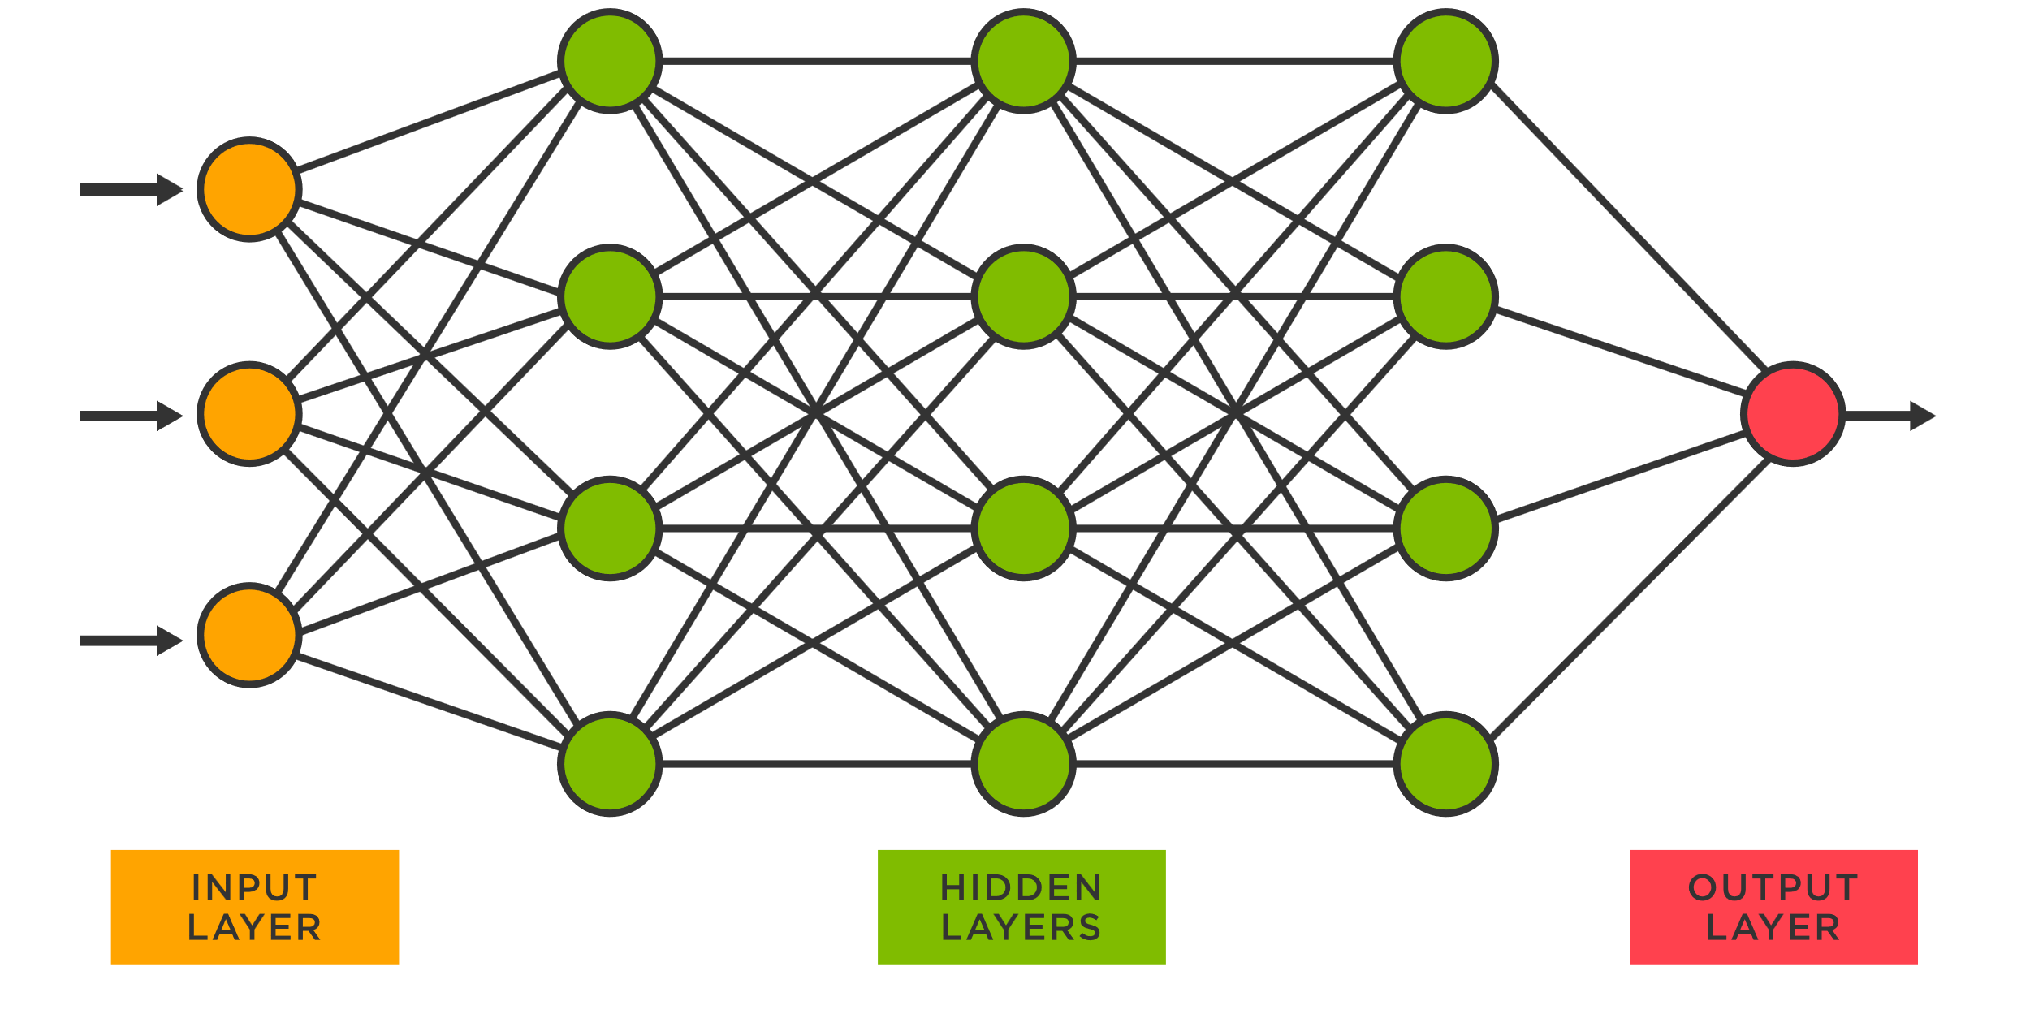
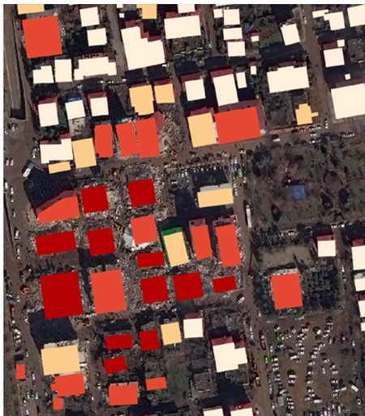
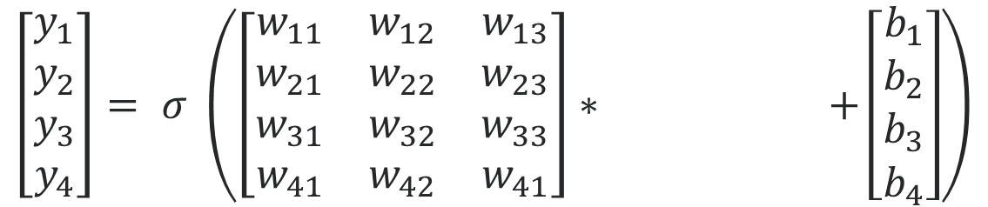
Neural networks (short recap)
$$\left[\begin{matrix}y_{1} \\ y_{2} \\ y_{3} \\ y_{4}\end{matrix}\right]= σ \left(\left[\begin{matrix}w_{11} & w_{12} & w_{13} \\ w_{21} & w_{22} & w_{23} \\ w_{31} & w_{32} & w_{33} \\ w_{41} & w_{42} & w_{41}\end{matrix}\right]∗ +\left[\begin{matrix}b_{1} \\ b_{2} \\ b_{3} \\ b_{4}\end{matrix}\right]\right)$$
Notes:
Hidden layer

Slide 16

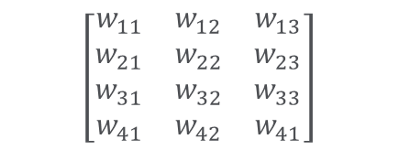
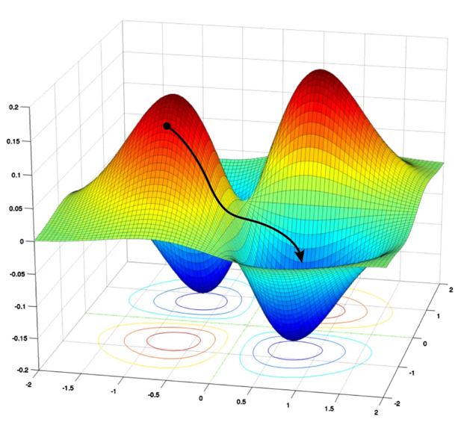







Neural networks (short recap)
$$\left[\begin{matrix}w_{11} & w_{12} & w_{13} \\ w_{21} & w_{22} & w_{23} \\ w_{31} & w_{32} & w_{33} \\ w_{41} & w_{42} & w_{41}\end{matrix}\right]$$
$$\left[\begin{matrix}w_{11} & w_{12} & w_{13} \\ w_{21} & w_{22} & w_{23} \\ w_{31} & w_{32} & w_{33} \\ w_{41} & w_{42} & w_{41}\end{matrix}\right]$$
$$\left[\begin{matrix}w_{11} & w_{12} & w_{13} \\ w_{21} & w_{22} & w_{23} \\ w_{31} & w_{32} & w_{33} \\ w_{41} & w_{42} & w_{41}\end{matrix}\right]$$
$$L$$
Objective function:
$L( ,$ $)=2.4 ❌$
$$w_{11}$$
x
x
Current $w$ values
$$w_{12}$$
Better $w$ values

Slide 17

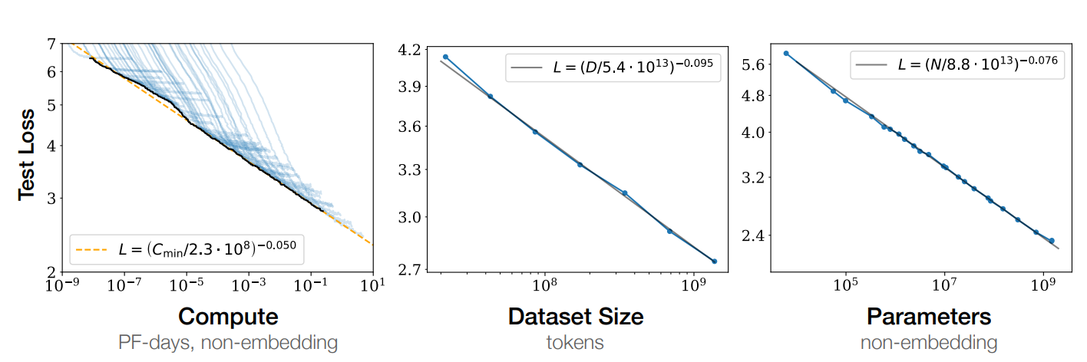
Neural networks need a lot of data
Kaplan, Jared, et al. "Scaling laws for neural language models." arXiv preprint arXiv:2001.08361 (2020).
Notes:
Bigger the dataset e model – lower is the error, risolvi meglio il task in Foudation Models (focus su LLM)

Slide 18
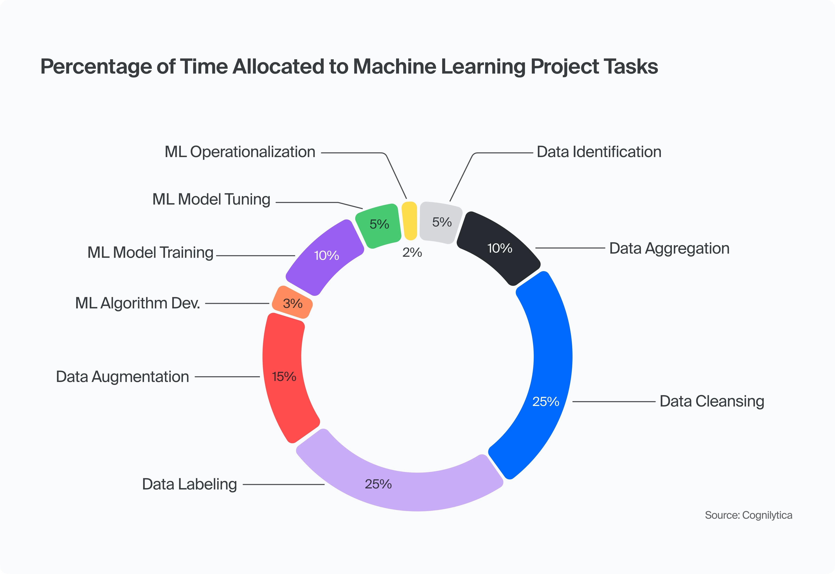
(Labelled) data is expensive
Cognilytica, A. I. "Data Engineering Lifecycle Checklist." (2020).

Slide 19
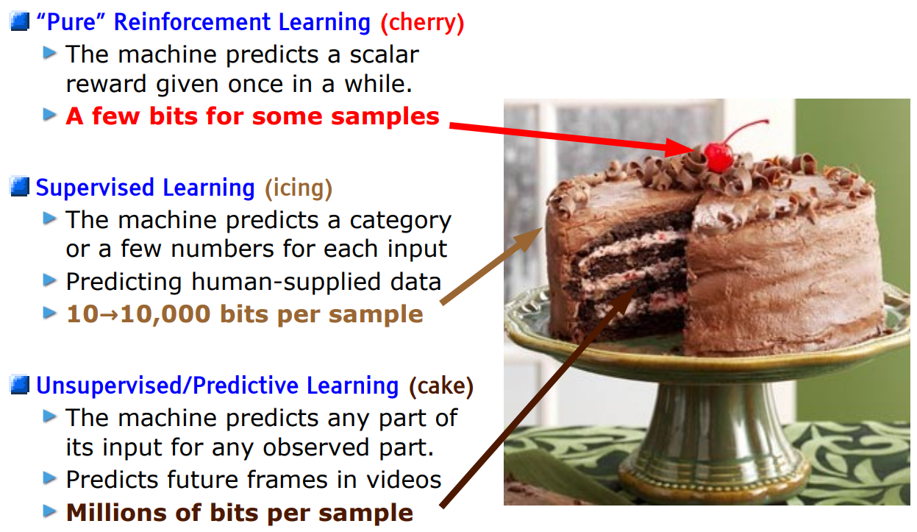
Make optimal use of information contained in data
Cognilytica, A. I. "Data Engineering Lifecycle Checklist." (2020).

Slide 20
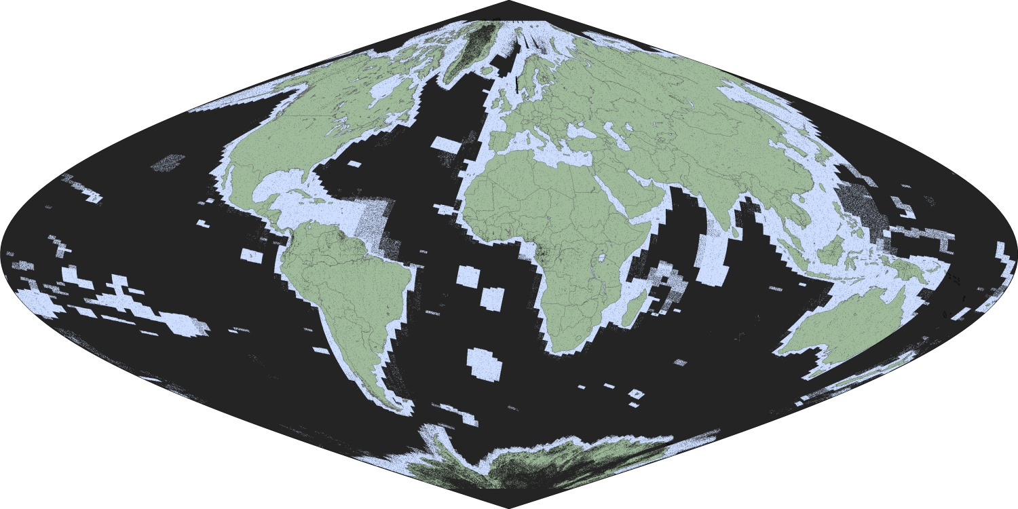
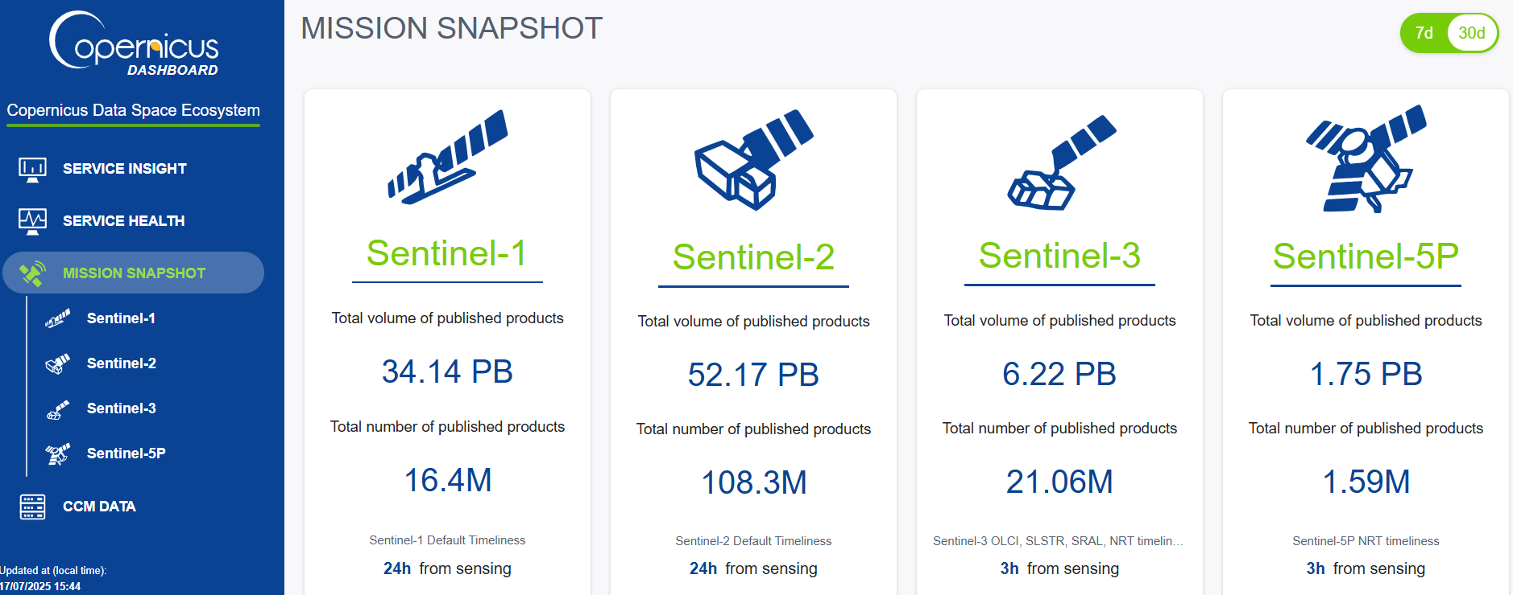
There is a lot of EO data
https://dashboard.dataspace.copernicus.eu/#/mission-snapshot
https://philab.esa.int/hello-major-tom-esa-%CF%86-lab-releases-largest-ml-ready-sentinel-2-dataset-ever-published/

Slide 21
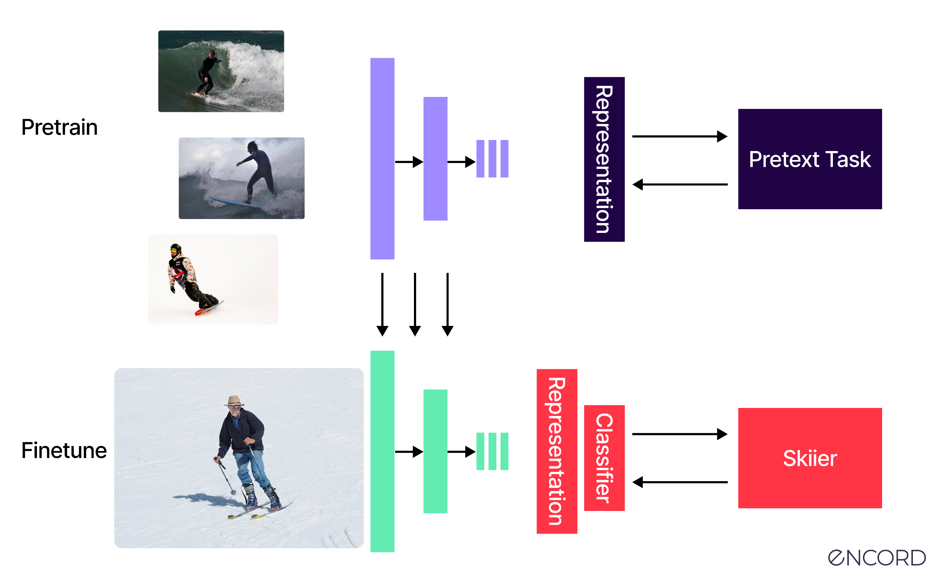
Self-supervised learning
https://encord.com/blog/self-supervised-learning/
Notes:
Encoder e’ sempre lo stesso → nel primo impari rappresentazioni di dati senza labels (come rotazione, no label manuali) // sotto classificazione dopo aver Imparato le features (nella seconda parte ho le lables) → CON IL Pretext Task l idea e’ di imparare la rappresentazione dei dati

Slide 22
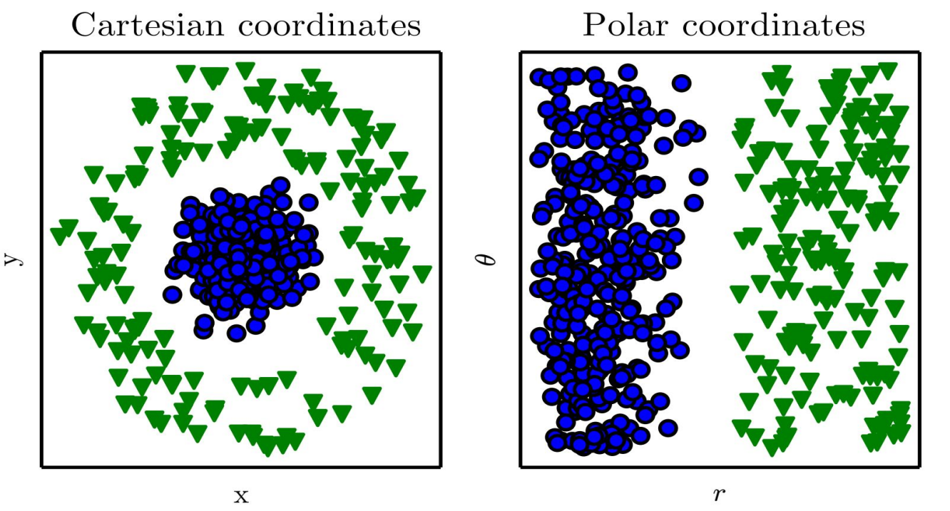
Representations are important
Rotation example
https://encord.com/blog/self-supervised-learning/
Notes:
Per esempio, la rotazione puo’ essere imparata come rototraslazioni cartesiane o polari dipende dal task …

Slide 23
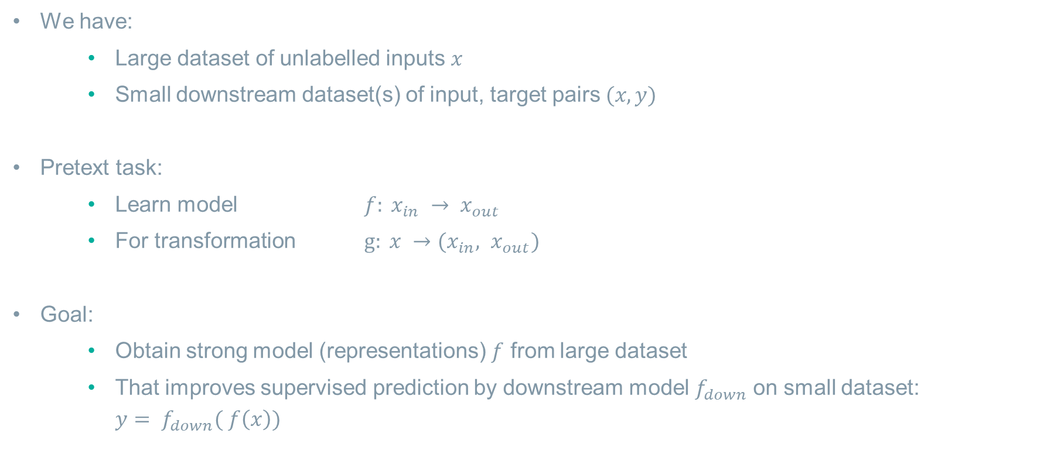
Self-supervised learning
We have:
Large dataset of unlabelled inputs $x$
Small downstream dataset(s) of input, target pairs $(x, y)$
Pretext task:
Learn model $f: x_{in} → x_{out}$
For transformation $g: x →(x_{in}, x_{out})$
Goal:
Obtain strong model (representations) $f$ from large dataset
That improves supervised prediction by downstream model $f_{down}$on small dataset: ${y= f}_{down}( f\left(x\right))$

Slide 24
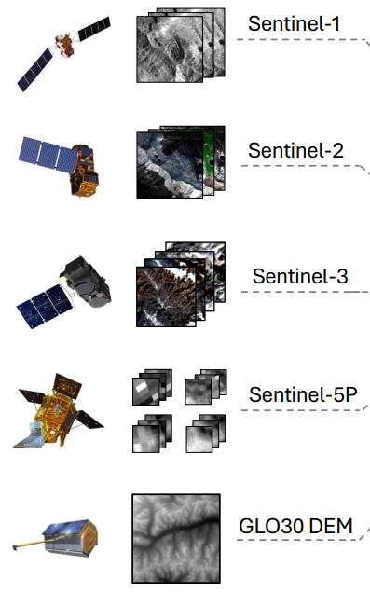
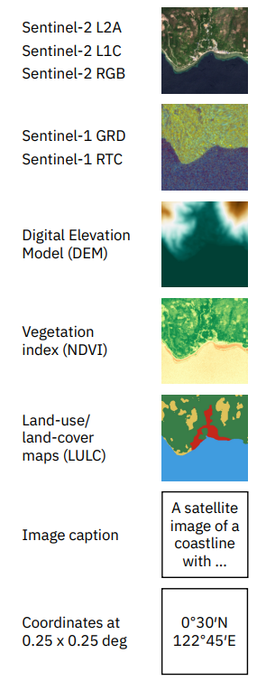
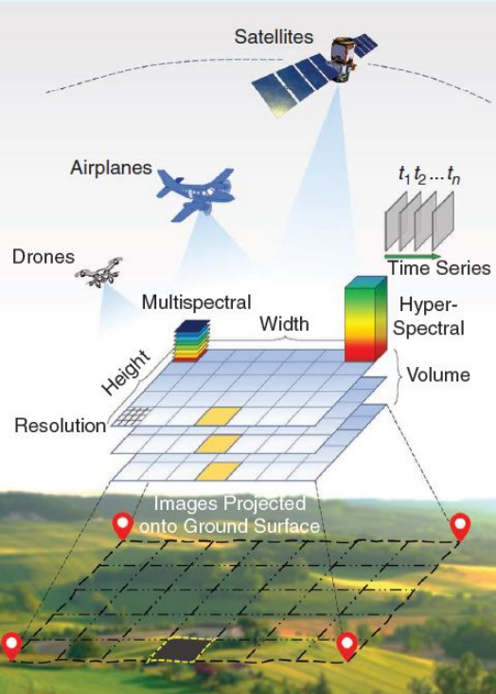
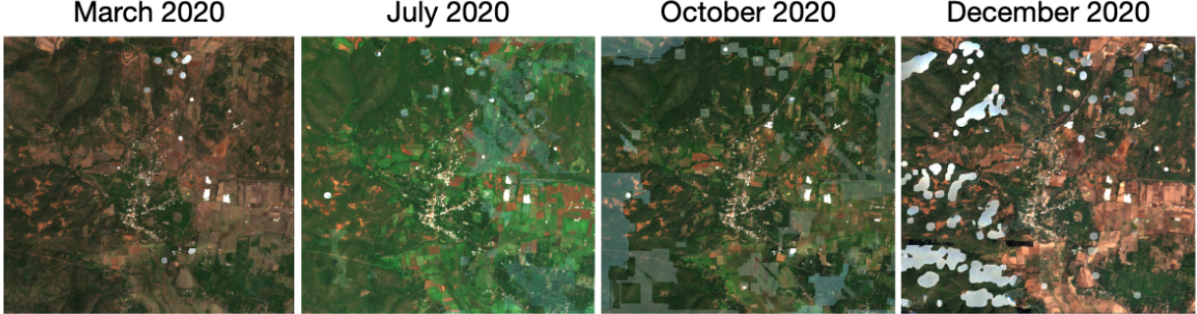
Input modalities
Wang, Yi, et al. "Towards a unified copernicus foundation model for earth vision." arXiv preprint arXiv:2503.11849 (2025).
Tseng, Gabriel, et al. "Lightweight, pre-trained transformers for remote sensing timeseries." arXiv preprint arXiv:2304.14065 (2023).
Jakubik, Johannes, et al. "Terramind: Large-scale generative multimodality for earth observation." arXiv preprint arXiv:2504.11171 (2025).
Schmitt, Michael, et al. "There are no data like more data: Datasets for deep learning in earth observation." IEEE Geoscience and Remote Sensing Magazine 11.3 (2023): 63-97.

Slide 25
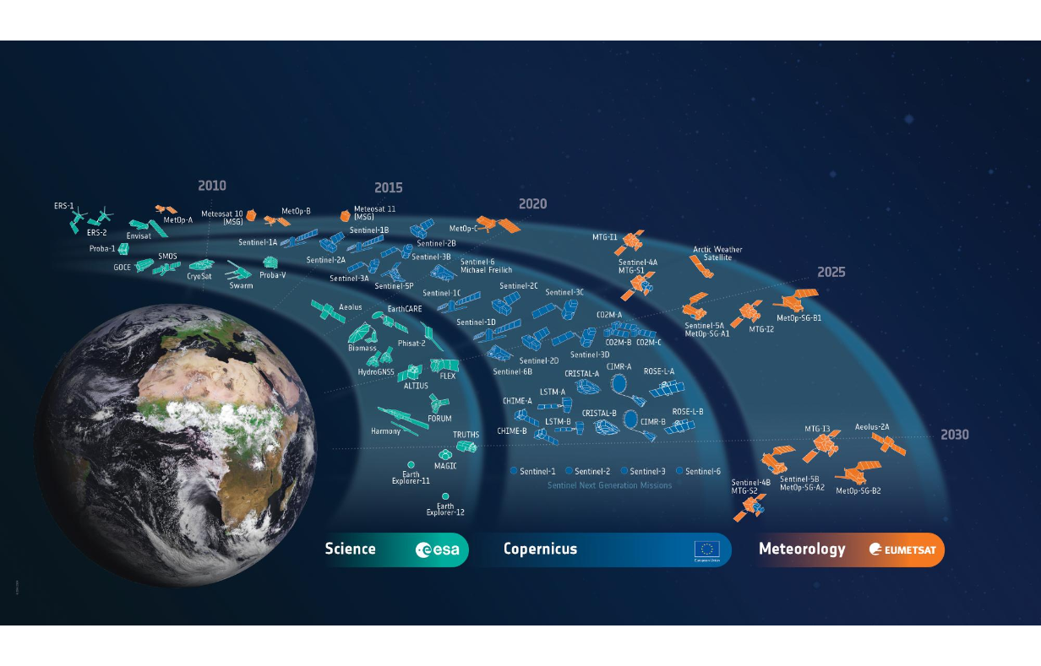
Input modalities

Slide 26
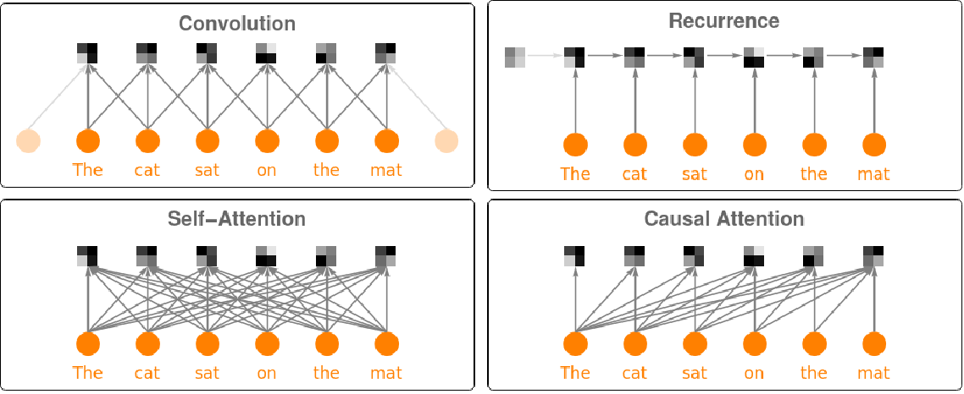
Architectures
Convolutional Neural Networks (CNNs):
Local, spatial feature extraction
Recurrent Neural Networks (RNNs):
Process sequential data step by step, ideal for time-series analysis
Transformers:
(Self-)attention to capture global spatial, temporal, inter-modality relationships
Train in parallel so especially fit for large datasets
https://www.wolfram.com/language/12/neural-network-framework/use-transformer-neural-nets.html

Slide 27
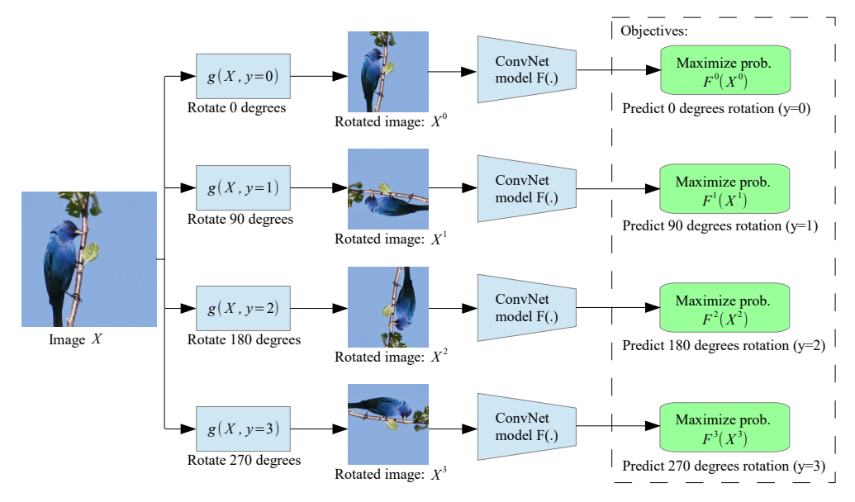

Learning metadata
SSL:
Learn model $f: x_{in} → x_{out}$
For transformation $g: x →(x_{in}, x_{out})$
Learning rotations:
$x_{out}= angle ∈$ {0, 90, 180, 270}
$g: x →(x_{rotated}, angle)$
Gidaris, Spyros, Praveer Singh, and Nikos Komodakis. "Unsupervised representation learning by predicting image rotations." arXiv preprint arXiv:1803.07728 (2018).
Notes:
Esempio di SSL (la rotazione la dai come input insieme all imagine)

Slide 28
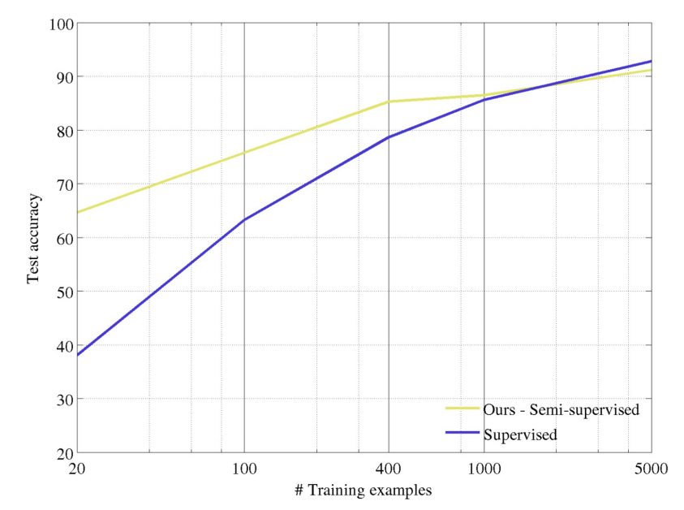
Learning metadata
Gidaris, Spyros, Praveer Singh, and Nikos Komodakis. "Unsupervised representation learning by predicting image rotations." arXiv preprint arXiv:1803.07728 (2018).

Slide 29
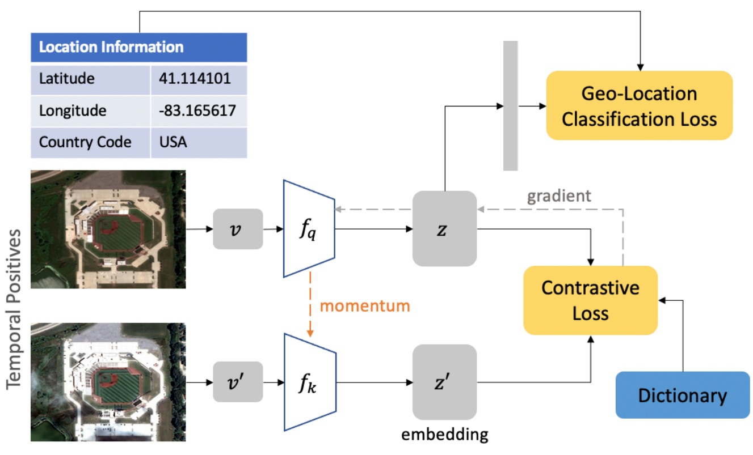
Learning metadata: Geography-aware self-supervised learning
Ayush, Kumar, et al. "Geography-aware self-supervised learning." Proceedings of the IEEE/CVF International Conference on Computer Vision. 2021.
Notes:
Esempio di SSL → in caso da satellite due coppie di immagini in 2 timestep differenti e voglio imparare che insistano sulla stessa zona. Predire anche la location → representations invariant from the time transformation.
Contrastive loss = se immagini uguale loss minima
IN pretext task solo metadata, stesso o diverso. Nel downstream task classificazione, segmentation , ecc … dipende dalle labels …

Slide 30
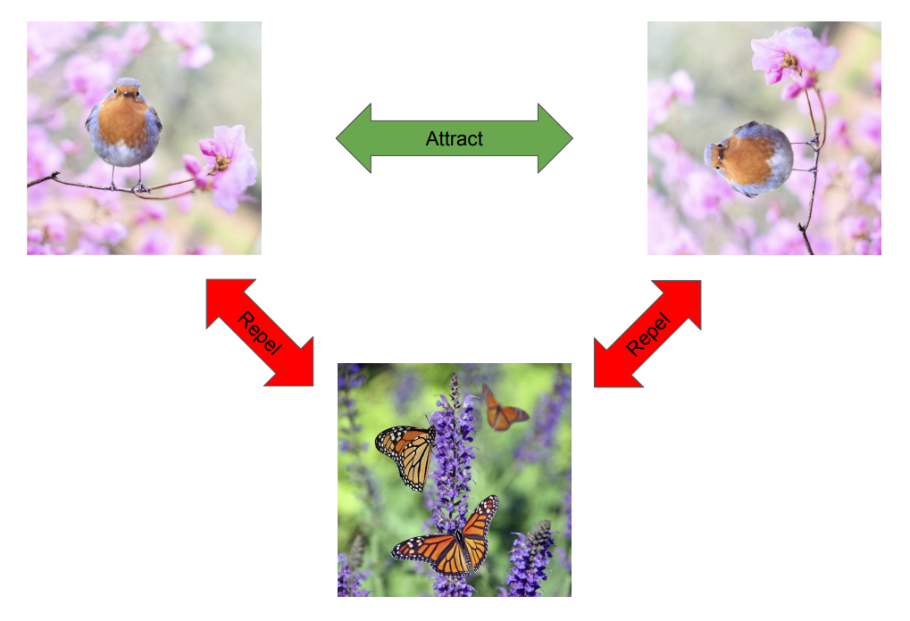
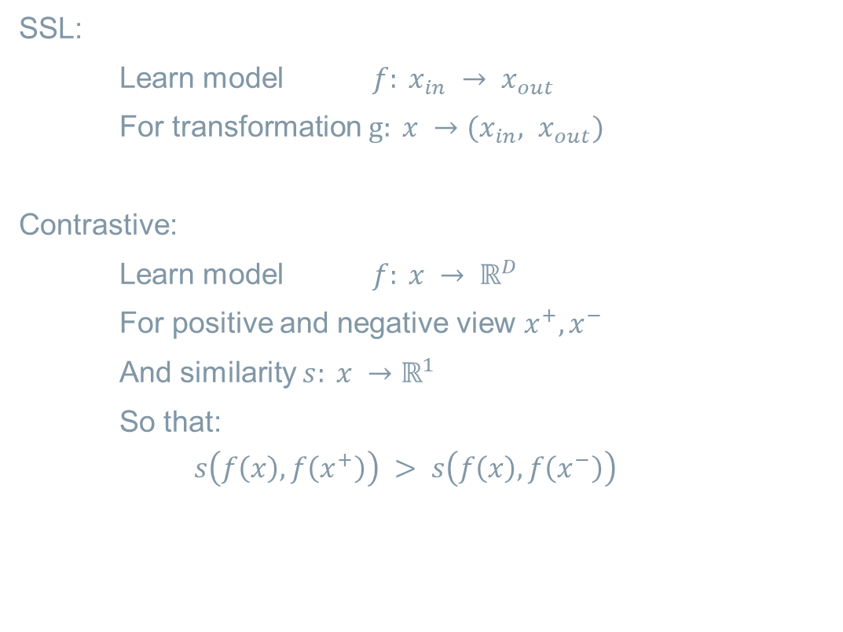
Contrastive learning
SSL:
Learn model $f: x_{in} → x_{out}$
For transformation $g: x →(x_{in}, x_{out})$
Contrastive:
Learn model $f: x → ℝ^{D}$
For positive and negative view $x^{+},x^{−}$
And similarity $s: x →ℝ^{1}$
So that:
$$s\left(f\left(x\right), f\left(x^{+}\right)\right) > s\left(f\left(x\right), f\left(x^{−}\right)\right)$$

Slide 31
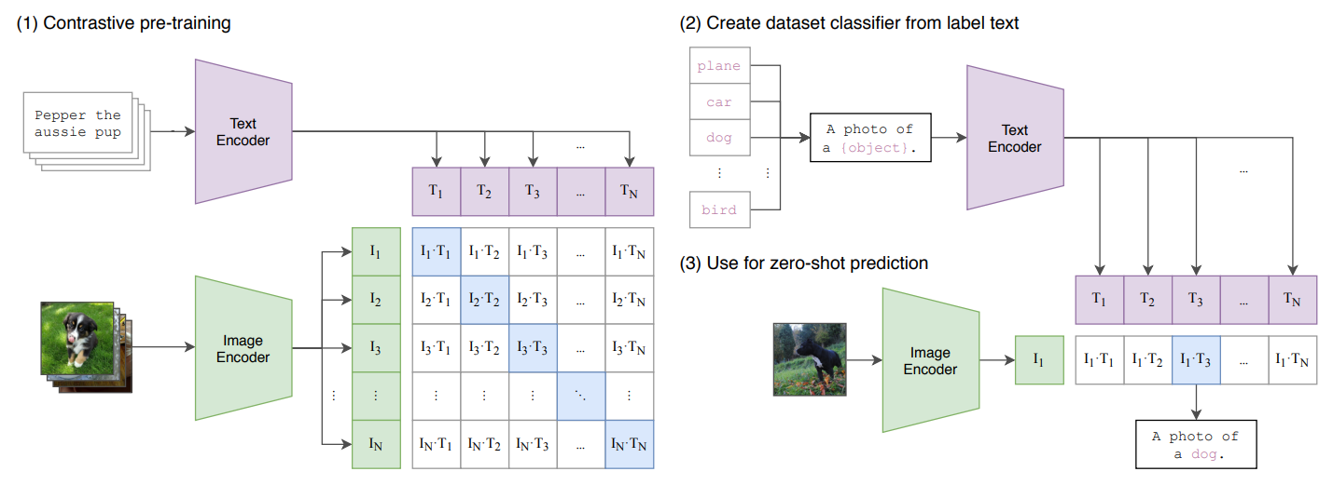
CLIP
Radford, Alec, et al. "Learning transferable visual models from natural language supervision." International conference on machine learning. PmLR, 2021.
Notes:
Esempio SSL → Testo + immagini (coppia) → si assume che la maggior parte delle coppie siano abbastanza corrette (foto + didascalia) → in base a cio impara una similitude incroiata tra immaigni e testo (matrice) nel batch e tutte le alter sono considerate negative → aumentare la similarita’’(loss) → problema con batch piccoli ma s resolve con batch grandi → impara la corerenza

Slide 32
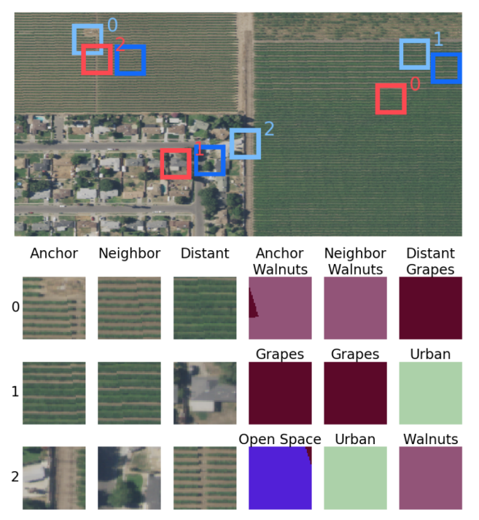
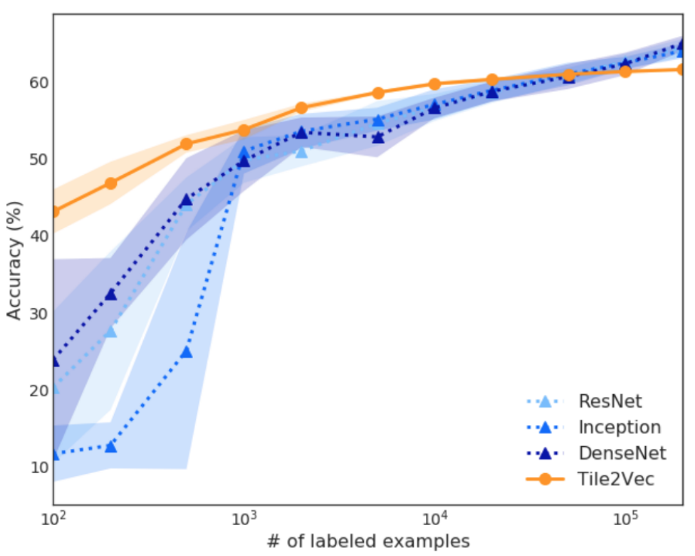
Tile2vec
Jean, Neal, et al. "Tile2vec: Unsupervised representation learning for spatially distributed data." Proceedings of the AAAI Conference on Artificial Intelligence. Vol. 33. No. 01. 2019.
Notes:
Se sono vicini, simile feature → simile a CLIP ma per le immagini tiles

Slide 33
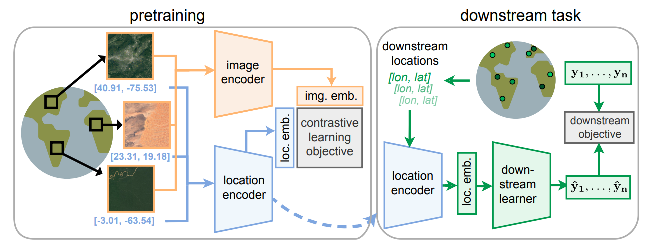
SatCLIP
Notes:
Esempio SSL

Slide 34
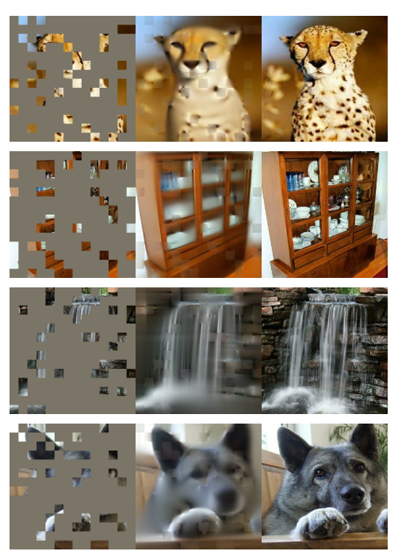
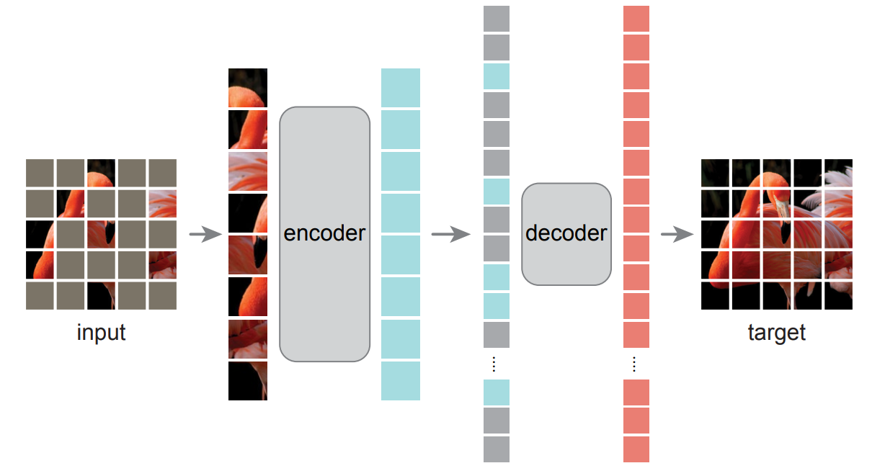
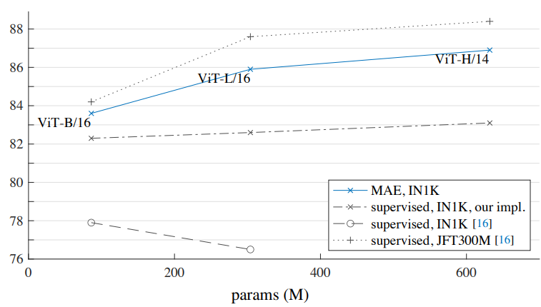
Reconstruction
He, Kaiming, et al. "Masked autoencoders are scalable vision learners." Proceedings of the IEEE/CVF conference on computer vision and pattern recognition. 2022.
Notes:
Esempio SSL per reconstruction → no label (input + maschera)

Slide 35
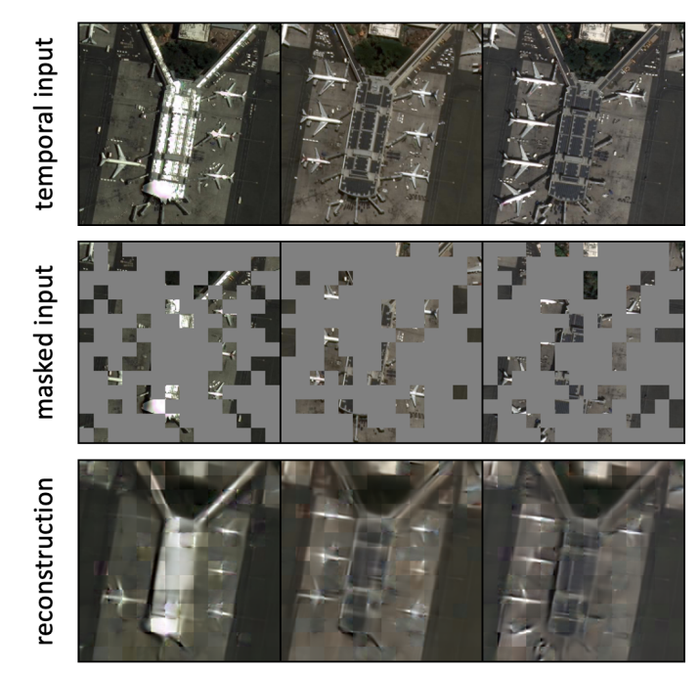
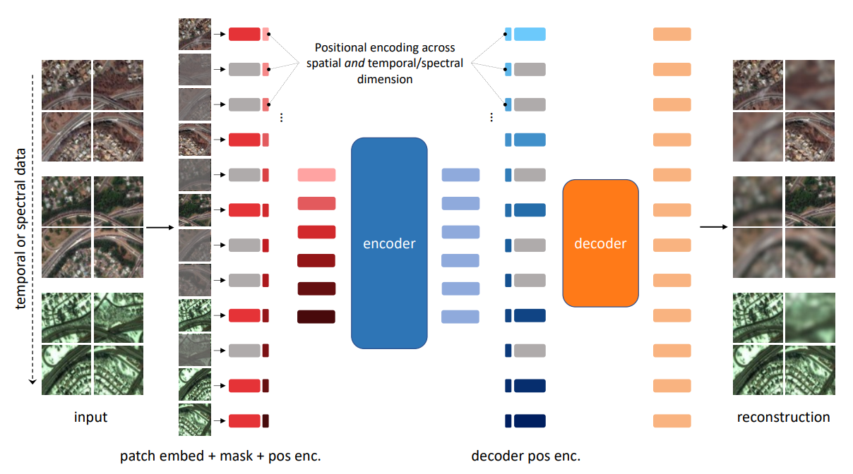
SatMAE
Cong, Yezhen, et al. "Satmae: Pre-training transformers for temporal and multi-spectral satellite imagery." Advances in Neural Information Processing Systems 35 (2022): 197-211.
Notes:
Esempio SSL

Slide 36
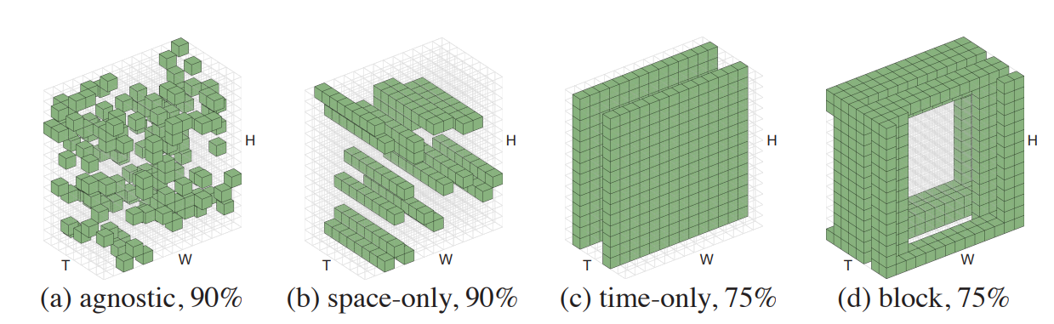
SatMAE
Feichtenhofer, Christoph, Yanghao Li, and Kaiming He. "Masked autoencoders as spatiotemporal learners." Advances in neural information processing systems 35 (2022): 35946-35958.
Notes:
Diversi modi di mascherare l imagine perche’ Lavoro su multitemporal images

Slide 37
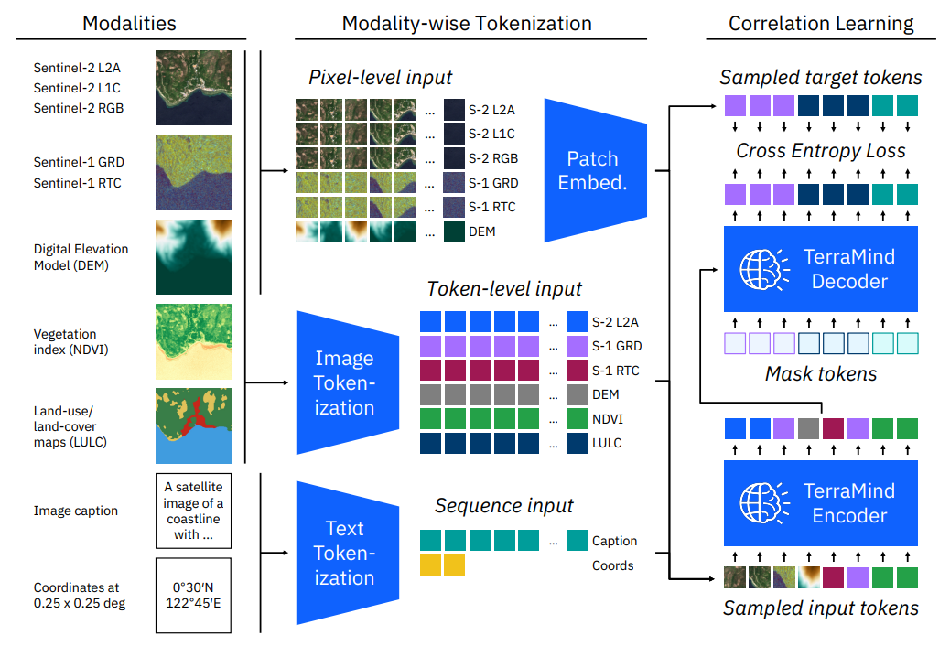
TerraMind
Jakubik, Johannes, et al. "Terramind: Large-scale generative multimodality for earth observation." arXiv preprint arXiv:2504.11171 (2025).
Notes:
Esmpio di SSL → ma il piu fico sviluppato da ESA, IBM, Julich → e’ sia per task generative che per task discriminative tasks (vero FM, risponde a tutti I parametri visti all inizio)

Slide 38
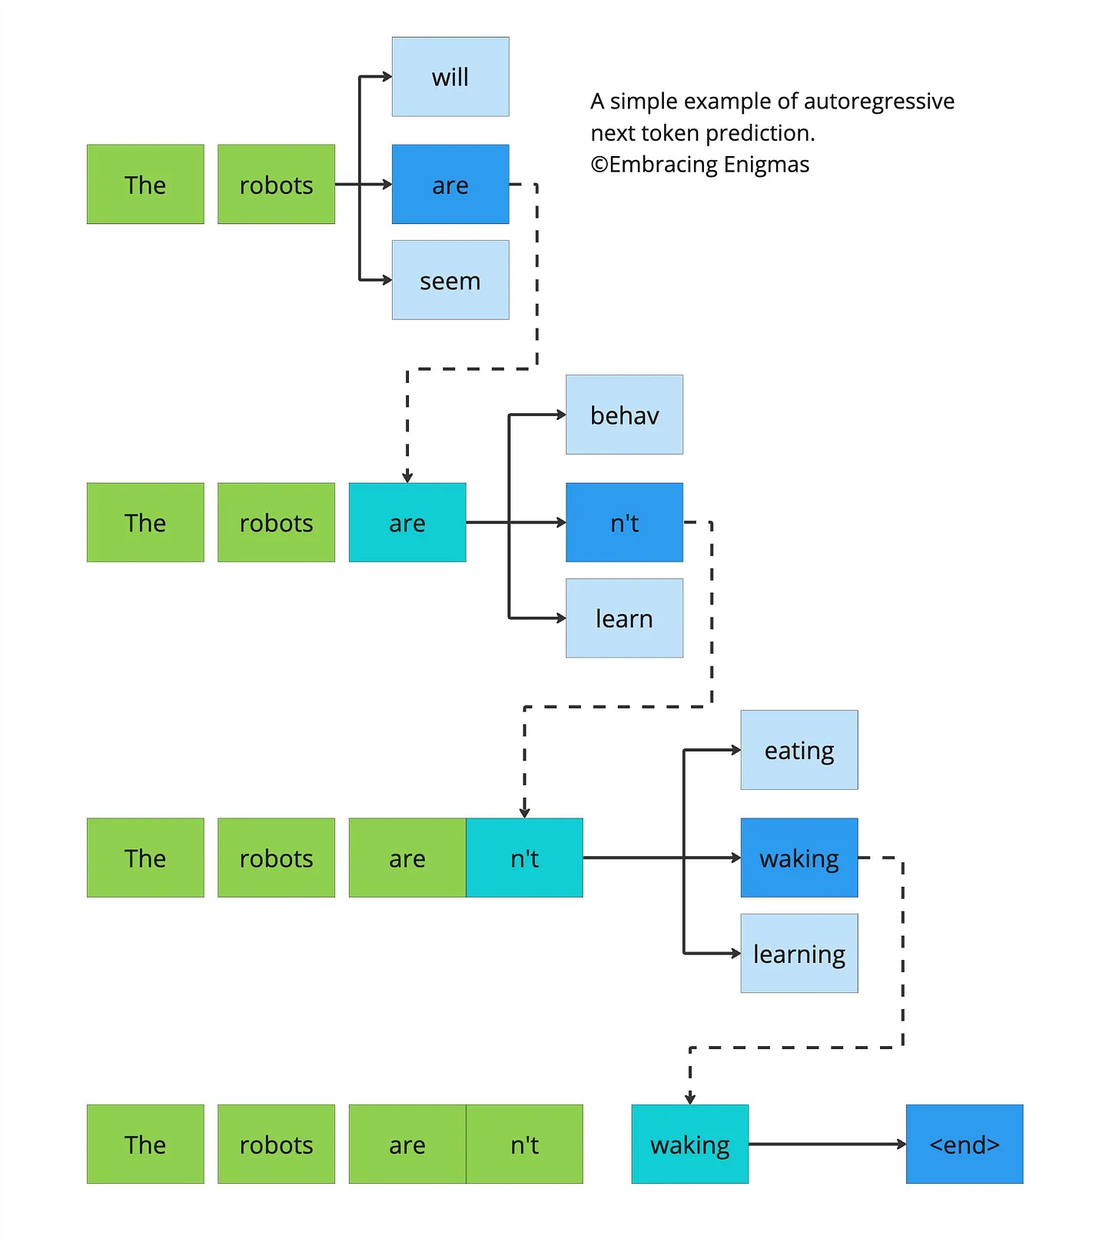
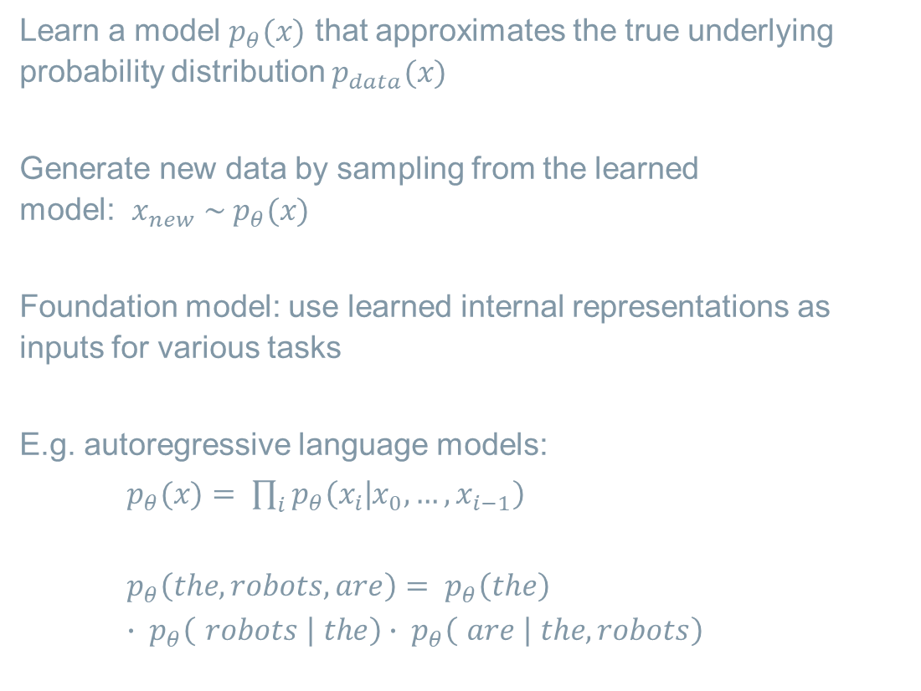
Generative models
Learn a model $p_{θ}(x)$ that approximates the true underlying probability distribution $p_{data}(x)$
Generate new data by sampling from the learned model: $x_{new} \sim p_{θ}(x)$
Foundation model: use learned internal representations as inputs for various tasks
E.g. autoregressive language models:
$p_{θ}(x)$ $= \prod_{i}{p_{θ}\left(x_{i}\text{|}x_{0}, …,x_{i−1}\right)}$
$${p_{θ}\left(the, robots, are\right)= p}_{θ}\left(the\right) ∙ p_{θ}\left( robots \text{| }the\right){ ∙ p}_{θ}\left( are \text{| }the, robots\right)$$
https://embracingenigmas.substack.com/p/next-token-prediction-is-a-fundamental

Slide 39
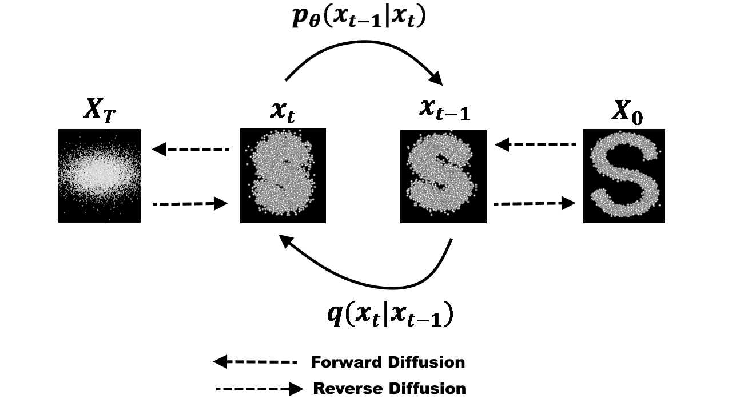

Generative models
Learn to reverse a process of adding noise
Forward (Fixed):
Start with a real image $x_{0}$
Gradually add Gaussian noise until image equals pure noise $x_{T}$
Reverse (Learned):
Train a neural network $p_{θ}(x)(x_{t−1}\text{|}x_{t})$ to denoise the image
Model learns to predict a slightly less noisy image $x_{t−1}$ from $x_{t}$.
After T steps, it generates a clean image.
https://towardsdatascience.com/diffusion-models-made-easy-8414298ce4da/

Slide 40

Generative models
Espinosa, Miguel, et al. "COP-GEN-Beta: Unified Generative Modelling of COPernicus Imagery Thumbnails." Proceedings of the Computer Vision and Pattern Recognition Conference. 2025.
Notes:
Esempio di SSL FM x Generative AI → e’ uno dei primi ad usare un transformer (tokenizza invece di usare la Unet) → e’ piu flessibile di Terramid, funziona anche senza alcune modalita’

Slide 41


Generative models
Espinosa, Miguel, et al. "COP-GEN-Beta: Unified Generative Modelling of COPernicus Imagery Thumbnails." Proceedings of the Computer Vision and Pattern Recognition Conference. 2025.

Slide 42

What is next?
Performance improvements versus supervised baselines
Increase efficiency, accessibility, trust
Expand scope: more diverse input modalities, temporal and spatial resolutions, downstream tasks
Towards data-driven digital twin Earth components

Slide 43


What is next?
Notes:
Cosa si puo fare in future, perche img. Satellitari sono fichissime

Slide 44
BENCHMARKING GEOSPATIAL FOUNDATION MODELS

Slide 45

Which is the best among all available GFMs?

Slide 46

Which is the best among all available GFMs?
Let’s benchmark them and find out

Slide 47
Why Benchmarking GFMs
Performance Evaluation
Fairness & Robustness
Guiding Improvements
Research themes:
Effective benchmarking can enhance the capabilities of GFMs themselves, improving the easiness of adoption and finding the limitations to be considered

Slide 48


PANGAEA

Slide 49

PANGAEA

Slide 50

PANGAEA: the datasets

Slide 51

PANGAEA: the datasets

Slide 52

PANGAEA: the models

Slide 53

Some results

Slide 54

Some results
Notes:
Forte correlazione tra il sensore di pretraining ed il sensore di downstram task → ci da idea di come sviluppare il FM → vedi esempio di Croma che e’ il best poiche’ allenato su questi due dati ….

Slide 55


Some results: about data scarcity
50% labels
10% labels
Notes:
Unet perde colpi se riduci I dati → FM hanno senso

Slide 56

The codebase
>200 stars

Slide 57

Some nice achievements
AnySat [CVPR 2025 Highlight]: One Earth Observation Model for Many Resolutions, Scales, and Modalities
TerraMind [ICCV 2025]: Large-Scale Generative Multimodality for Earth Observation
Several newly added features (e.g. kNN, classification, thematic benchmarks, challenges)

Slide 58

Final Remarks
Geospatial Foundation Models: hype or the new big thing?
Importance of benchmarking
Importance of an open-source project

Slide 59
ESA Φ-lab

Slide 60

The ESA Φ-lab – Why ?
from Earth Observation to Earth Action
From data to actionable information

Slide 61







The ESA Φ-lab – How?
Φ-lab aims to become “the reference” for the transformational innovation and a key influencer (by reputation and authority) in the Earth Observation ecosystem
Catalyst
Attract EO academic and industrial researchers to generate transformative ideas
Exploit fail fast ethos, rapidly prototyping concepts
An informal but rigorous, multi-disciplinary, collaborative environment
Act as facilitator to foster competitiveness growth and entrepreneurial initiatives
Implement investment actions from ESA MSs or in the investors industry
Bridge
Be the bridge between the European start-ups, academic and industrial researchers, New Space operators, Investors, ICT players, EO world leaders, and ESA
Act as hub stimulating, connecting, and developing a growing ecosystem of talents and capabilities across Europe
ESA Φ-lab
ESA
Φ-lab

Slide 62



Innovation Technologies axis and Applications
AXIS I
Augmented Intelligence
AXIS II
Innovative Computing Paradigms
AXIS III
Innovative Computing Paradigms
Foundation Models
Digital Assistant and Twins
Generative AI
Decision Intelligence, Agentic AI
Explainability (xAI)
Physics-Informed ML
AI4EO for Climate, Health, and Human
On-Board AI
Quantum Computing
Hybrid HPC Computing
Neuromorphic
Biocomputing and others
Cognitive Space
VR/AR Immersive Visualisation
Web 3.0
IOT
Distributed Ledgers/Blockchain

Slide 63


Collaboration opportunities at Φ-lab
Shared mutual interest
Join the Φ-lab to explore disruptive ideas
as a Visiting Researcher (industry, academia),
Visiting Professor, Research Fellow, PhD, YGT, etc.
Funded
Φ-lab’s Invitation To Tender on ESA-STARS
Foundation Models, Generative AI, QC4EO, Edge computing, Web 3.0, etc..
InCubed : partnership development of commercial products or services
Open Space Innovation Platform : co-funded research or researchers
EO Science4Society : no SOW, 100/200K, 6/18 months
ESA Technology Programmes like GSTP and TDE

Slide 64
Working with us it is easy
Visiting Researchers (Industrial and Scientific)
Visiting Professor
ESA Research Fellowships
ESA Co-funded PhD
ESA Early Graduate Traineeships (EGT), Internships, National trainee

Slide 65


Join ESA Φ-lab through CIN
The Collaborative Innovation Network (CIN) by ESA Φ-lab, provides to leading researchers and University Professors the opportunity to join ESA Φ-lab and be actively involved in accelerating the future of Earth Observation with ESA.
The ESA Φ-lab CIN aims to:
Establish a global network through which researchers and innovators can JOIN ESA Φ-LAB
Promote knowledge sharing and develop groundbreaking EO solutions
Check the open calls
Follow CIN on Linkedin

Slide 66


What to go deeper into Φ-lab disruptive innovation?
Don’t miss our spotlight session at Big Data from Space
(Day 2 – October 2nd at 17:50)
Notes:
Back to the past …

Slide 67


ESA – European Space Agency
Internal Research Fellow, Φ-lab Division
Earth Observation Climate Action, Sustainability and Science Department (EOP-S)
Directorate of Earth Observation Programme
lorenzo.papa@esa.int | www.esa.int | https://philab.esa.int

