Slide 1
Introduction to AI and ML
Dr. Lorenzo Papa
Internal Research Fellow in AI4EO, ESA ESRIN Frascati, Rome, Italy
Email: lorenzo.papa@esa.int

Slide 2

A brief introduction of me
Internal Research Fellow, ESA Φ-lab, ESRIN, IT
PhD in Computer Science Engineering, Sapienza University, IT
Master degree in AI and Robotics, Sapienza University, IT
Visiting Research, The University of Sydney, NSW, Australia
Visiting Research, ESA Φ-lab, ESRIN, IT
Links & Contacts:
Email: Lorenzo.Papa@esa.int
Google Scholar: ‪Lorenzo Papa‬ - ‪Google Scholar‬
LinkedIn: Lorenzo Papa | LinkedIn

Slide 3
Outline
Introduction to AI, ML and DL
ESA’s Earth Observation Missions and ESA Φ-lab
Data handling: from ML to DL
A DL training pipeline
https://github.com/lorenzopapa5/BiDs_training_course_2025/tree/main

Slide 4
Overview of Learning systems
“Machine learning is the subfield of computer science that gives computers the ability to learn without being explicitly programmed” — Arthur Samuel, 1959
AI
ML
DL
Notes:
1) AI is the broad field of building machines that can perform tasks requiring human-like intelligence — such as reasoning, perception, and decision-making.
2) ML is a subset of AI focused on algorithms that learn patterns from data and improve over time without being explicitly programmed.
3) DL is a subset of ML that uses multi-layered neural networks to learn complex representations from large amounts of data.

Slide 5
Artificial Intelligence
AI refers to computer systems designed to execute tasks that typically demand human intellect, including interpreting visual data, recognizing speech, and making decisions.
It is a scientific discipline focused on replicating and explaining intelligent actions through computational methods.
AI comes into play when machines simulate "cognitive" abilities commonly linked to human thought processes, such as acquiring knowledge and solving complex problems.

Slide 6
From Machine Learning to Deep Learning
Learning is the process of acquiring knowledge or skills through experience, study, or instruction. In humans and animals, it involves adapting behaviour based on past outcomes. In machines, it means improving performance on a task based on data.
Machine Learning is a subset of learning where machines learn from data to make predictions or decisions without being explicitly programmed. It uses algorithms that identify patterns and improve over time.
Deep Learning is a specialized branch of ML that uses artificial neural networks with many layers to learn complex patterns from large datasets. It powers modern AI applications like image recognition, natural language processing, and autonomous systems.

Slide 7


From Deep Learning to … Future?
Yes, we’ve all heard these buzzwords …
… but first, why we need all of this?
Notes:
Back to the past …

Slide 8
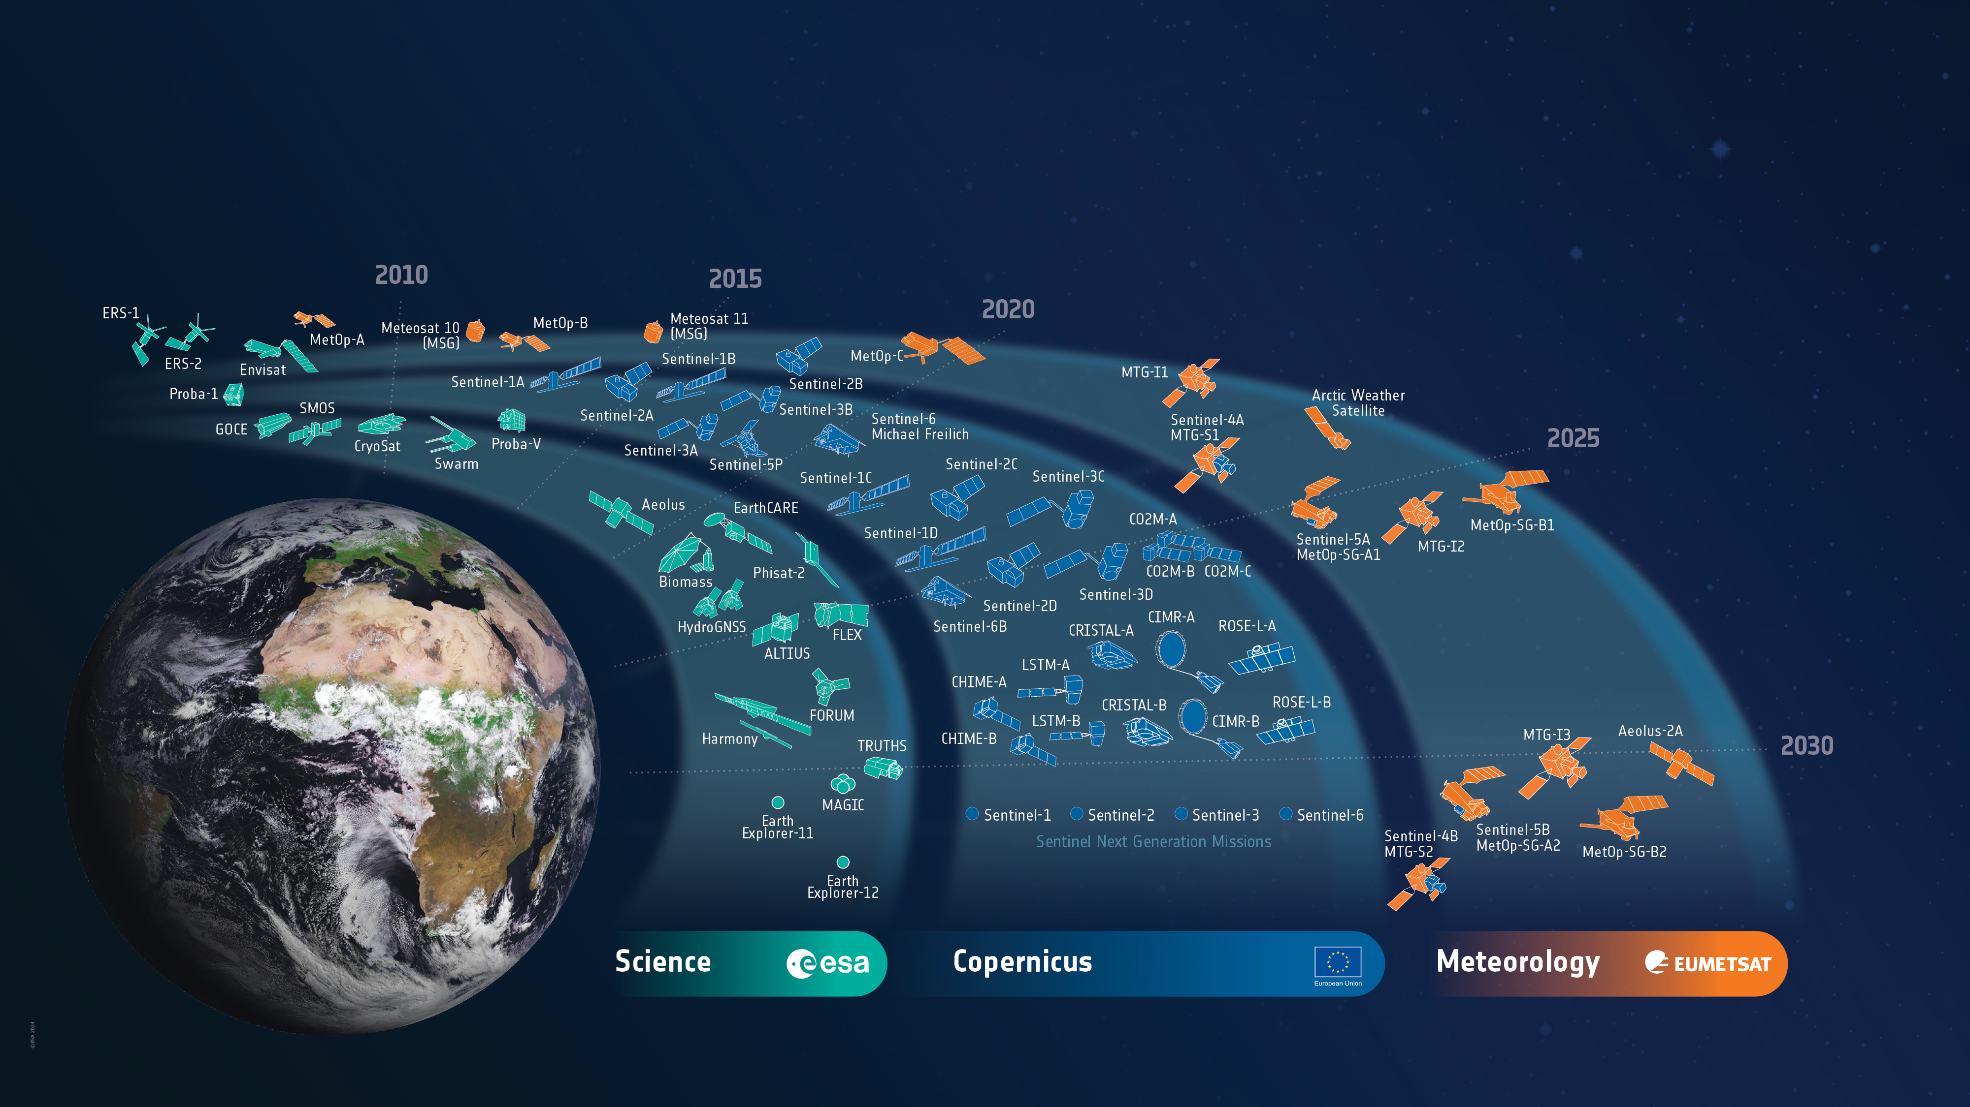
ESA’s Earth Observation Missions
Satellites
Heritage 08
Operational 16
Developing 40
Preparing 22
Total 86
World-class Earth Observation systems developed with European and global partners to address scientific & societal challenges
8
Notes:
HERITAGE MISSIONS
7 Missions/8 Satellites:
Earth Explorers+ (5M/6S)
1 GOCE
1 Aeolus
2 ERS (ERS-1/2)
1 Envisat
1 Proba-1
Earth Watch (1M/1S)
1 Proba-V
Sentinels (1M/1S)
1 Sentinel-1 (S1-B)
Met Missions (2M/8S) (EUMETSAT managed so not counted in total)
7 Meteosat (#1-7)
1 Meteosat SG (#8)
OPERATIONAL MISSIONS
10 Missions (16 satellites):
Earth Explorers+ (5M/7S)
1 SMOS
1 CryoSat
3 Swarm
1 EarthCARE
1 PhiSat-2
Earth Watch (0M/0S)
0
Sentinels (5M/9S)
2 Sentinel-1 (S-1A/1C)
3 Sentinel-2 (S-2A/2B/2C)
2 Sentinel-3 (S-3A/3B)
1 Sentinel-5P
1 Sentinel-6 (S-6A)
Met Missions (4M/8S) (EUMETSAT managed so not counted in total)
3 Meteosat SG (#9-11)
1 Arctic Weather Satellite
1 Meteosat TG (MTG-I1)
3 MetOp (A/B/C)
MISSIONS IN DEVELOPMENT
23 Missions (40 satellites):
Earth Explorers+ (5M/6S)
1 Biomass
1 Flex
1 Forum
1 Harmony
2 Scout-2 (HydroGNSS)
Earth Watch (2M/2S)
1 TRUTHS
1 ALTIUS
Sentinels (12M/24S)
1 Sentinel-1 (S-1D)
1 Sentinel-2 (S-2D)
2 Sentinel-3 (S-3C/3D)
2 Sentinel-4 (S-4A/4B)
3 Sentinel-5 (S-5A/5B/5C)
2 Sentinel-6 (S-6B/C)
2 CO2M (A/B/C)
2 CRISTAL (A/B)
2 CIMR (A/B)
2 LST (A/B)
2 CHIME (A/B)
2 ROSE-L (A/B)
Met Missions (4M/8S)
1 Aeolus-2
3 Meteosat TG-I (MTG-I2/3/4)
2 Meteosat TG-S (MTG-S1/2)
2 MetOp SG (A1/B1)
MISSIONS IN PREPARATION
9 Missions (22 satellites):
Earth Explorers (3M/11S)
2 EE11
4 EE12
3 Scout-3 (NanoMagSat)
2 Scout-4 (TANGO)
MoO (1M/2S)
2 NGGM
Sentinels (5M/9S)
2 Sentinel-1 NG
(S-1NG A/B)
2 Sentinel-2 NG
(S-2NG A/B)
2 Sentinel-3 NG OPT
(S-3NGO A/B)
2 Sentinel-3 NG TOPO
(S-3NGT A/B)
1 Sentinel-6 NG
(S-6NG A)
Met Missions (0M/0S)
0

Slide 9
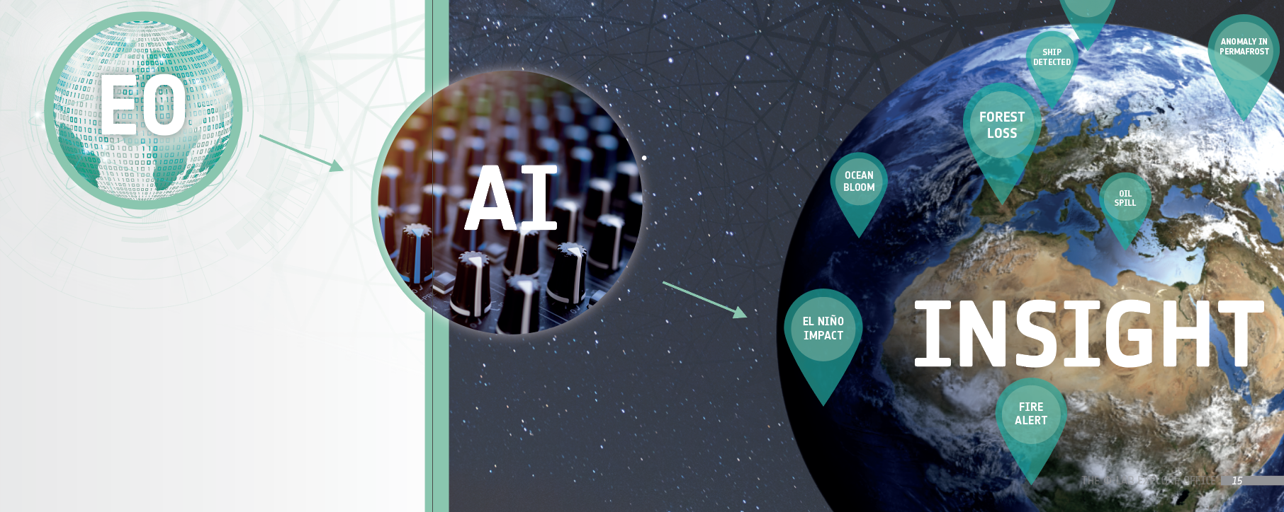
The ESA Φ-lab – Why ?
from Earth Observation to Earth Action
From data to actionable information

Slide 10




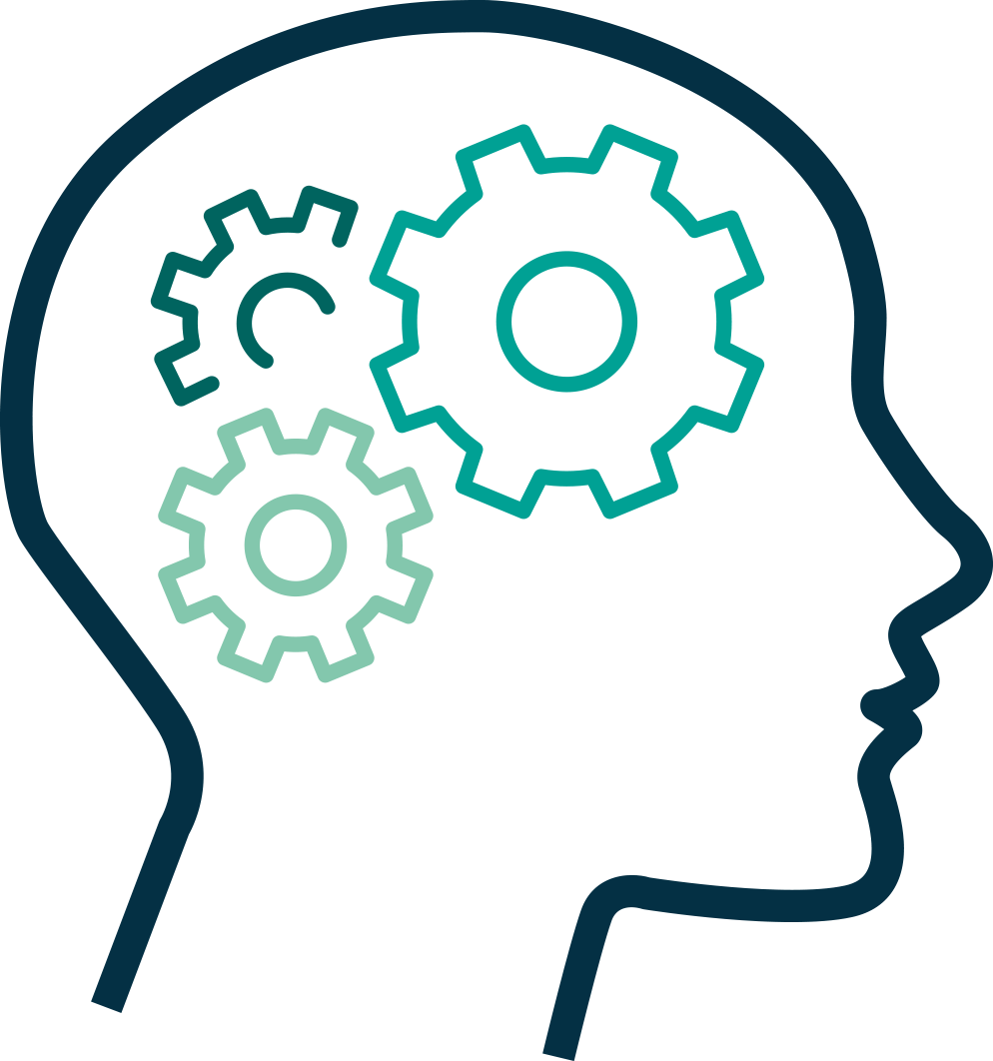


The ESA Φ-lab – How?
Φ-lab aims to become “the reference” for the transformational innovation and a key influencer (by reputation and authority) in the Earth Observation ecosystem
Catalyst
Attract EO academic and industrial researchers to generate transformative ideas
Exploit fail fast ethos, rapidly prototyping concepts
An informal but rigorous, multi-disciplinary, collaborative environment
Act as facilitator to foster competitiveness growth and entrepreneurial initiatives
Implement investment actions from ESA MSs or in the investors industry
Bridge
Be the bridge between the European start-ups, academic and industrial researchers, New Space operators, Investors, ICT players, EO world leaders, and ESA
Act as hub stimulating, connecting, and developing a growing ecosystem of talents and capabilities across Europe
ESA Φ-lab
ESA
Φ-lab

Slide 11
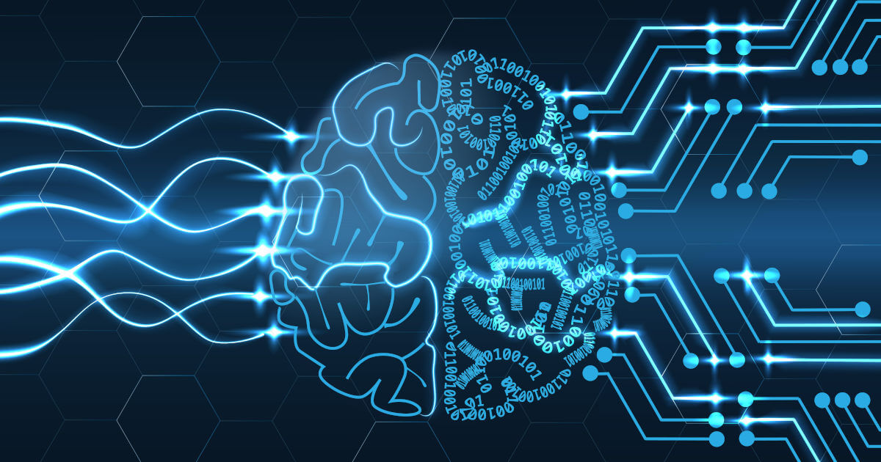
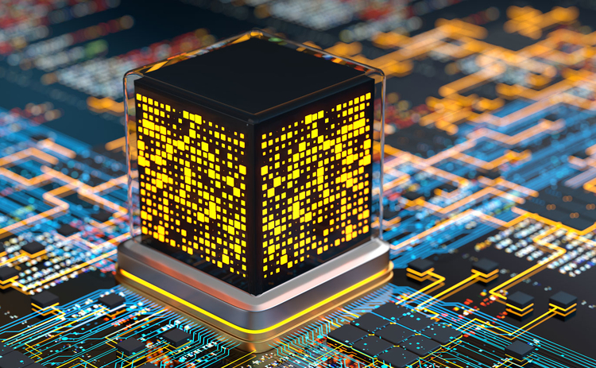

Innovation Technologies axis and Applications
AXIS I
Augmented Intelligence
AXIS II
Innovative Computing Paradigms
AXIS III
Innovative Computing Paradigms
Foundation Models
Digital Assistant and Twins
Generative AI
Decision Intelligence, Agentic AI
Explainability (xAI)
Physics-Informed ML
AI4EO for Climate, Health, and Human
On-Board AI
Quantum Computing
Hybrid HPC Computing
Neuromorphic
Biocomputing and others
Cognitive Space
VR/AR Immersive Visualisation
Web 3.0
IOT
Distributed Ledgers/Blockchain

Slide 12

Data handling: from manual feature extraction (ML) to automatic processing (DL)

Slide 13
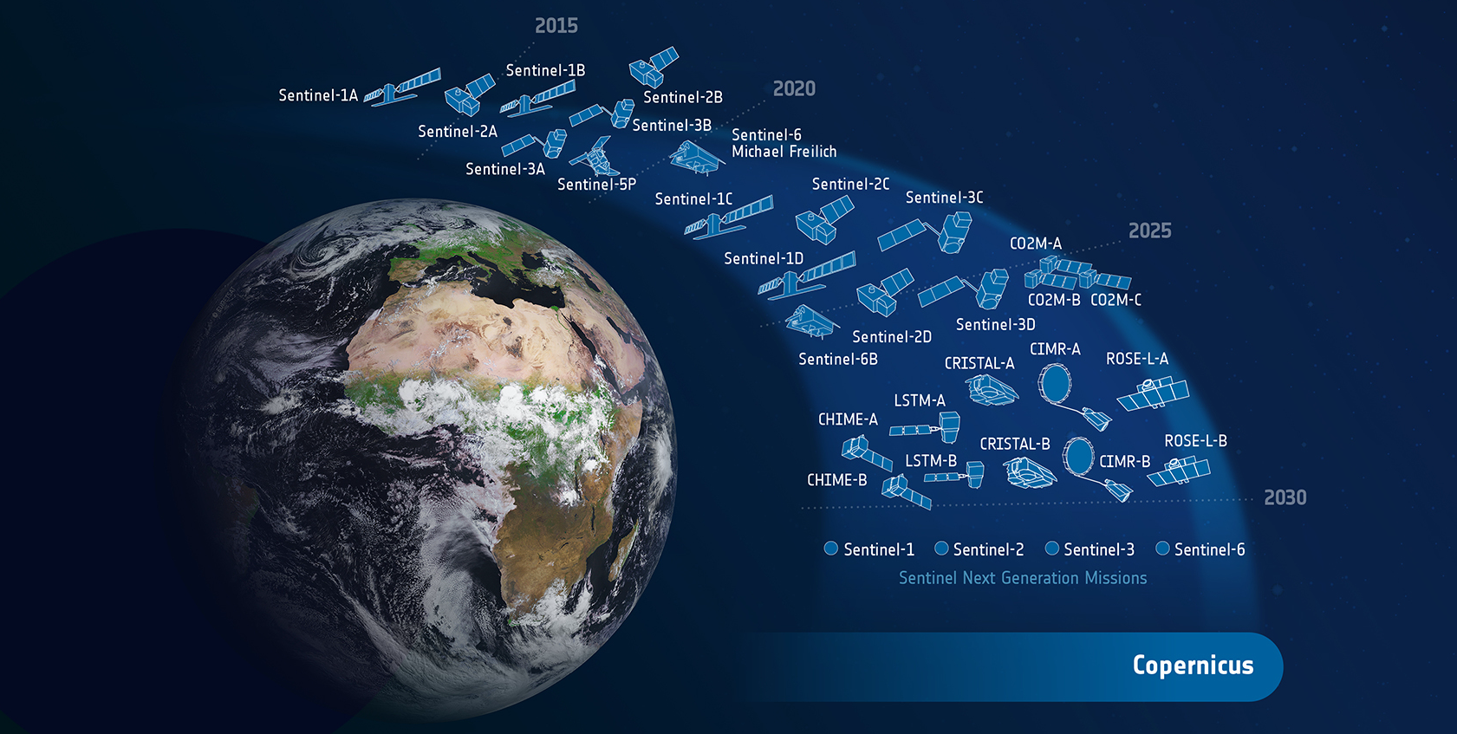
Remote Sensing Data

Slide 14



Remote Sensing Data
Active Sensors
Passive Sensors
So, based on these settings, which are the sensor-level attributes that affect the quality and type of features that can be extracted from satellite images?

Slide 15
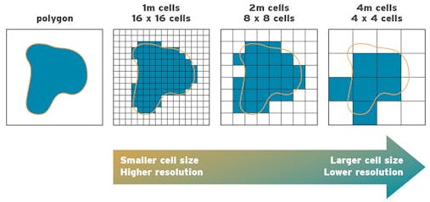
Remote Sensing Data
Spatial Resolution*: it represents the smallest possible feature that can be detected. The spatial resolution quantifies the capability to separate two close targets. The pixel size is often considered as spatial resolution. It depends on the design of the sensor, while the pixel size depends on the digital sampling of the signal.
* Optical/Multispectral sensors. For SAR sensors, this is primarily determined by the acquisition mode

Slide 16
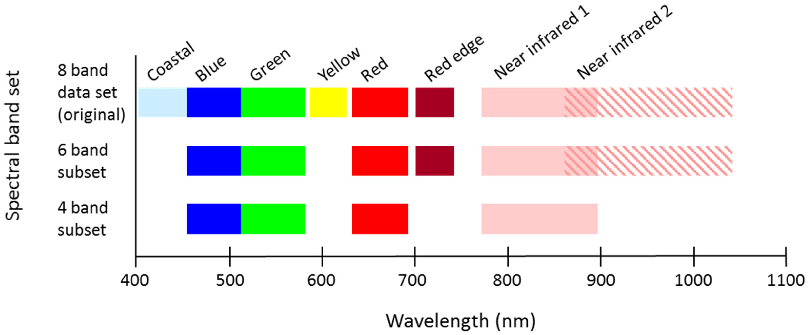
Remote Sensing Data
Spectral Resolution*: it represents the wavelength of the different frequency bands recorded. Spectral resolution describes the ability of a sensor to define fine wavelength intervals.
* Optical/Multipsectral sesnors. For SAR sensors, this corresponds to radar frequency and signal polarization

Slide 17
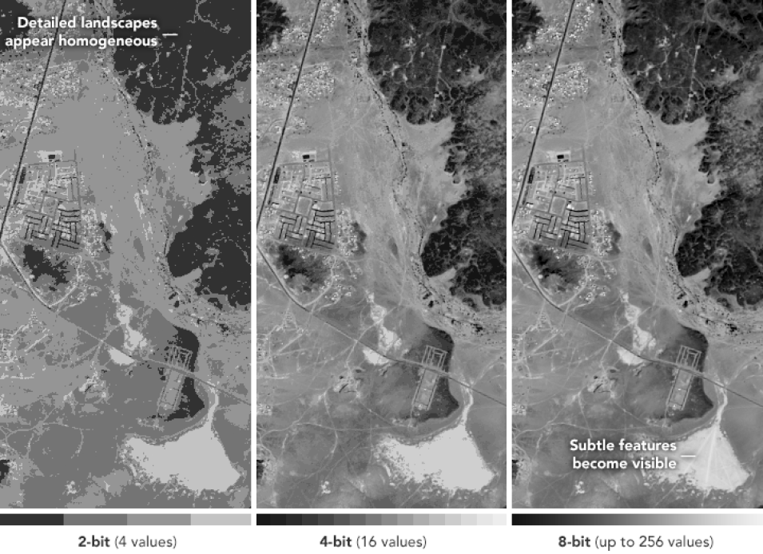
Remote Sensing Data
Radiometric Resolution*: it refers to the number of different intensities of radiation the sensor can distinguish. The greater the radiometric resolution, the more accurate the sensed image will be.
* Measured in bits for optical sensors (light intensity), and typically in decibels for SAR (signal power)

Slide 18
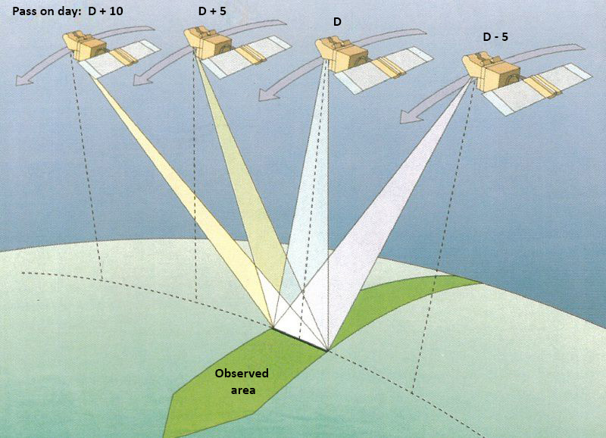
Remote Sensing Data
Temporal Resolution: is the frequency of flyovers by the satellite. This resolution can become relevant in time series studies or those requiring an averaged or mosaic image. (revisit time)

Slide 19
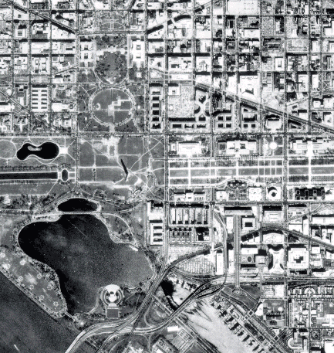
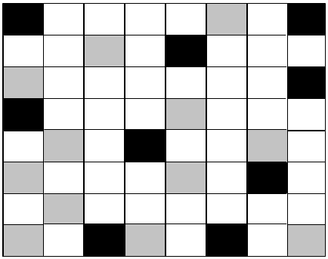

Introduction
An image, is represented as a matrix of numerical values
255
135
0
255
Notes:
Images are data — matrices of pixels that we can analyze and manipulate. In many applications, like machine learning and control systems, image processing is a key step for extracting information or building intelligent behavior.
An image, is represented in a computer as a matrix of numerical values.
Each element of this matrix corresponds to a pixel, which encodes color information through one or more channels — typically red, green, and blue (RGB).
In grayscale images, each pixel holds a single intensity value. This matrix-based representation allows images to be processed mathematically and manipulated through linear algebra operations.
Understanding images as numerical arrays is fundamental for techniques like image handling and feature extraction, where algorithms analyze pixel values and patterns to identify edges, textures, shapes, and other meaningful features.

Slide 20

Introduction
An image, is represented as a matrix of numerical values
255
135
0
255
… it seems easy, no? …

Slide 21



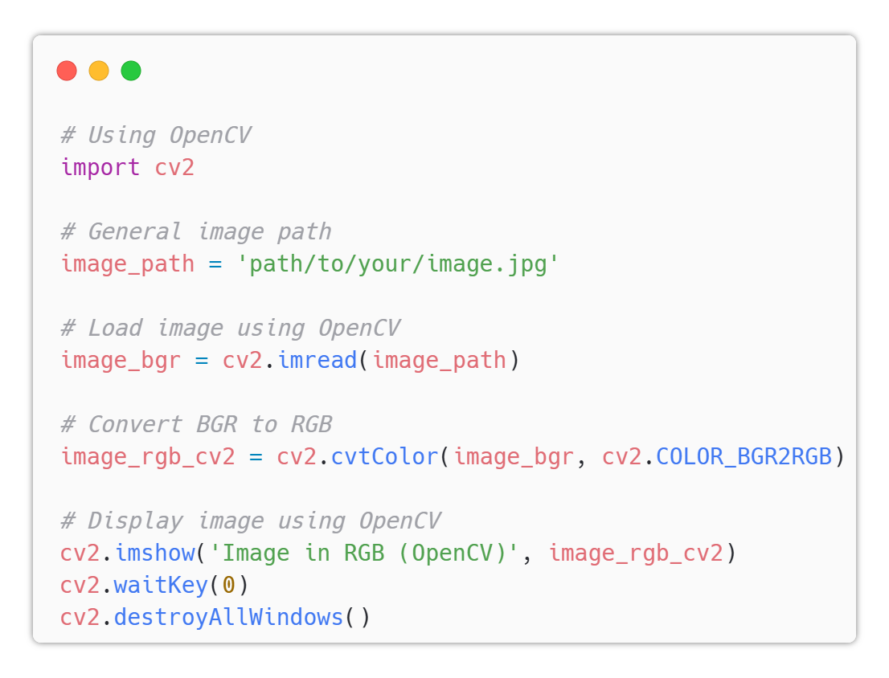
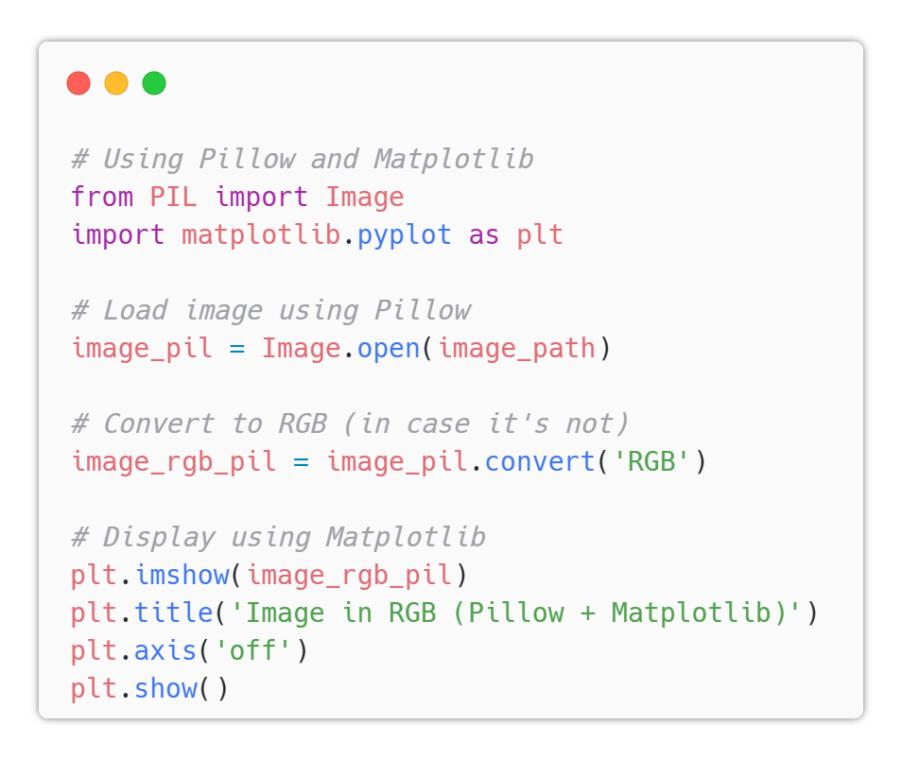
How to handle Images in Python
Notes:
To work with images, we often use libraries like OpenCV, PIL or matplotlib
We can visualize images using OpenCV or matplotlib. Also, we can convert colour formats …

Slide 22

From Images to Feature Extraction with Filters
… GoTo Image_Filtering.ipynb
Notes:
Filters help extract important visual features. For example, edge detection highlights contours and structure. One classic filter is the Canny edge detector, which finds edges in the image.
→ So far, we’ve applied filters like edge detection, blur, and emboss manually. These are examples of hand-crafted features—we decide what to extract from the image.

Slide 23
Machine Learning
Data Building
Data Processing
Strategy Selection
Training
Evaluating
Deployment
Notes:
Regression models: Linear Regression, Polynomial Regression.
Classification models: Logistic Regression, Naive Bayes.
Models used for both: Decision Tree, Random Forest, Support Vector Machines, K-Nearest Neighbors.
Ensembles: Bagging, Boosting, Voting and Stacking.
Deep Learning: Fully Connected (Dense) Neural Networks.
Unsupervised learning: K-Means clustering and Principal Component Analysis (PCA) dimensionality reduction technique.

Slide 24
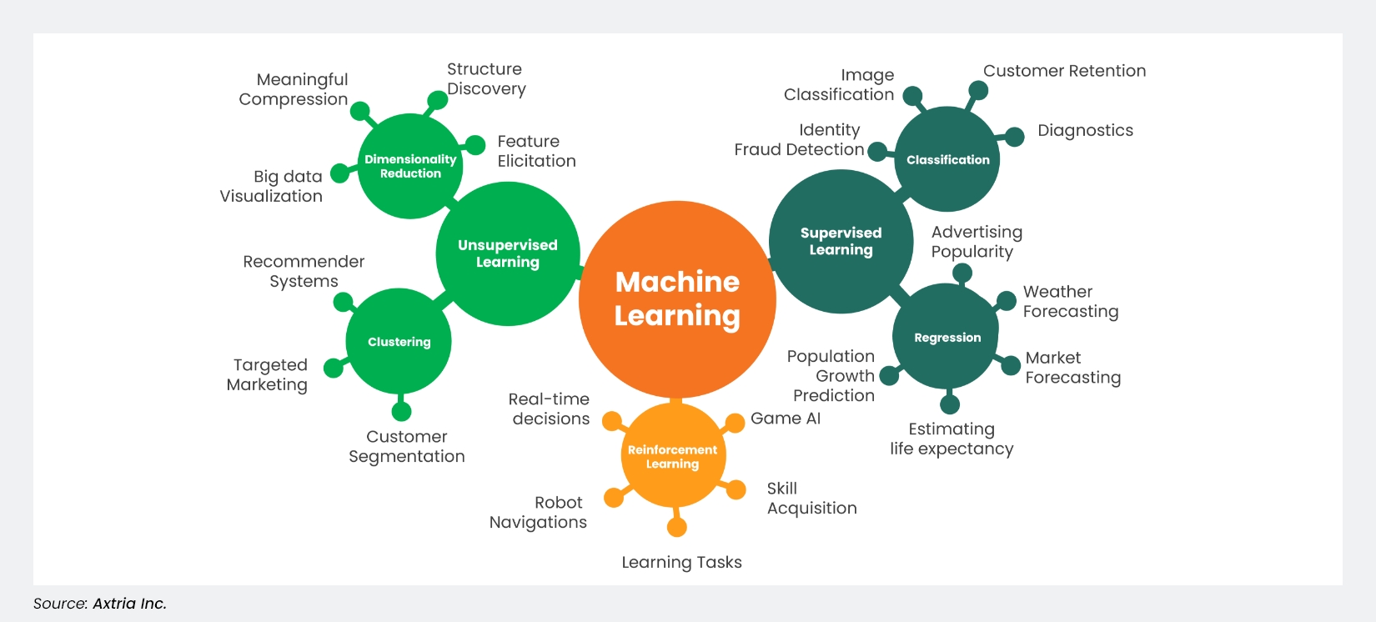
Machine Learning
Notes:
Regression models: Linear Regression, Polynomial Regression.
Classification models: Logistic Regression, Naive Bayes.
Models used for both: Decision Tree, Random Forest, Support Vector Machines, K-Nearest Neighbors.
Ensembles: Bagging, Boosting, Voting and Stacking.
Deep Learning: Fully Connected (Dense) Neural Networks.
Unsupervised learning: K-Means clustering and Principal Component Analysis (PCA) dimensionality reduction technique.

Slide 25






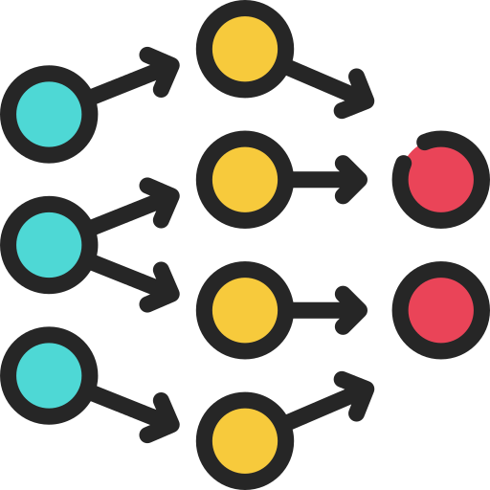
From Filters to Deep Learning
ML
DL
Notes:
But what if we want the computer to learn which features are important by itself?
In ML, we extract features (e.g., edges, textures, color histograms) and feed them into algorithms like:
SVMs
Decision Trees
k-NN
These models learn patterns from labeled data (e.g., cats vs. dogs).
Problem with ML: “The challenge is that feature extraction is still manual and may not capture complex patterns.”
Solution: “Deep Learning, especially Convolutional Neural Networks (CNNs), solves this by learning features automatically from raw pixels
------------------------------
Traditional filters like Canny or Sobel are examples of manual feature extraction — we design them to highlight specific patterns like edges or textures. But in deep learning, especially with Convolutional Neural Networks (CNNs), the model learns its own filters from the data.
Instead of manually specifying features, we provide labelled images, and the network automatically learns what to focus on — like corners, shapes, and higher-level patterns — in order to classify or detect objects. This shift from hand-crafted features to learned representations is a key reason deep learning has become so powerful in image-related tasks.
In the realm of machine learning and computer vision, how data is handled and processed plays a crucial role in the success of any application. Traditional machine learning approaches often rely on manual feature extraction, where domain experts design specific algorithms to highlight important patterns in the data.
However, with the advent of deep learning, this paradigm has shifted dramatically. Deep learning models, particularly convolutional neural networks, learn to automatically extract relevant features directly from raw data, reducing the need for handcrafted preprocessing.
This chapter explores this transition from manual feature engineering to automatic feature learning, highlighting the implications for data handling, model performance, and real-world applications.

Slide 26
From Filters to Deep Learning
ML
DL
Notes:
But what if we want the computer to learn which features are important by itself?
In ML, we extract features (e.g., edges, textures, color histograms) and feed them into algorithms like:
SVMs
Decision Trees
k-NN
These models learn patterns from labeled data (e.g., cats vs. dogs).
Problem with ML: “The challenge is that feature extraction is still manual and may not capture complex patterns.”
Solution: “Deep Learning, especially Convolutional Neural Networks (CNNs), solves this by learning features automatically from raw pixels
------------------------------
Traditional filters like Canny or Sobel are examples of manual feature extraction — we design them to highlight specific patterns like edges or textures. But in deep learning, especially with Convolutional Neural Networks (CNNs), the model learns its own filters from the data.
Instead of manually specifying features, we provide labelled images, and the network automatically learns what to focus on — like corners, shapes, and higher-level patterns — in order to classify or detect objects. This shift from hand-crafted features to learned representations is a key reason deep learning has become so powerful in image-related tasks.
In the realm of machine learning and computer vision, how data is handled and processed plays a crucial role in the success of any application. Traditional machine learning approaches often rely on manual feature extraction, where domain experts design specific algorithms to highlight important patterns in the data.
However, with the advent of deep learning, this paradigm has shifted dramatically. Deep learning models, particularly convolutional neural networks, learn to automatically extract relevant features directly from raw data, reducing the need for handcrafted preprocessing.
This chapter explores this transition from manual feature engineering to automatic feature learning, highlighting the implications for data handling, model performance, and real-world applications.

Slide 27
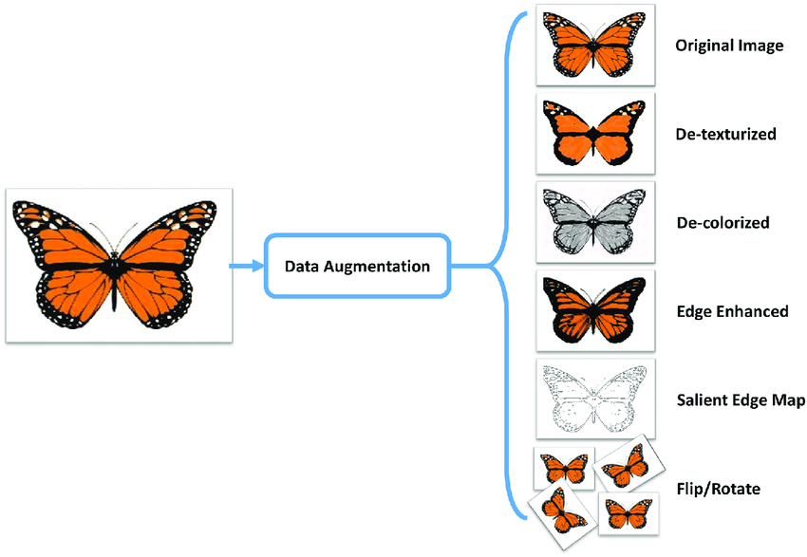
Data Augmentation
However, image processing is still fundamental in DL …
Notes:
Data augmentation plays a key role in both traditional and deep learning pipelines. Why? Because the more varied the input images, the more robust the model becomes — especially in deep learning, where the model learns features directly from the data.
By applying transformations like rotation, zoom, flips, or brightness shifts, we simulate different real-world conditions and help the model generalize better. This makes it less likely to overfit and more capable of recognizing features under diverse scenarios — even if those features were learned automatically by a CNN.
In essence, data augmentation feeds the deep learning model with richer, more diverse feature representations — strengthening its ability to learn effectively and robustly.

Slide 28




Data Augmentation
However, image processing is still fundamental in DL …
(Invariant)
Notes:
Data augmentation plays a key role in both traditional and deep learning pipelines. Why? Because the more varied the input images, the more robust the model becomes — especially in deep learning, where the model learns features directly from the data.
By applying transformations like rotation, zoom, flips, or brightness shifts, we simulate different real-world conditions and help the model generalize better. This makes it less likely to overfit and more capable of recognizing features under diverse scenarios — even if those features were learned automatically by a CNN.
In essence, data augmentation feeds the deep learning model with richer, more diverse feature representations — strengthening its ability to learn effectively and robustly.

Slide 29
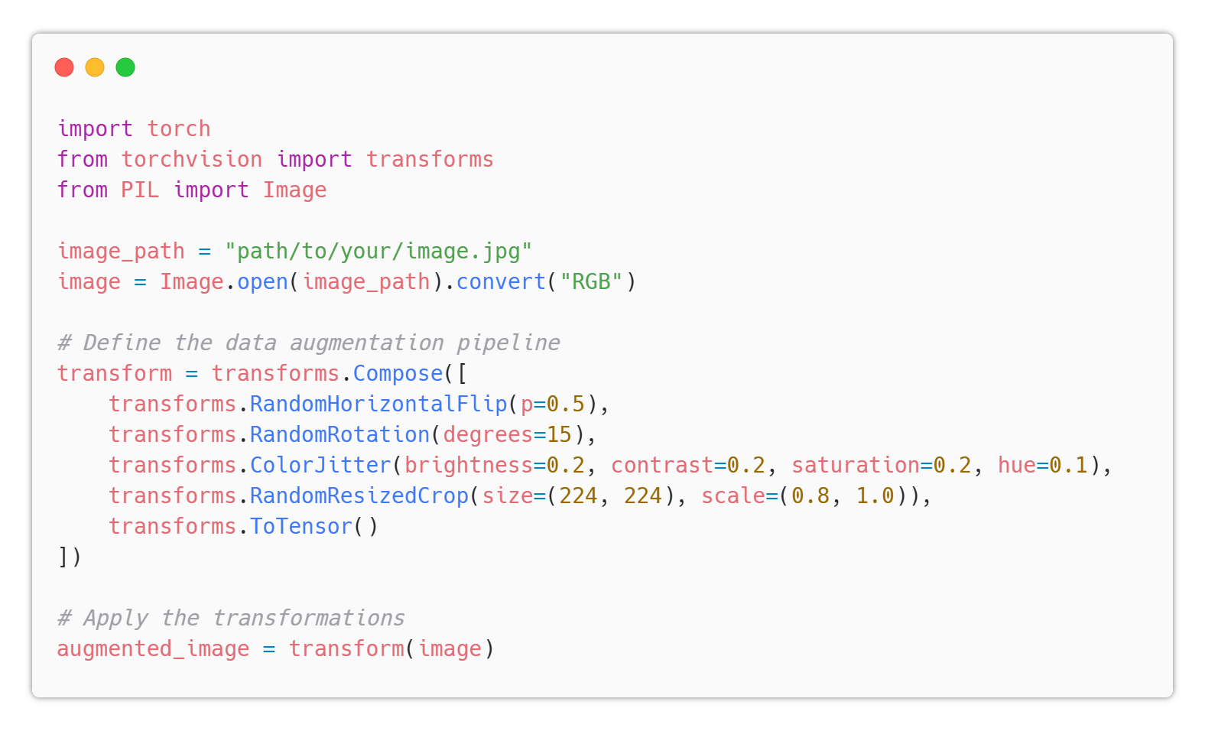
Data Augmentation
However, image processing is still fundamental in DL …
Notes:
Data augmentation plays a key role in both traditional and deep learning pipelines. Why? Because the more varied the input images, the more robust the model becomes — especially in deep learning, where the model learns features directly from the data.
By applying transformations like rotation, zoom, flips, or brightness shifts, we simulate different real-world conditions and help the model generalize better. This makes it less likely to overfit and more capable of recognizing features under diverse scenarios — even if those features were learned automatically by a CNN.
In essence, data augmentation feeds the deep learning model with richer, more diverse feature representations — strengthening its ability to learn effectively and robustly.

Slide 30

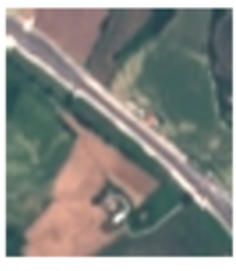
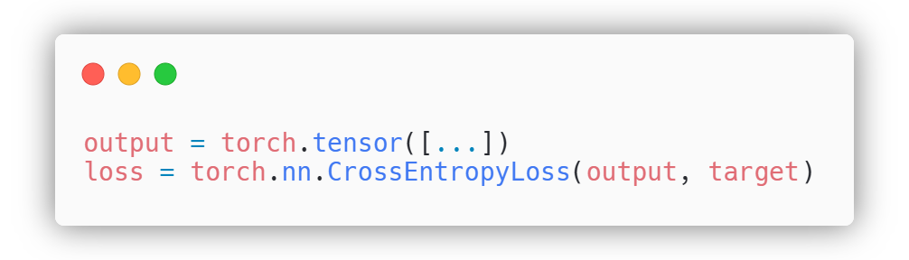
From ML to DL (pipeline)
Data Building
Data Processing
Strategy Selection
Training
Evaluating
Deployment
w1
w3
w2
Notes:
ML usa algoritmi di ottimizzazione metematica, come riduzione la distanza dalle distrubuzioni o regole statistiche / DL usa backpropagation algorithm

Slide 31
From ML to DL (pipeline)
Data Building
Data Processing
Strategy Selection
Training
Evaluating
Deployment
1
w1
5
w3
2
w2
4
3
Notes:
Ora ci andremo a foclaizzare sui punti chiave 1,2,3,4,5 …

Slide 32
From ML to DL (pipeline)
Data Building
Data Processing
Strategy Selection
Training
Evaluating
Deployment
1
w1
5
w3
2
w2
4
3
Notes:
Ora ci andremo a foclaizzare sui punti chiave 1,2,3,4,5 …

Slide 33
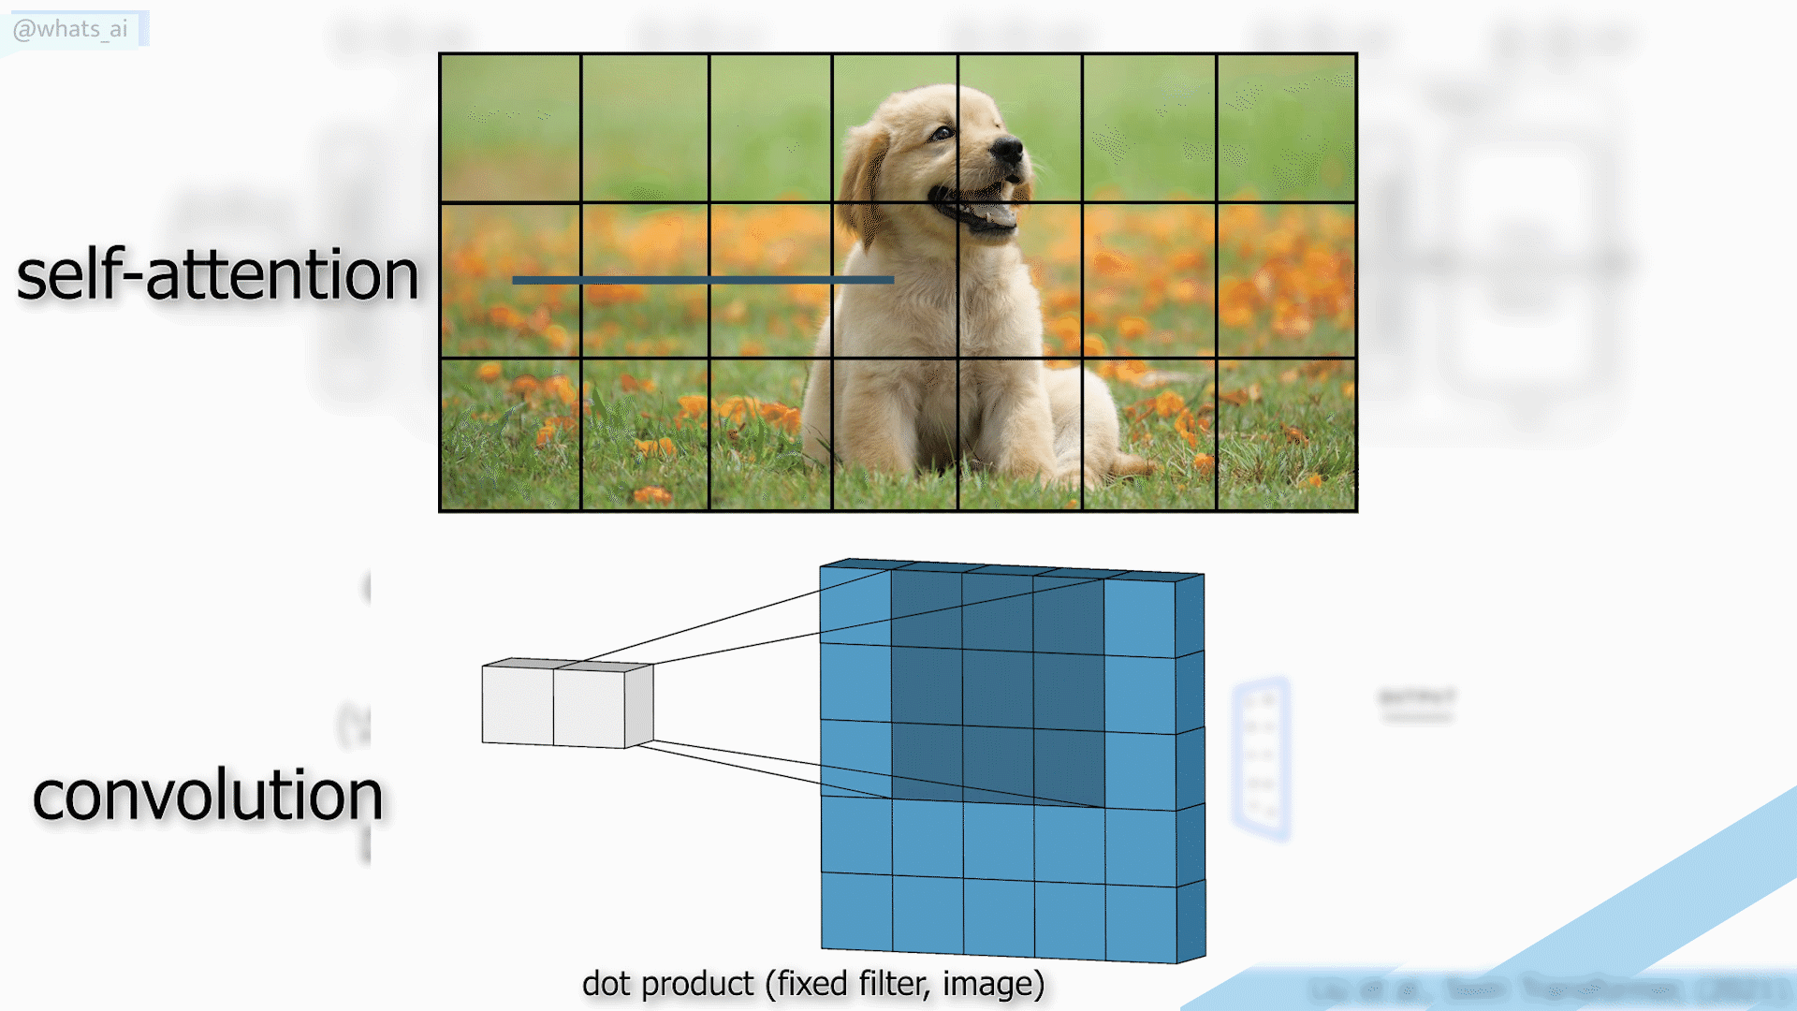
1 Layers & Neural Networks
Notes:
Up to now, fully connected network … but how we can extract more complex patters? More complex layers 1) Convolution → CNN
2) Self attention → ViT

Slide 34
From ML to DL (pipeline)
Data Building
Data Processing
Strategy Selection
Training
Evaluating
Deployment
1
w1
5
w3
2
w2
4
3
Notes:
Ora ci andremo a foclaizzare sui punti chiave 1,2,3,4,5 …

Slide 35

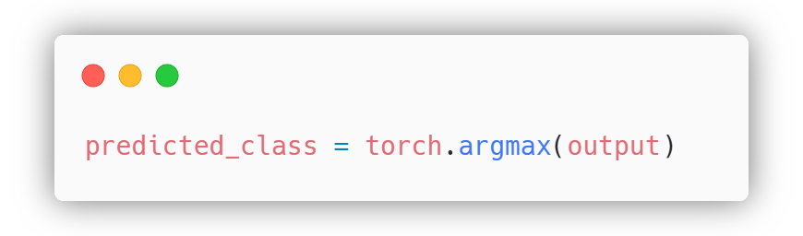
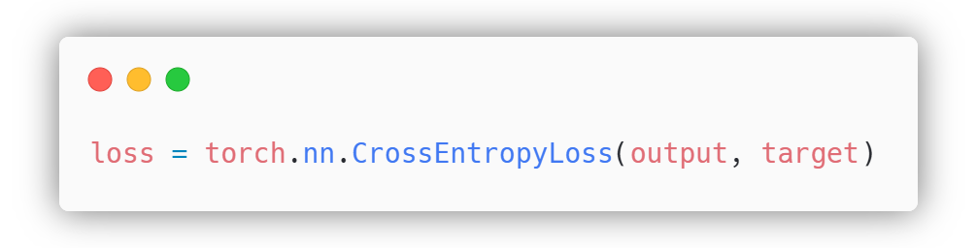
2 Forward Pass & Loss Function
How good or bad (accurate) is the prediction?
Notes:
To evaluate how good or bad that prediction was, we use something called a loss function.
The loss function compares the model’s prediction to the actual label
The loss function gives us a single number that represents the error — the bigger the number, the worse the prediction.
The training process will then try to reduce this number by adjusting the model’s weights — we’ll see how in the next section.
For regression problems — predicting continuous numbers — we often use Mean Squared Error (MSE). It calculates the squared difference between the predicted and actual values.

Slide 36
From ML to DL (pipeline)
Data Building
Data Processing
Strategy Selection
Training
Evaluating
Deployment
1
w1
5
w3
2
w2
4
3
Notes:
Ora ci andremo a foclaizzare sui punti chiave 1,2,3,4,5 …

Slide 37
3 Backpropagation Algorithm & Optimizer
Once the model makes a prediction and we’ve calculated the loss, we need to tell the model how to improve.
w1
w3
w2
Notes:
Once the model makes a prediction and we’ve calculated the loss, we need to tell the model how to improve. That’s where backpropagation comes in.
Backpropagation is the process of passing the error backwards through the network, layer by layer, to understand how much each weight contributed to the mistake.
It’s like asking: ‘If this prediction was wrong, who’s responsible, and by how much?’
The network then uses that information to slightly adjust the weights and try again in the next training step.
---
Behind the scenes, backpropagation uses derivatives — you can think of them as a way of measuring how sensitive the error is to each weight.
The chain rule allows us to connect those sensitivities across layers. For example:
If changing weight A affects neuron B, and neuron B affects the output, the chain rule tells us how much weight A indirectly affects the final prediction.
No need to dive into the math — just remember: The network uses this chain of influence to figure out how to update each parameter so the next prediction is slightly better.

Slide 38
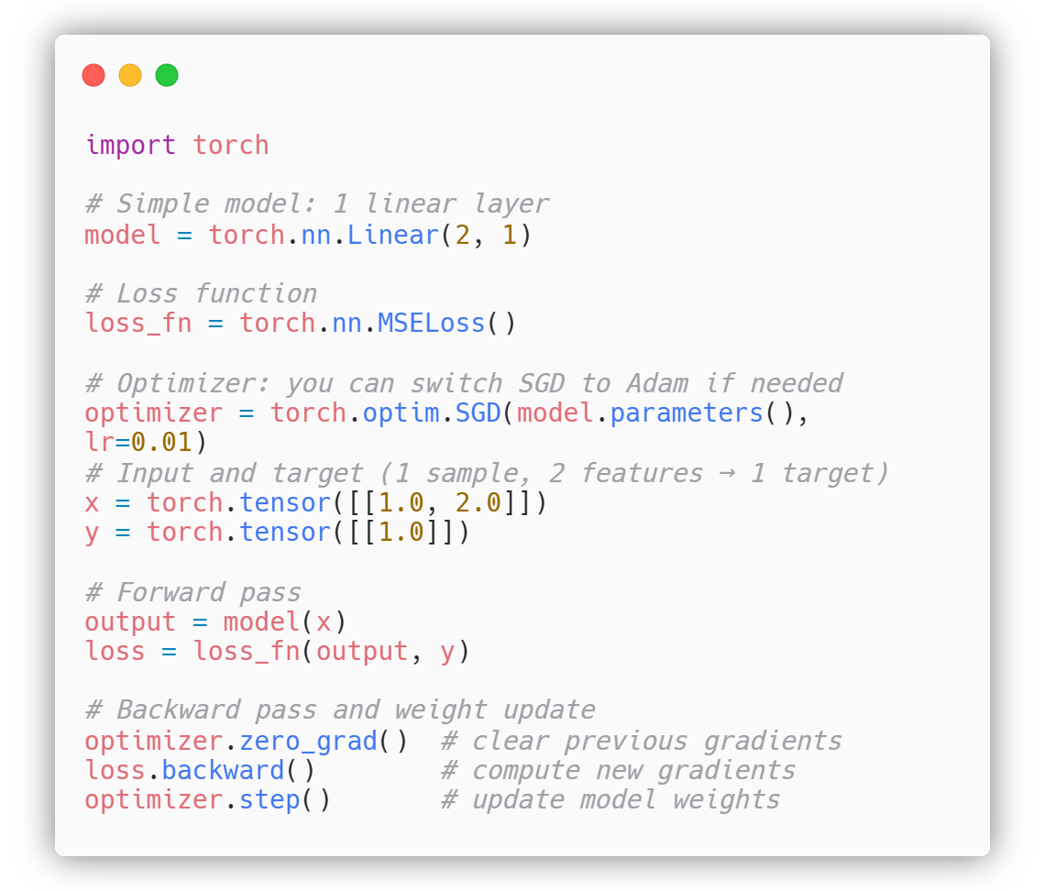
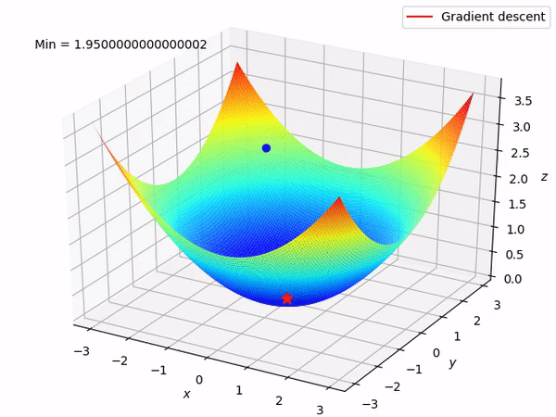
3 Backpropagation Algorithm & Optimizer
Notes:
Once we know how to adjust the weights, we use an optimizer to actually perform that update.
The simplest one is Stochastic Gradient Descent (SGD): it moves the weights a little bit in the direction that reduces the error.
But there are smarter ones, like Adam, which adapt the learning rate for each parameter individually and often lead to faster and more stable training.
You can think of the optimizer as the coach of the network — it decides how aggressively or carefully the model should adjust itself based on the feedback it gets.

Slide 39
From ML to DL (pipeline)
Data Building
Data Processing
Strategy Selection
Training
Evaluating
Deployment
1
w1
5
w3
2
w2
4
3
Notes:
Ora ci andremo a foclaizzare sui punti chiave 1,2,3,4,5 …

Slide 40
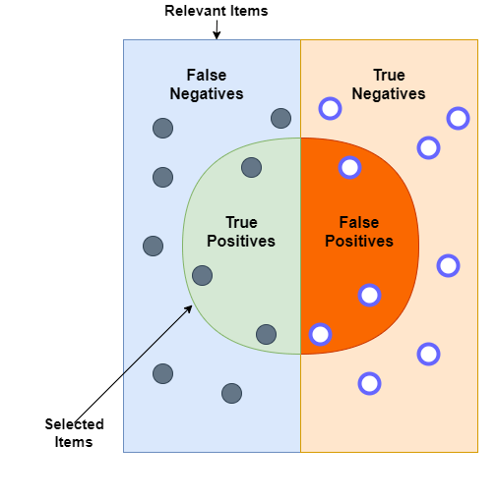
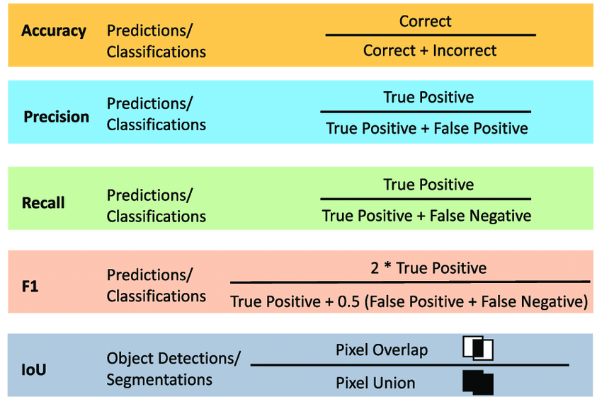
4 Evaluation Metrics
Notes:
Now, let's talk about how we can measure the performance of our models once they're trained.
In deep learning, we often use different evaluation metrics to assess how well the model is performing on tasks like classification or regression
Accuracy: One of the most common metrics is Accuracy. It simply measures the percentage of correct predictions out of all predictions. For example, if your model predicts correctly 90 out of 100 times, the accuracy would be 90%. Accuracy is useful when the classes are balanced, meaning there’s no huge disparity between the number of examples in each class.
Precision and Recall:
1) Precision tells us how many of the predicted positive labels were actually correct. For example, if our model predicted 10 emails as spam and only 7 were truly spam, the Precision is 70%
2) Recall tells us how many of the actual positive labels were correctly identified by the model. For example, if there were 20 actual spam emails, but the model only detected 7, the Recall is 35%.

Slide 41
From ML to DL (pipeline)
Data Building
Data Processing
Strategy Selection
Training
Evaluating
Deployment
1
w1
5
w3
2
w2
4
3
Notes:
Ora ci andremo a foclaizzare sui punti chiave 1,2,3,4,5 …

Slide 42



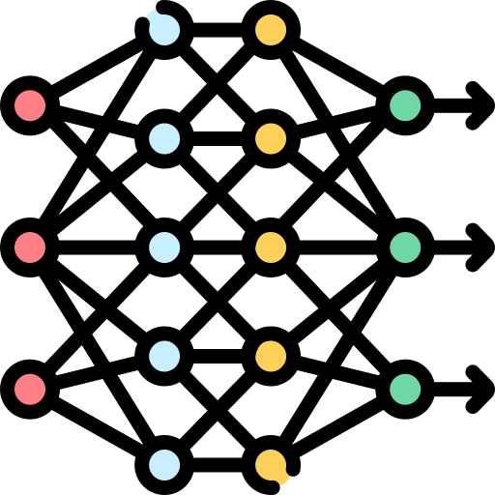
5 Pretrained & Finetuning Models
Training from scratch
Pretrained Model
Finetuning
Notes:
Pre-trained Model
One of the most powerful techniques in deep learning today is the use of pre-trained models.
A pre-trained model is a neural network that has been trained on a large dataset (such as ImageNet) for a specific task, like image classification, and is available for us to use. Instead of training a model from scratch, we can take advantage of the knowledge the model has already learned from this massive dataset.
The real benefit of pre-trained models is that they can save us a lot of time and computational resources. Training a deep neural network from scratch can take weeks or even months, depending on the complexity of the task. But with a pre-trained model, we can start with a model that already understands general features, like edges, textures, or basic shapes, which it learned from its initial training.
Fine-tuning the Pre-trained Model
But here’s the interesting part: we don’t have to use these pre-trained models as-is. We can also do what’s called fine-tuning.
Fine-tuning means taking a pre-trained model and training it further on our own dataset. We essentially adapt the model to our specific problem without starting from scratch. This is particularly useful when we have limited data for the task at hand.
The typical process for fine-tuning involves freezing most of the layers (i.e., not updating their weights) and only training the final layers of the model. This allows the model to adjust to the specific features of the new data, without forgetting the useful patterns it has already learned.

Slide 43
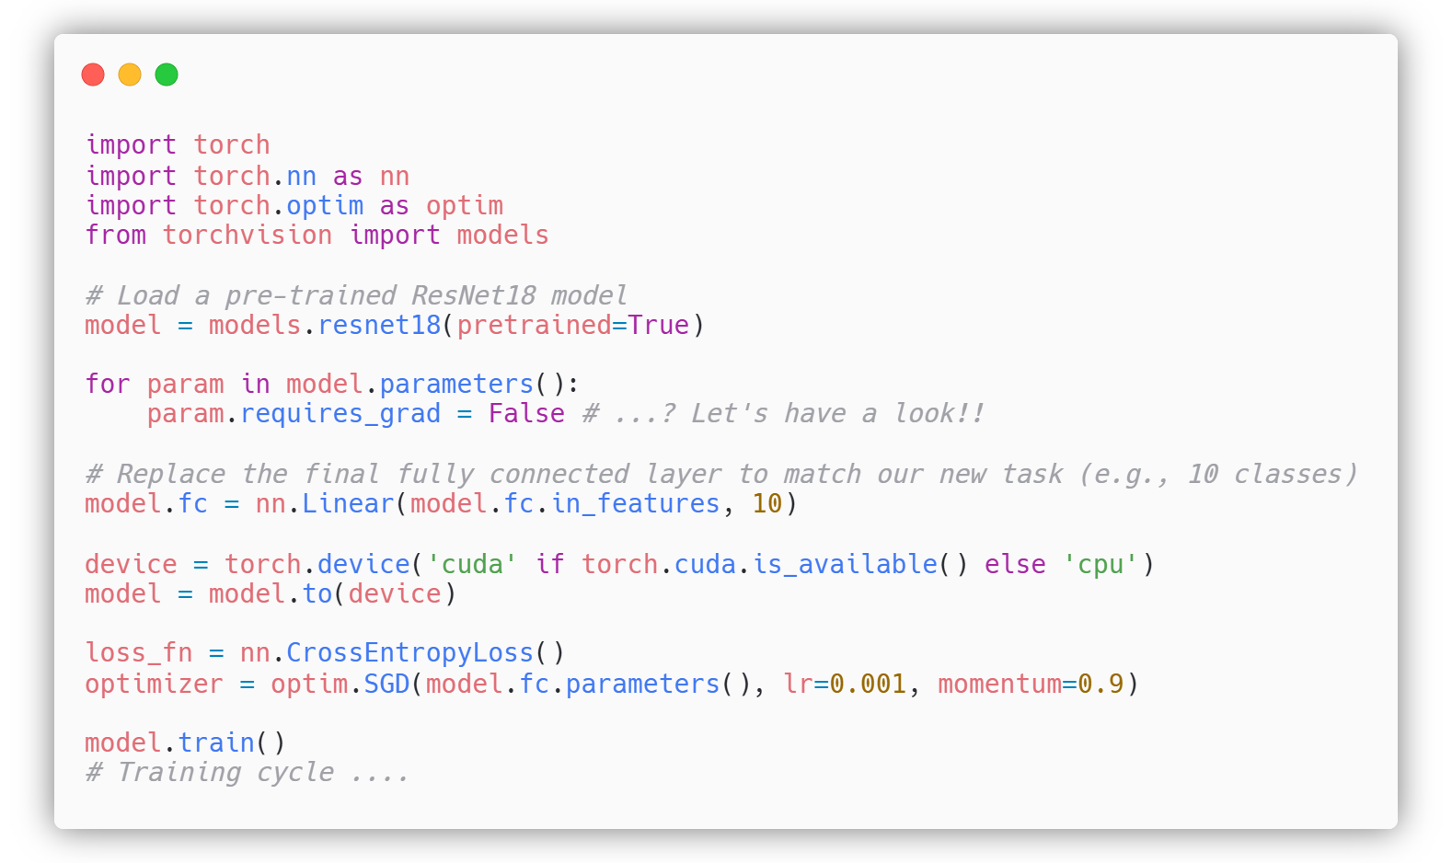
5 Pretrained & Finetuning Models
Notes:
Pre-trained Model
One of the most powerful techniques in deep learning today is the use of pre-trained models.
A pre-trained model is a neural network that has been trained on a large dataset (such as ImageNet) for a specific task, like image classification, and is available for us to use. Instead of training a model from scratch, we can take advantage of the knowledge the model has already learned from this massive dataset.
The real benefit of pre-trained models is that they can save us a lot of time and computational resources. Training a deep neural network from scratch can take weeks or even months, depending on the complexity of the task. But with a pre-trained model, we can start with a model that already understands general features, like edges, textures, or basic shapes, which it learned from its initial training.
Fine-tuning the Pre-trained Model
But here’s the interesting part: we don’t have to use these pre-trained models as-is. We can also do what’s called fine-tuning.
Fine-tuning means taking a pre-trained model and training it further on our own dataset. We essentially adapt the model to our specific problem without starting from scratch. This is particularly useful when we have limited data for the task at hand.
The typical process for fine-tuning involves freezing most of the layers (i.e., not updating their weights) and only training the final layers of the model. This allows the model to adjust to the specific features of the new data, without forgetting the useful patterns it has already learned.

Slide 44
Let’s code …
… GoTo EuroSATClassifier.ipynb

Slide 45


Collaboration opportunities at Φ-lab
Shared mutual interest
Join the Φ-lab to explore disruptive ideas
as a Visiting Researcher (industry, academia),
Visiting Professor, Research Fellow, PhD, YGT, etc.
Funded
Φ-lab’s Invitation To Tender on ESA-STARS
Foundation Models, Generative AI, QC4EO, Edge computing, Web 3.0, etc..
InCubed : partnership development of commercial products or services
Open Space Innovation Platform : co-funded research or researchers
EO Science4Society : no SOW, 100/200K, 6/18 months
ESA Technology Programmes like GSTP and TDE

Slide 46
Working with us it is easy
Visiting Researchers (Industrial and Scientific)
Visiting Professor
ESA Research Fellowships
ESA Co-funded PhD
ESA Early Graduate Traineeships (EGT), Internships, National trainee

Slide 47


Join ESA Φ-lab through CIN
The Collaborative Innovation Network (CIN) by ESA Φ-lab, provides to leading researchers and University Professors the opportunity to join ESA Φ-lab and be actively involved in accelerating the future of Earth Observation with ESA.
The ESA Φ-lab CIN aims to:
Establish a global network through which researchers and innovators can JOIN ESA Φ-LAB
Promote knowledge sharing and develop groundbreaking EO solutions
Check the open calls
Follow CIN on Linkedin

Slide 48

What to go deeper into Φ-lab disruptive innovation?
Don’t miss our spotlight session at Big Data from Space
(Day 2 – October 2nd at 17:50)
Notes:
Back to the past …

Slide 49
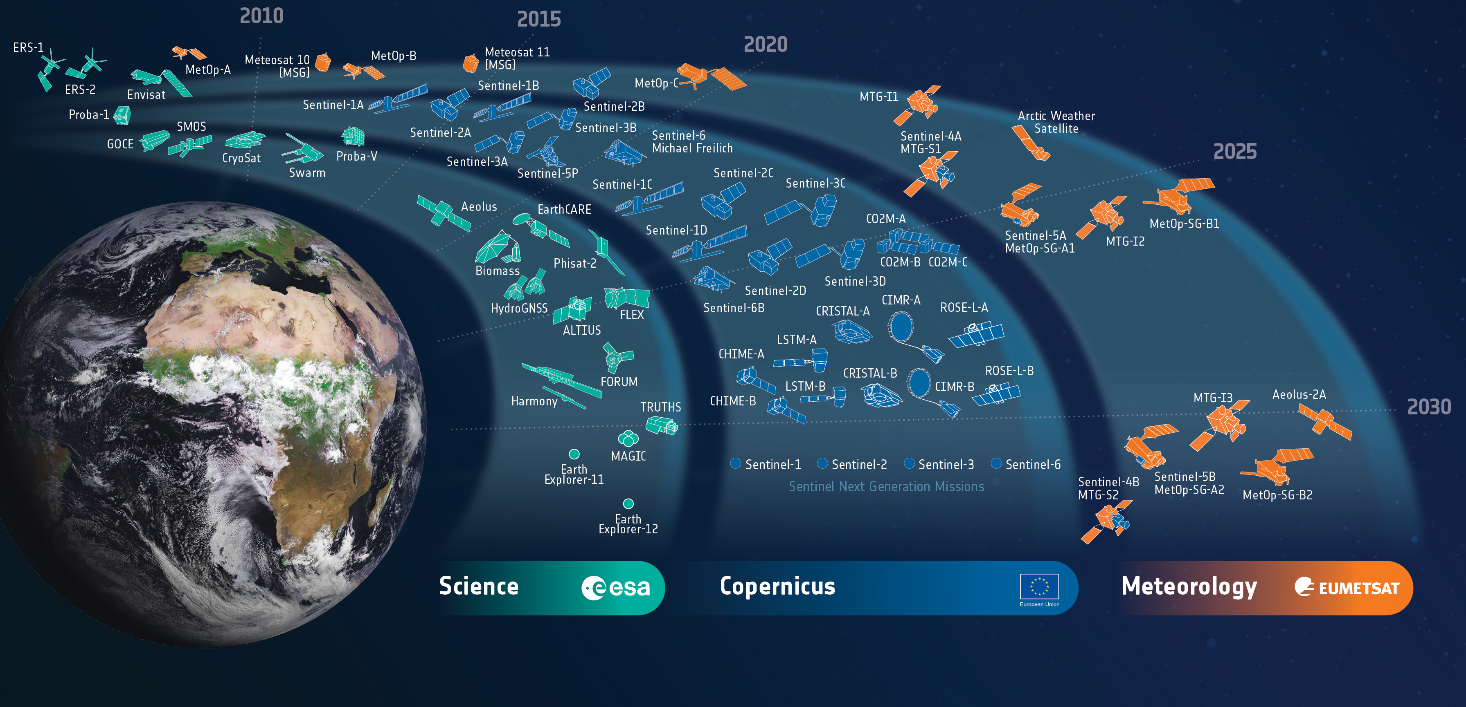

ESA – European Space Agency
Internal Research Fellow, Φ-lab Division
Earth Observation Climate Action, Sustainability and Science Department (EOP-S)
Directorate of Earth Observation Programme
lorenzo.papa@esa.int | www.esa.int | https://philab.esa.int

