Slide 1







ESA’s 2025 Big Data Foundations for Earth Observation Training Course
Thematic EO Applications & use-cases I (GREEN DEAL)
Helmut Herglotz
EOX IT Services
22.09.2025

Slide 2

Content
11:30 – 13:00
About EOX and me
What is the Green Deal?
Domains of the Green Transition
Strategies applied to reach those goals
EO applications and decision support with EO
Synergy between big data methodologies and EO
Overview of typical use cases

Slide 3

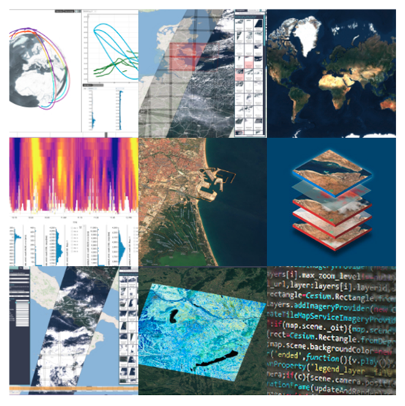
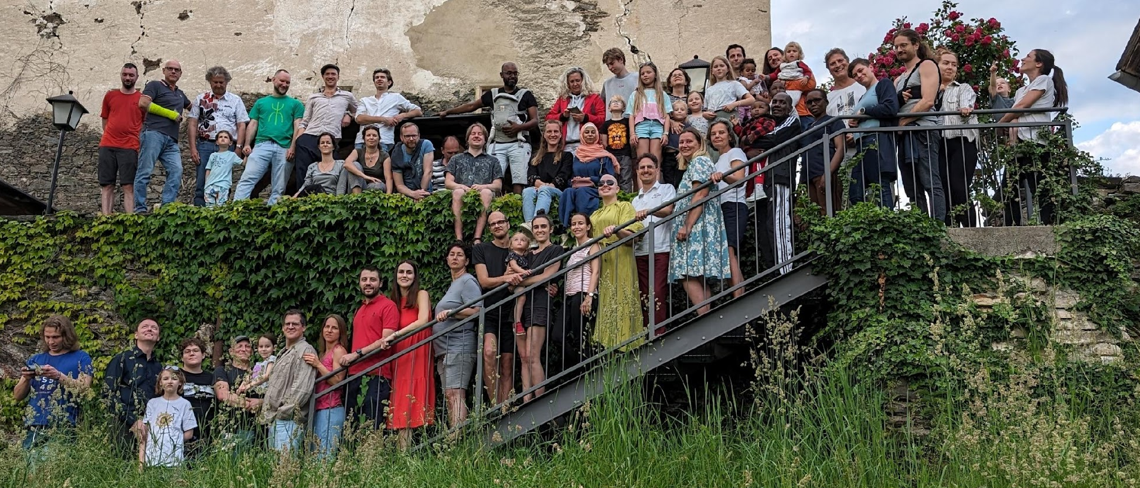
About EOX
EOX IT Services GmbH, Vienna, Austria
https://eox.at
Geospatial IT engineering, product and operations services
Cloud-based platforms and (graphical) Web applications, EO-dashboards
Value from Earth observation satellites data
Customers in governments, space application industry, and geoscience
Over 70 ESA contracts since establishment of EOX in 2008
EOxFamily June 2024

Slide 4
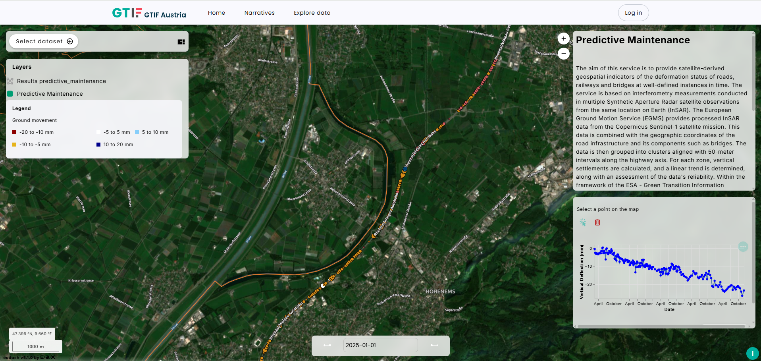
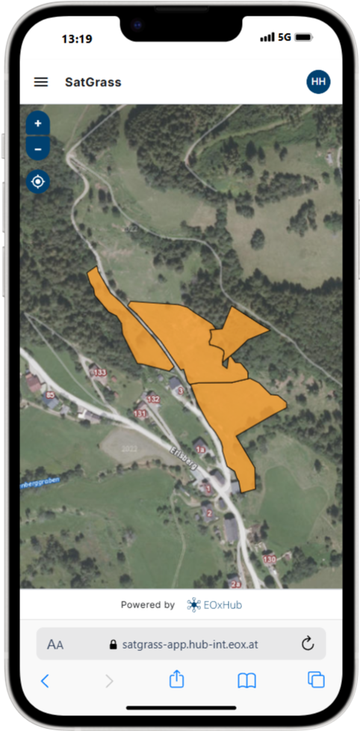

About Me
GTIF Austria Consolidation
SatInSys (Satgrass Application)
Helmut Herglotz
Project Manager
EOX IT Services GmbH
helmut.herglotz@eox.at

Slide 5
The Green Deal

Slide 6

Communication from the Commission to the European Parliament, the European Council, the Council, the European Economic and Social Committee and the Committee of the Regions the European Green Deal, 2019
The Green Deal
‘a new growth strategy that aims to transform the EU into a fair and prosperous society, with a modern, resource-efficient and competitive economy where there are no net emissions of greenhouse gases in 2050 and where economic growth is decoupled from resource use’ EU Commission, 2019

Slide 7

The Green Deal
The EU Green Deal serves as a roadmap for sustainable growth and development within the European Union
Its goal is to make Europe the world’s first climate-neutral continent by 2050
Introduced by the European Commission in December 2019
Created to address climate change, biodiversity decline, and environmental pollution

Slide 8
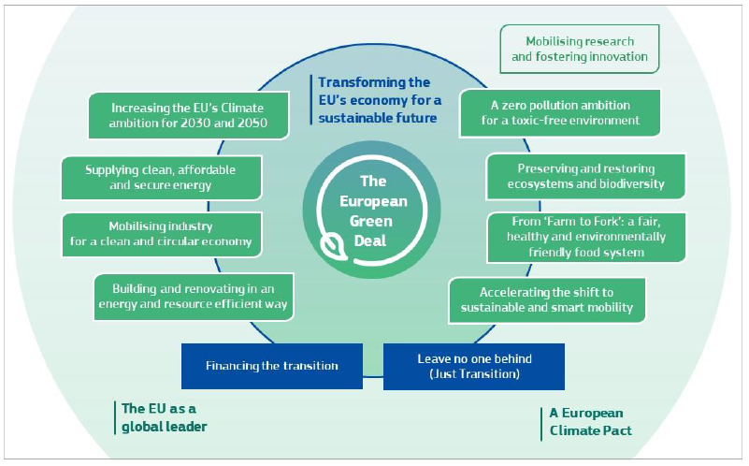
Notes:
The Green Deal is an integral part of this Commission’s strategy to implement the United Nation’s 2030 Agenda and the sustainable development goals3, and the other priorities announced in President von der Leyen’s political guidelines4. As part of the Green Deal, the Commission will refocus the European Semester process of macroeconomic coordination to integrate the United Nations’ sustainable development goals, to put sustainability and the well-being of citizens at the centre of economic policy, and the sustainable development goals at the heart of the EU’s policymaking and action.

Slide 9
Key Objectives
The Green Deal
Reduce greenhouse gas emissions by at least 55% by 2030
Establish a clear pathway toward achieving climate neutrality by 2050
Transition the EU economy toward greater sustainability
Promote a circular economy that minimizes waste and encourages recycling
Improve energy efficiency and expand the use of renewable energy
Safeguard and restore biodiversity and natural ecosystems

Slide 10
Domains of the Green Deal

Slide 11
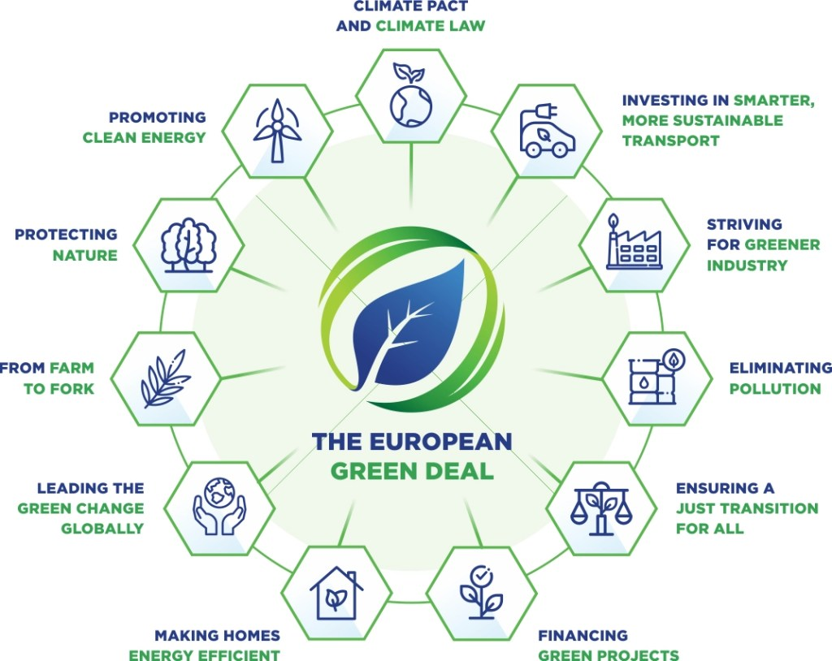
Domains of the Green Deal

Slide 12
Domains of the Green Deal
EO Climate Adaptation
Energy Transition
Mobility Transition
Carbon Accounting
Sustainable Cities

Slide 13
Strategies to Reach the Key Objectives

Slide 14
Strategies to reach Key Objectives
Policy Framework & Legislation ("Fit for 55")
Raising the 2030 climate target (cutting emissions by at least 55%).
Revising laws on emissions trading (ETS), renewables, energy efficiency, cars, aviation, etc.
Carbon Border Adjustment Mechanism (CBAM) to prevent carbon leakage.
Sustainable Finance & Investment
EU Green Taxonomy: defining what counts as a “green” investment.
Sustainable Finance Strategy to guide private and public money into green projects.
Just Transition Mechanism: support for regions, industries, and workers most affected.
Research, Innovation & Digital Tools
Funding through Horizon Europe for clean tech, energy storage, and climate solutions.
Digitalization and AI for smarter resource management.
Earth observation (Copernicus Programme) → monitoring emissions, land use, biodiversity, oceans, disasters.
Sectoral Roadmaps & Action Plans
Farm to Fork Strategy → sustainable food systems.
Circular Economy Action Plan → product design, recycling, waste reduction.
Biodiversity Strategy 2030 → protect 30% of EU land and seas.
Renovation Wave → energy efficiency in buildings.
Sustainable and Smart Mobility Strategy → green transport shift.

Slide 15
Strategies to reach Key Objectives
Carbon Pricing & Market Mechanisms
Expanding the EU Emissions Trading System (ETS).
Pricing carbon in aviation, shipping, and road transport.
Linking carbon pricing with global partners.
International Action & Diplomacy
EU leadership in global climate negotiations (Paris Agreement, COP summits).
Partnerships for green energy and raw materials.
Green Deal diplomacy with developing countries.
Citizen & Business Involvement
European Climate Pact: engaging citizens and organizations.
Support for SMEs to transition sustainably.
Education and skills programs for the green economy.

Slide 16
Space for a Green Future
EO applications and decision support systems

Slide 17
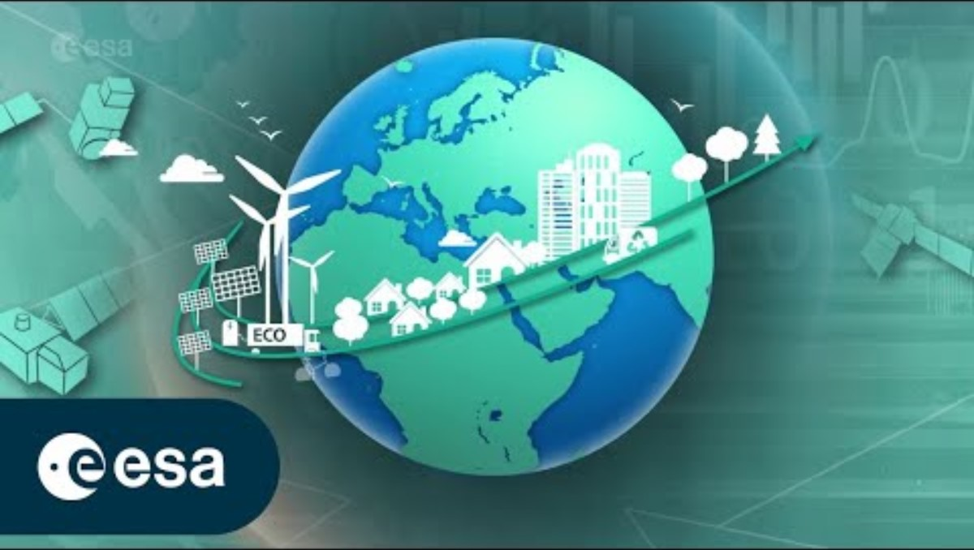
Space for a Green Future

Slide 18
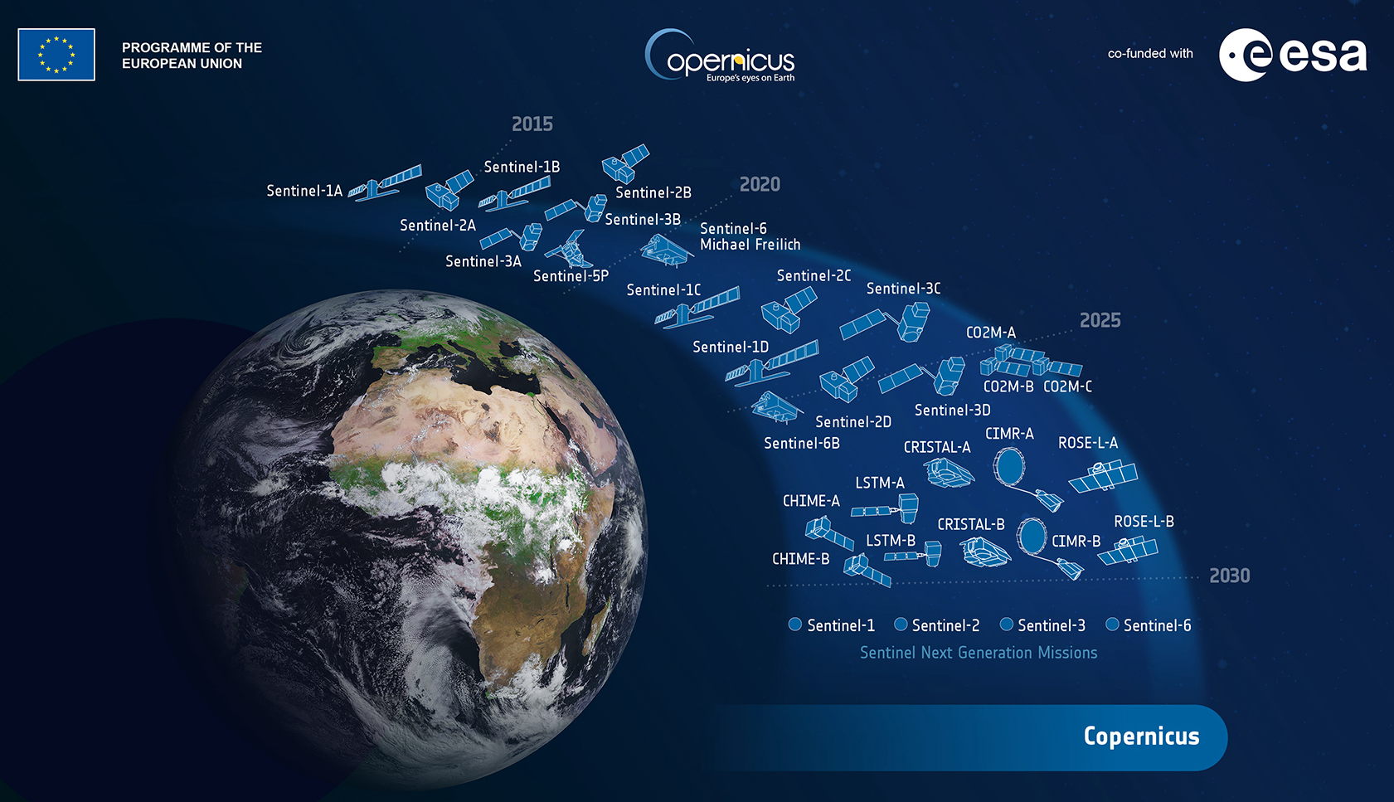

Slide 19

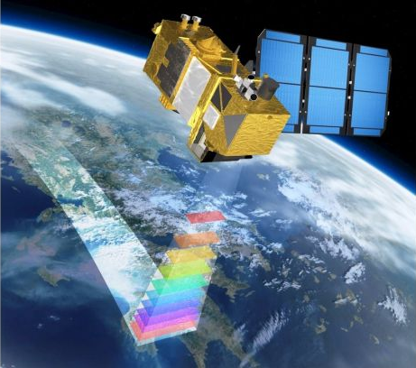
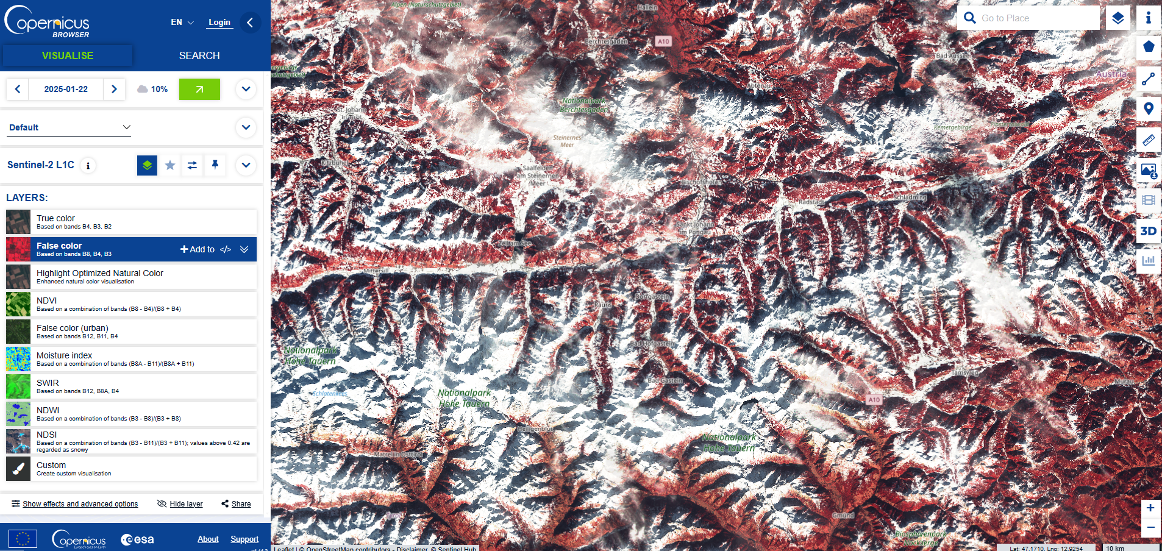
Earth Observation – Data from Space
Copernicus Data Space Ecosystem – EO Browser
Copernicus Sentinel-2 satellite:
multispectral
10 m resolution on ground
~ weekly revisit

Slide 20

From Monitoring to Managing
Earth observation data from space was crucial to identifying climate change.
ESA is helping Europe to move from monitoring to managing, and to harness the use of space to pursue climate action, supporting national and European efforts to become carbon neutral by 2050.
Working with international partners – many of whom are from outside the space industry – ESA accelerates the use of space for a green future.

Slide 21
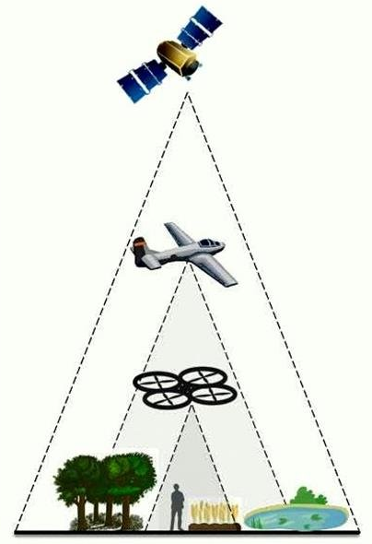
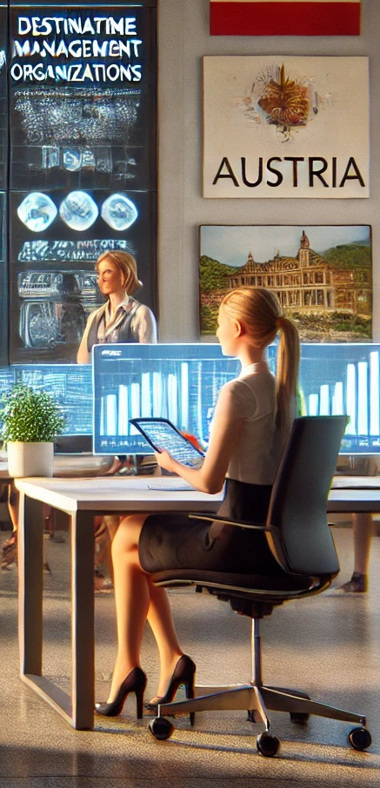



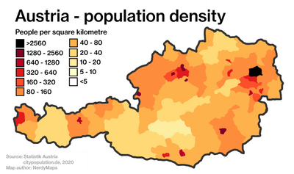
EO applications and decision support systems
(Value Adding)
Data
Information
Decision Ready Information
Data
Processing
Delivery
Application & Cockpit
Data
Analytics
Interactive (WebUI)
Data
fusion
Earth-observation
AI / ML
Models
machine 2 machine (API)
Socio-economic

Slide 22
Synergy between big data methodologies and EO

Slide 23
How much data does the Copernicus Data Space Ecosystem (CDSE) produce daily?
Synergy between big data methodologies and EO

Slide 24
How much data does the Copernicus Data Space Ecosystem (CDSE) produce daily?
Synergy between big data methodologies and EO
Up to 30 TB
(source: https://sentinels.copernicus.eu/-/copernicus-data-space-ecosystem-cdse-releases-annual-report-2023)

Slide 25
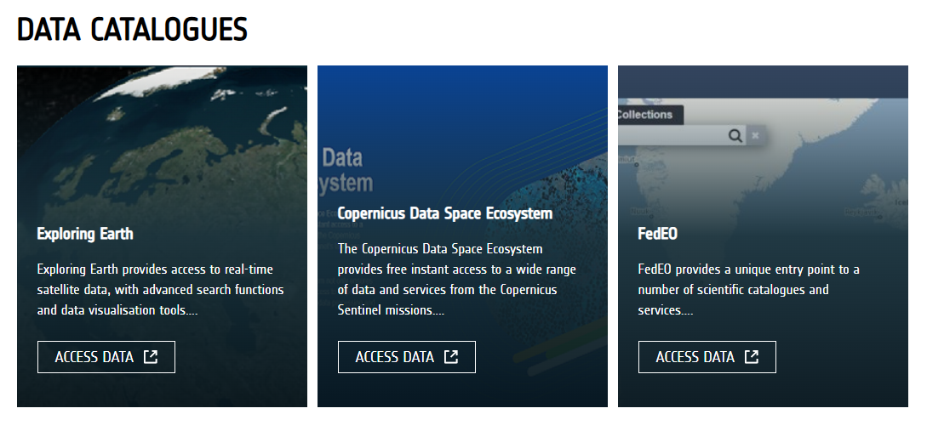
Synergy between big data methodologies and EO
https://earth.esa.int/eogateway/catalog

Slide 26
1. Big Data Processing & Infrastructure
Synergy between big data methodologies and EO
Hadoop, Spark, Dask
Google Earth Engine, AWS Earth on Cloud
Kafka, Flink
Example: Real-time flood mapping

Slide 27
2. Artificial Intelligence / Machine Learning
Synergy between big data methodologies and EO
Random Forests, SVM, Gradient Boosting
CNNs, RNNs, Transformers
Transfer learning, AutoML
Example: Crop yield prediction

Slide 28
3. Data Fusion & Interoperability
Synergy between big data methodologies and EO
Combination of different remote sensing sources (Optical + Radar + LiDAR + Meteorological, etc.)
Open Data Cube, xarray
OGC, STAC standards
Example: Biodiversity & climate studies

Slide 29
4. Visualization, Analytics & Decision Support
Synergy between big data methodologies and EO
GTIF Platform (eodash, EOxHub), ArcGIS, QGIS, PostGIS
Dash, Kepler.gl, PowerBI
Time-series visual analytics
Example: Water management & carbon accounting

Slide 30
Overview of typical EO Usecases
Synergy between big data methodologies and EO

Slide 31
Agriculture & Food Security
Overview of typical EO Usecases
Crop mapping, yield prediction, irrigation, area monitoring systems
E.g. Normalized difference vegetation index (NDVI) for health and density of vegetation
Machine Learning Models combining NDVI, metereological data trained with in situ data for yield and quality prediction

Slide 32
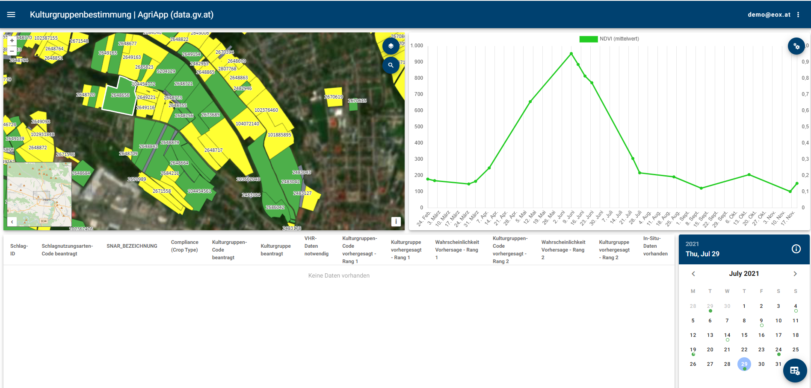
Overview of typical EO Usecases

Slide 33
Biodiversity & Ecosystem Monitoring
Overview of typical EO Usecases
Habitat mapping, species detection

Slide 34
Forestry
Overview of typical EO Usecases
Deforestation, fire risk, carbon stocks

Slide 35
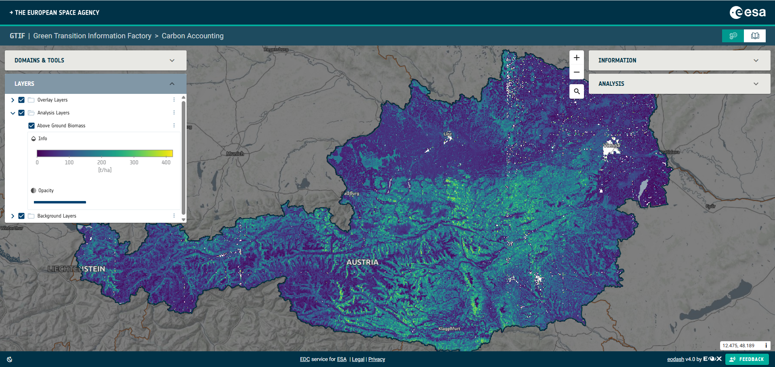
Overview of typical EO Usecases

Slide 36
Urban Development
Overview of typical EO Usecases
Land use change, heat islands

Slide 37
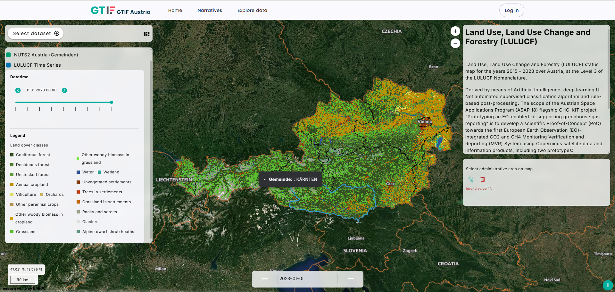
Overview of typical EO Usecases

Slide 38
Water Resources
Overview of typical EO Usecases
Droughts, glaciers, water quality

Slide 39
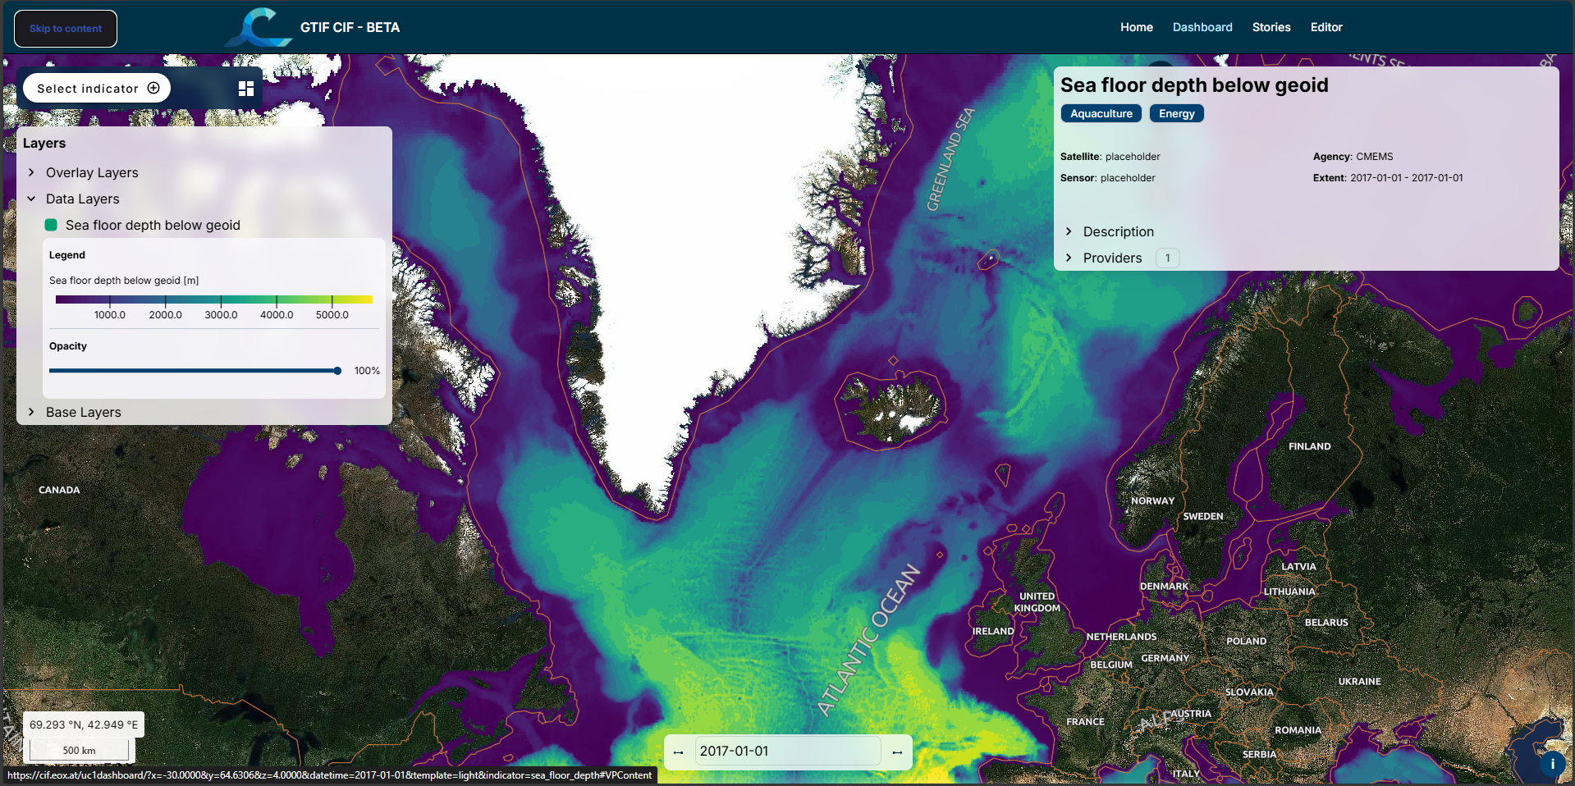
Overview of typical EO Usecases

Slide 40
Disaster Management
Overview of typical EO Usecases
Floods, landslides, wildfires

Slide 41
Climate & Atmosphere
Overview of typical EO Usecases
GHG, air quality, sea-level rise

Slide 42
Coastal & Marine Systems
Overview of typical EO Usecases
Coral reefs, oil spills, fishing

Slide 43
ESA’s 2025 Big Data Foundations for Earth Observation Training Course
Basic EO data exploration with Green Transition Information Factory (GTIF)
Helmut Herglotz
EOX IT Services
22.09.2025

Slide 44
Content
14:00 – 15:30
What is GTIF?
Past and ongoing GTIF initiatives in Europe
GTIF domains
GTIF capabilities
DEMO
Infrastructure Predictive Maintenance (AIT)
The Austrian GTIF platform

Slide 45
What is GTIF?

Slide 46
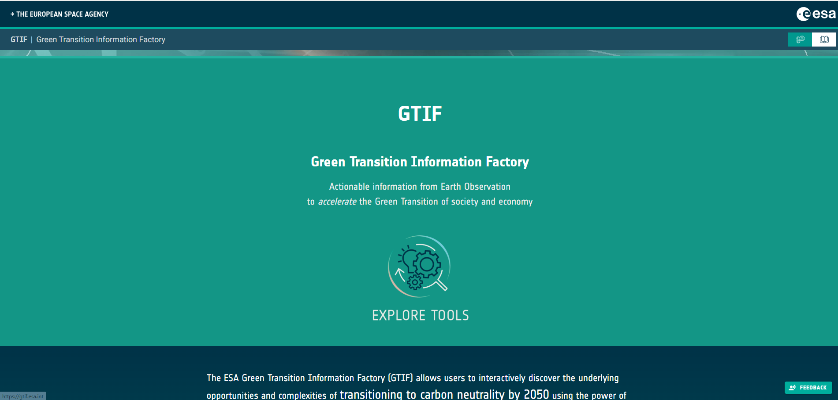
What is GTIF (the Green Transition Information Factory)
Actionable information from Earth Observation to accelerate the Green Transition of society and economy

Slide 47
RECAP: EO applications and decision support systems
Data
Information
Decision Ready Information
Data
Processing
Delivery
Application & Cockpit
Data
Analytics
Interactive (WebUI)
Data
fusion
Earth-observation
AI / ML
Models
machine 2 machine (API)
Socio-economic

Slide 48

DATA FLOW – VALUE CHAIN – CONCEPT
Green Transition Information Factories
Renewable Energy Potentials
Data
Information
Decision Ready Information
Microclimate Trends & Impacts
GTIF Ecosystem
Application & Cockpit
Ecosystems & Natural Resources
Interactive (WebUI)
Earth-observation
Brownfields, soil sealing, re-naturalization potential
Air quality and health risk indicators
machine 2 machine (API)
Legend
Socio-economic
Third Party Info Source (non-GTIF)
GTIF Capability

Slide 49
Past and Ongoing GTIF Initiatives

Slide 50
Past and ongoing GTIF activities in Europe
GTIF Activity | Focus
GTIF Austria Demonstrator | Austria
GTIF Austria Consolidation | Austria
Baltic GTIF | Baltic Sea States
Cerulean GTIF | Arctic Seas
Danube Information Factory | River Ecosystems (flooding, irrigation)
UK GTIF | UK, Ireland, Canada
GTIME | Vegetation Change
NoiseSphere | Mobility (noise)
Popsicle | Population simulation (resilience against climate change and related emergencies)
SAFIR | Sentinel assisted Forestry insight and research
[AND MANY MORE!!!]

Slide 51

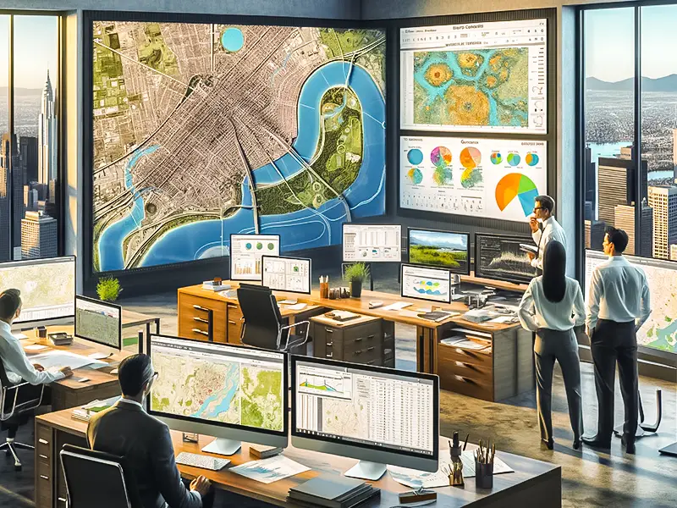
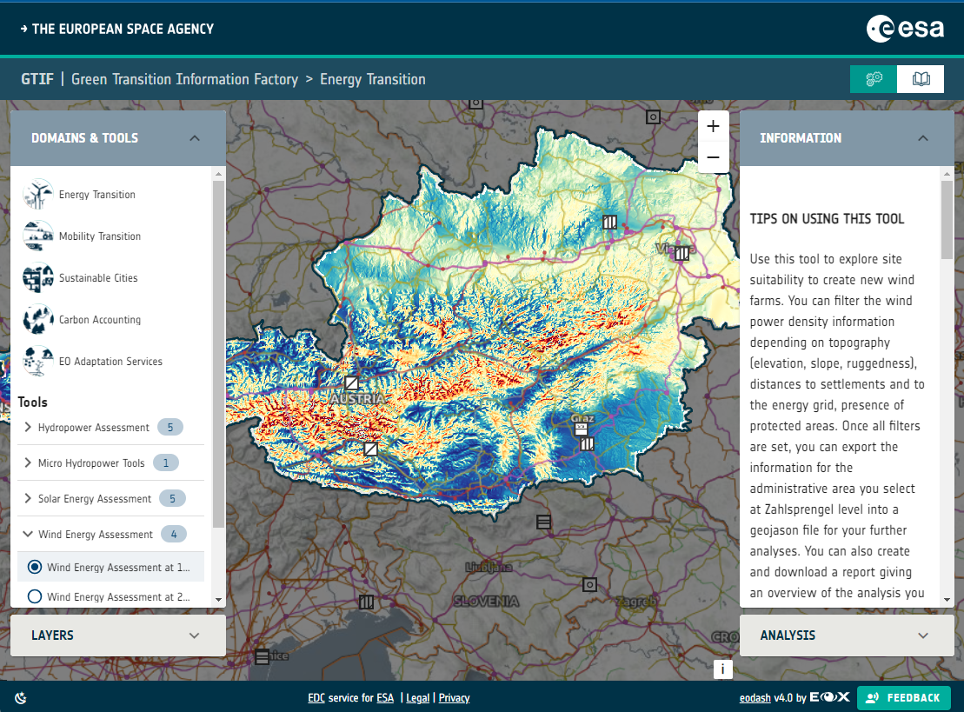
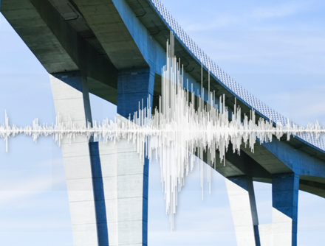
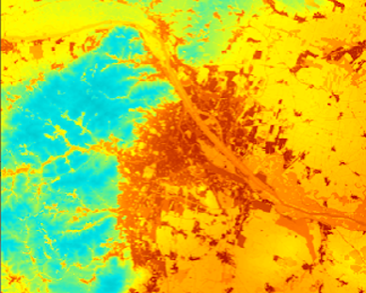
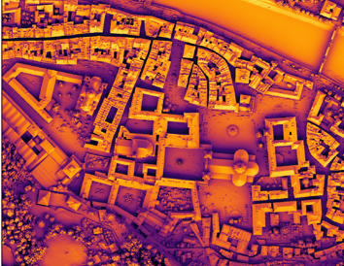
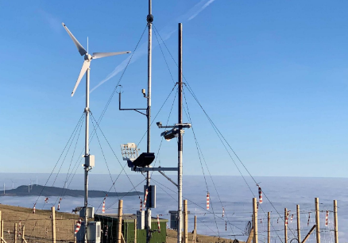

Past and ongoing GTIF activities in Europe
Handover of Governance
National
Stakeholders
GTIF-AT Demonstrator
Infrastructure
Temperature
Solarpotential
Wind Energy
https://gtif.esa.int/explore

Slide 52
GTIF domains

Slide 53
Domains of the Green Deal
EO Climate Adaptation
Energy Transition
Mobility Transition
Carbon Accounting
Sustainable Cities

Slide 54
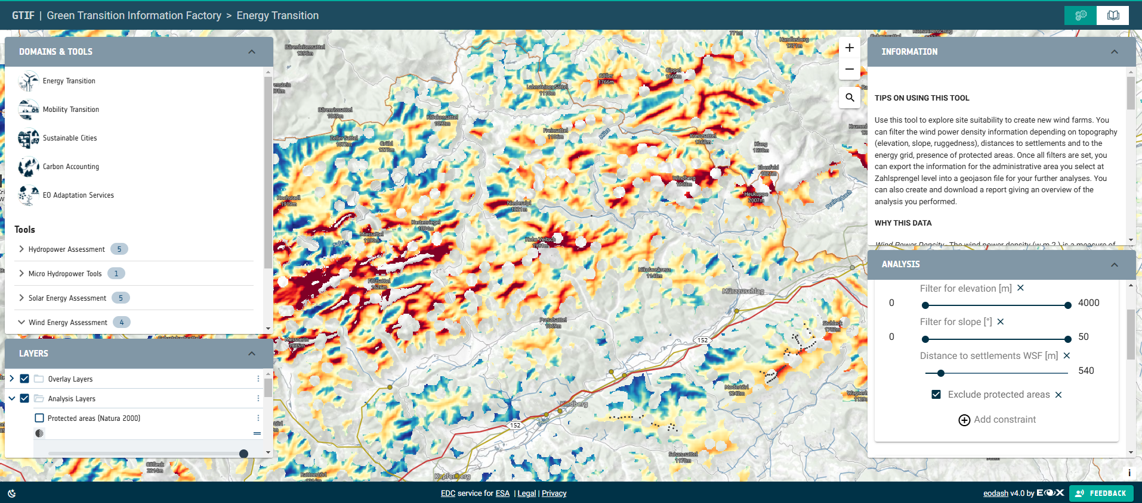
Energy Transition
Example: Wind Atlas

Slide 55
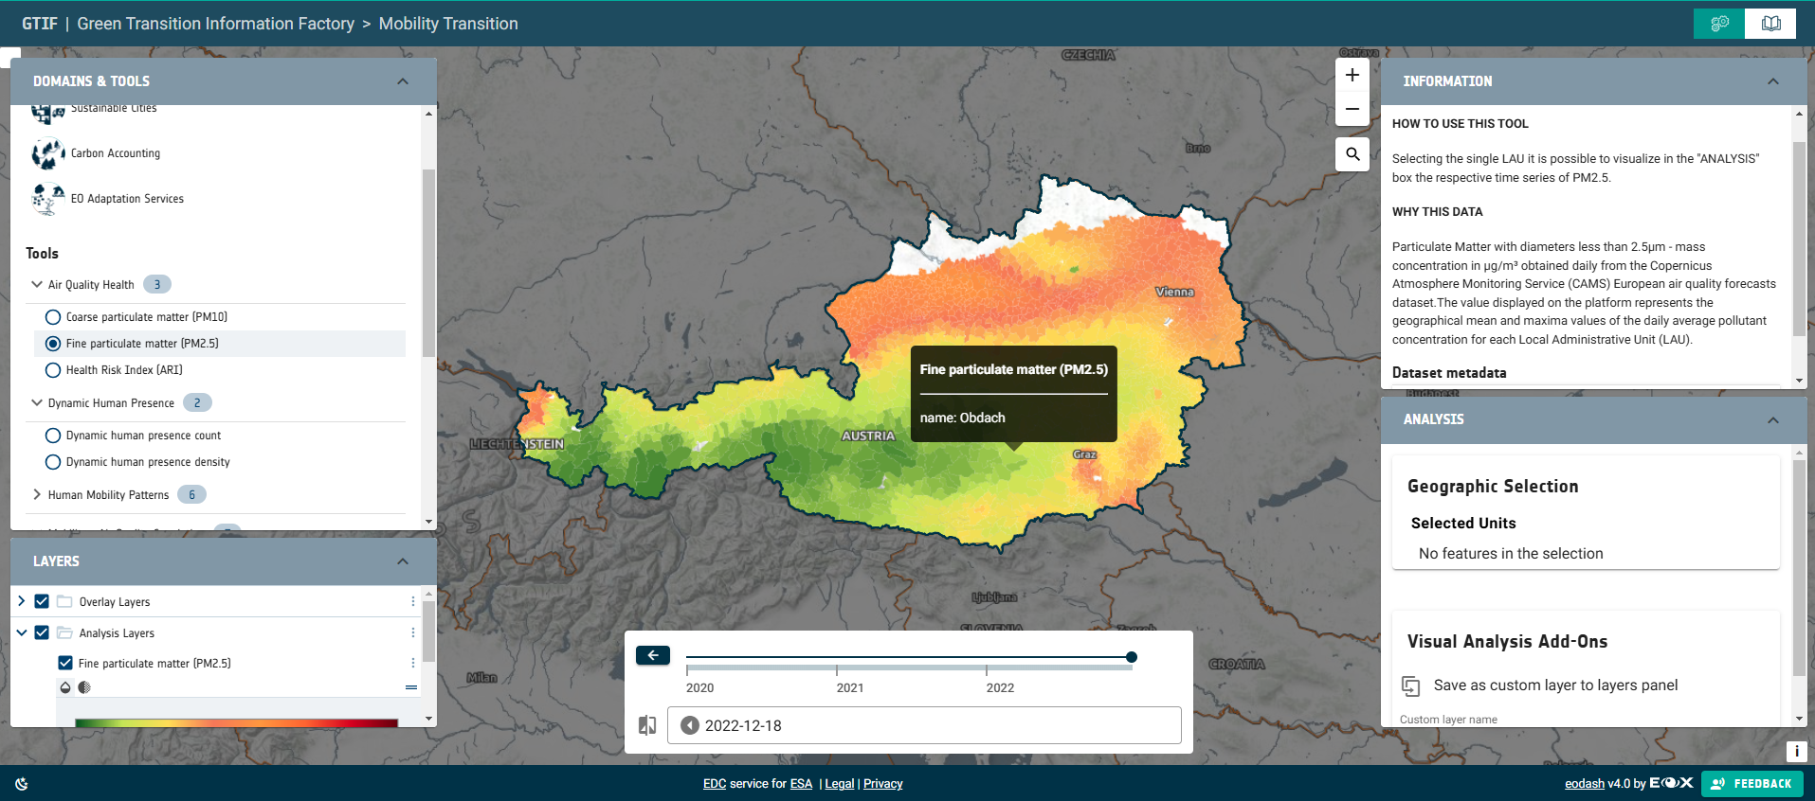
Mobility Transition
Example: Particulate Matters

Slide 56
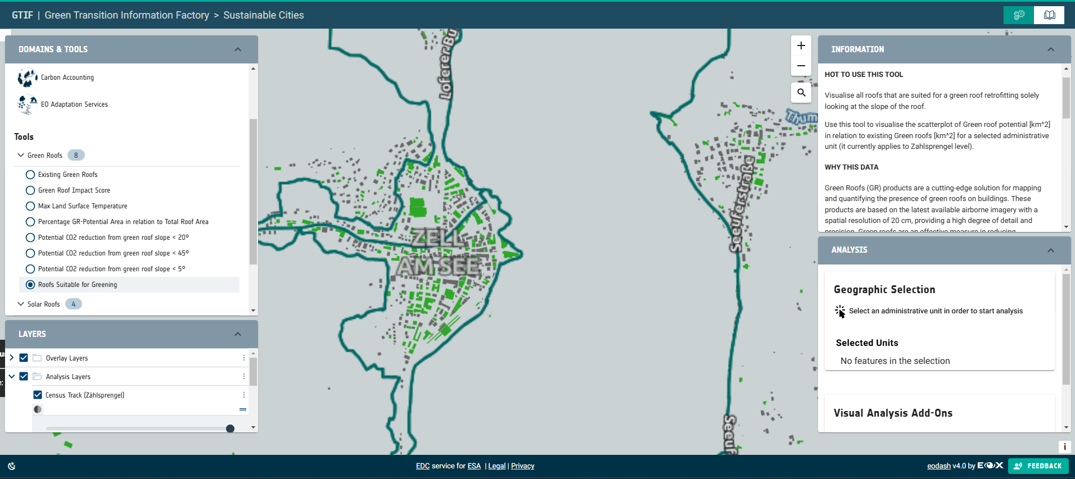
Sustainable Cities
Example: Green Roofs (suitability for greening)

Slide 57
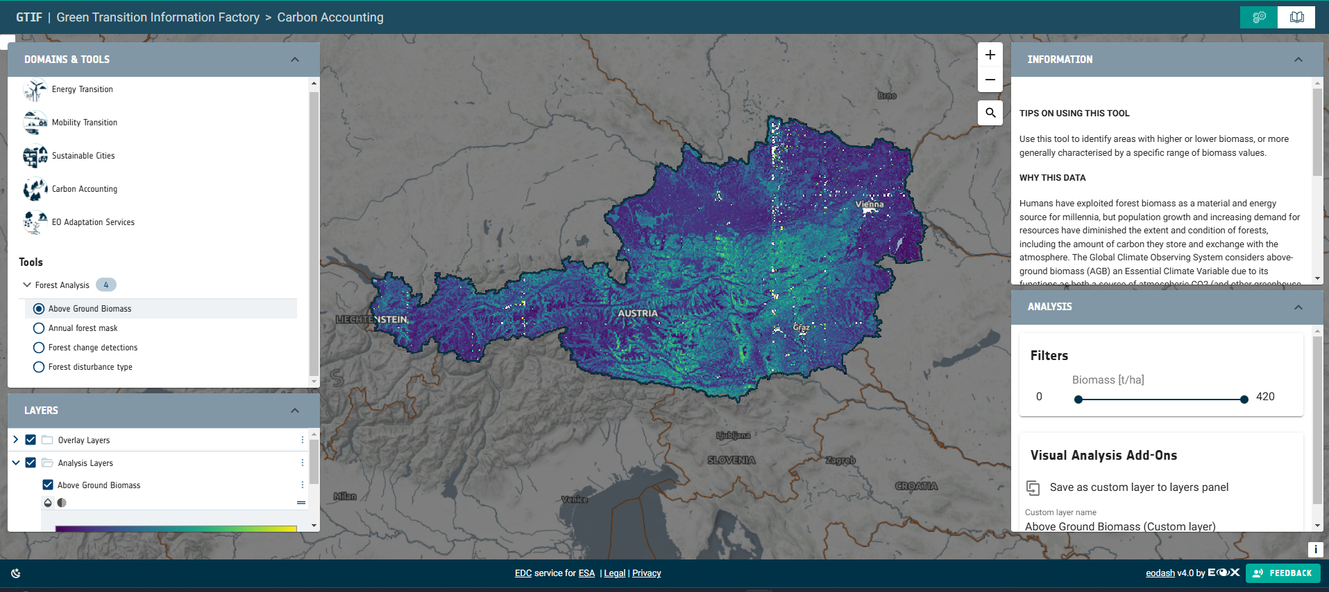
Carbon Accounting
Example: Forest Biomass

Slide 58
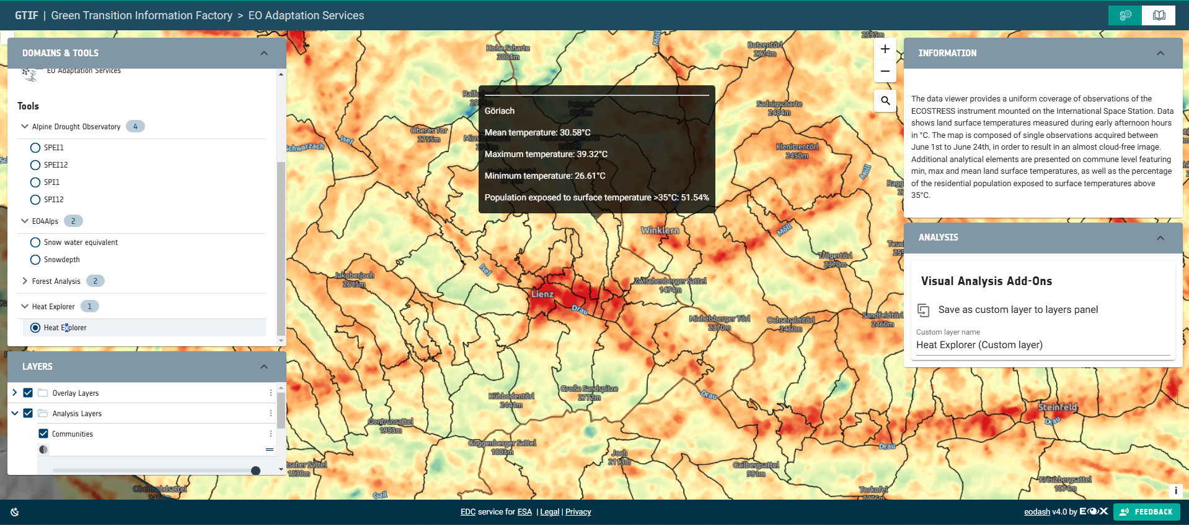
EO Adaptation Services
Example: Land Surface Temperature

Slide 59
GTIF capabilities

Slide 60
Internal tracking of GTIF Capabilities
EO Adaptation Services
Currently ca. 170 Capabilities
AI/ML based capabilities (e.g. Windpower Assessment) – ENERGY DOMAIN
Capabilities based on big data processing (Predictive Mobility Maintenance) – MOBILITY DOMAIN
Capabilities based on Data Fusion (Renewable Energy Site Identification) – ENERGY DOMAIN
…
Notes:
5 Domains auf 3; 37 capabilities to 14

Slide 61
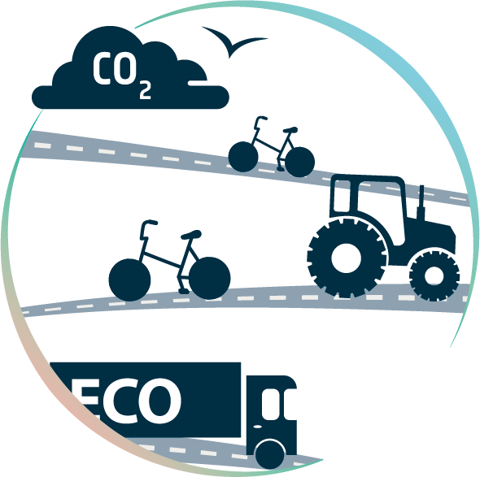








Supported domains & GTIF capabilities (Austria)
Consolidation & Evolution
& Operationalisation
22
12
2
4
15
11
8
4
+ consolidation and assessment of remaining GTIF-capabilities
Notes:
5 Domains auf 3; 37 capabilities to 14

Slide 62
Current GTIF enhancement implementations
GTIF Consolidation (ESA Work Requirements)
Energy Transition | WR-01 | WPD-as-a-service & update AT Wind Atlas
 | WR-02 | Evolve site identification capabilities for renewable energy expansion to support the identification of acceleration areas of the RED-III regulation
 | WR-03 | Energy nowcasting for solar- and wind energy
 | WR-04 | Support for energy supply and demand planning
 | WR-05 | Support the creation of “energy plans” for every community
 | WR-06 | Integration of energy grid capacity information
 | WR-07 | Explore support for geothermal energy potential assessment
 | WR-08 | Integrate BMK energy dashboard
Mobility Transition | WR-09 | Assessment and integration of human mobility data sources
 | WR-10 | Transport Infrastructure Predictive maintenance
Sustainable Cities | WR-11 | Rooftop characterisation as a service
 | WR-12 | Develop comparison feature for cities/regions as part of GTIF UI
 | WR-13 | Urban Vegetation monitoring
 | WR-14 | Fallow land and soil sealing identification and assessment capability
Notes:
5 Domains auf 3; 37 capabilities to 14

Slide 63
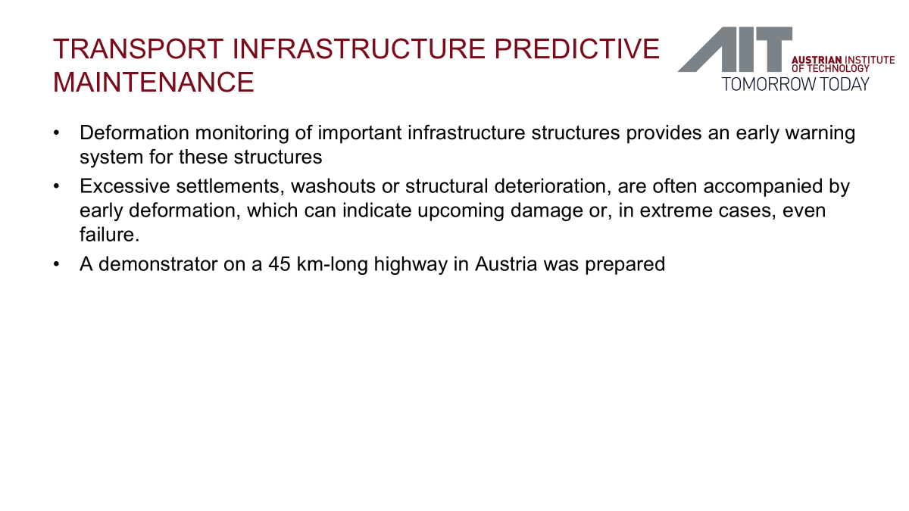

Slide 64
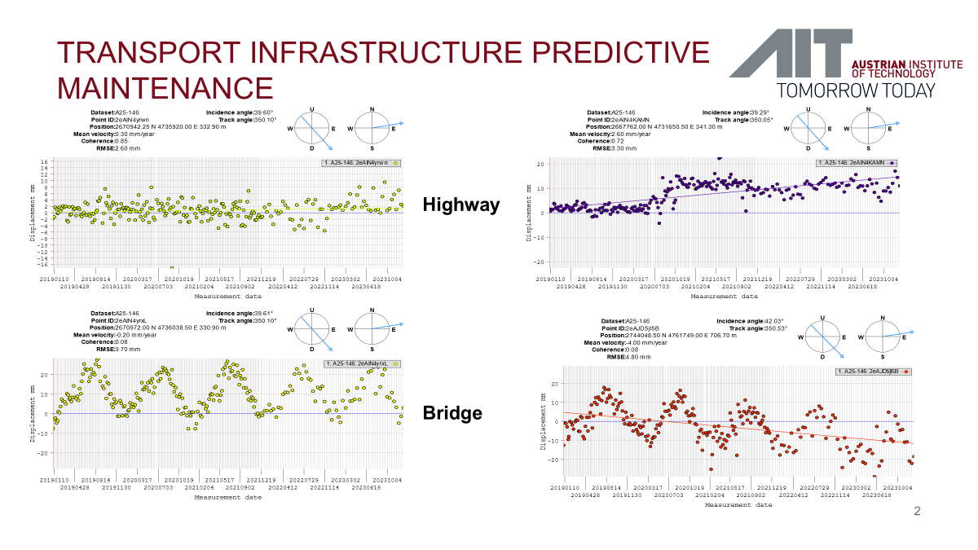

Slide 65
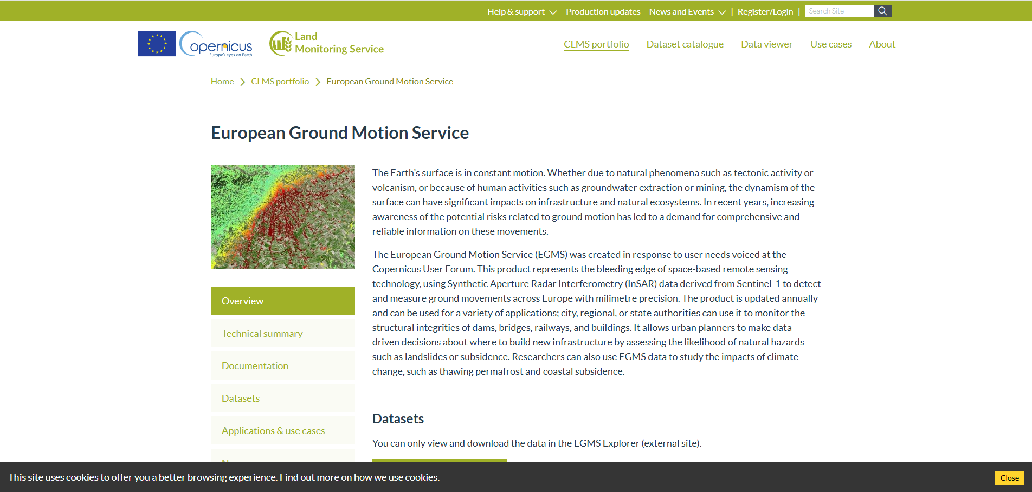
European Ground Motion Service

Slide 66
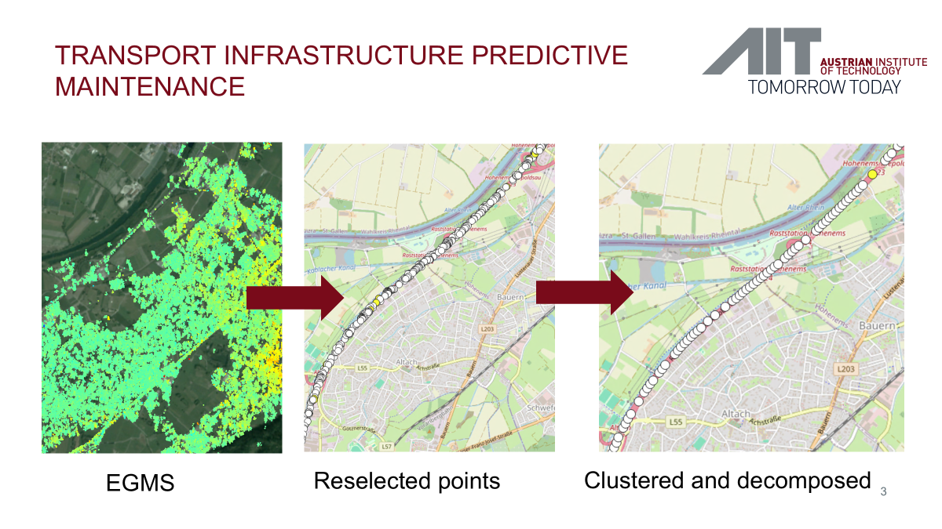

Slide 67
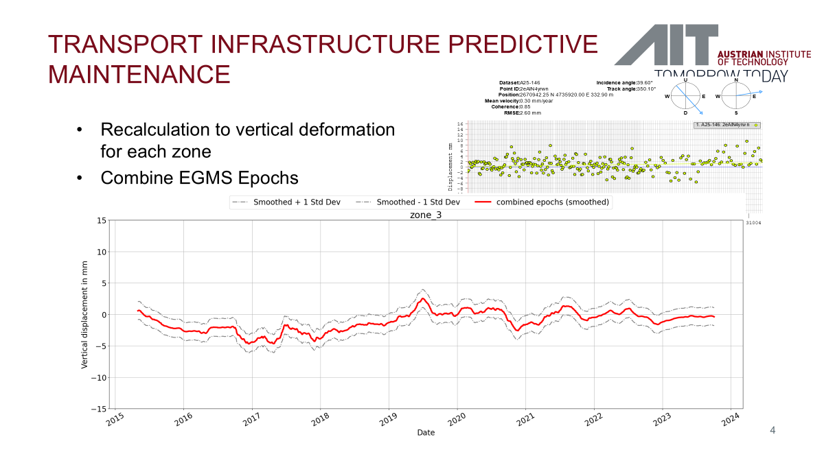

Slide 68
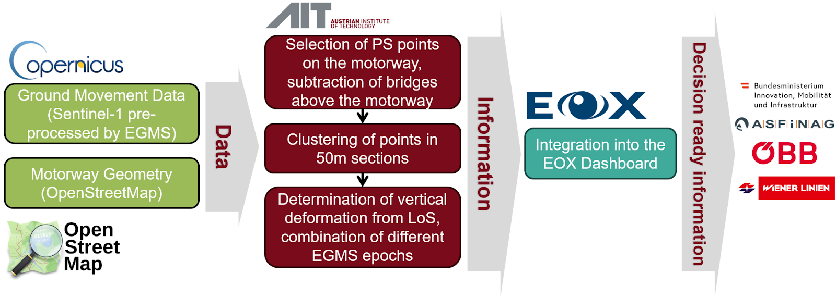
GTIF capabilities

Slide 69
DEMO

Slide 70
The Austrian GTIF platform
Storytelling / Narratives
Explore
Repository
Workspace
https://gtif-austria.info

Slide 71
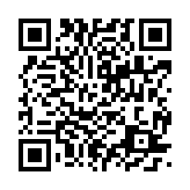
Thank you
Thank you for your attention.
Helmut Herglotz
EOX IT Services
helmut.herglotz@eox.at
Find out more about GTIF Austria at
https://gtif-austria.info
https://github.com/GTIF-Austria
Gerhard Triebnig
EOX IT Services GmbH
gerhard.triebnig@eox.at
+43 664 6207655
71

