Slide 1
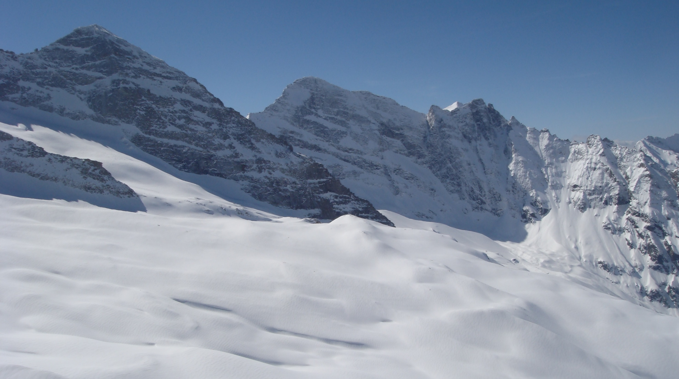
SAR Basics and Radar Signal Interaction with Snow and Ice
Helmut Rott
ENVEO IT, Innsbruck
& University of Innsbruck, Austria
ESA LTC, 16-20 September 2024, Innsbruck

Slide 2
Contents of the Lecture
Basic components and concepts of imaging radar systems
SAR image formation
SAR signal characteristics
Satellite SAR operation modes
SAR geometry and image features in complex terrain
Characteristics of complex radar backscatter signals
Dielectric and scattering properties of snow and ice
Basics of across-track SAR interferometry
InSAR procedures and examples for mapping surface topography and ice motion

Slide 3
Radar Frequency Bands and Atmospheric Transmittance
One-way atmospheric transmittance for Standard Atmosphere
---- with stratus (Δz = 500 m) ; - · - · stratocumulus, (Δz = 2 km)
→ Absorption bands

Slide 4
Basic Equation for Radar Scattering Measurement
Bistatic Radar Configuration
Radar Equation
Bistatic
Monostatic
σ° – Radar cross section per unit area (distributed target)
G = 4πA_{a}/λ² - Antenna Gain (A_{a} – Antenna area)
σ_{i} Radar cross section of incremental scattering element
A _{i} Size of scattering element
A ₀ Surface resolution cell
P Power [W]
G Antenna Gain
R Range
σ Scattering Cross Section

Slide 5
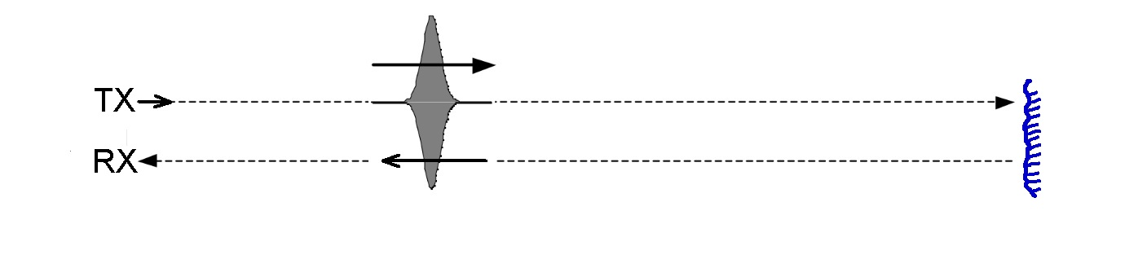
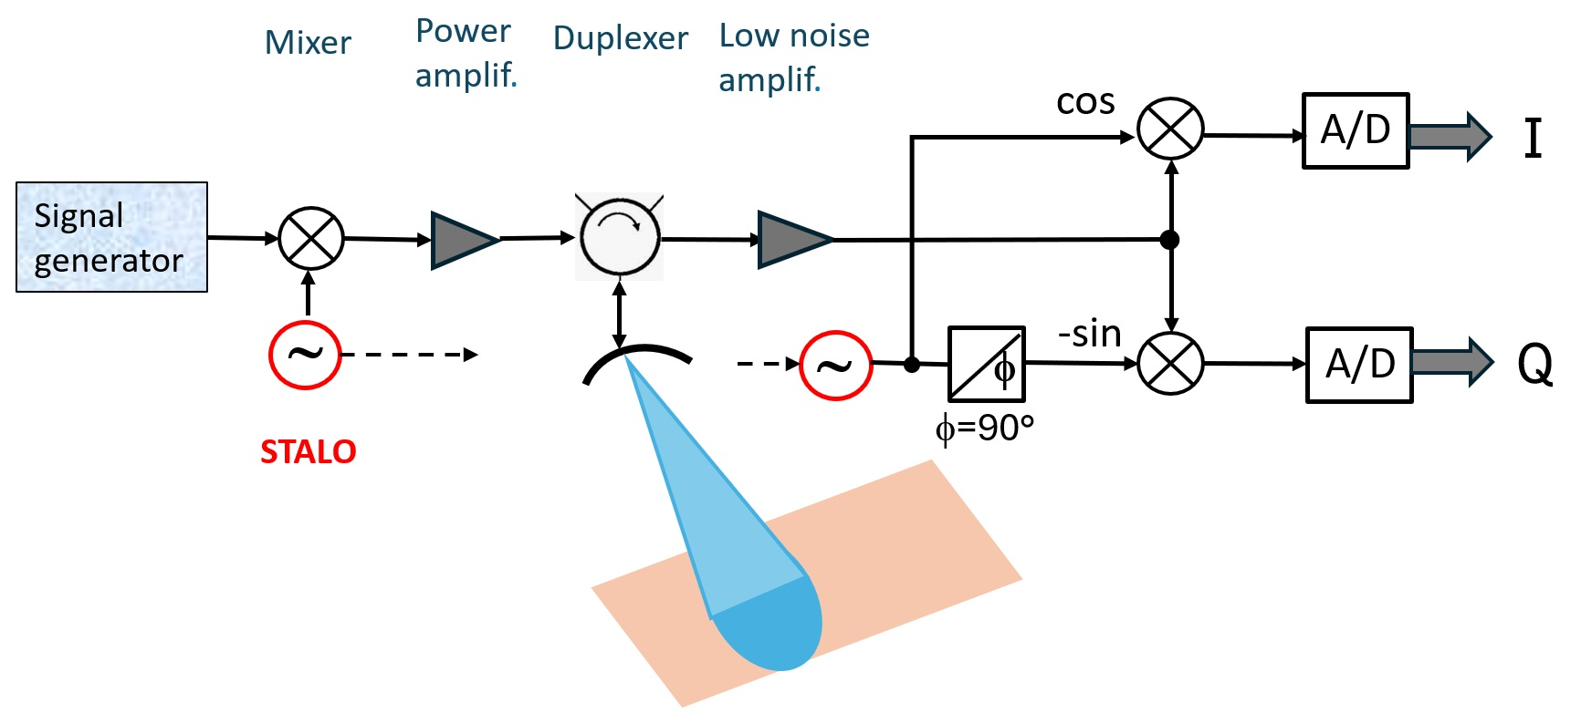
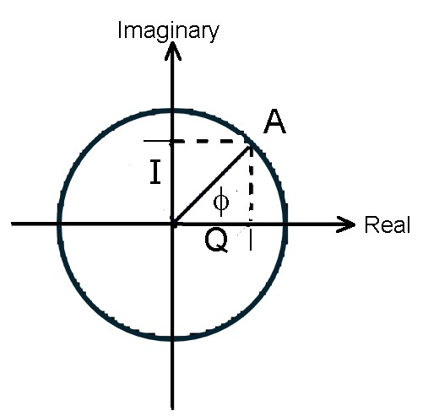
Basic Components of SAR Systems
R₀
Total time delay: 2 R₀/c
In order to digitize the complex input radar signal, it is split in two components, in which the phase of one component is shifted by 90°:
The in-phase (I) and quadrature (Q) components.
I = A cos φ ; Q = A sin ϕ
A² = I² + Q² ; φ = arctan (Q/I)
A - Amplitude

Slide 6
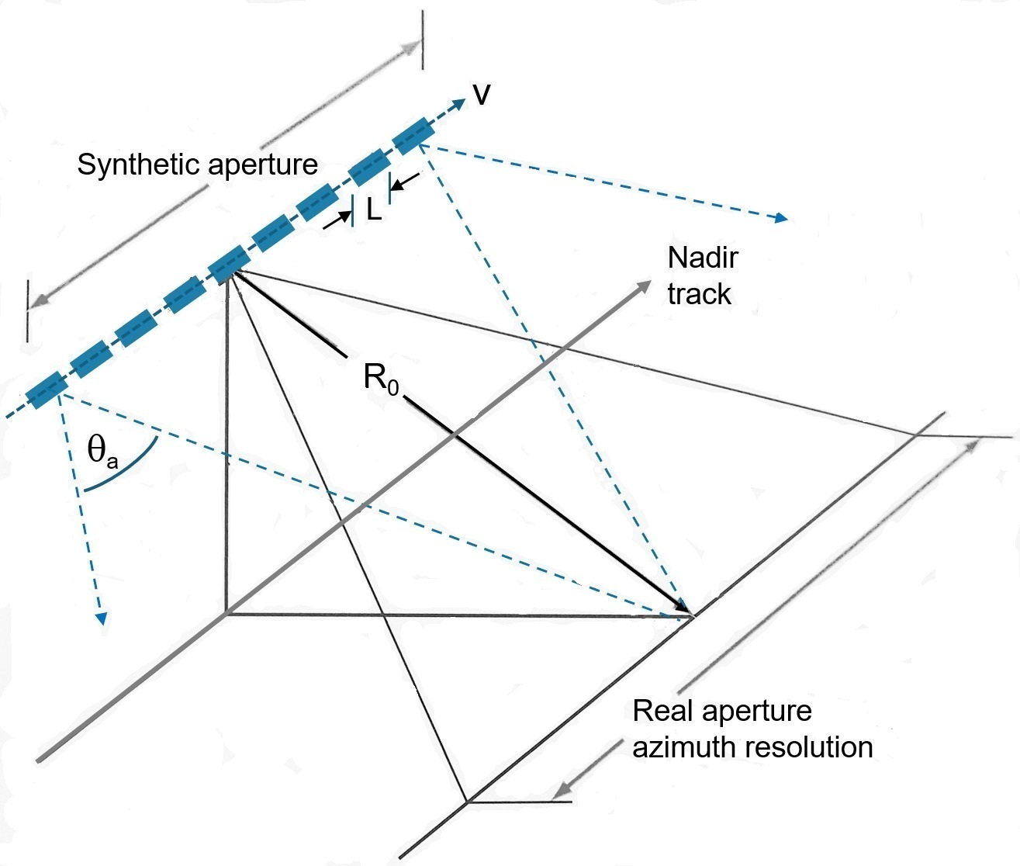
Geometry and Resolution of Imaging Radar Sensors
Synthetic aperture
Virtual beamwidth
θ_{SA} = λ/L_{SA}
⇐ Real aperture
beamwidth θ_{a} = λ/L [rad]
τ
R
Spatial Resolution
r_{a} = L/2 Azimuth resolution
Synthetic aperture
r_{r} = c⋅τ/2 Slant range resol.
r_{g} = r_{r}/sin θ_{i} Ground range res.
Dense azimuth sampling required:
PRF > 2v/L (signal Doppler BW)
Slant range resolution
r_{a} = λR/L Real aperture

Slide 7
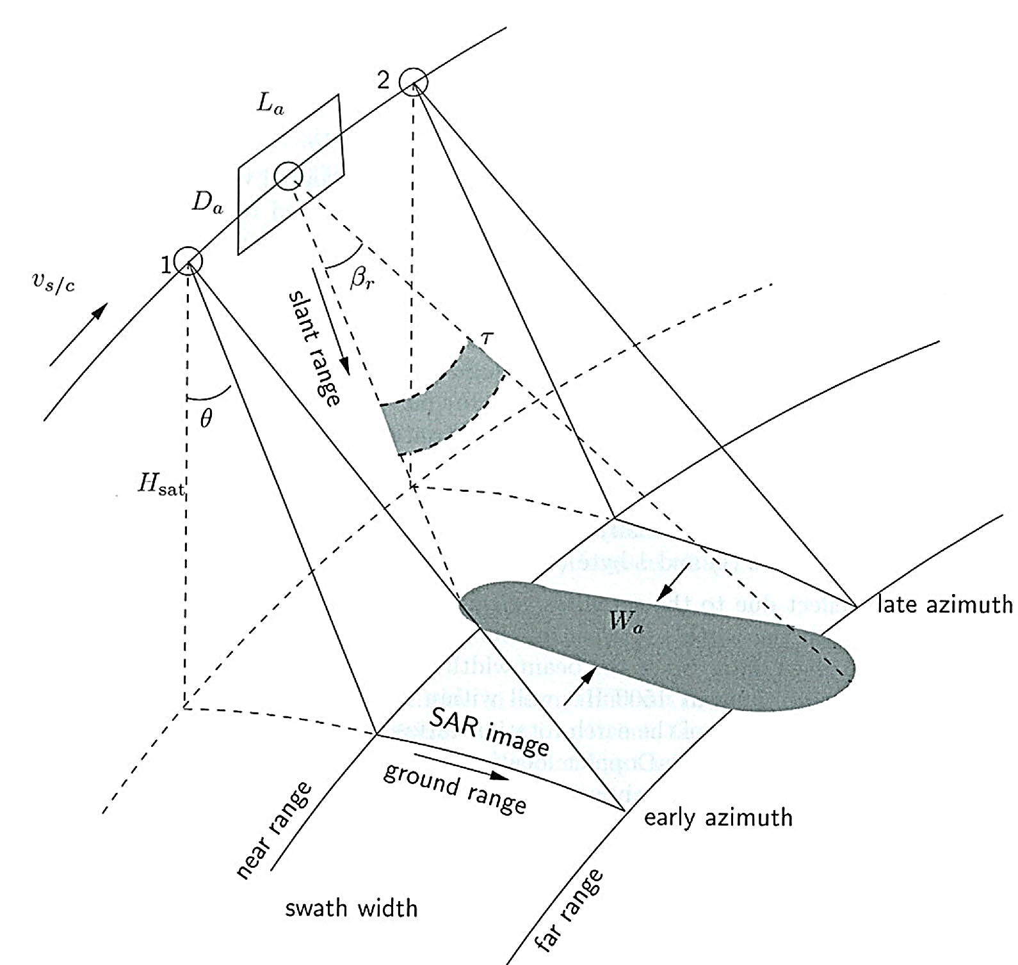
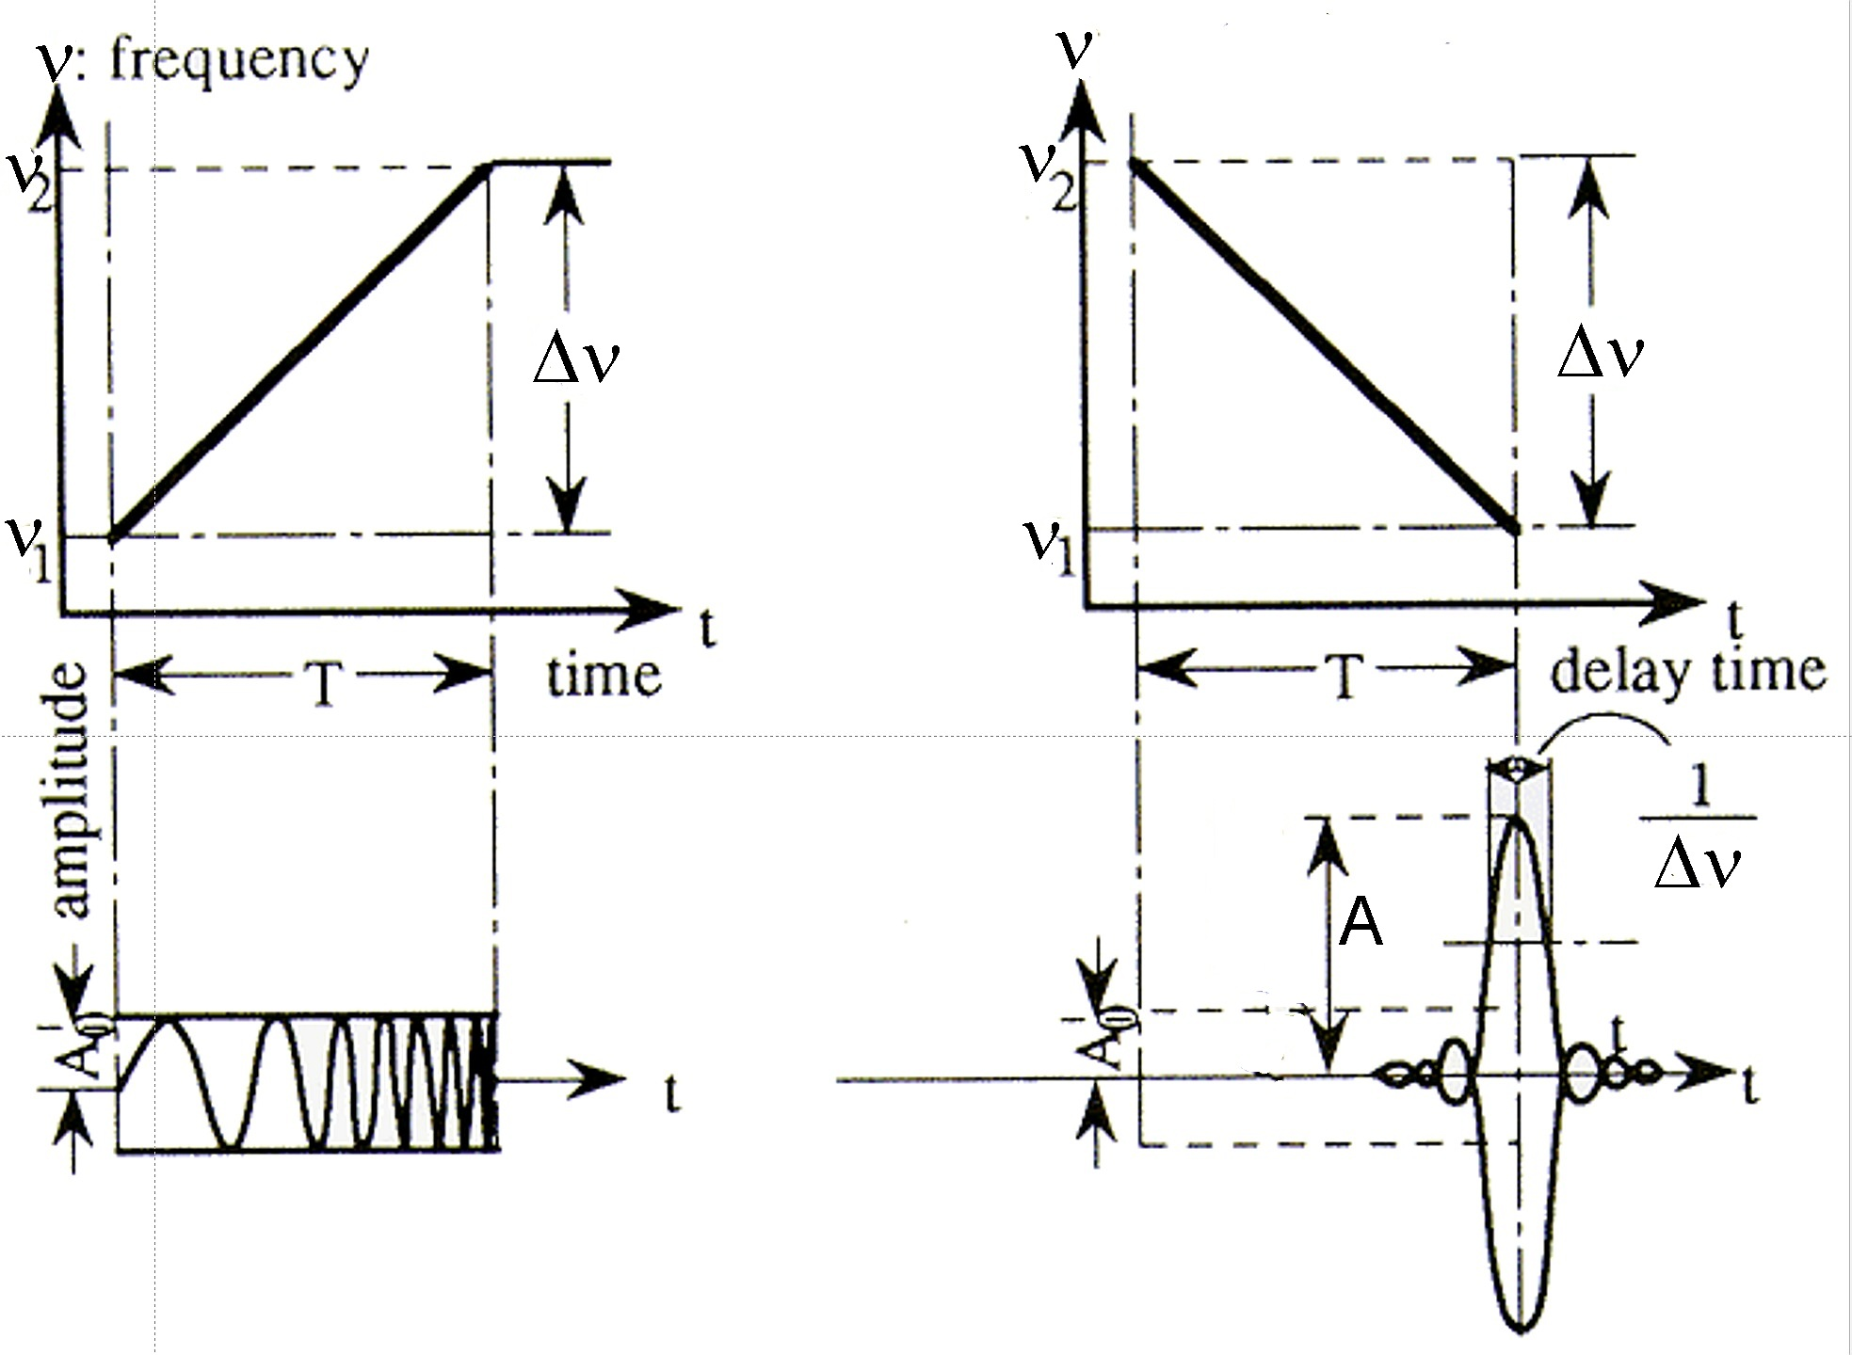
SAR Image Formation – Range Compression
Half power (3dB)
beamwidth:
Slant range
β_{r} = 0.866 λ/D_{a} [rad]
Azimuth
β_{a} = 0.866 λ/L_{a}
Footprint (azimuth)
W_{a} = (λ R) /L_{a}
Slant range compression
Chirp
Transmitted waveform De-chirped waveform
The uncompressed pulse length is several μsec
Linear frequency modulation (chirp) for improving range resolution:
The frequency changes during one pulse from ν₀ to (ν₀ + Δν)
Chirp (Range) Bandwidth: B_{R} = ⏐(ν₀ + Δν) - ν₀ ⏐ = ⏐Δ ν ⏐
The pulse is de-compressed using a replica of the transmitted chirp
Compressed pulse length: τ_{c} ≅ 1/B_{R} ⇒ range resolution r_{r} = c⋅τ/2
Fig. R. Hanssen, 2001
B_{R} = 100 MHz ⇒ r_{r} = 1.50 m

Slide 8
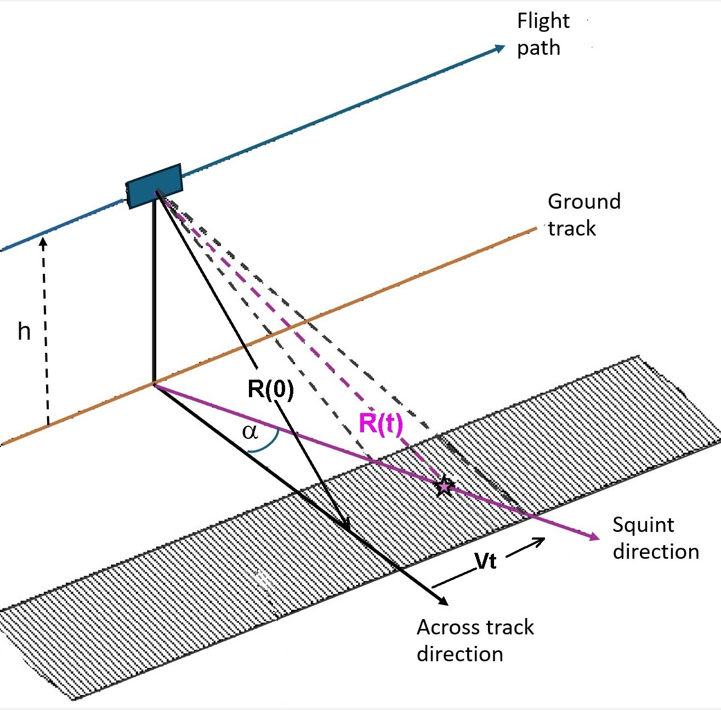
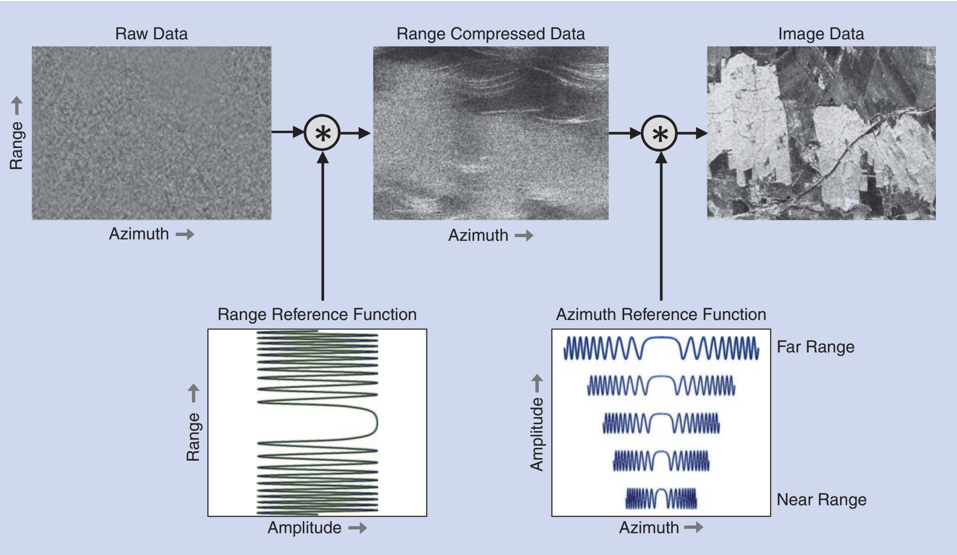
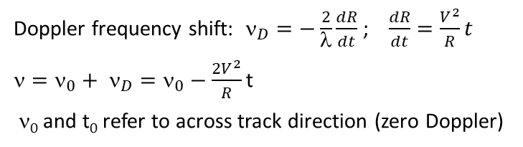
SAR Image Formation – Range / Doppler Algorithm
Geometry for Doppler shift estimate
Main SAR processing steps: Range and azimuth compression by convolution with the corresponding reference functions.
α squint angle
Doppler frequency shift: $_{D}=−\frac{2}{λ}\frac{dR}{dt}$ ; $\frac{dR}{dt}=\frac{V^{2}}{R}t$
${=ν_{0}+ ν}_{D}=ν_{0}−\frac{2V^{2}}{R}$t
ν₀ and t₀ refer to across track direction (zero Doppler)
Fig. Moreira et al. 2013

Slide 9
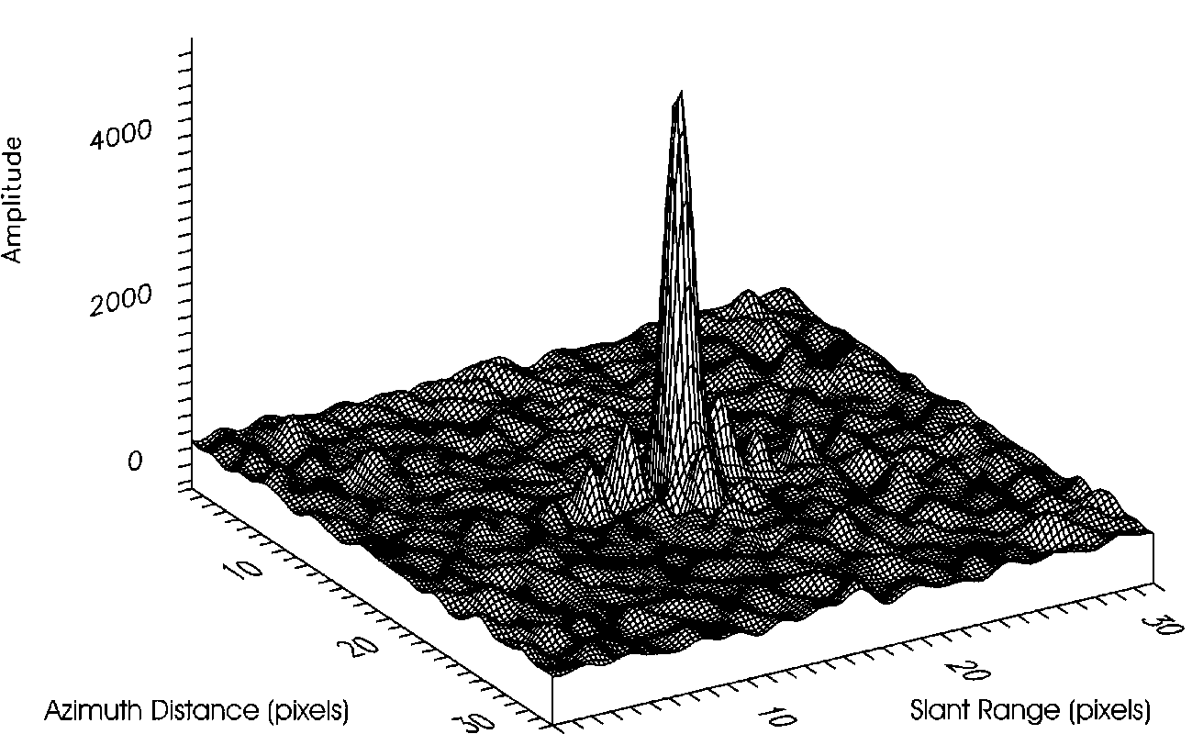
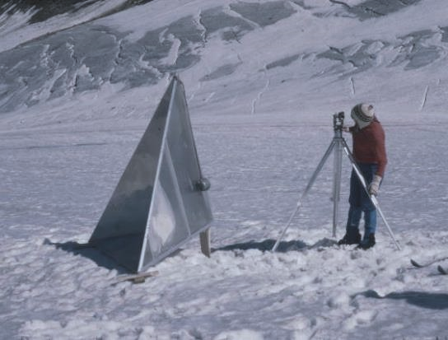
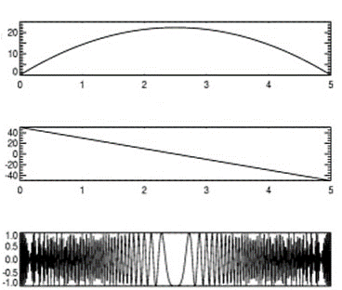
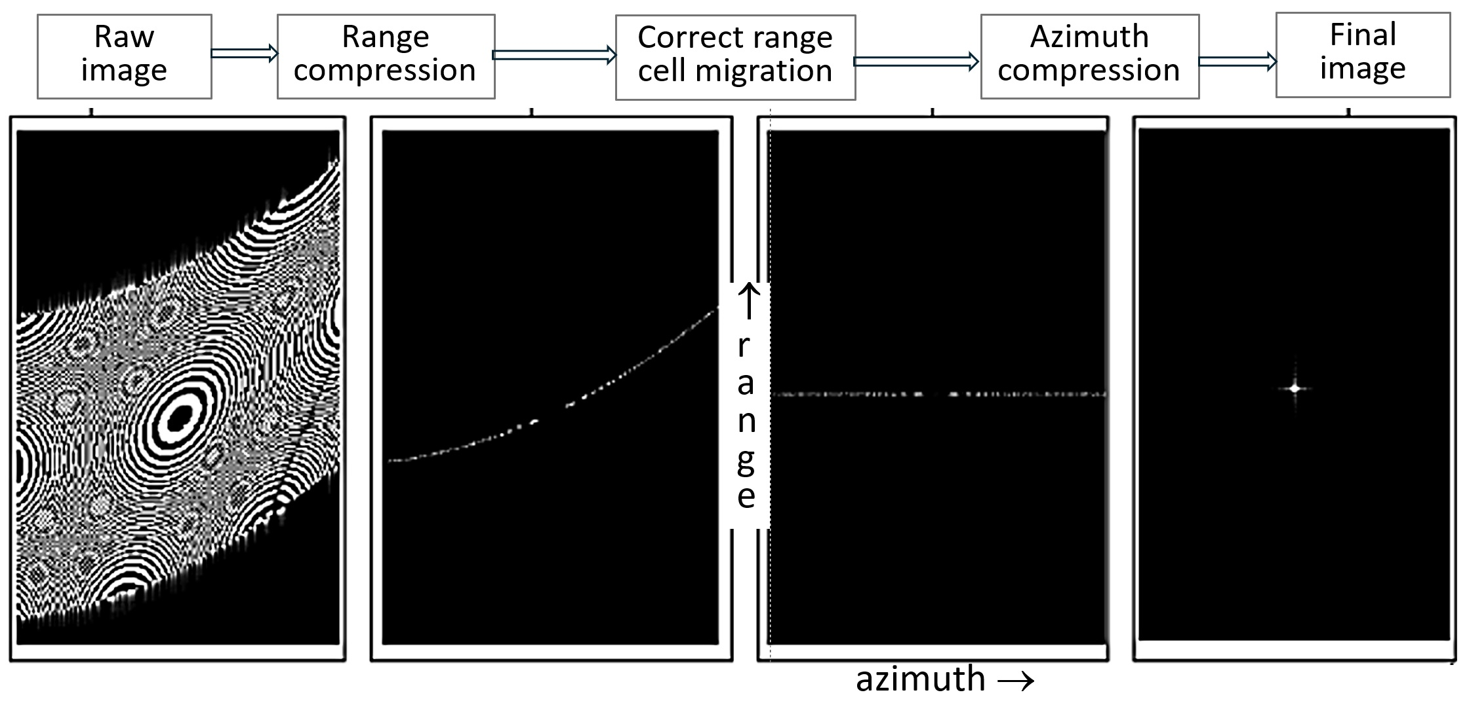
SAR Image Formation – Example for Point Target
Along-track point target signal
phase
time →
chirp (Δf_{az})
amplitude
X-SAR Amplitude Image of Corner Reflector
CR edge length 1.8 m
Pixel spacing (range x azimuth) 6.66 m x 4.88 m
SIR-C/X-SAR test site Ötztal, Oct. 1994
Chirp BW 20 MHz, Range res. 7.5 m
Azimuth res. 7.1 m

Slide 10
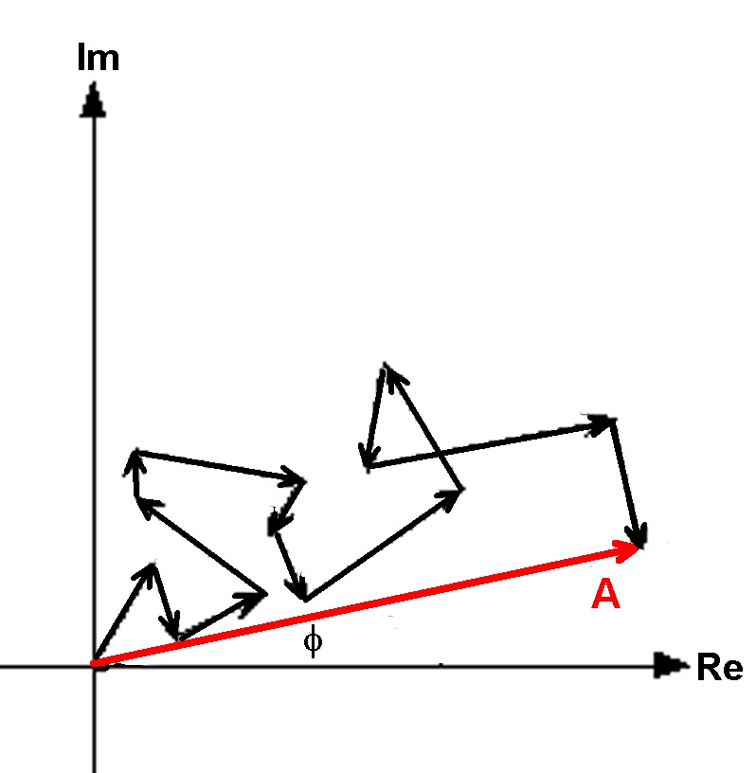
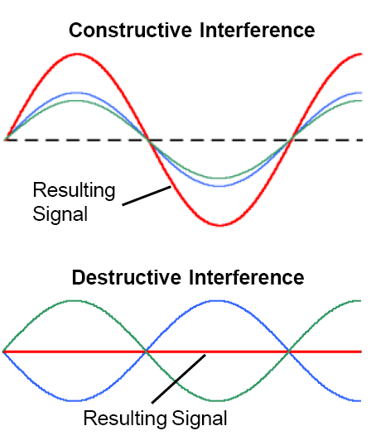
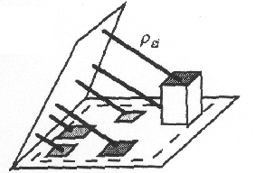
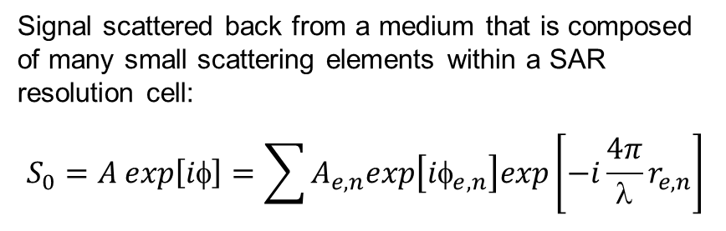
SAR Signal Characteristics
Signal scattered back from a medium that is composed of many small scattering elements within a SAR resolution cell:
$$S_{0}=A exp\left[iφ\right]=\sum{A_{e,n}exp\left[iφ_{e,n}\right]exp\left[−i\frac{4π}{λ}r_{e,n}\right]}$$
The signal is the coherent sum of contributions from all (n) elemental scatterers (e) in the resolution cell A_{e,n}exp[iφ_{e,n}], accounting also for the differential path delays r_{e,n} between the scatterers and the wave front.
Du to this effect the amplitude of distributed targets in a SAR image show a noisy pattern, called speckle.
Speckle is spatially random multiplicative noise due to coherent superposition of multiple backscatter sources within a SAR resolution cell.
If the scattering properties of a target are preserved the speckle pattern is conservative ⇒ images suitable for repeat-pass InSAR processing.
r_{e,n}
.

Slide 11
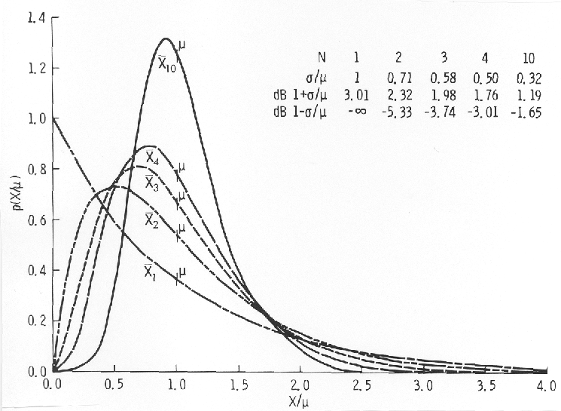
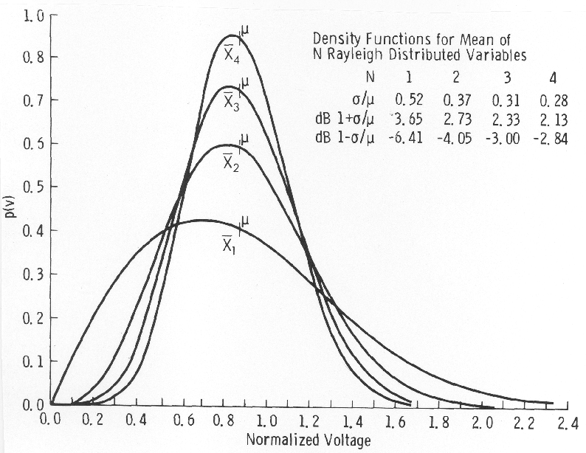
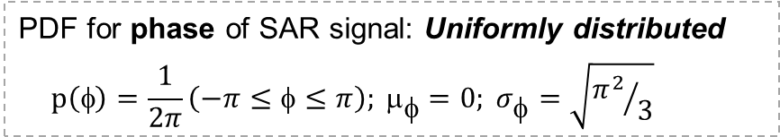
Probability Density Functions for Exponentially and Rayleigh Distributed Variables
μ Mean value ; σ Standard deviation
Statistical distribution of amplitude (A = √P) of homogeneous distributed target: Rayleigh distribution
Ulaby & Long, 2014
Statistical distribution of power (P) of homogeneous distributed target for N number of looks:
N = 1 Exponential PDF
N > 1 χ² - PDF with 2N degrees of freedom
Standard dev. over N independent resolution cells: σ(N) =μ/√N
PDF for phase of SAR signal: Uniformly distributed
$$p\left(φ\right)=\frac{1}{2π}\left(−π≤φ≤π\right); μ_{φ}=0; σ_{φ}=\sqrt{{π^{2}}/3}$$

Slide 12
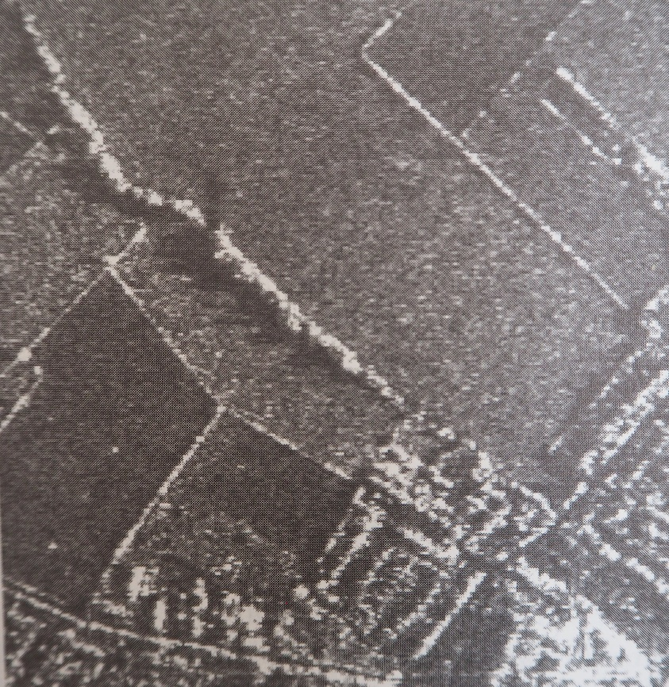
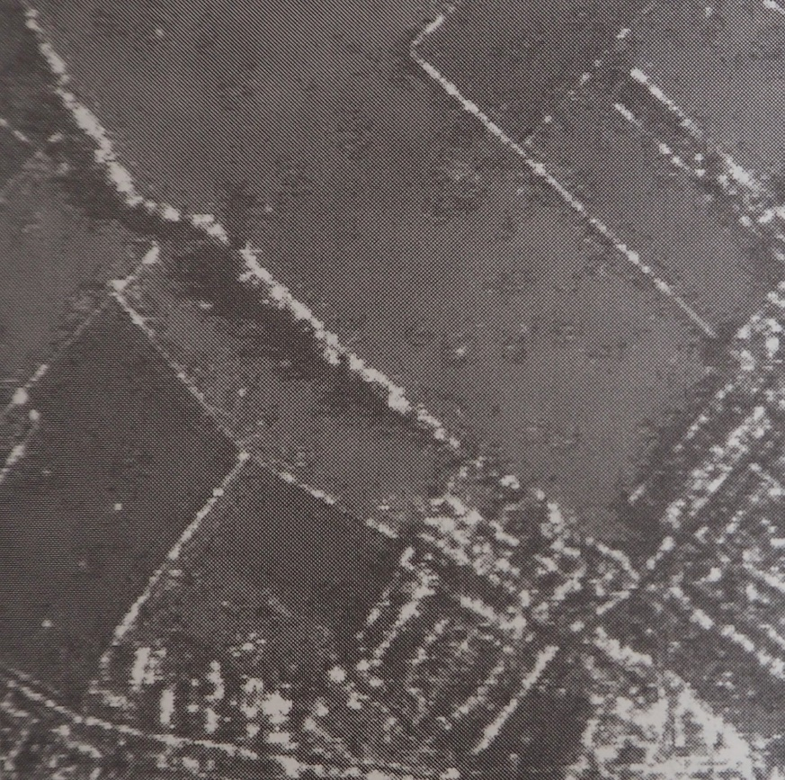
Probability Density Functions and Example for Despeckling
PDF for power (P) for N >1: Chi-square distribution,χ² = (2P/μ_{P})
Standard deviation for N number of looks: σ_{P}(N) = μ_{P}/√(N)
Single Look:
PDF for amplitude (A): Rayleigh distribution
Standard dev. for N number of looks: σ_{A}(N) = 0.523 μ_{A}/√(N)
X-band SAR image 3 m resolution
N = 2
Despeckling with gamma Map filter (structure preserving low-pass filter)
11x11 window size
Oliver & Quegan, 1998

Slide 13
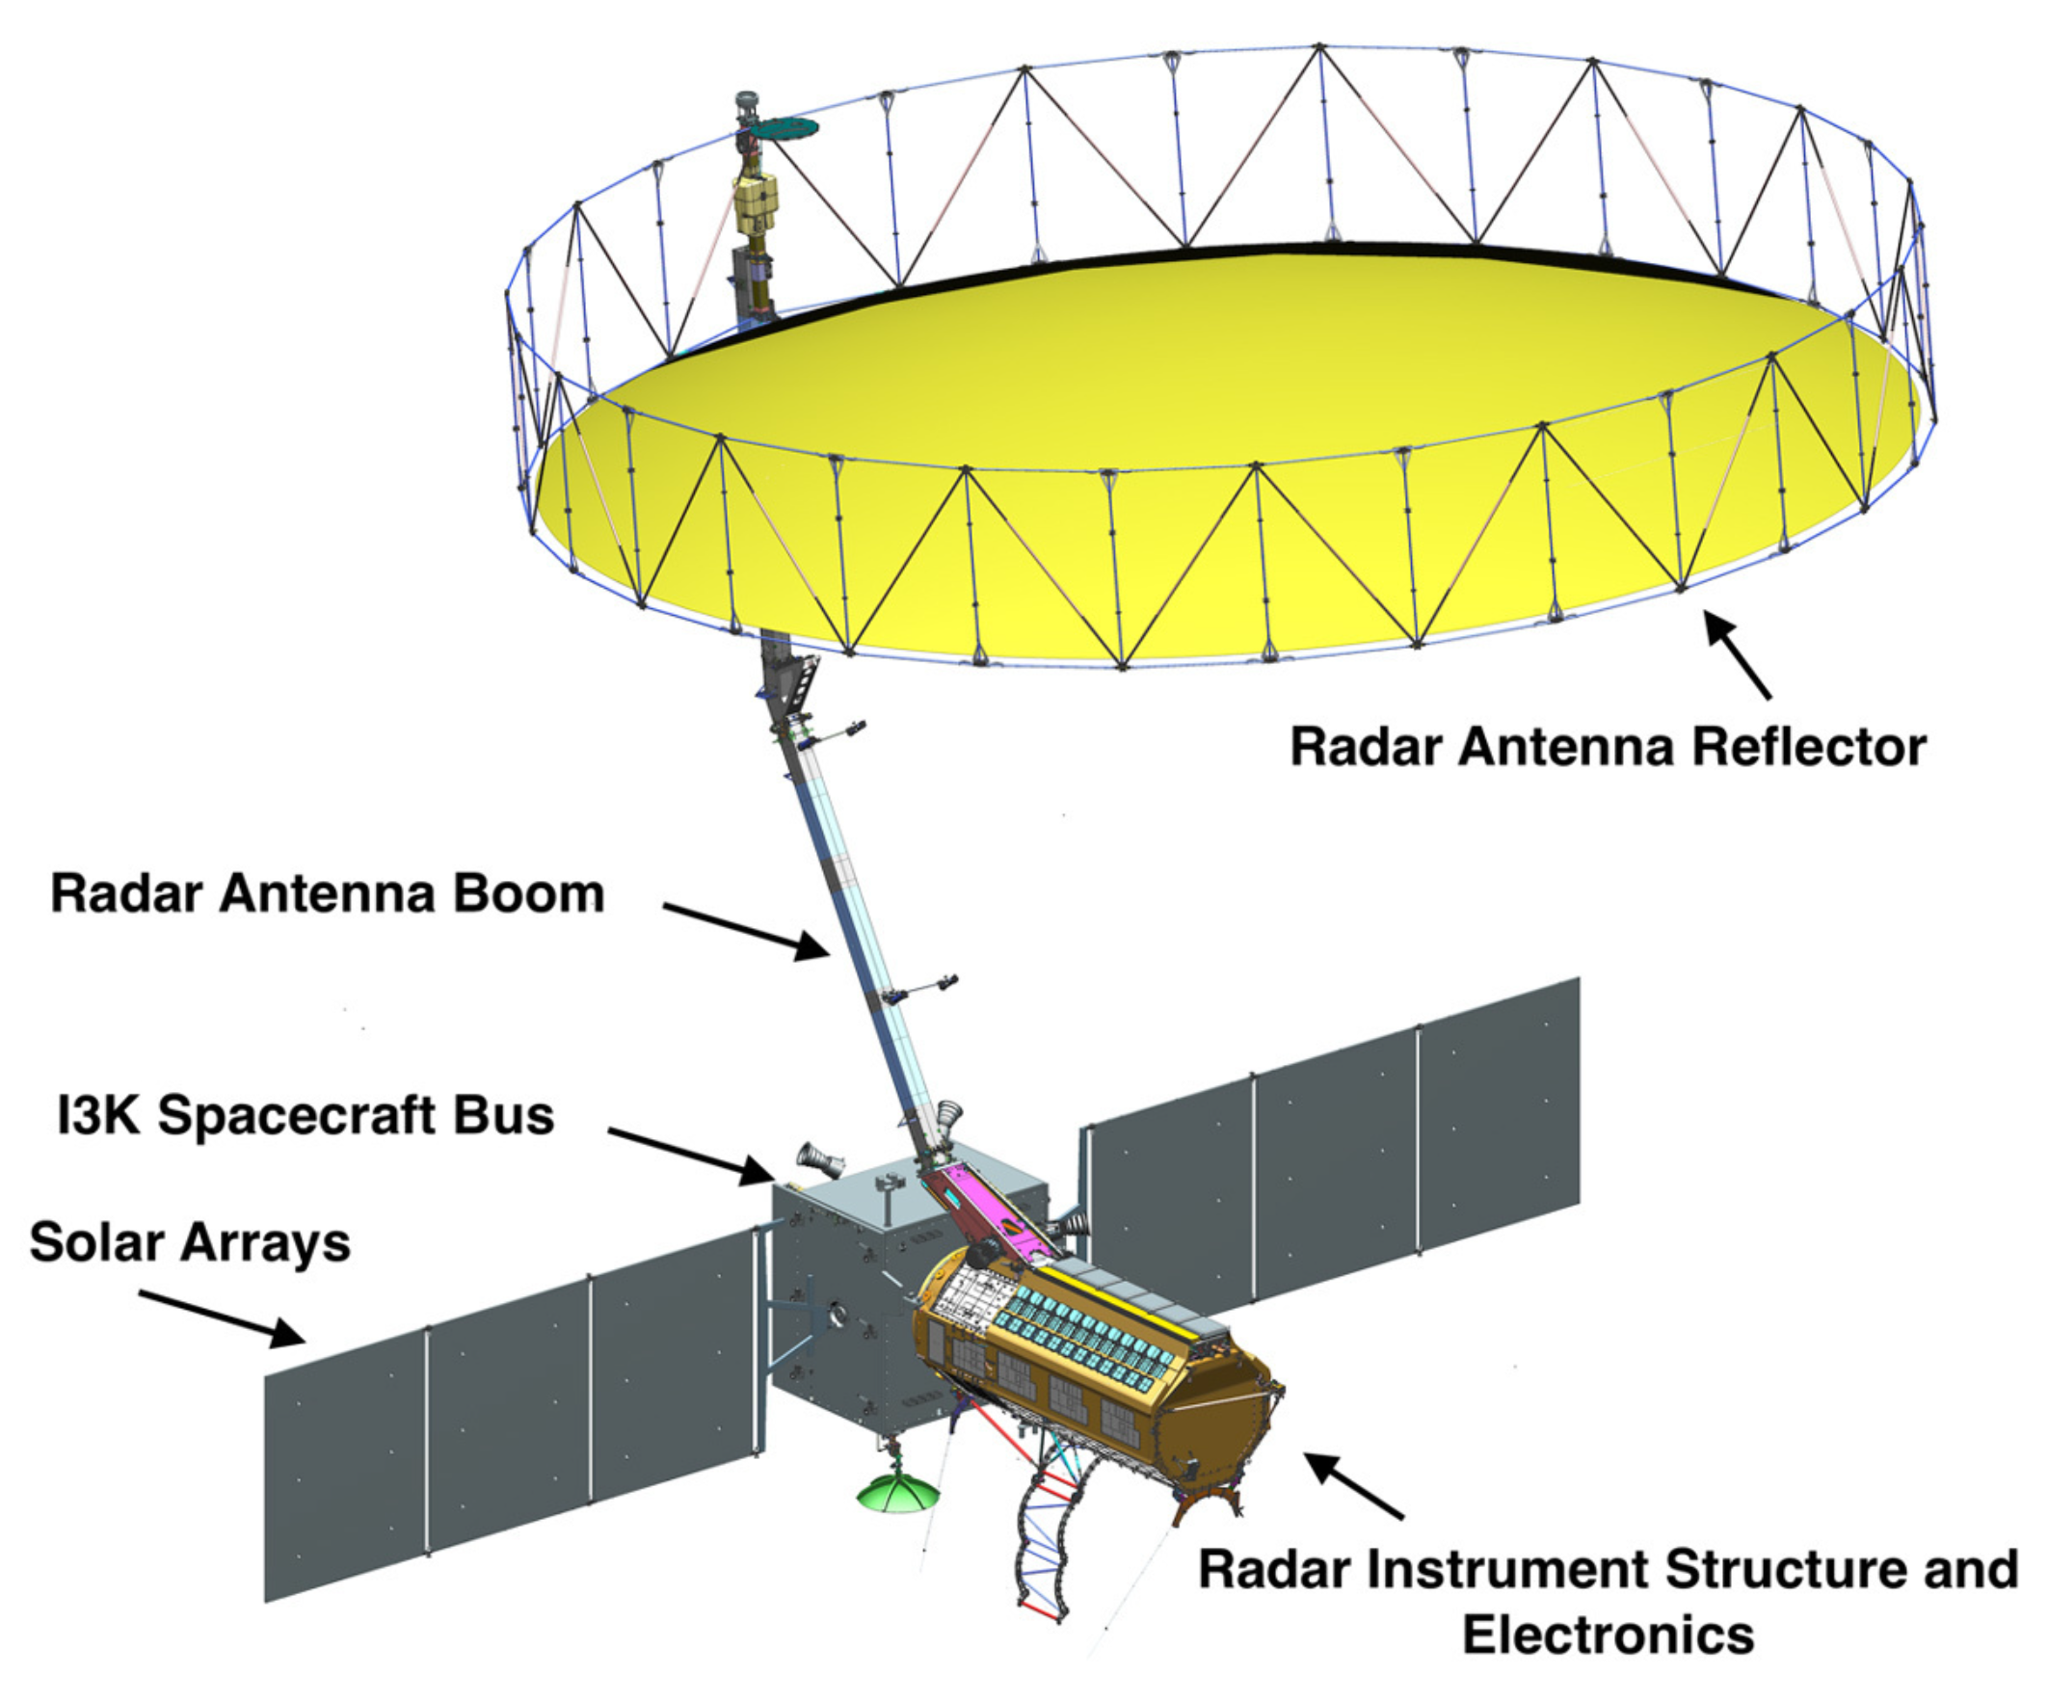
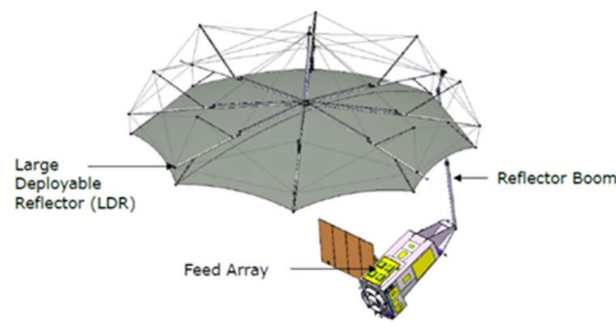
SAR Satellite Missions for Earth Observation (Sample)
Sensor Satellite [GHz]. Resolution/Swath Repeat option
Past
AMI ERS-1,-2(1991-2011) 5.3 VV 25 m - 100 km 35d / 1 d
SIR-C/X-SAR Shuttle (1994) 1.2,5.3,9.6 25 m / 40 km 2 campaigns
SIR-C/X-SAR SRTM (Feb.2000) 5.3, 9.6 50/100 m / 100/200 InSAR DEM
ASAR Envisat (2002-12) 5.3 30,100,1000 -/ 100-400 km 35 d
Present
SAR Radarsat2 (2007-) 5.4 3, 10, 30 m, / ≥20 km 24 d
TerraSARX TerraSAR-X(2007-) 9.6 1, 3,10 m / 10,30,100 km 11 d
TerraSARX TanDEM-X (2010-) 9.6 in Tandem with TerraSAR-X 11 d, SP-InSAR
SAR2000 COSMO-SkyMed(2007- 9.6 3m .. 100 m / 10-100 km 1d..16d, 4 Sat.
CSAR Sentinel-1 (2013-) 5.4 5m ….40 m / 80 … 410 km 12 d
PALSAR-2 ALOS-2 (2014-) 1.27 3m….100 m / 25 …. 490 km 14 d
X-Band SAR ICEYE Constell. (2018-) 9.6 1m …. 15 m /5 …. 100 km daily, 17 Sat.
SAR-L SAOCOM (2018- ) 1.27 10m… 100 m / 20 … 350 km 16d, 8d 2 Sat
CSAR Radarsat Constell.(2019 -) 5.4 3 m …100m / 20 …500 km 12d, 4d, 3 Sat.
Future
L/S-SAR NISAR (2025-) 1.25, 3.2 3m ….48 m / …. 240 km 12 d
P-Band SAR BIOMASS (2025-) 0.435 50 m / 150 km 3d …228 d
L-Band SAR ROSE-L (2027-) 1.25 10m ….100m / …..260 km 12 d
Passive C-band HARMONY (2028-) 5.4 2-satellite constellation using S1 active signal
NISAR
BIOMASS

Slide 14
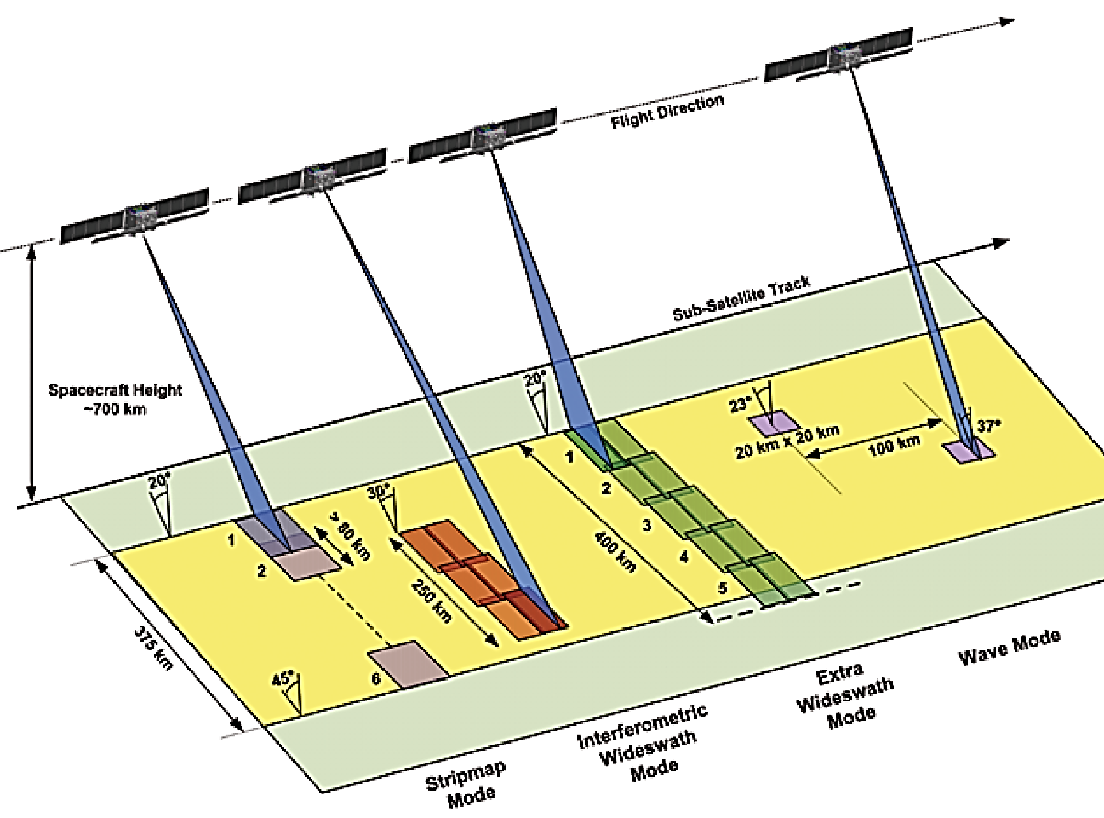
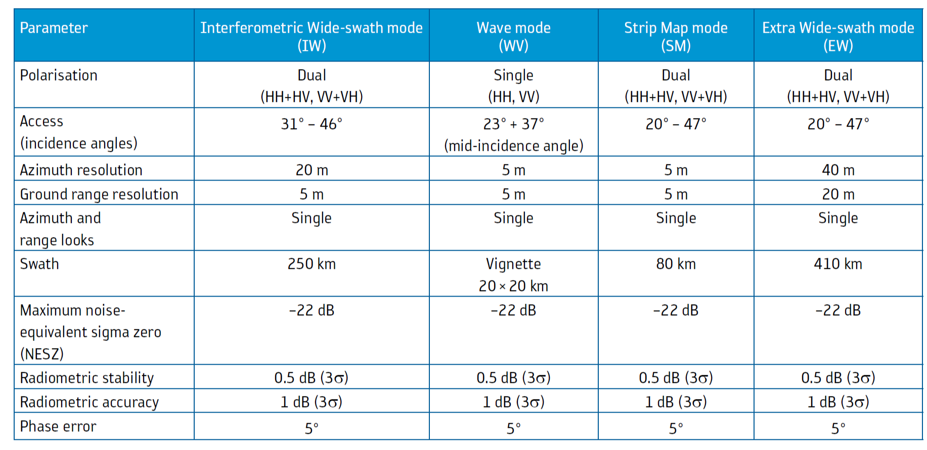
Sentinel-1 SAR Operation Modes
Main characteristics of the Sentinel-1 nominal measurement modes
Typical numbers for IW mode bandwidth
Sub-swath | Bandwidth | Slant Range resolution
IW1 | 56.5 MHz | 2.65 m
IW2 | 48.3 MHz | 3.11 m
IW3 | 42.8 MHz | 3.50 m
ESA SP-1322/1

Slide 15
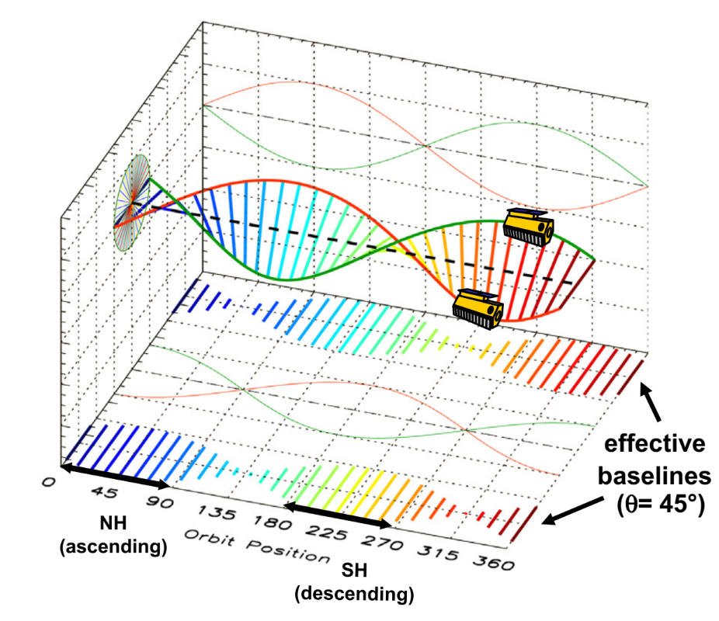
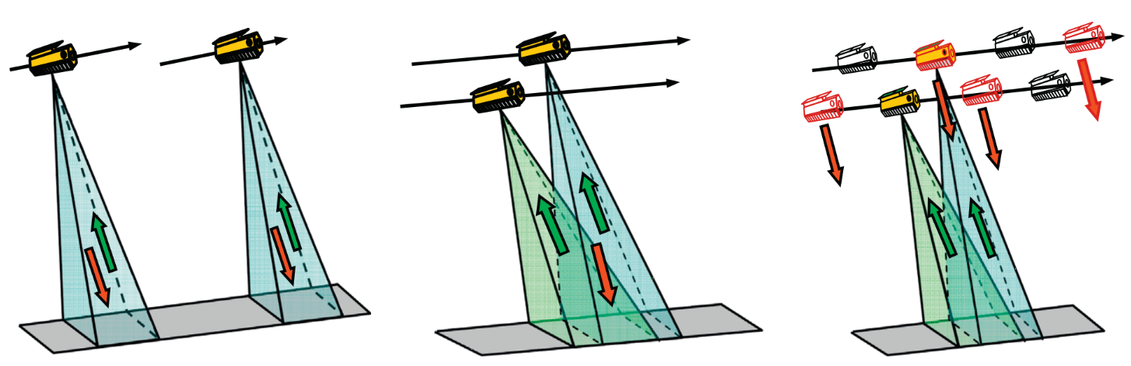
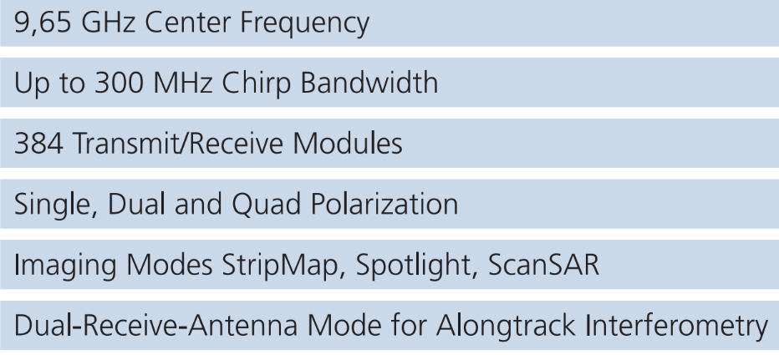
TanDEM-X - Formation Flying Radar Mission
Helix satellite formation for DEM acquisition
TanDEM-X (TerraSAR-X add-on for Digital Elevation Measurements) is a spaceborne radar interferometric mission that is based on two TerraSAR-X satellites flying in close formation. Primary objective is DEM acquisition.
Data modes for DEM acquisition
Pursuit monostatic Bistatic Alternating bistatic
Radar instrument characteristics
Krieger et al., 2013

Slide 16
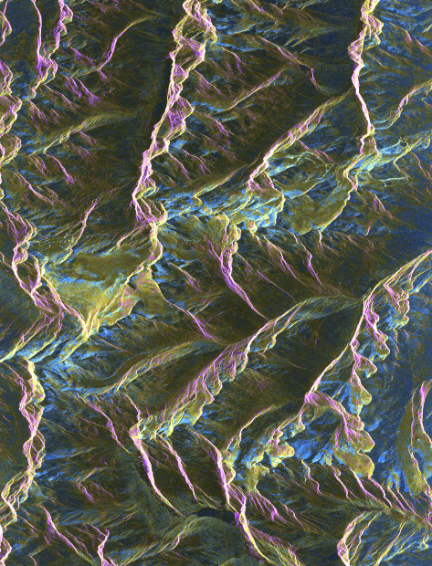
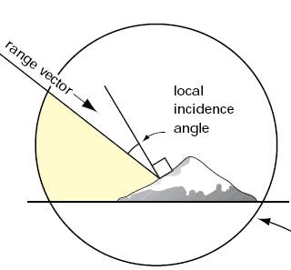
Imaging Radar Geometry - Terrain Induced Distortions
Across track radar geometry
Slant range
Layover
Azimuth
Image Plane
Vent
Surface resolution across track: Δr = cτ/(2sinθ_{i})
θ_{i} Local incidence angle
Tandem-X, 2021-11-13, VV HH, θ_{h} = 30.5°

Slide 17
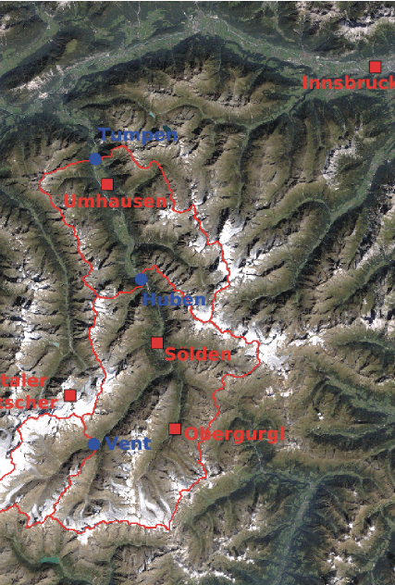
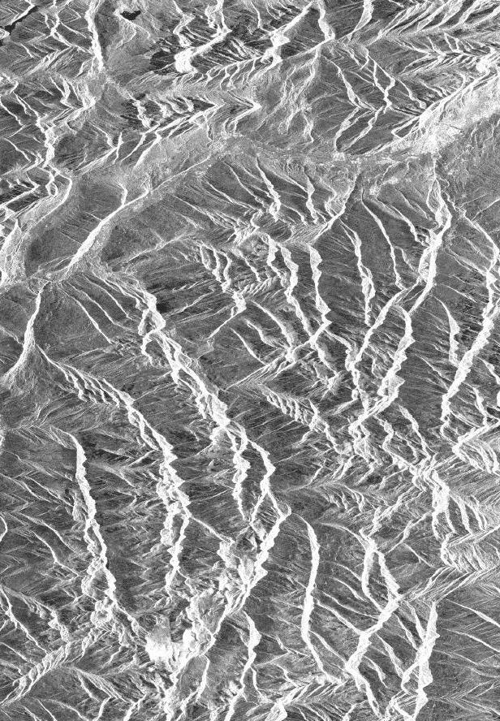
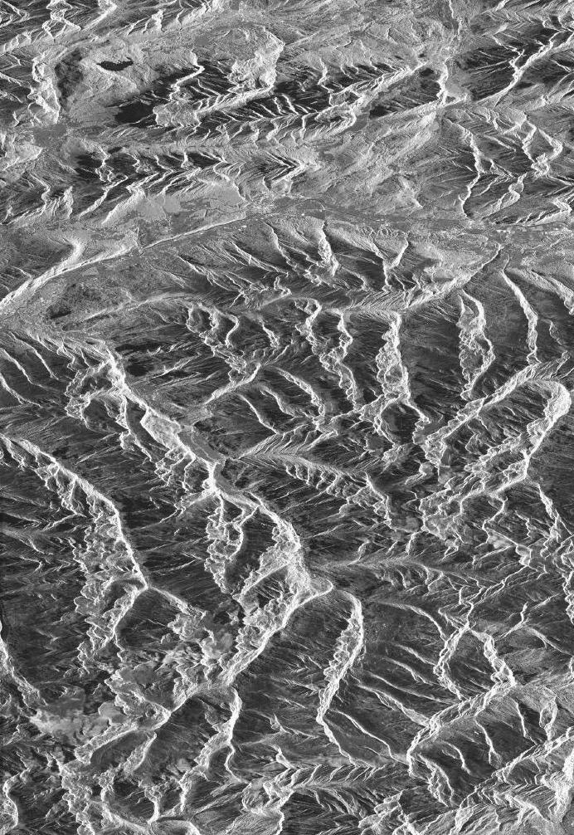
Terrain Induced Distortions – Impact of Look Angle
IS 2 Track 437
θ_{h} = 23°
ASAR IS 6 Track 308
θ_{h} = 41°.
LOS
LOS
Inntal
Inntal
Ötztal
Ötztal
■ Sölden
■ Sölden

Slide 18
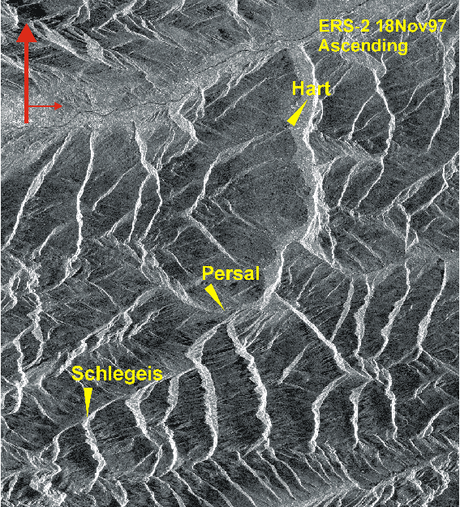
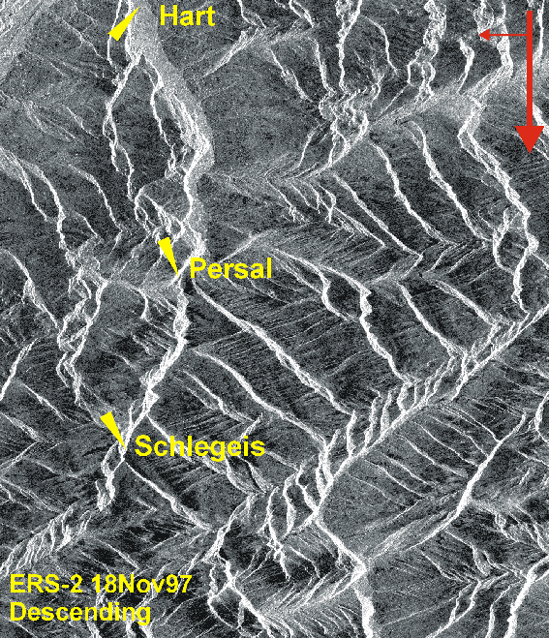
⇐ Direction of Illumination
Terrain Induced Distortions – Crossing Orbits
LOS
LOS
Hintertux
Hintertux

Slide 19
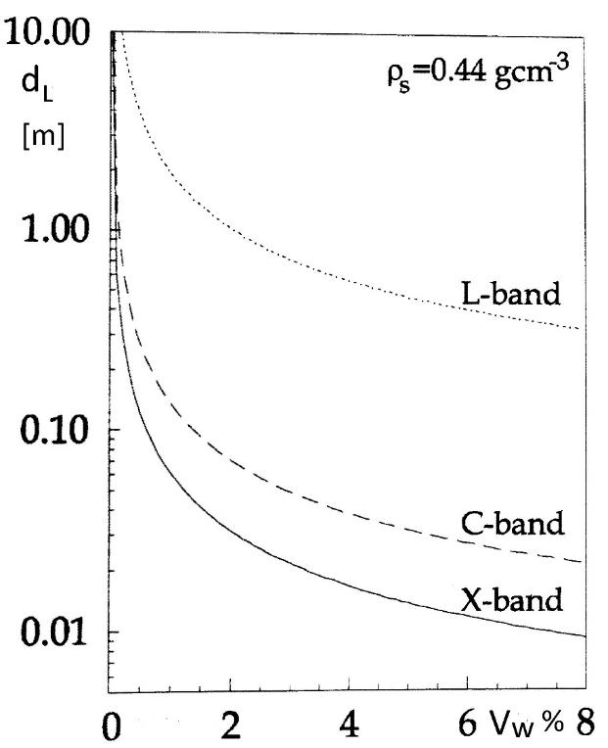
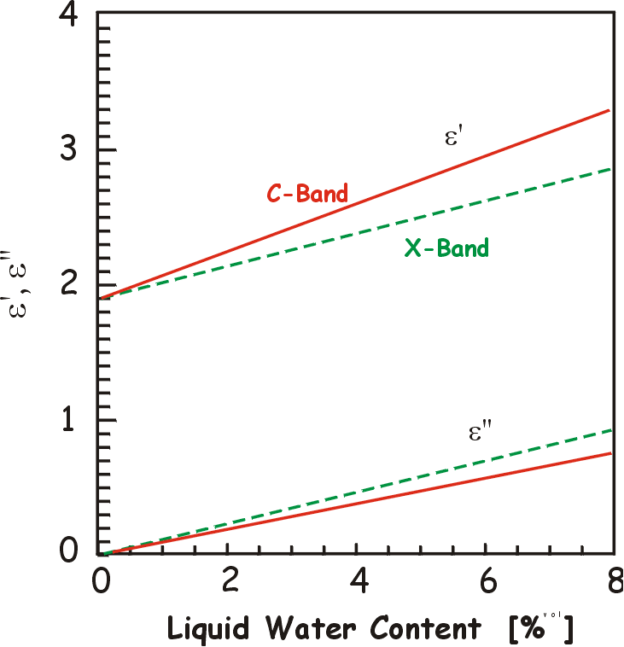
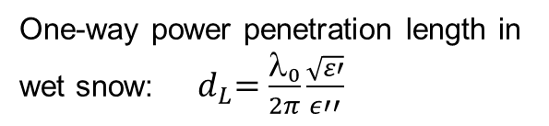
Dielectric Properties of Snow and Ice
Microwave Permittivity for snow
with density ρ_{S} = 0.45 g/cm³
One-way power penetration length in wet snow: ${ d}_{L}=\frac{λ_{0}}{2π}\frac{\sqrt{ε′}}{ε′′}$
Permittivity:
Ice: є‘ = 3.15 є‘‘ < 0.001 f (υ, T)
Dry snow:
є‘ =1.0 + 1.6 ρ + 1.86 ρ³ ; ρ in g cm⁻³
Wet snow:
є‘ = є‘ (dry) + Δ є
є = 0.23 V_{w} / [1 - i(ν/ ν₀)]
V_{w} [liquid water, volume %]
ν₀ ≈ 9 GHz, relaxation frequency of wet snow
є‘‘ ≈ 0.5 in C-band with V_{w}= 6 %

Slide 20
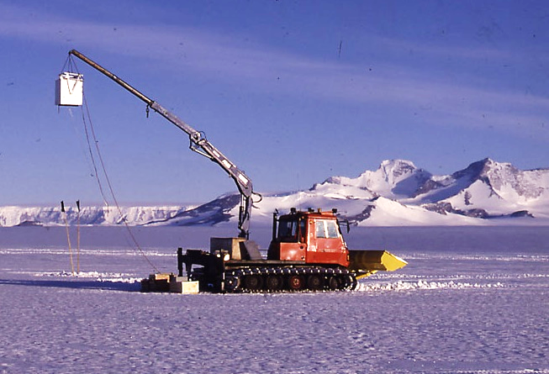
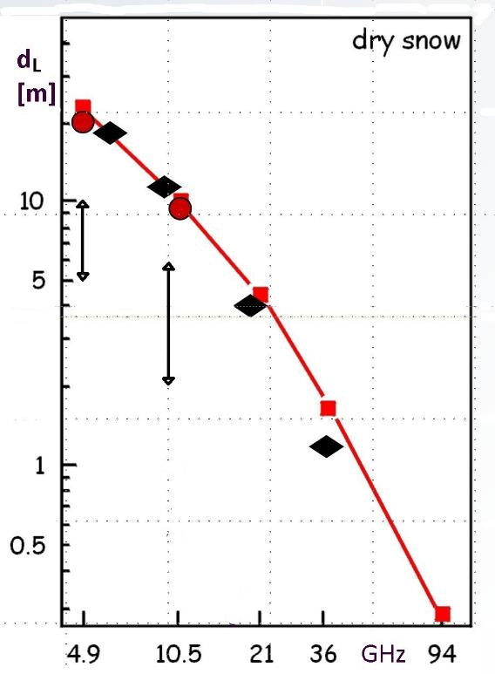
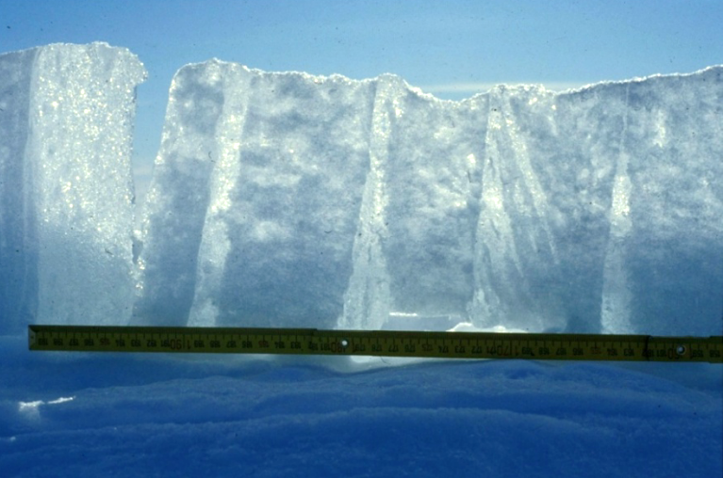
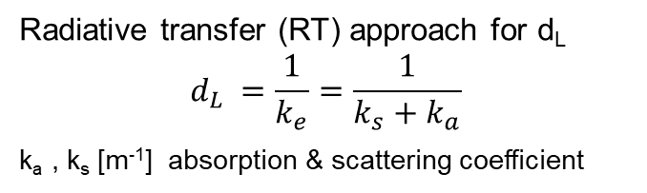
Microwave Penetration in Dry Snow and Firn
MW emission & backscatter measurements
Dronning Maud Land, Antarctica
Radiative transfer (RT) approach for d_{L}
$$d_{L }=\frac{1}{k_{e}}=\frac{1}{k_{s}+k_{a}}$$
k_{a} , k_{s} [m⁻¹] absorption & scattering coefficient
d_{L} based on experimental data →
High Alpine snow (Mätzler, 1987)
Antarctic dry snow zone (Rott et al., 1993)
Inversion of satellite MW radiometer data, Antarctica
□ Percolation zone of glaciers and ice sheets (frozen state)
Vertical section of near-surface layers
Percolation zone, Ekström Ice Shelf
z

Slide 21
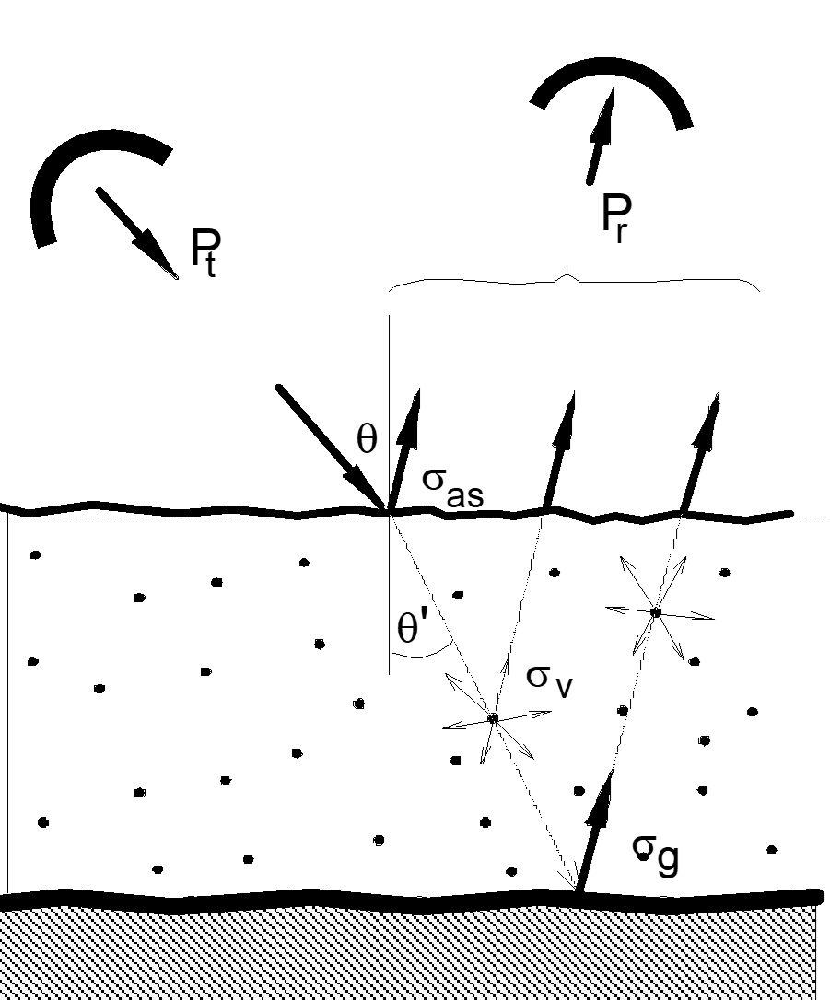
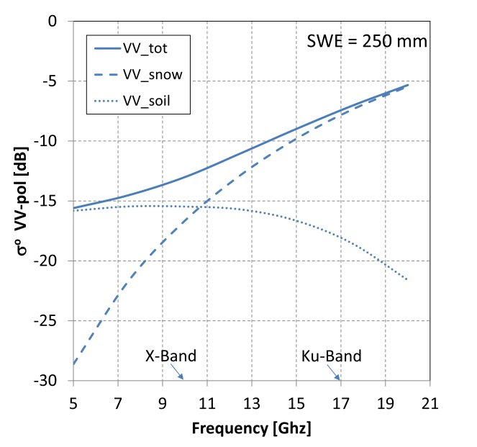
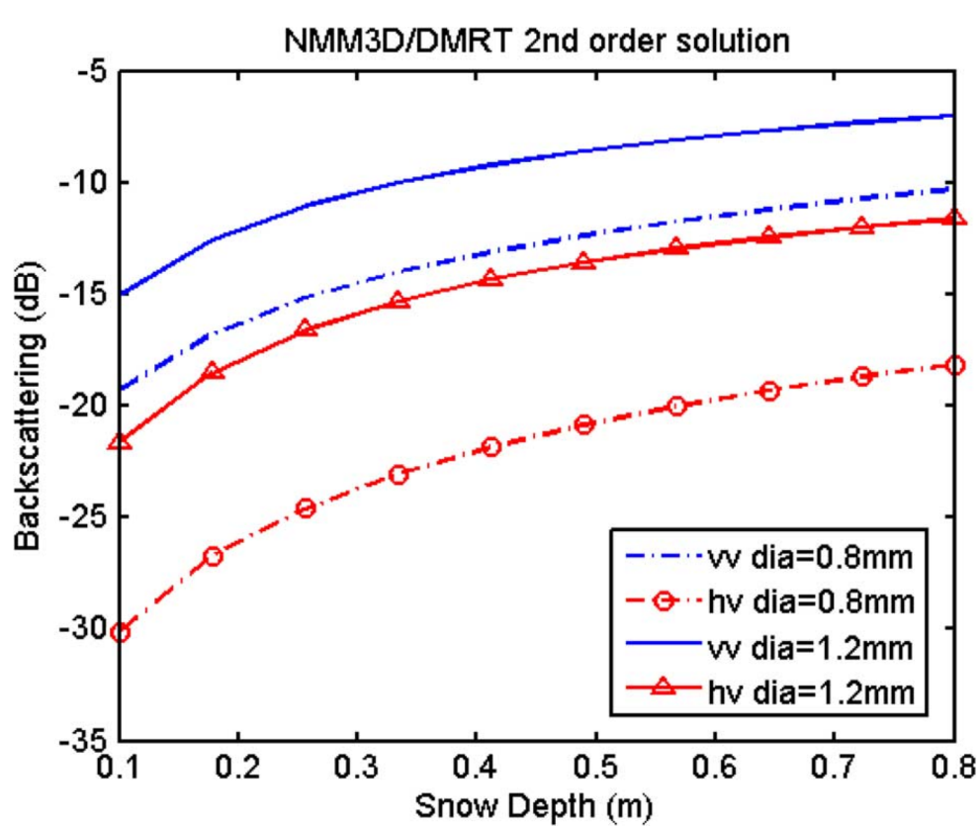
Radar Backscatter Signal for Dry Snow over Ground
σ°_{t}
1st order RT model, single layer
σ°_{t} = σ°_{as} + σ°_{v} + ϒ²_{as}(σ°_{g}τ²_{s})
ϒ transmissivity air/snow interface
σ°_{as} backscatter coeff. air/snow interface
σ°_{v} snow volume backscatter. coeff.
σ°_{g} backscatter coefficient of ground
τ_{s} = exp(-k_{e}d_{s}/cos θ’) transmissivity
d_{S}
τ_{S}
Backscatter contributions in dependence of radar frequency (single-layer DMRT model) θ_{i} = 40°, effective grain size R_{E} = 1.0 mm
Volume scattering: the size of scattering elements is critical ⇒
⇐ 13.95 GHz σ⁰ as function of snow depth with different grain size (Xu et al., 2010)

Slide 22
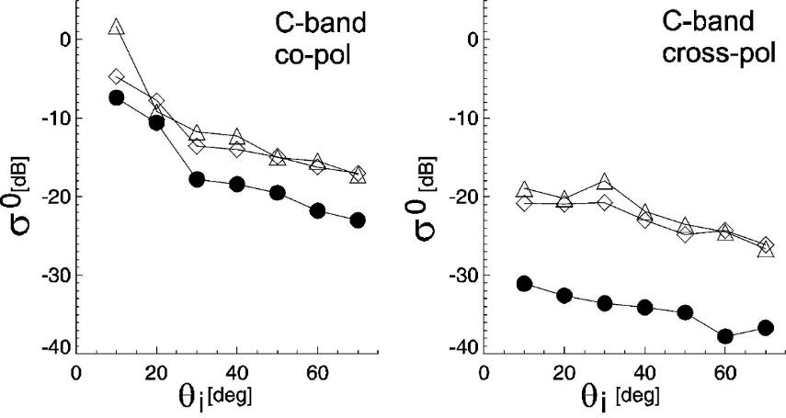
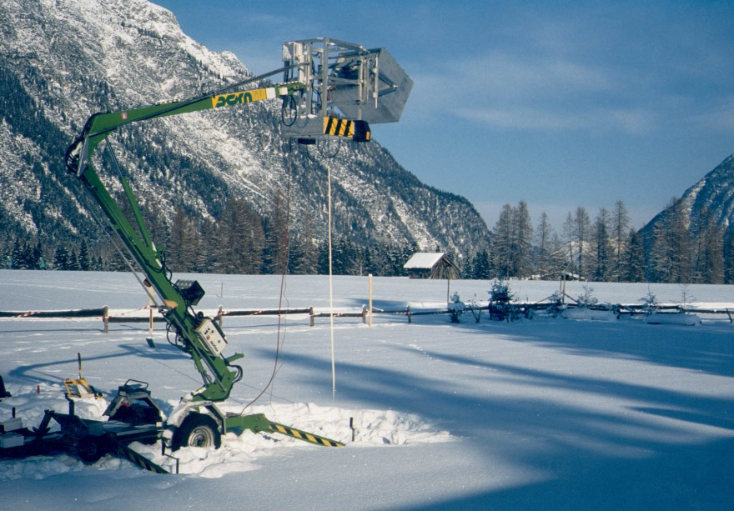
Backscatter Signals of Dry and Wet Snow
θ_{i}
Average backscatter coefficients for dry and wet snow over ground (meadow) by ground-based scatterometry
Test site: Leutasch
❒ Snow-free (meadow)
Dry snow (fine grained), low-loss medium, signal dominated by backscatter at subnivean ground
 Wet snow (high absorption losses)

Slide 23
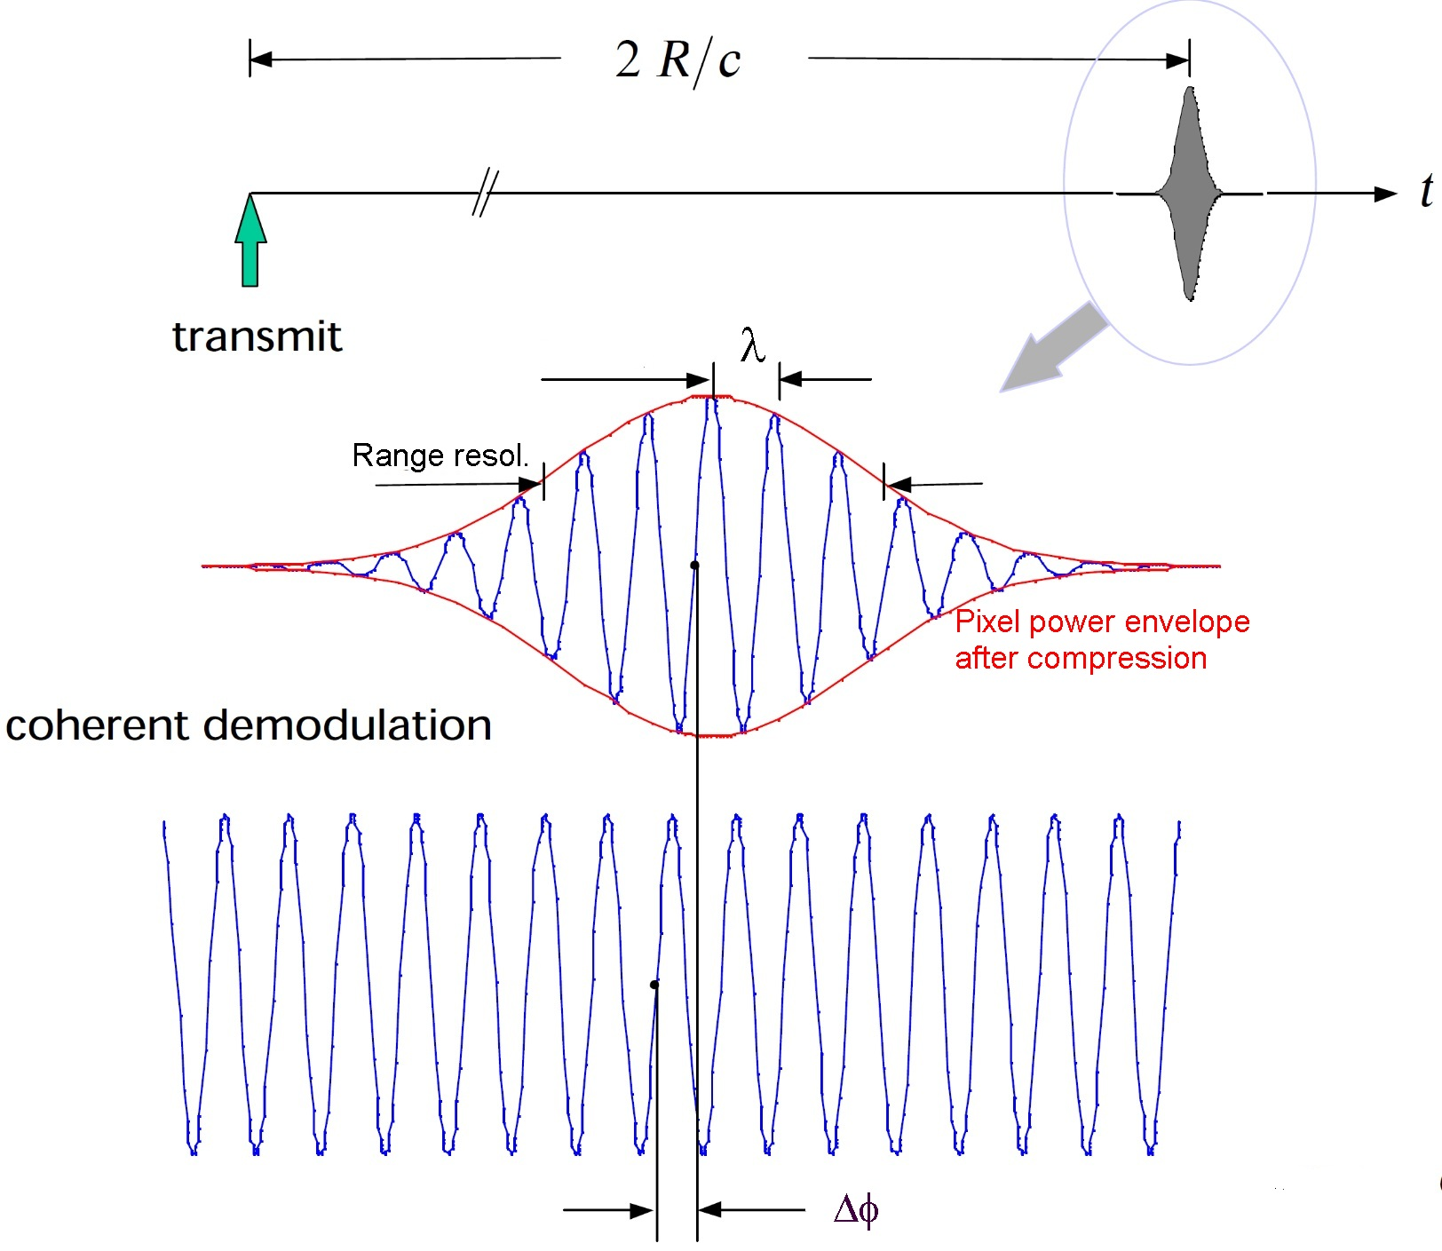

SAR Interferometry for Land Snow and Ice Applications
Configurations for Land Snow and Ice Observations
Coherently Received Signal of a Point Scatterer
InSAR Configuration | Measurement Parameter | Applications
Across-track | Δθ Look angle | DEM & topographic change
Across-track differential | Δr/Δt LOS displacement | Ice motion, surface deformation
Differential | Δϕ/Δt phase delay | Change in snow mass, ΔSWE
Across-track, multi-baseline tomography | backscatter intensity (azim., range, z) | Internal structure of glaciers and ice sheets
Interferogram computation: V (m,n) = V₁ (•) V₂* (•) = |V₁ (•)| |V₂ (•)| exp [i φ (•)]
SAR echo image Nr. 1: V₁(m,n) = | V₁ (m,n) | exp [i φ₁(m,n)]
SAR echo image Nr. 2: V₂ (m,n) = | V₂ (m,n) | exp [i φ₂(m,n)]
amplitude phase
Interferometric phase: φ (m,n) = φ ₁ (m,n) - φ ₂ (m,n)
m,n – range, azimuth coordinate of pixel
V* complex conjugate
Absolute phase of received signal: $∅_{abs}=−\frac{4πR}{λ}+∅_{sce}$
$∅_{sce}$phase of surface scattering element

Slide 24




Interferometric Coherence of Snow and Ice
Complex correlation coefficient (coherence) of two SAR images
Total normalized coherence:
$$_{total}= _{SNR}∙_{Quant}∙_{Amb}∙_{Rg}∙_{Az}∙_{Vol}∙_{Temp}$$
$_{Quant} , _{Amb} ,_{Rg} ,_{Az}$Related to processing parameters, minor loss in coherence by choosing suitable configurations
γ_{SNR} Related to thermal noise, critical for wet snow due to low σ°
γ_{Volume} Volumetric decorrelation, due to penetration in dry snow and firn; depends on baseline and snow microstructure
γ_{Temp} Temporal decorrelation; main factors for snow: surface melt, snowfall, snow drift (wind erosion and deposition) – impact depending on radar frequency
ERS-1/2 One-day interferogram
Summer
Wet snow
& ice
⏐γ_{tot}⏐ 3-day repeat pass C-band SAR data (ERS), Antarctic dry snow zone (Dronning Maud Land), no snowfall ⇒
Dominated by γ_{Volume}
Hintereisferner
$$γ_{Vol}= 1/{\sqrt{1+{\left(\frac{π \sqrt{ε}{ d}_{L} cosθ_{i}}{H_{a}}\right)}^{2}}}$$

Slide 25


Coherence Estimate
Phase noise in dependence of coherence and number of resolution elements (number of looks, N_{L})
N_{L} = 1
N_{L} = 4
⏐γ⏐
Estimate of ⏐γ⏐
For accurate coherence estimates window (W) size with large N_{L} is needed
Figs. R. Bamler

Slide 26




Geometry of Across-Track SAR Interferometry
B_{n} – perpendicular
baseline
Phase Image 1: $∅_{1}=\frac{4π}{λ}R_{1}+∅_{sce,1}$
Image 2: $∅_{2}=\frac{4π}{λ}R_{2}+∅_{sce,2}$
Requirement for full coherence: φ _{sce,1} = φ _{sce,2}
Relation between phase and difference in distance:
${∆∅}_{1,2} =∅_{1}−∅_{2}=\frac{4π}{λ}∆R$
where $∆R=B sin\left(θ−x\right)$
${∆∅}_{1,2} =\frac{4πB}{λ}\sin\left(θ−\right)$
Interferogram: the phase Δφ _{1,2} is given modulo 2π
$${∆∅}_{1,2}\left(interferogram\right)={∆∅}_{1,2} −2nπ$$
Wrapped Phase: -π ≤ φ ≤π
η)
η)
Graphic representation

Slide 27


Across-Track InSAR –Topographic Mapping
Change across swath
Δφ = ( 4π/λ) ΔR
Iso-range line:
R = const., φ = const.
For a non-moving target the total phase is made up by:
Δφ= Δφ(flat) + Δφ(topo)+ Δφ(atmos)
Δφ = 2π
Δφ(atmos): change in atmospheric phase delay

Slide 28


Example for Interferograms with Flat Earth and Topographic Fringes
Interferograms (wrapped phase) in radar geometry
⇐ Flat Earth and Topography
Topography ⇒
Elevation contour lines
Unwrapped phase
2π
2π
0
Simulated interferogram for a cone using ERS SAR parameters
θ_{i} = 23°, B_{n} = 100m
Interferogram geometrically corrected ⇒

Slide 29




InSAR Sensitivity to Elevation and Impact of Penetration
H_{a}, orbit height 780 km, θ = 23°
The InSAR-based elevation refers to the scattering phase centre, in dry snow and ice located below the surface.
The depth of the phase centre, Z_{φ}, below the surface can be derived from the volumetric coherence γ_{Vol}:
$$Z_{φ} ≈−\left|\frac{H_{aVol}}{2π}\right|arctan \left(\sqrt{{\left|γ_{Vol}\right|}^{−2}−1}\right)$$
$$_{Vol}=\frac{_{tot}}{_{therm} _{Quant }_{Amb}{ }_{Rg }_{Az}}$$
Height of ambiguity in volume:
${ H}_{aVol}= \frac{2π}{Ha} \sqrt{ε} \frac{\cos{ θ_{i}}}{\cos{{ θ}_{r}}}$
Δh
Phase sensitivity to elevation
monostatic mode
Z_{φ} derived from γ_{Vol} (TanDEM-X) vs Δh (TDMX – optical DEM) at sites with different accumulation rates an snow/firn morphology, Union Glacier, Antarctica
Rott et al., 2021
H_{a}, Height of ambiguity
(height for Δφ = 2π)
Z_{φ}

Slide 30



InSAR DEM Differencing - Estimating Glacier Volume Change & Mass Balance
Surface elevation change (Δh/Δt) of Antarctic Peninsula Glaciers (Larsen B)
TDM CoSSC data acquired from same satellite track in winter (frozen snow/ice), with same σ°, coherence and θ (repeat tracks)
Comparison of TDM with airborne lidar (ATM) data of NASA IceBridge - high agreement
2011-2013
-6.29 Gt/yr
2013-2016
-2.90 Gt/yr
Δh/Δt ATM - TDM
Mean difference 0.01 m/yr RMSD = 0.22 m/yr
Rott et al., 2018

Slide 31

InSAR Glacier Motion - Interferogram
TerraSAR-X interferogram (topography & motion)
2008/10/13 - 2008/10/24, B_{n} = 129 m
V_{c} =0.25m/d
Sea Ice
Calving Front
Topographic fringes
Shear zone -> decorrelation
11 day repeat pass
1 Fringe = 1.5 mm/day LOS
0 km 2

Slide 32





Across-track InSAR Measurement of Surface Displacement
Across-track view
v_{y}
$v_{z }$=$v_{y }\frac{∂S}{∂y}$
θ
LOS
LOS: Δφ_{dis} = (4π/λ)ΔR = (4π/λ)(Δy sin θ - Δz cos θ)
$$\frac{∂S}{∂t}$$
Band | X | C | L
ΔR (2π) = λ/2 | 1.56 cm | 2.83 cm | 12.50 cm
y
ΔR
RP- InSAR measures displacement in LOS of the radar beam
refers to the scattering phase centre
∂S/∂t = w + b local surface displacement
w - vertical shift of ice body
b - surface balance (melt)

Slide 33


3D Ice Motion and Surface Parallel Flow Assumption
InSAR from a single track yields one component of the velocity vector.
Observations from three directions are needed to obtain the 3D vector:
V_{h} horizontal velocity vector
True 3D vectors are obtained by InSAR if at least 3 sufficiently different LOS views are available.
By offset tracking using data from crossing orbits
Surface-parallel flow assumption – Approximation for 3D motion.
Assumes glacier surface in equilibrium state
Single track InSAR, Surface-parallel flow: LOS displacement projected onto surface in slope direction ⇒
InSAR motion of crossing orbits: combines interferograms of ascending & descending orbits: provides magnitude and argument of 2D v in LOS/azimuth coordinates.
2D v is projected onto surface to obtain 3D velocity approximation

Slide 34


Ice Motion based on Horizontal Flow Assumption
Topographically corrected interferogram
↓ Horizontal velocity field, assuming surface parallel flow; argument of v_{h} derived from stacks of ascending and descending InSAR tracks
Magnusson et al., 2007
ERS1/2
27/28 03 1996
Flow path of jökulhlaup
Skeidararjökull
Radar LOS ⇒

Slide 35

Example for 3D Ice Motion based on Offset Tracking of Crossing Orbits
Horizontal flow velocity along centre line
Doyle et al., 2015
Vertical displacement rates along centre line
Uplift & acceleration in late August related to rainfall
TanDEM-X repeat pass image pairs of ascending & descending orbits:
4 projections of the displacement vector:
ΔLOS & ΔAlong-track (Asc, Desc)
→ 3D Displacement

Slide 36




Surface Motion Product Based on InSAR and Offset Tracking
⇐ InSAR surface velocity from S1 6-day repeat images of winter campaigns, crossing orbits
InSAR applies data stacking; 50 m grid size
Requires non-melting surfaces
InSAR gaps in areas with high flow velocities near calving fronts (are filled by offset-tracking)
JH – Jakobshaven Glacier Offset tracking
JH
OT
⇐ Comparison of InSAR and Offset-tracking profiles across the ice divide (250 m grid)
Low velocities
InSAR
Data available at:
http://cryoportal.enveo.at/

Slide 37
References
Bamler, R. and Hartl, P.: Synthetic aperture radar interferometry, Inverse Problems, 14, R1 - R54, 1988.
Doyle, H.S., Hubbard, A., van de Wal, R.S.W. et al. Amplified melt and flow of the Greenland ice sheet driven by late-summer cyclonic rainfall. Nature Geosc., 8, doi: 10.1038/NGEO242, 2015.
ESA SP-1322/1: Sentinel-1: ESA’s Radar Observatory Mission for GMES Operational Services. March 2012.
Hanssen, R.F.: Radar Interferometry, Data Interpretation and Error Analysis. Kluwer Academic Publishers, 2001.
Krieger, G., Zink, M., Bachmann, M., Bräutigam, B., Schulze, D., Martone, M., Rizzoli, P., Steinbrecher, U., Anthony, J. W., et al.: TanDEM-X: a radar interferometer with two formation flying satellites, Acta Astronaut., 89, 83–98, doi:10.1016/j.actaastro.2013.03.008, 2013.
Magnússon, E., Rott, H., Björnsson, H., Pálsson, F.: The impact of jökulhlaups on basal sliding observed by SAR interferometry on Vatnajökull. J. Glaciol., 53 (181), 232-240, 2007.
Mätzler, C. Applications of the interaction of microwaves with the natural snow cover. Remote Sensing Review, 2, 259-387, 1987.
Moreira, A., Prats-Iraola, P., Younis, M., Krieger, G., Hajnsek, I., Papathanassiou, K.: A tutorial on synthetic aperture radar, IEEE Geosci. Rem. Sens. Mag., 1(1), 6–43, https://doi.org/10.1109/MGRS.2013.2248301, 2013.
Oliver, C., Quegan, S.: Understanding Synthetic Aperture Radar Images. Artech House, Boston, London, 1998.
Rott, H., Sturm, K.,. Miller, H.: Active and passive microwave signatures of Antarctic firn by means of field measurements and satellite data. Ann. Glaciol., 17, 337-343, 1993.
Rott, H., Abdel Jaber, W., Wuite, J. et al.: Changing pattern of ice flow and mass balance for glaciers discharging into the Larsen A and B embayments, Ant. Peninsula, 2011 to 2016. The Cryosphere, 12, 1273-1291, 2018..
Rott, H., Scheiblauer, S., Wuite, J., Krieger, L., Floricioiu, D., Rizzoli, P., Libert, L., Nagler, T.: Penetration of interferometric radar signals in Antarctic snow. The Cryosphere, 15, 4399–4419, 2021.
Ulaby, F.T. and Long, D.G.: Microwave and Radar Remote Sensing, Univ. Michigan Press, Ann Arbor, 2014.
X. Xu, D. Liang, L. Tsang, K. M. Andreadis, E. G. Josberger et al.: Active remote sensing of snow using NMM3D/DMRT and comparison with CLPX II airborne data. IEEE J. Sel. Topics Appl. Earth Observ. Remote Sens., vol. 3, 689–697, 2010.

