Slide 1
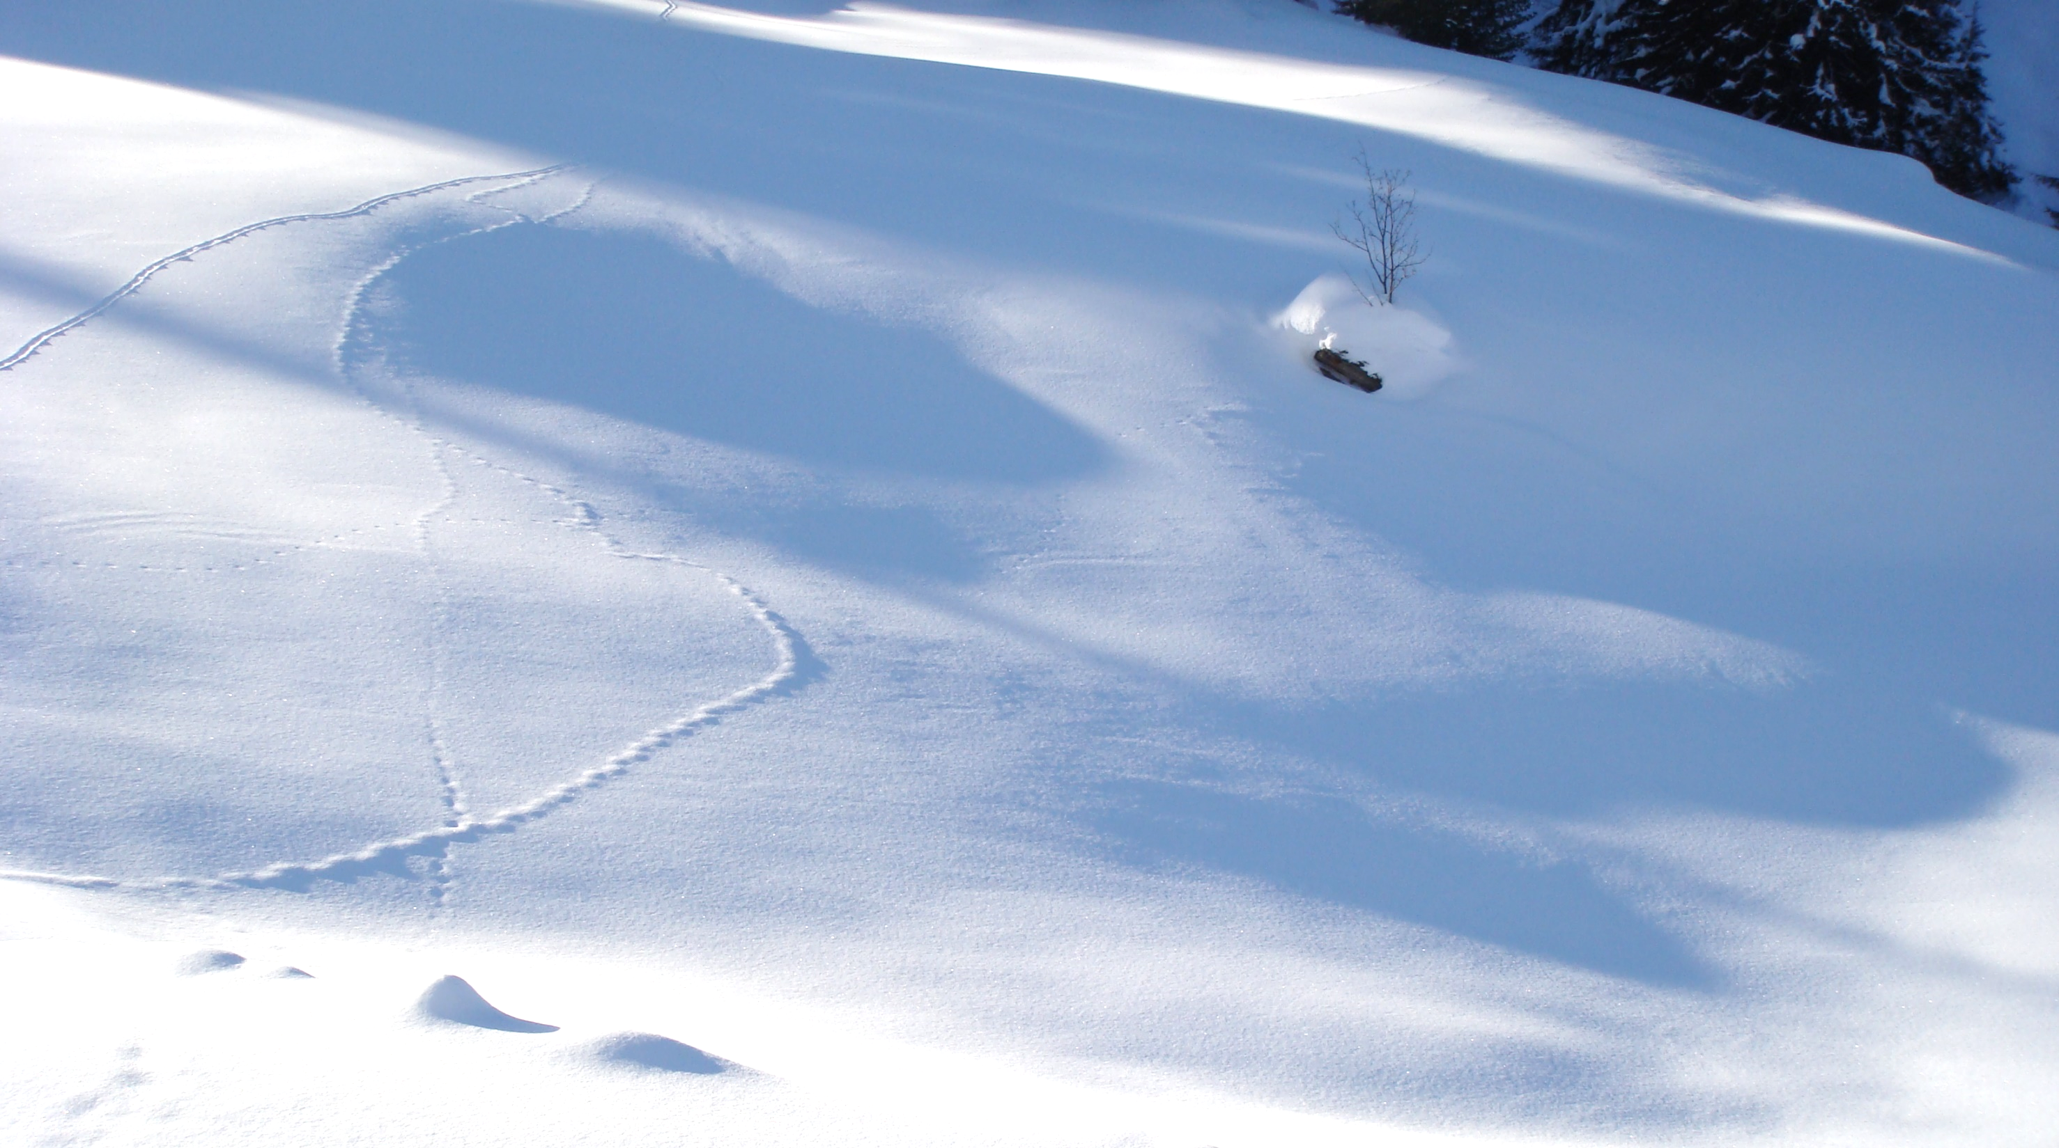
Introduction to Optical Remote Sensing of Snow and Ice
Helmut Rott
ENVEO IT, Innsbruck
& University of Innsbruck, Austria
ESA LTC, 16-20 September 2024, Innsbruck

Slide 2
Contents of the Lecture
Radiometric Quantities
Refractive Index and spectral reflectivity of snow and ice
Impact of pollution
Angular dependence of reflectivity
Infrared emissivity
Atmospheric Radiative Transfer
Corrections for impacts of atmospheric propagation
Solar illumination and reflectance in complex terrain

Slide 3
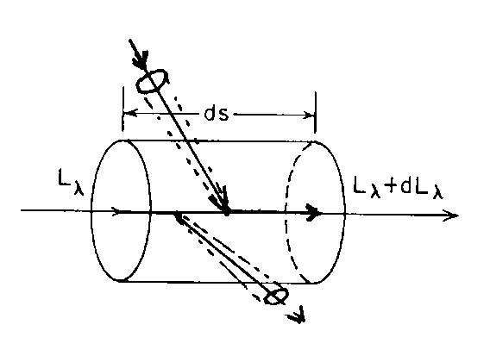
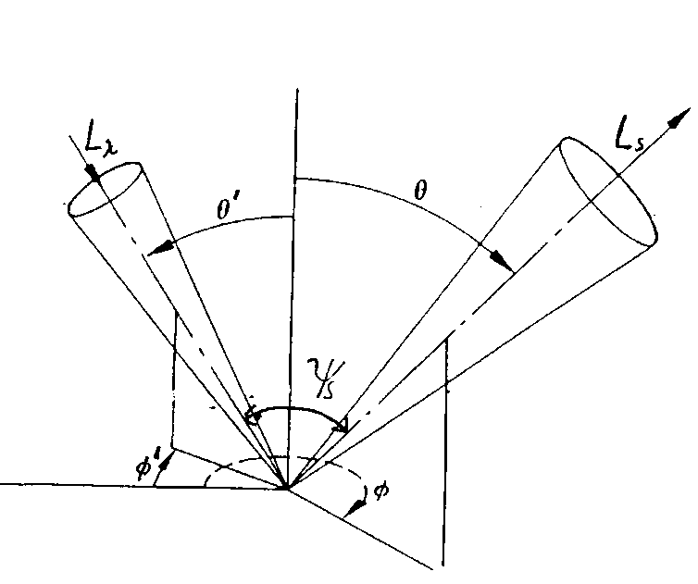
Radiometric Quantities
Radiometric Quantities Symbol Unit
Radiant energy Q J, Ws
Radiant flux (power) Φ Φ = dQ/dt W, J s⁻¹
Intensity (point source) I I = dΦ/dΩ W sr⁻¹
Irradiance(flux density) M, E M = dΦ/dA W m⁻²
Radiance L = d²Φ/(cosθ dA dΩ) W m⁻² sr⁻¹
Spectral radiance L_{λ} W m⁻² sr⁻¹ μm ⁻¹
Radiative Transfer (RT) Equation
Loss term for absorption: V_{a}(λ) = -κ_{a}(λ) L _{λ} κ_{a}(λ) [m⁻¹]
Loss term for scattering: V_{s} (λ) = -κ_{s}(λ) L _{λ} κ_{s} (λ) [m⁻¹]
Total losses: V_{a} (λ) + V_{s} (λ) = -κ_{e}(λ) L _{λ} κ_{e} = κ_{a} + κ_{s}
Source term for emission: J_{a}(λ) = κ_{a}(λ) B _{λ} (T)
B (T) [W m⁻² sr ^{–1} μm⁻¹] blackbody radiance
Source term for scattering:
P(ψ_{s} ) phase function

Slide 4
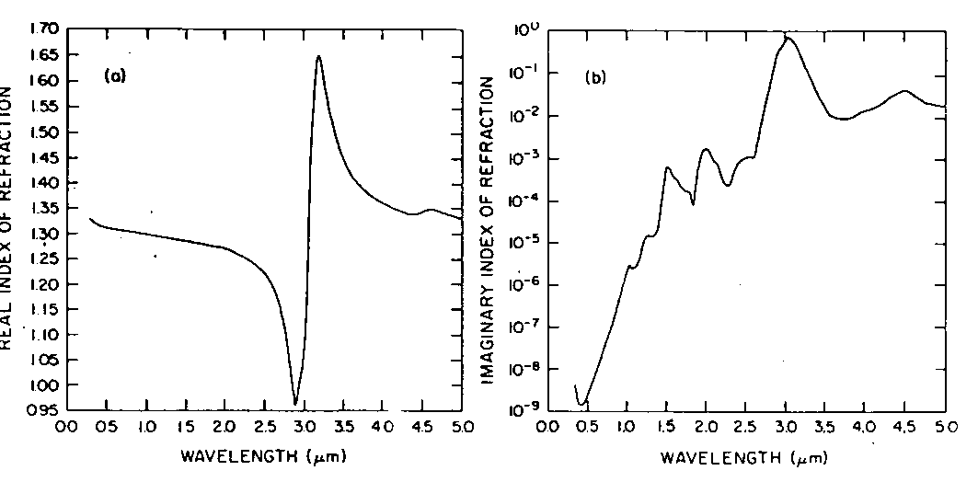
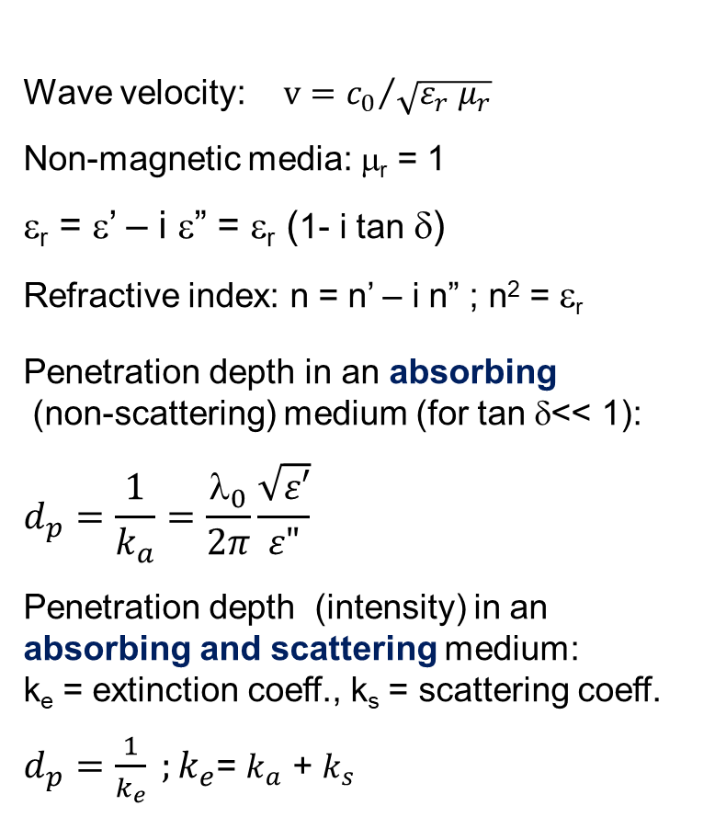
Refractive Index of Ice in VIS and IR
c₀ = 2.9979 E8 m/s
ε₀ = 8.8554 E-12 [As/Vm]
ε_{r} = ε/ε₀ Relative permittivity
δ = ε“/ε‘ Loss tangent
κ_{a} Absorption coefficient
Wave velocity: $v={c_{0}}/{\sqrt{{ε_{r} μ}_{r}} }$
Non-magnetic media: μ_{r} = 1
ε_{r} = ε’ – i ε” = ε_{r} (1- i tan δ)
Refractive index: n = n’ – i n” ; n² = ε_{r}
Penetration depth in an absorbing
(non-scattering) medium (for tan δ<< 1):
$$d_{p}=\frac{1}{k_{a}}=\frac{λ_{0}}{2π}\frac{\sqrt{ε′}}{ε"}$$
Penetration depth (intensity) in an absorbing and scattering medium:
k_{e} = extinction coeff., k_{s} = scattering coeff.
$d_{p}=\frac{1}{k_{e}} ;k_{e}$= $k_{a}$ + $k_{s}$
2.8 μm: resonance (electron oscillation)
Refractive index of clean ice
n’
n”

Slide 5
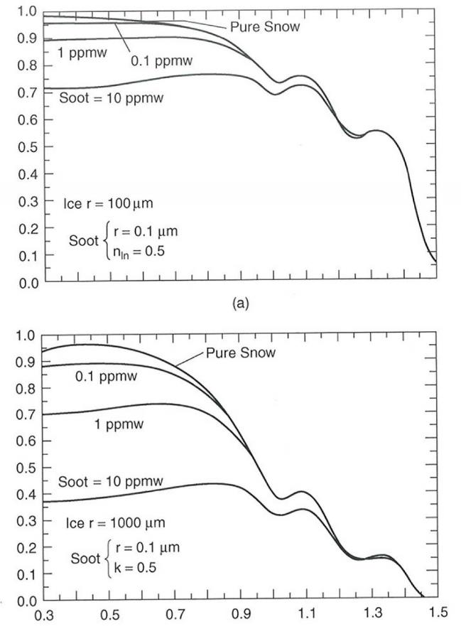
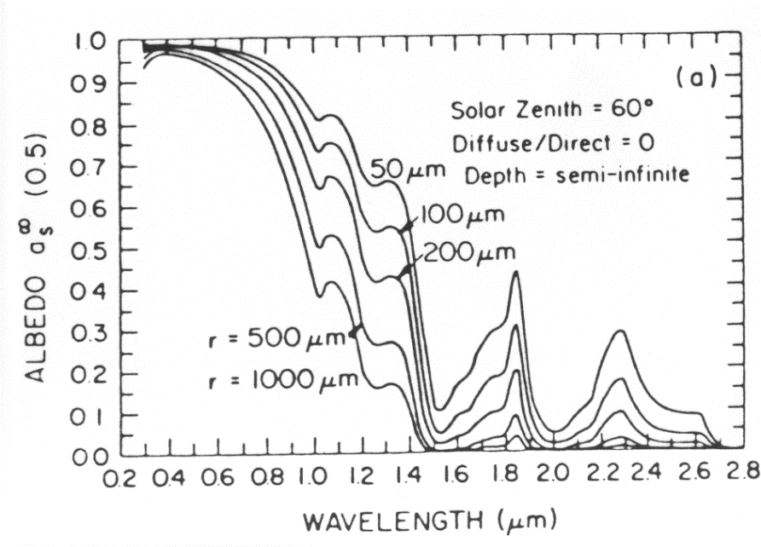
Spectral Reflectivity of Snow – Impact of Grain Size and Pollution
Spectral reflectivity in dependence of grain size
Albedo of snow polluted by soot
grain size r =0.1 mm
grain size r =1.0 mm
Model Calculations
Wiscomb and Warren, 1980

Slide 6
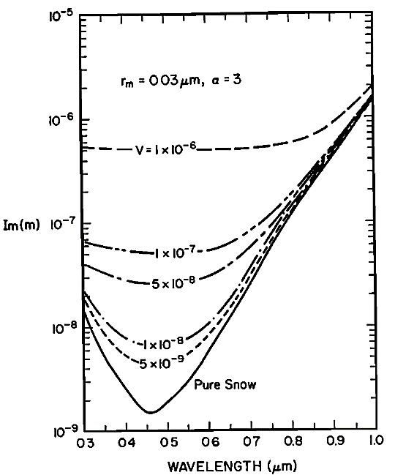
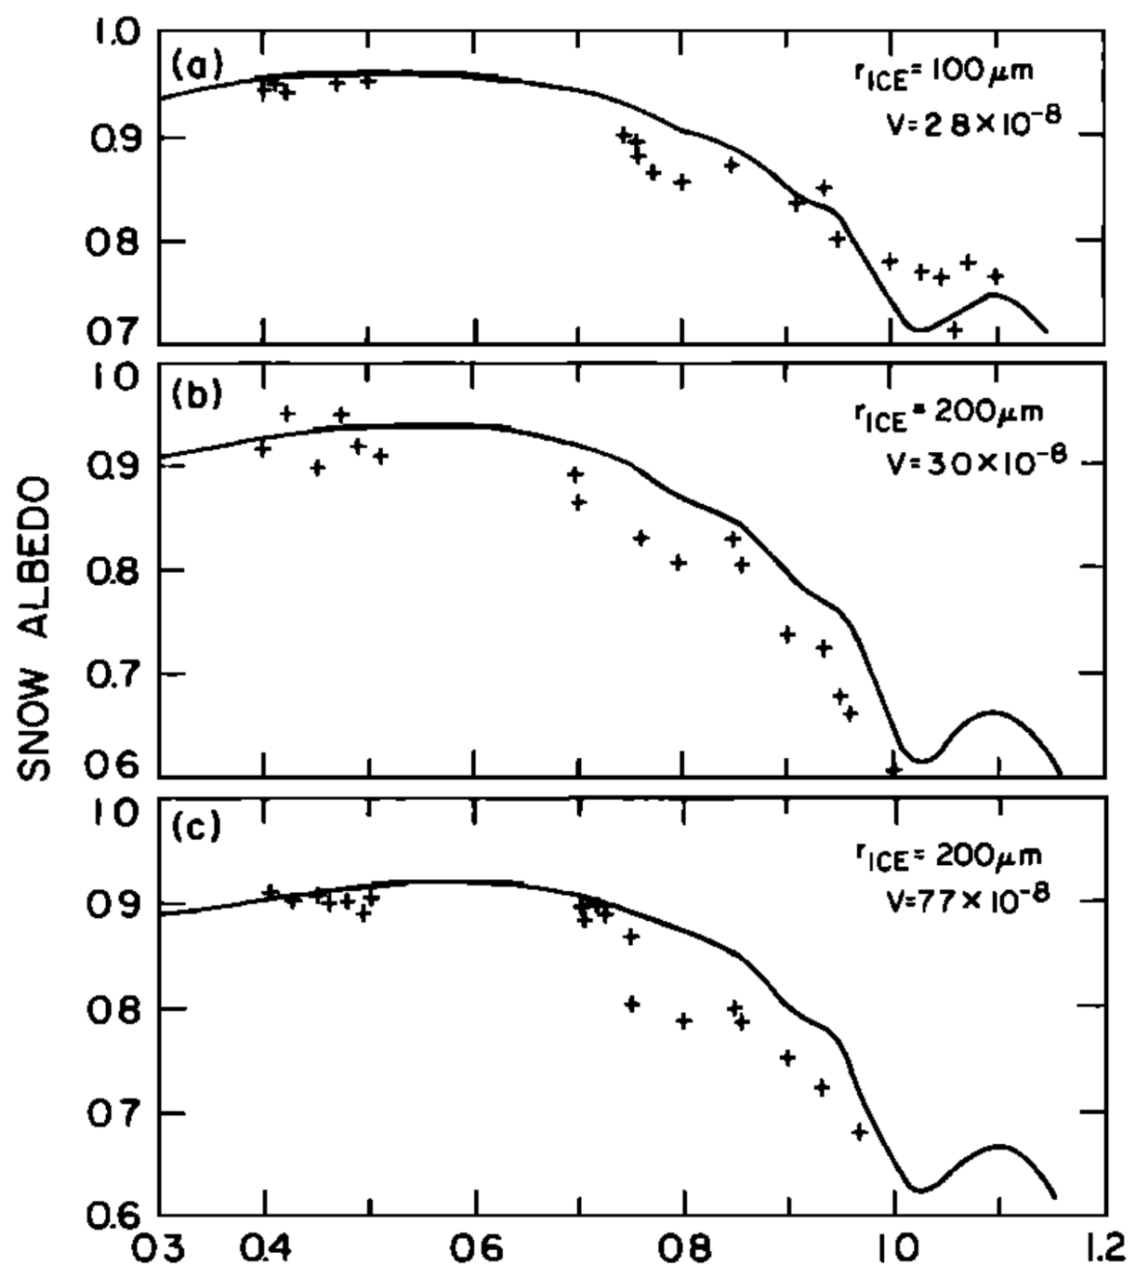
Refractive Index and Albedo of Polluted Snow
⇐ Imaginary part of refractive index of snow-soot
composition, assuming
gamma-type size distribution for carbon particle (α = 3)
V – volume fraction of soot
n_{soot} = 1.8 + 0.5 i
Model computations for snow albedo with different volume fractions of soot and comparison with measurements ⇒
Chylek et al., 1983
μm

Slide 7
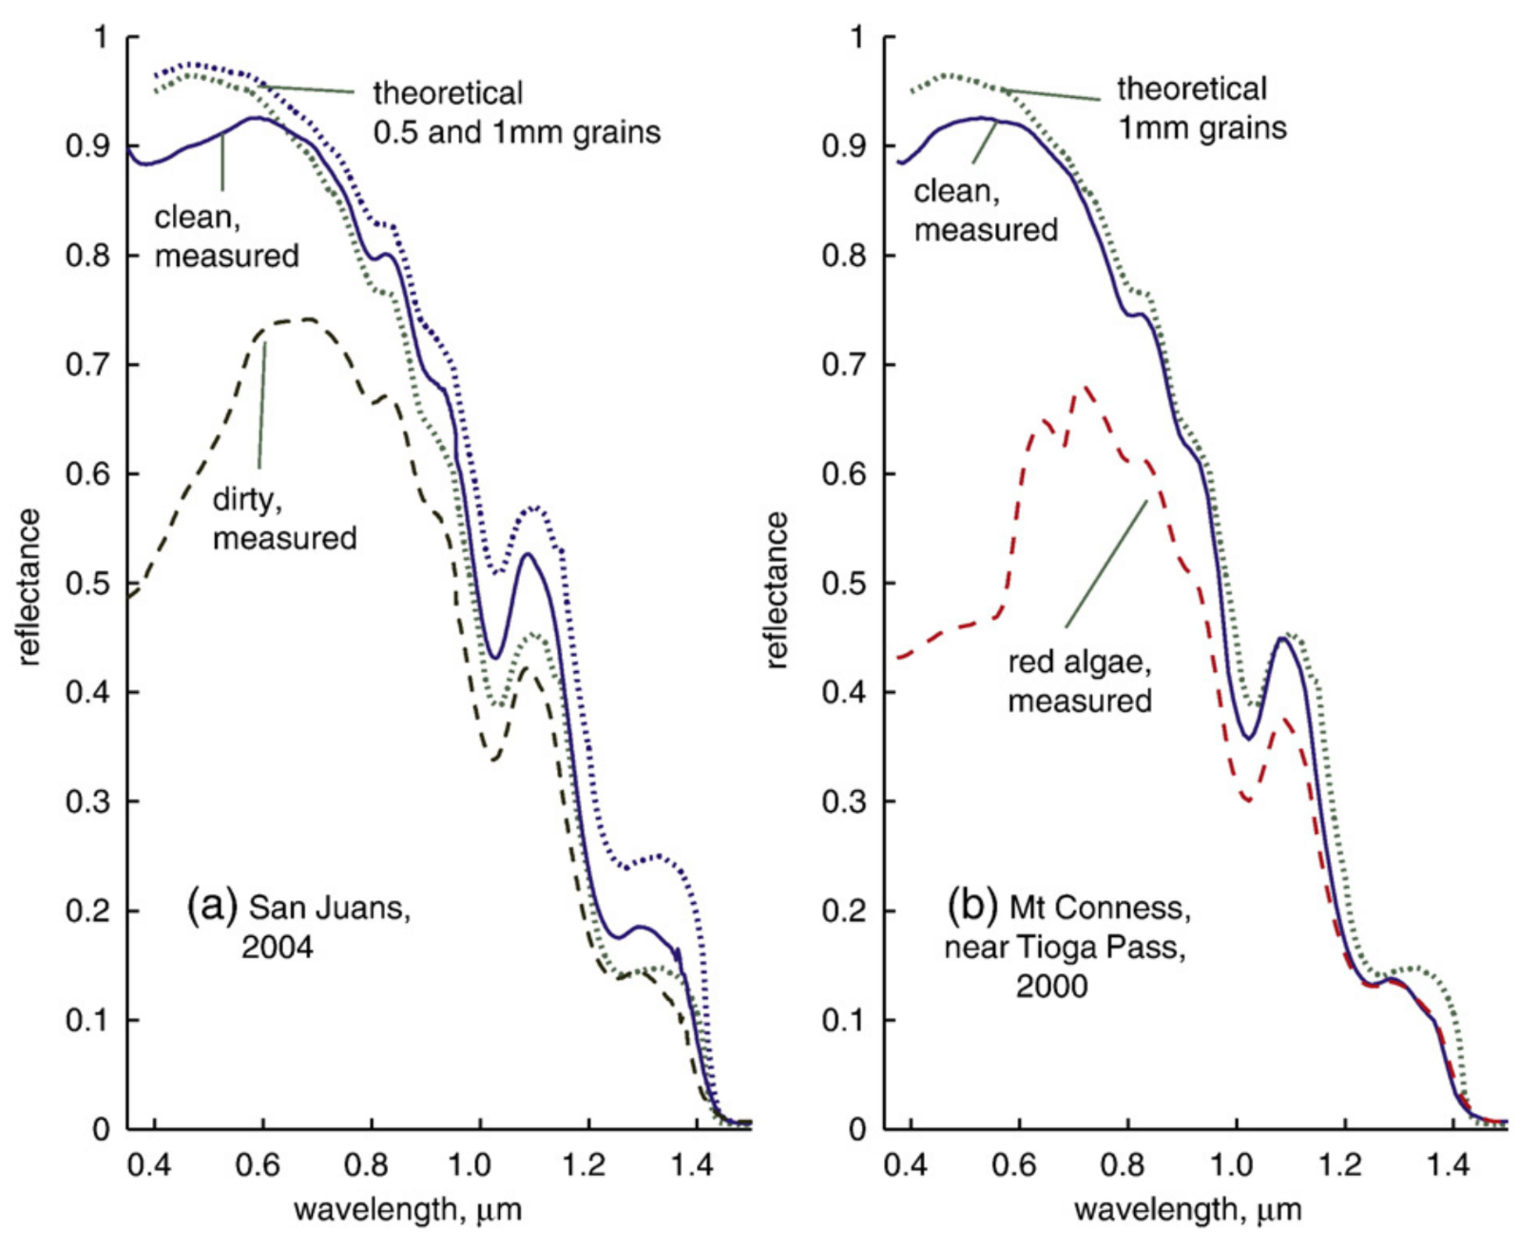
Spectral Reflectance of Polluted Snow
Impact of pollution type on spectral reflectivity
Field-measured of spectral reflectance (AVIRIS, Airborne Visible/Infrared Airborne Spectrometer, 224 channels)
(a) Dirty snow in the San Juan Mountains source of dust: deserts of the Colorado Plateau in Utah
(b) Snow with red algae in the Sierra Nevada
Dozier et al., 2009

Slide 8
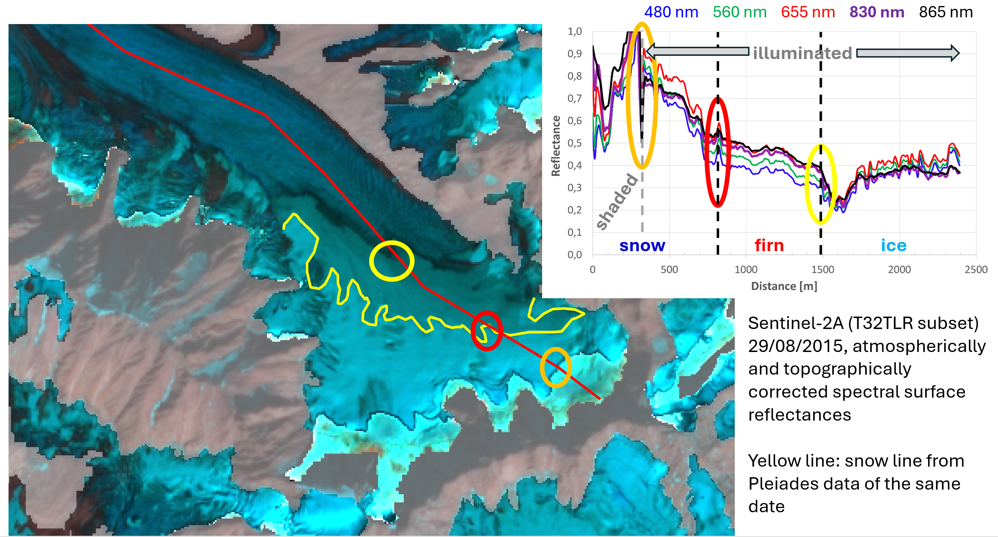
Late-Summer Albedo of Snow and Ice on Glaciers

Slide 9
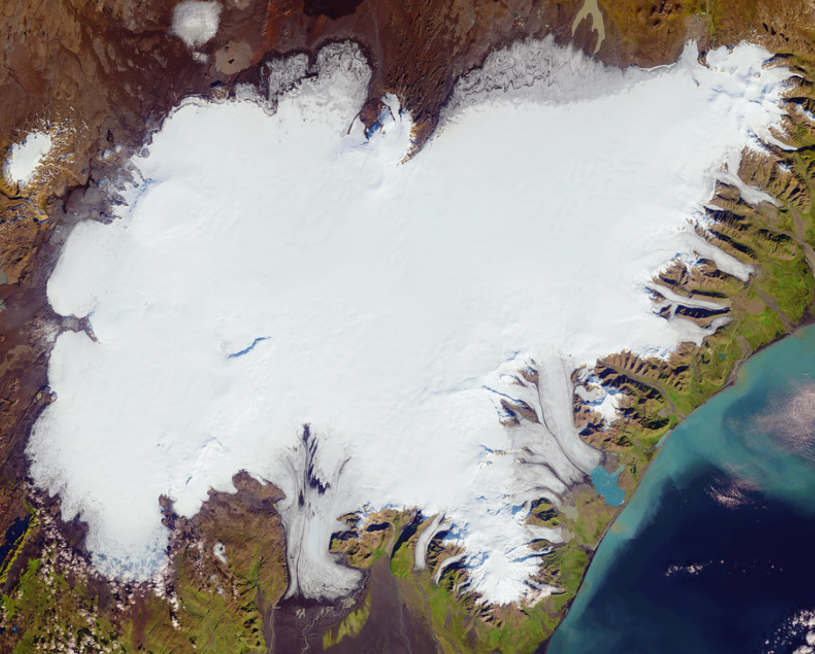
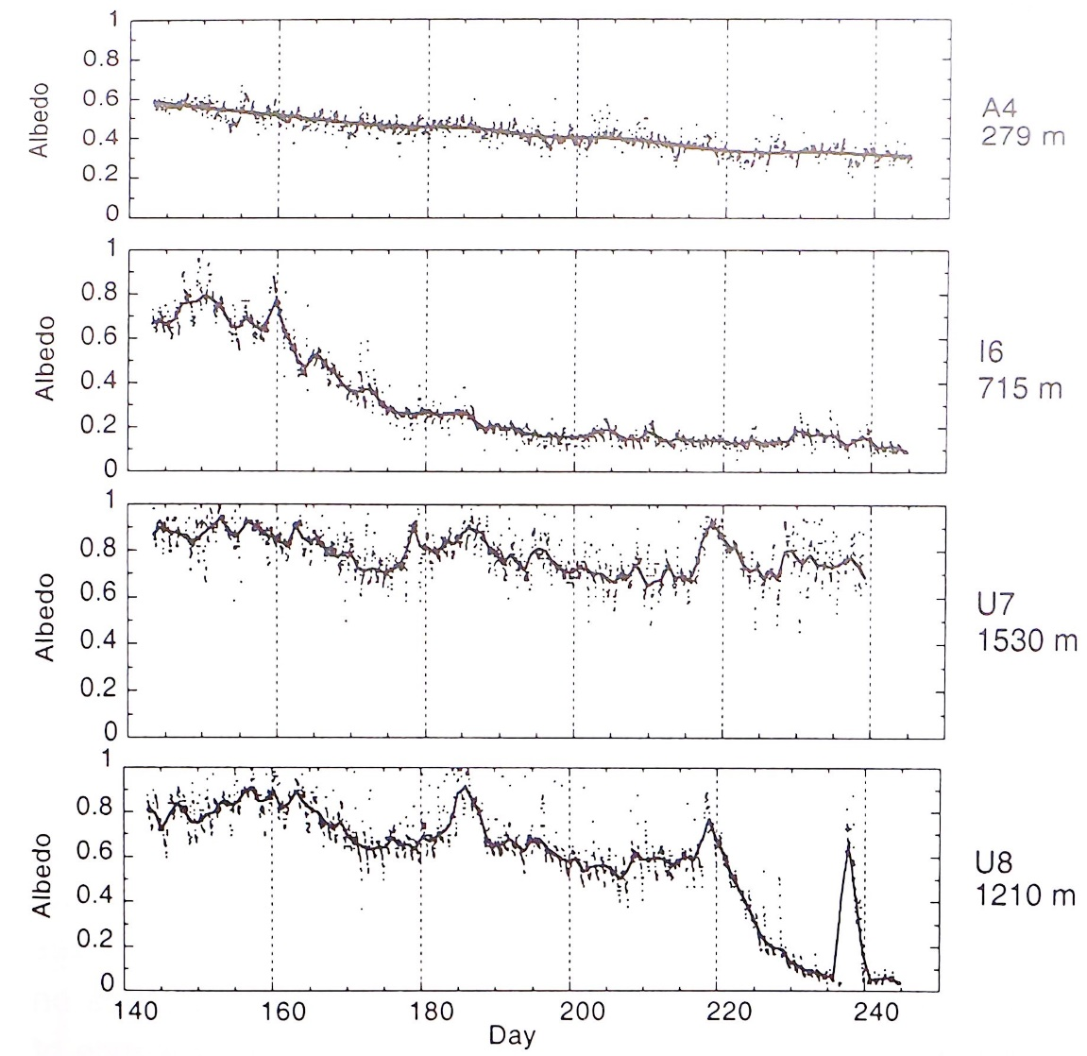
Large Spatial and Temporal Variability of Albedo on Glaciers
Albedo measurements from 19 May to 5 September 1996
Oerlemans, 2001
U8
U7
I6 
A4 
Landsat 8, Sept. 2015

Slide 10
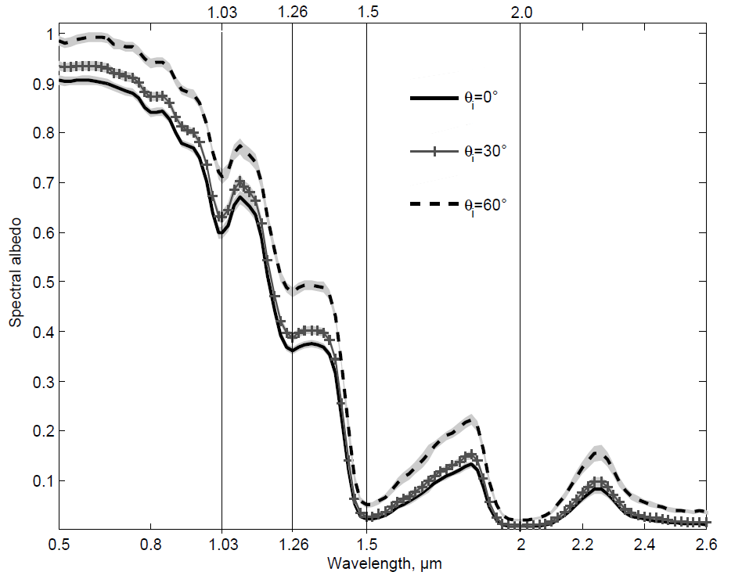
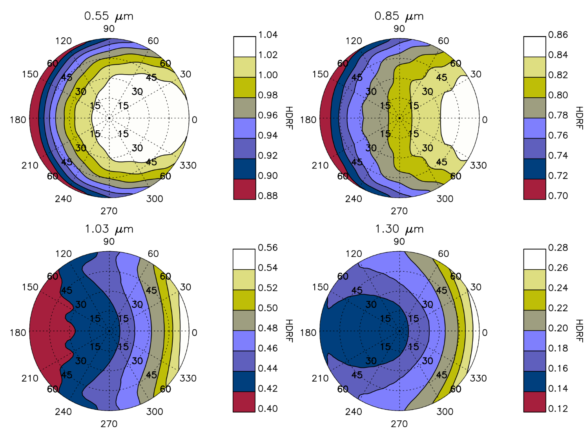
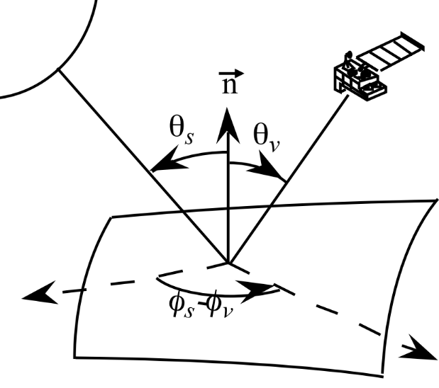
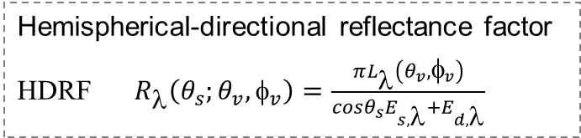
Angular Dependence of Snow Reflectivity
Painter and Dozier, 2004
Spectral albedo (hemispheric reflectance) calculated from BRDF measurements for 3 incident zenith angles. Snow surface: melt-freeze crust
Dumont et al., 2010
Hemispherical-directional reflectance factor
HDRF $R_{λ}\left(θ_{s};θ_{v}, φ_{v}\right)=\frac{πL_{λ}\left(θ_{v}, φ_{v}\right)}{cosθ_{s}E_{s,λ}+E_{d,λ}}$
Computed HDRF at different wavelength, θ_{s} = 30° Forward reflectance direction: φ_{v} =0°,
Grain size (a-/c-axis) 624 μm / 1560 μm

Slide 11
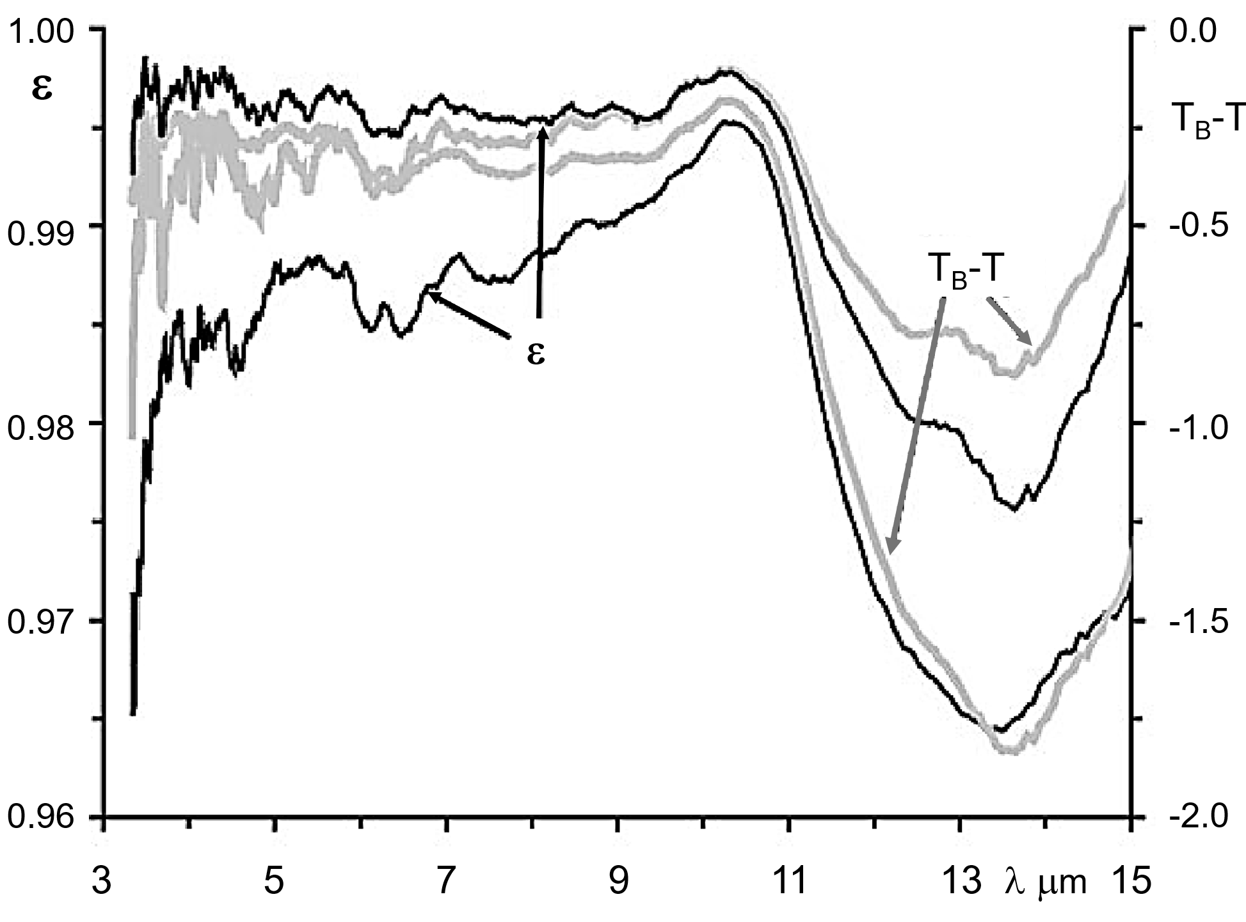
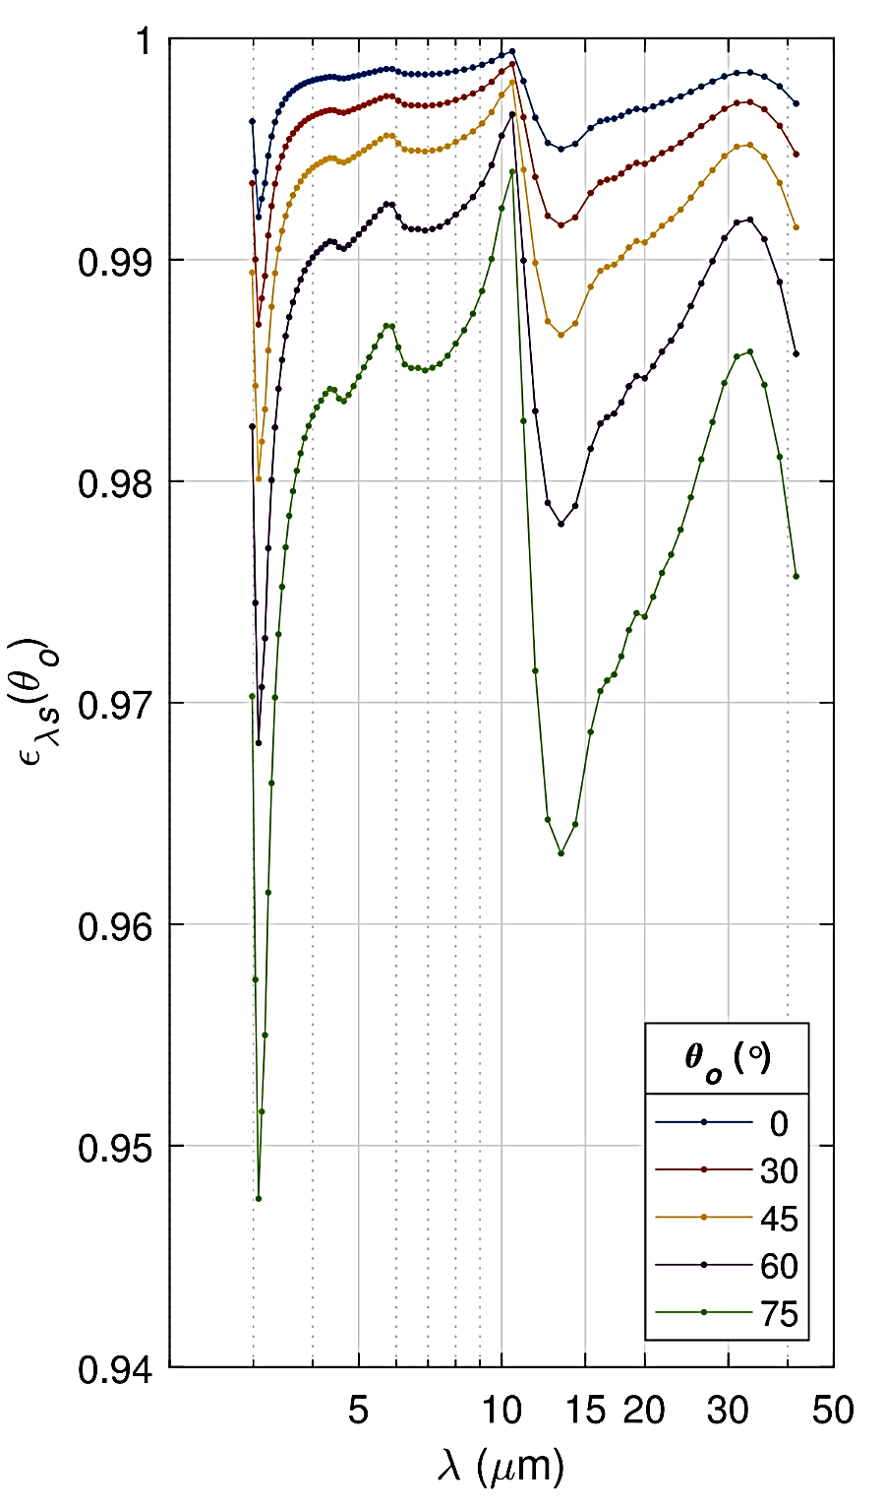
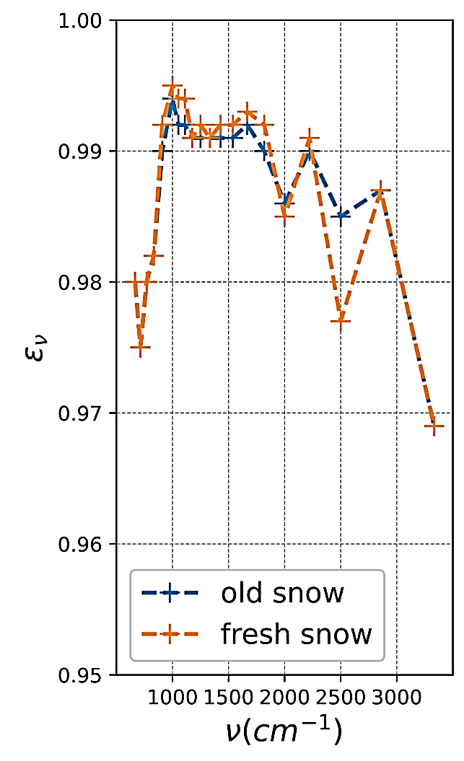
Snow Infrared Emissivity
Field measurements of the spectral variability of snow emissivity and its effect on brightness temperature (TB) for melting snow, near-normal viewing angle
↑
10 μm
↑
3.3μm
Snow surface emissivity spectra based on Wiscomb Warren albedo model, particle radius 0.2 mm, for different zenith angles
Snow surface emissivity spectra, community radiative transfer model (CRTM)
Painter and Dozier, 2004
Nalli et al., 2023

Slide 12
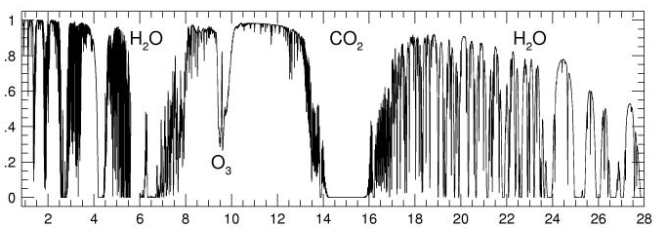
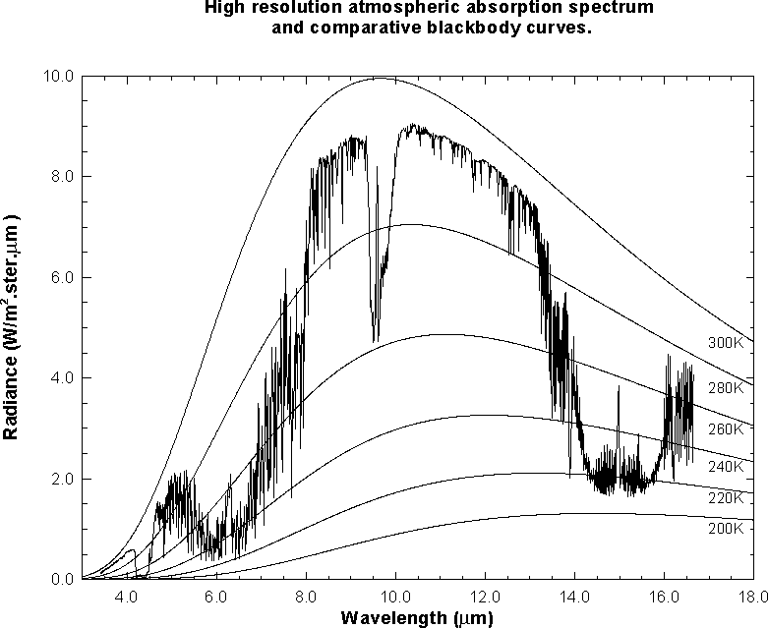
Atmospheric Transmittance and Surface Irradiance
Atmospheric IR transmittance – impact of gas absorption
Irradiance, top-of-atmosphere (TOA) and at surface, zenith angle θ =0°, standard atmosphere
IR atmospheric absorption spectrum and comparative blackbody curves

Slide 13
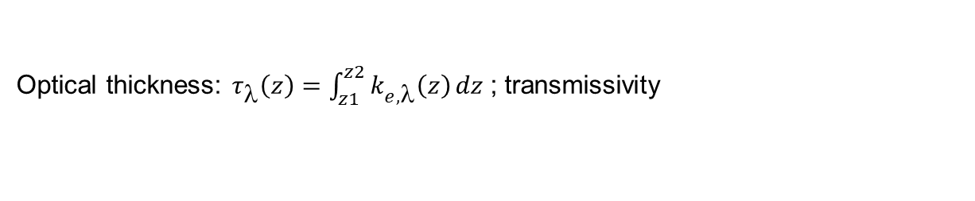
Atmospheric Radiative Transfer
1st Order Radiative Transfer Model: Main radiation fluxes
TOA radiance ⇒
L_{sat,λ}
Spectral surface reflectance ⇒
⎯ ⎯ measured
 deduced from MERIS data, using 6S atmos. correction
L_{p} - path radiance
r_{s}– surface reflectance
Forward model
L_{sat,λ} = r_{surf} (E_{dir} cos θ_{i} + E_{dif}) (1/π) exp(-τ_{atm}/cos θ_{r}) + L_{p} +L_{r}’ [W m⁻² sr⁻¹ μm⁻¹]
Optical thickness: $τ_{λ}\left(z\right)=\int_{z1}^{z2}{k_{e,λ}\left(z\right)}dz$; transmissivity

Slide 14
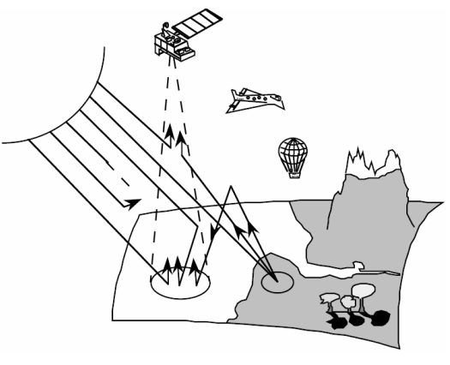
Correction for Atmospheric Attenuation and Scattering
reflected radiance atmosph. source function
μ - cos θ_{view} μ₀ - cos θ_{s} τ - optical thickness
s‘ – position of scattering volume element
E_{λ} - direct solar irradiance
P _{λ} - Scattering phase function
A tool for atmospheric correction of optical satellite observations:
6S Second Simulation of the Satellite Signal in the Solar Spectrum.
Computer code for calculating (down-looking) planetary albedo, ρ_{TOA}. Solves the equation of transfer for in-homogenous atmospheres with a discrete number of layers. Offers choice of different conditions in the layers (water vapour, aerosol type, optical thickness), type and properties of the ground.
Formulation for wavelength without gas absorption:
S spherical albedo of the atmosphere
<ρ> albedo of the surrounding area
ρ_{R+A} reflexion of the atmosphere due to scattering
t transmissivity of the atmosphere
t_{d} transmissivity for diffuse radiation

Slide 15
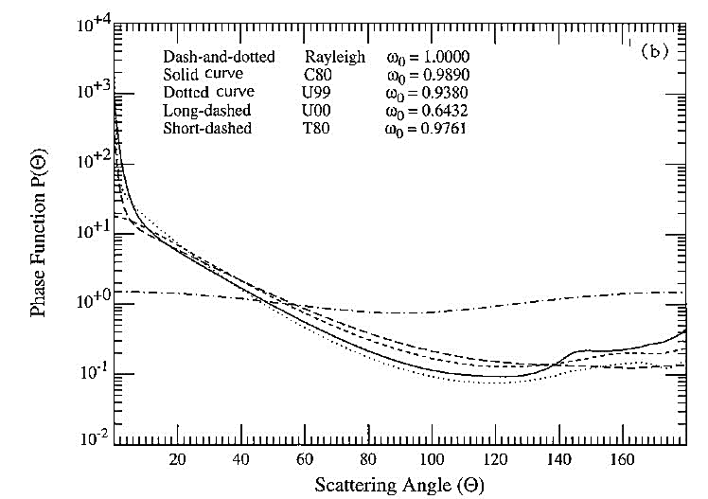
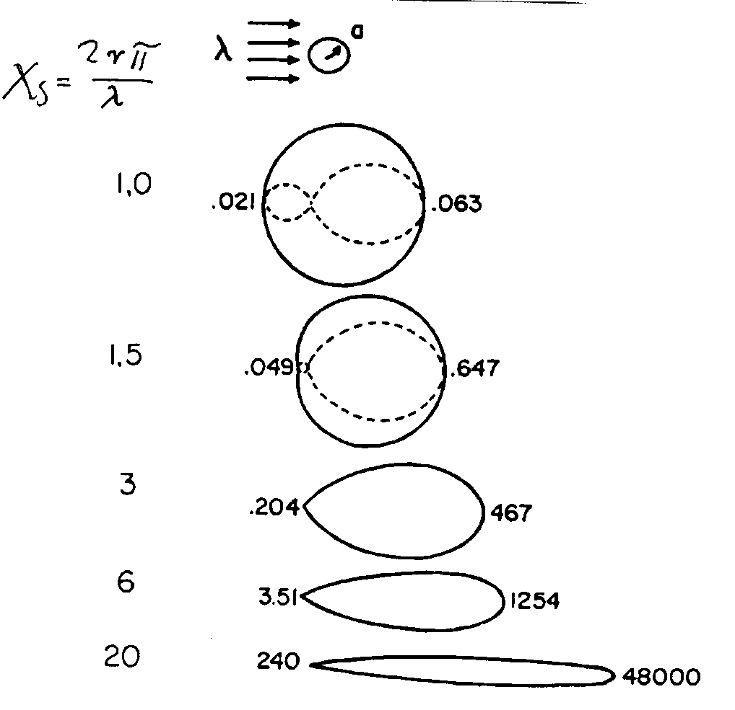
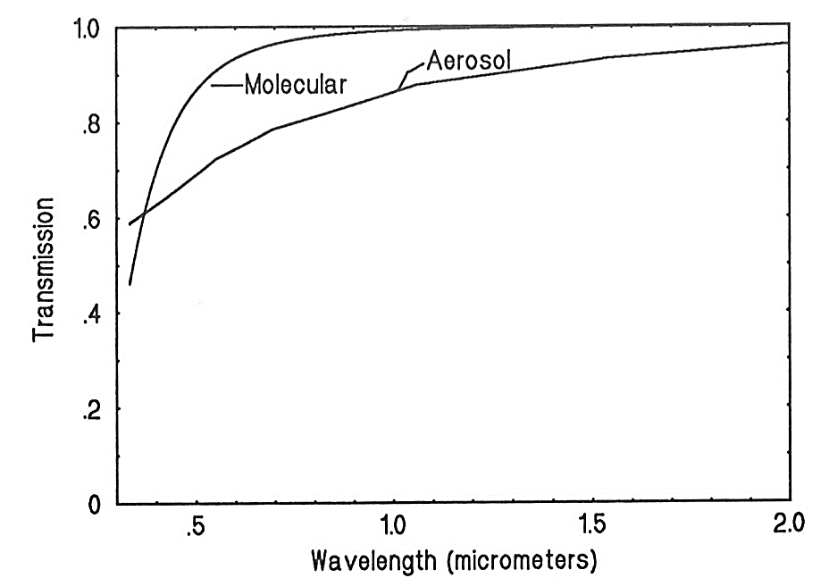

Angular Dependence of Scattering by Aerosol Particles
Typical phase functions at 443 nm
Directional dependence of scattering intensity
Size parameter
Difference in wavelength dependence of molecular at moderate atmospheric turbidity
χ_{s}
Typical values for single scattering albedo
Maritime particles ω₀ = 0.99
Carbon particles ω₀ = 0.25-0.30
Sahara dust ω₀ = 0.90-0.95

Slide 16
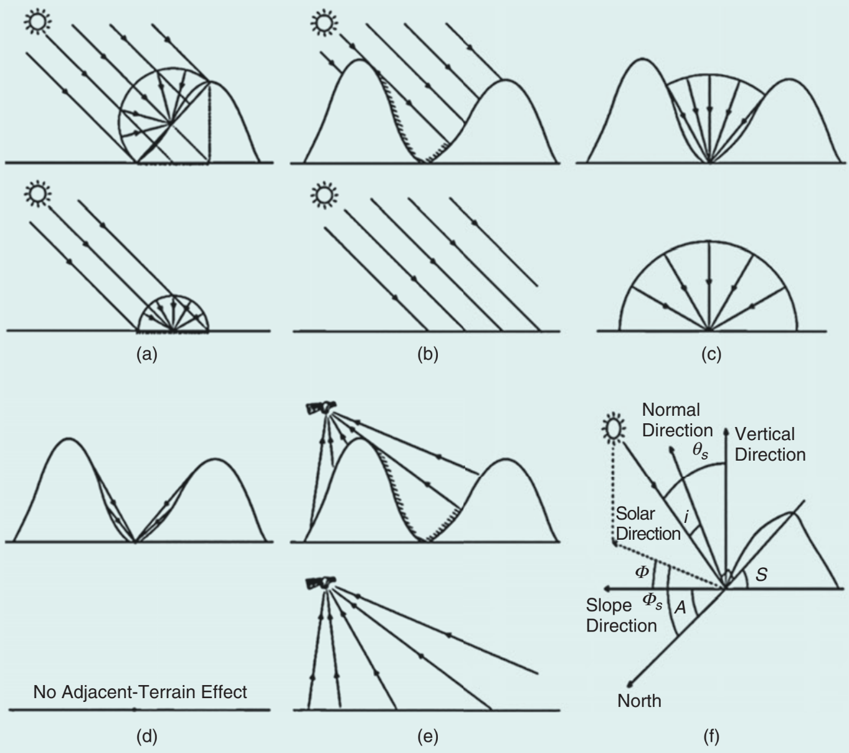
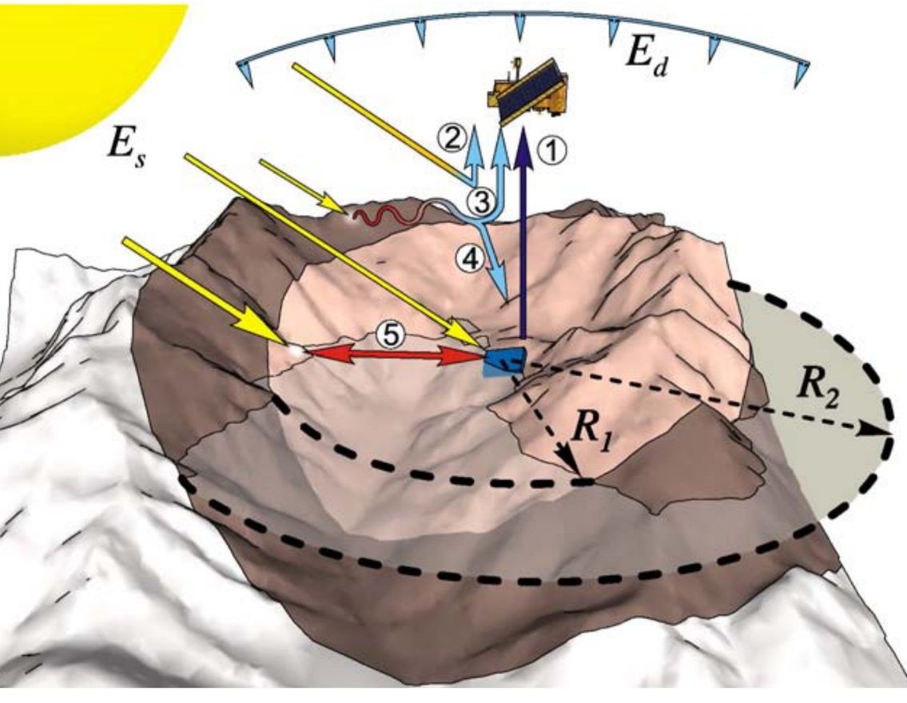
Solar illumination and Reflectance in Complex Terrain
direct & diffuse
direct solar
diffuse solar
adjacent terrain reflected
Slope reflected
Sirguey et al., 2009
E_{s} direct & E_{d} diffuse solar irradiance (1) target radiance, (2) atmospheric path rad:, (3) background rad., (4) diffuse environmental irradiance, (5) reflected terrain irradiance.
Chen et al., 2023: Review and evaluation of optical remote sensing terrain correction methods.

Slide 17
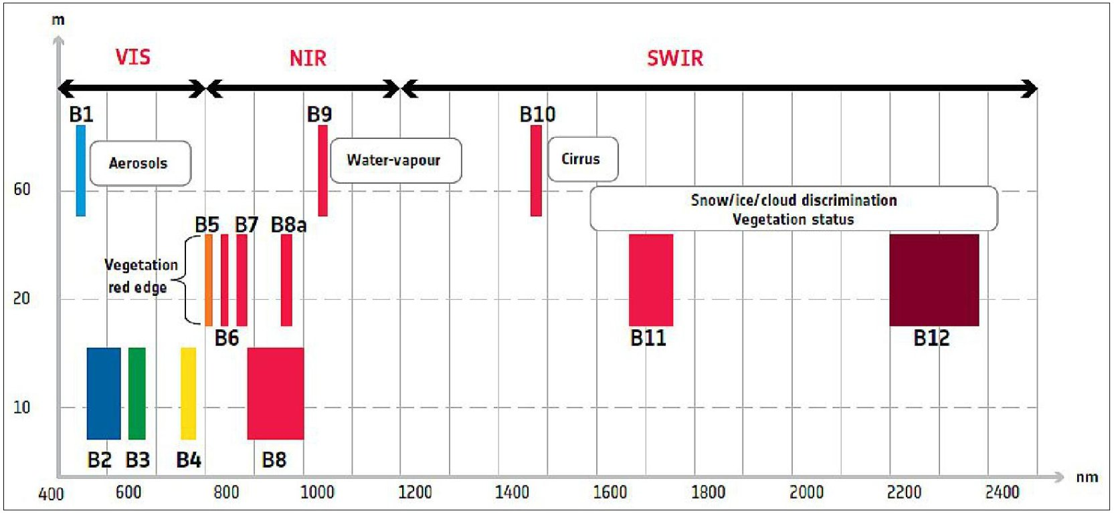
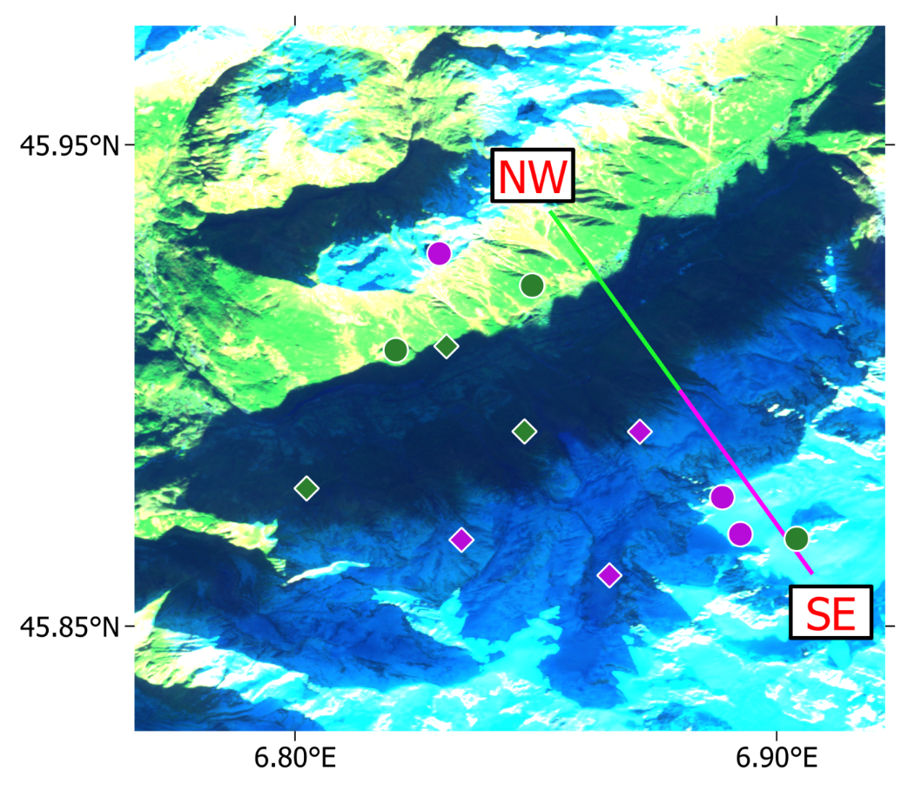
Impact of Spectral Reflectivity in Shadow Zones
S2 MSI, 25/11/2020, RGB channels 11/8/4
Sentinel-2 MSI channels
Accounting for different spectral irradiance in shadow zones:
Multispectral Unmixing with Locally Adaptive Endmember Selection LAMSU (Keuris et al., 2023)
  Use all available spectral bands
  Local selection of Endmembers:
  - snow free, fully snow covered
  - extracted directly from the image,
  separately for illuminated & shaded areas
  Use various combinations of nearby end-members
  Estimation of uncertainty using error propagation

Slide 18
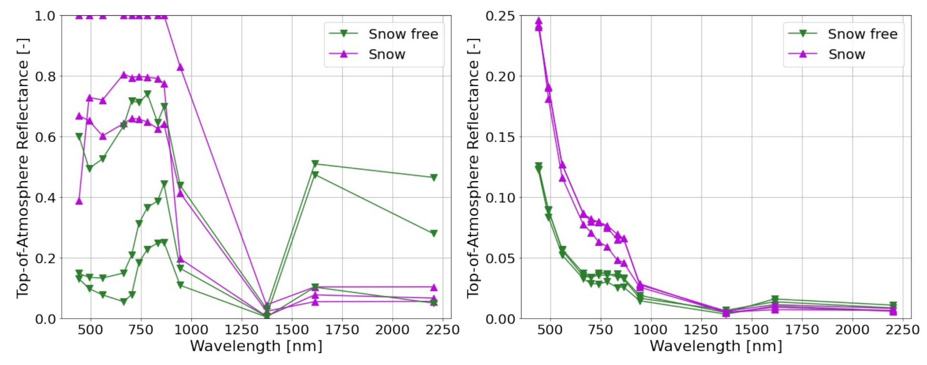
Spectral Reflectivity in Shadow Zones
Sentinel-2B MSI TOA reflectance values from the image of 25/11/2020. Left: reflectance of the well-illuminated spectra (round markers in the MSI image). Right: reflectance in the shadow zone (diamond markers).
Different scales of the y-axis.

Slide 19
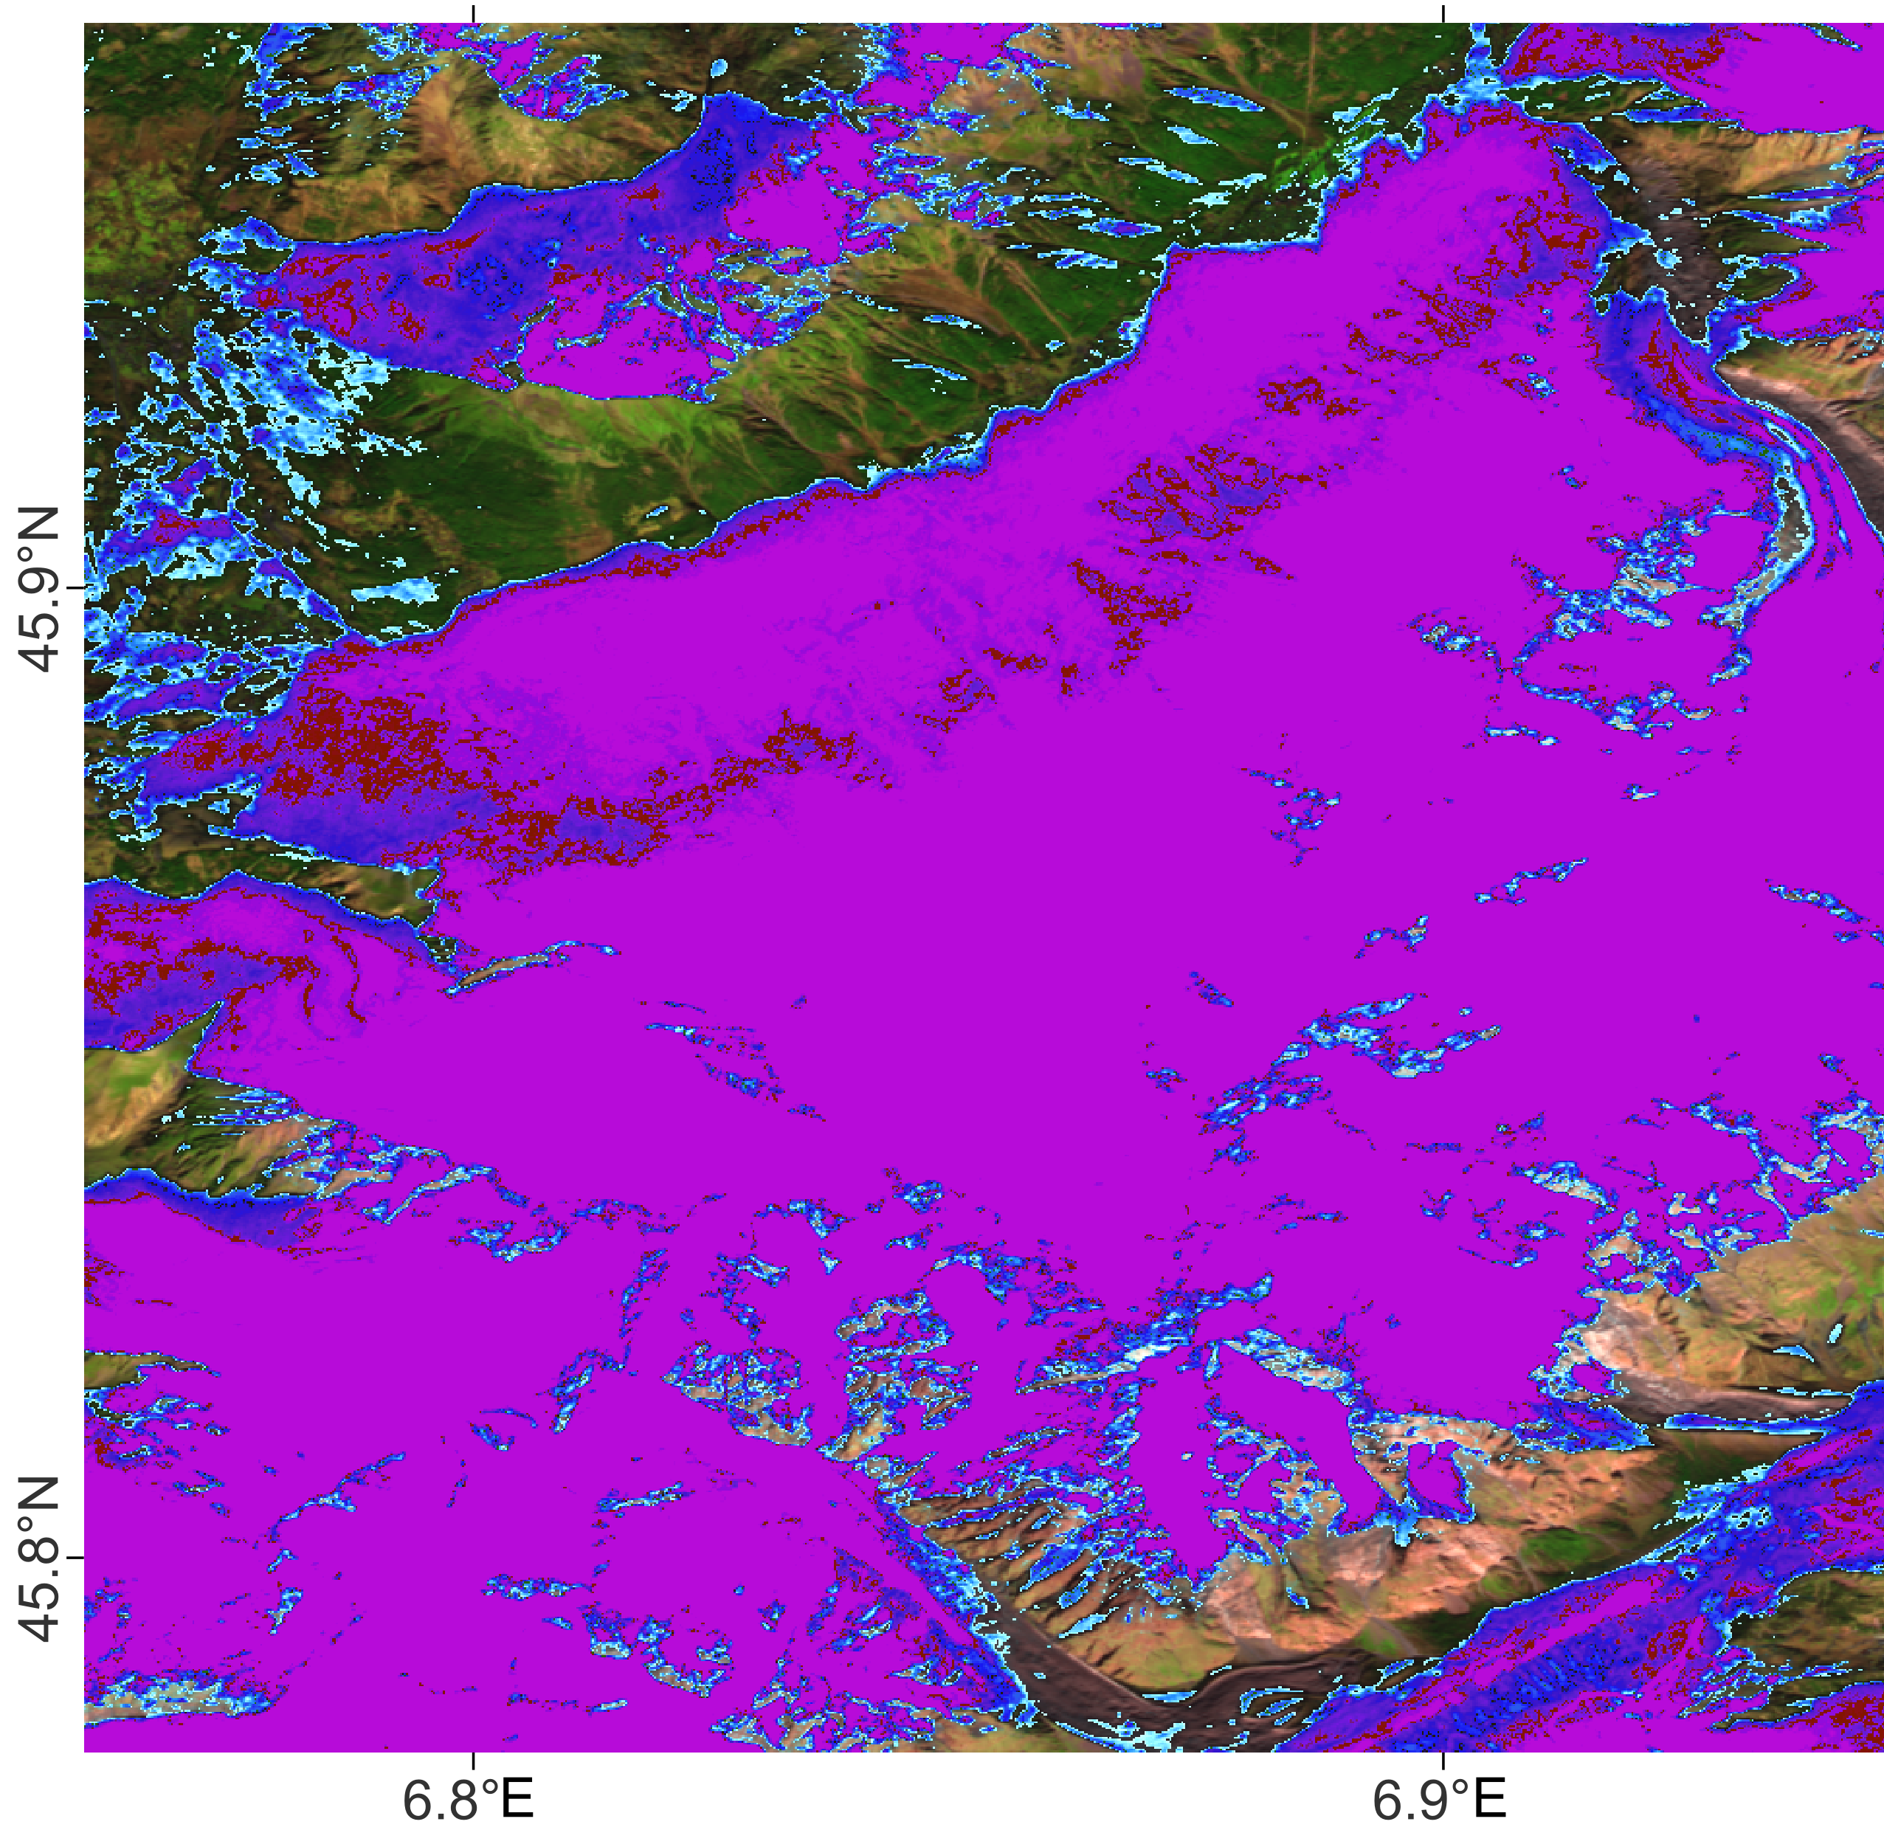
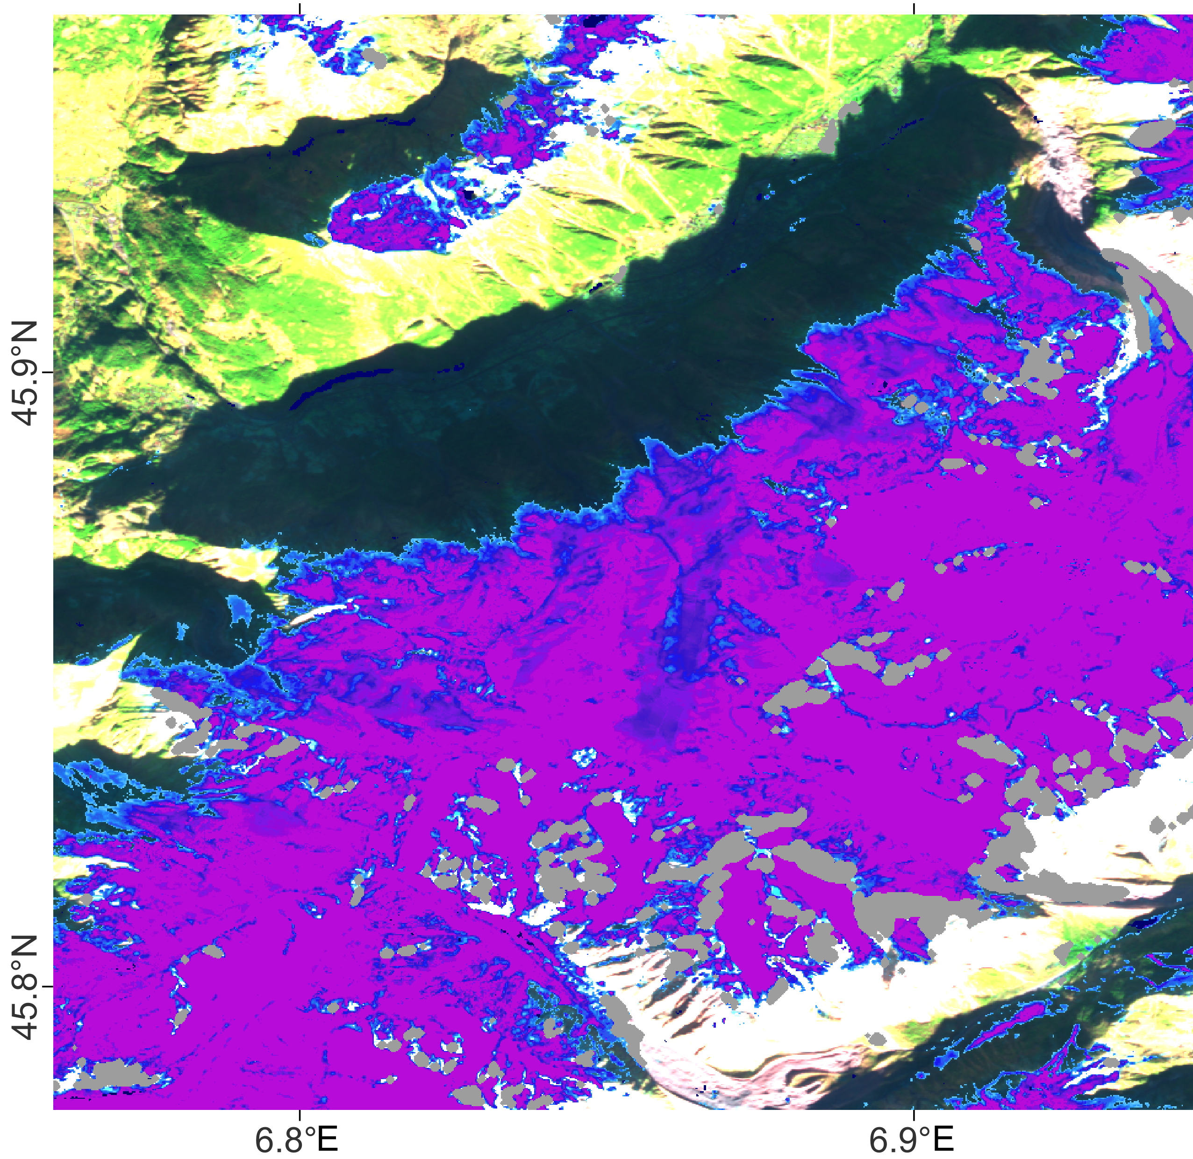
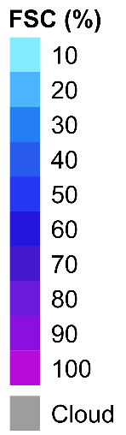

Accounting for Different Spectral Reflectivity in Shadow Zones
Fractional Snow Cover based on NDSI
FSC based on LAMSU (Keuris et al., 2023)
NDSI = $\frac{R_{VIS} −R_{SWIR}}{R_{VIS}+R_{SWIR}}$

Slide 20
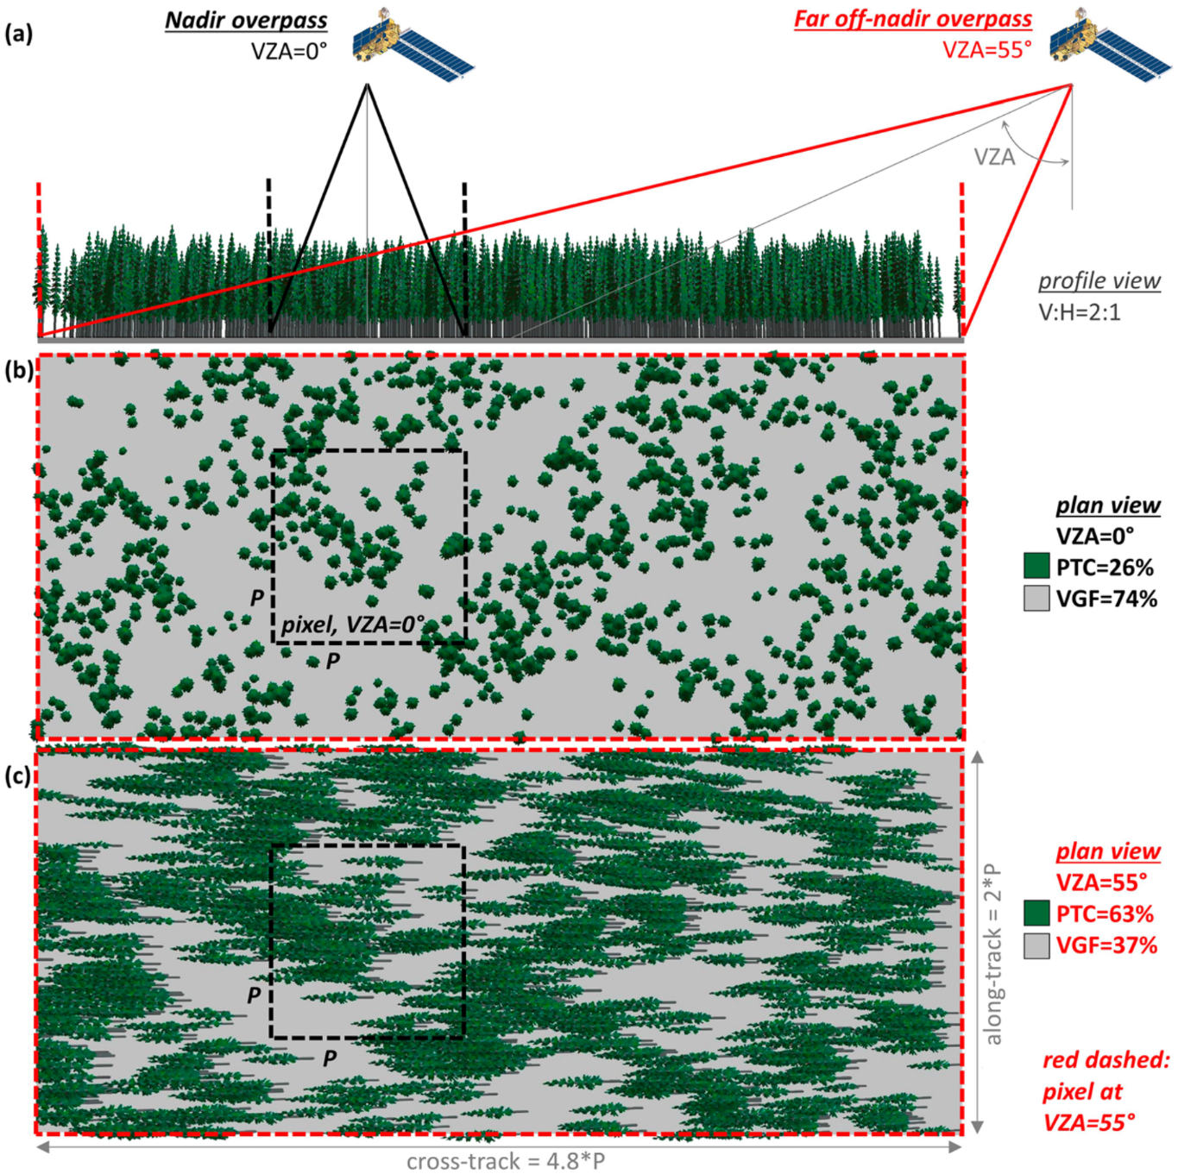
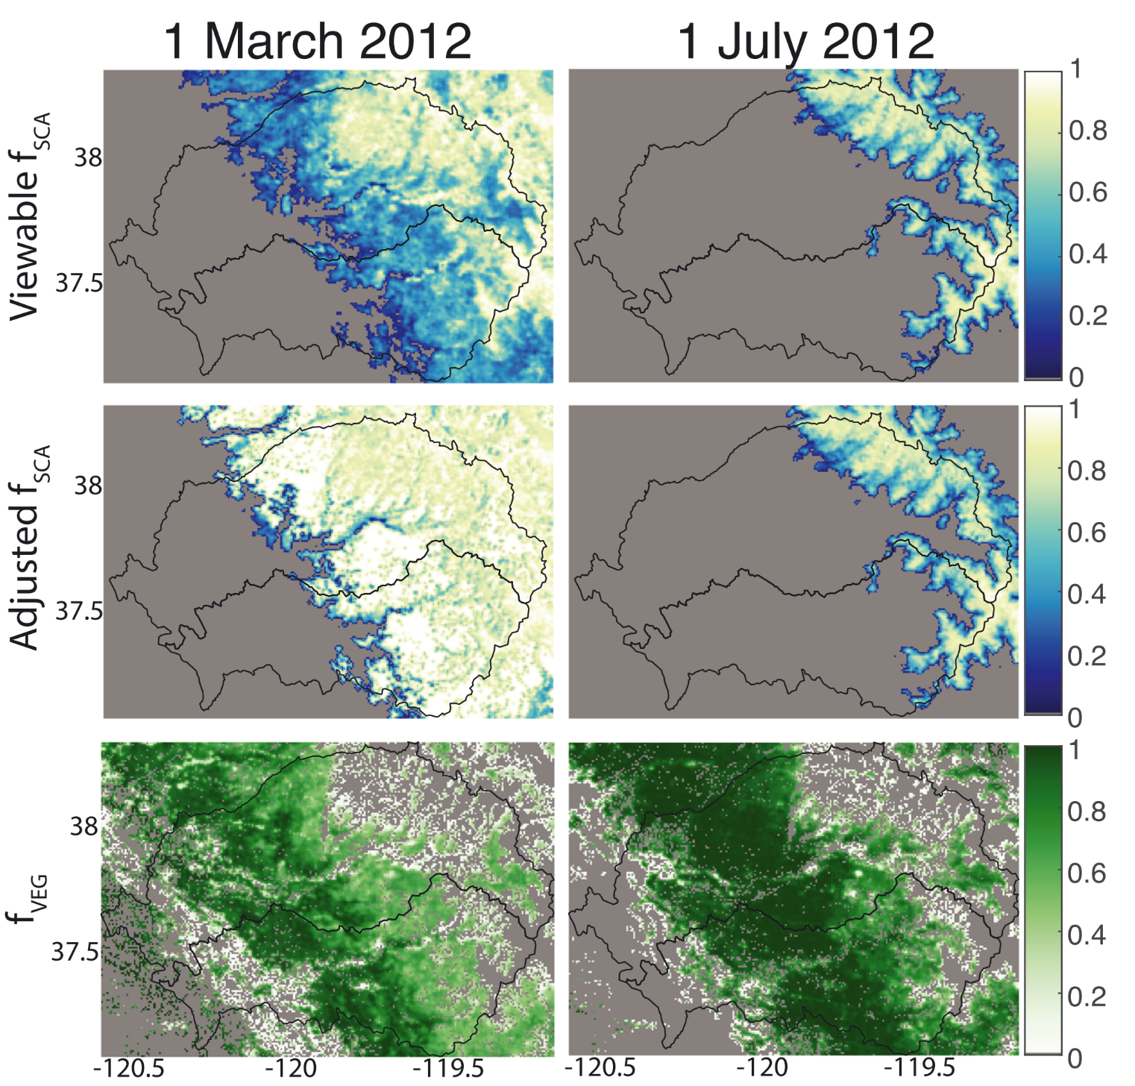
Impact of Canopy on Snow Cover Mapping
STC‐MODSCAG ⇒
viewable f_{SCA}
canopy adjusted f_{SCA}
vegetation fraction (f_{VEG})
f_{SCA} fractional snow cover
Rittger et al., 2020
Impact of viewing zenith angle (VZA) on visible gap fraction (VGF)
MODIS Snow Covered‐Area and Grain Size (MODSCAG) products provide fractional cover and snow grain size, applying multispectral unmixing based on multiple endmember spectral mixtures from a library of snow, vegetation, rock, and soil (Painter et al., 2009)

Slide 21
References
Chen, R., Yin, G., Zhao, W., Yan, K., Wu, S., Hao, D., Liu, G.: Topographic correction of optical remote sensing images of mountain areas. IEEE Geosc. Rem. Sens. Magazine, Vol. 11 (4), 125 – 145, 2023.
Chylek, P., Ramaswamy, V., Srivastava, V.: Albedo of soot-contaminated snow. J. Geophys. Res., Vol. 88, C15, 10827-10843, 1983.
Dozier, J., Painter, T.H.: Multispectral and hyperspectral remote sensing of Alpine snow properties. Annual Rev. Earth and Planetary Sciences, Vol. 32, 465-494, 2004.
Dozier, J., Nolin,A. W., Green, R. O., Painter, T. J: Interpretation of snow properties from imaging spectrometry. Rem Sens. Env., 113, 525 – 537, 2009.
Dumont, M., Brissaud, O., Picard, G., Schmitt, B-. Gallet, J.-c., Arnaud, Y.: High-accuracy measurements of snow Bidirectional Reflectance Distribution Function at visible and NIR wavelengths – comparison with modelling results. Atmos. Chem. Phys., 10, 2507–2520, 2010.
Keuris, L., Hetzenecker, M., Nagler, T., Mölg, N, Schwaizer, G.: An adaptive method for the estimation of snow-covered fraction with error propagation for applications from local to global scales. Remote Sensing, 15, 1231, https://doi.org/10.3390/rs15051231, 2023.
Nalli, R.N., Dang, C., Jung, A. et al.: Physically based thermal infrared snow/ice surface emissivity for fast radiative transfer models. Remote Sens. 15, 5509. https://doi.org/10.3390/rs15235509, 2023.
Oerlemans, J. : Glaciers and Climate Change. A.A. Balkema, Lisse, Abingdon, Exton, Tokyo, 2001.
Painter, T.H., Dozier, J.: Measurements of the hemispherical-directional reflectance of snow at fine spectral and angular resolution. J. Geophys. Res., 109(D18), D18115, (10.1029/2003JD004458.), 2004.

Slide 22
References
Painter, T. H., Rittger, K., McKenzie, C., Slaughter, P., Davis, R. E., Dozier, J.: Retrieval of subpixel snow covered area, grain size, and albedo from MODIS. Rem. Sens. Env., 113(4), 868–879. https://doi.org/10.1016/J.Rse.2009.01.001, 2009.
Painter, T.H., Seidel, F., Bryant, A.C., Skiles, S.M., Rittger, K.: Imaging spectroscopy of albedo and radiative forcing by light absorbing impurities in mountain snow. J. Geophys. Res. - Atmos. 118 (17), 9511–9523, 2013.
Rittger, K., Raleigh, M. S., Dozier, J., Hill, A. F., Lutz, J. A., Painter, T. H.: Canopy adjustment and improved cloud detection for remotely sensed snow cover mapping. Water Res. Research, 55, e2019WR024914. https://doi.org/10.1029/2019WR024914, 2020.
Sirguey, P., Mathieu, R., Arnaud, Y.: Subpixel monitoring of the seasonal snow cover with MODIS at 250 m spatial resolution in the Southern Alps of New Zealand: Methodology and accuracy assessment. Rem Sens. Env., 113, 160-181, 2009.
Vermote, E., Tanré, D., Deuzé, J. L., Herman, M., Morcrette, J. J.: Second simulation of the satellite signal in solar spectrum: An overview. IEEE Trans. Geoscience and Remote Sensing, 35, 675–686, 1997.
Warren, S. G., Wiscombe, W. J.: A model for the spectral albedo of snow: II/Snow containing Atmospheric Aerosols. J. Atmos. Sci., 37, 2734–2745, 1980.
Wiscombe, W. J., Warren, S. G.: A model for the spectral albedo of snow: I. Pure snow. J. Atmos. Sci., 37, 2712–2733, 1980.

