Slide 1



Assessment of War-caused Damage to Agricultural Fields Using
Satellite Data and Artificial Intelligence
Nataliia Kussul
University of Maryland, Department of Geographical Sciences
National Technical University of Ukraine ”Igor Sikorsky Kyiv Polytechnic Institute”, Department of Mathematical Modeling and Data Analysis
Space Research Institute NASU-SSAU, Department of Space Information Systems and Technologies

Slide 2
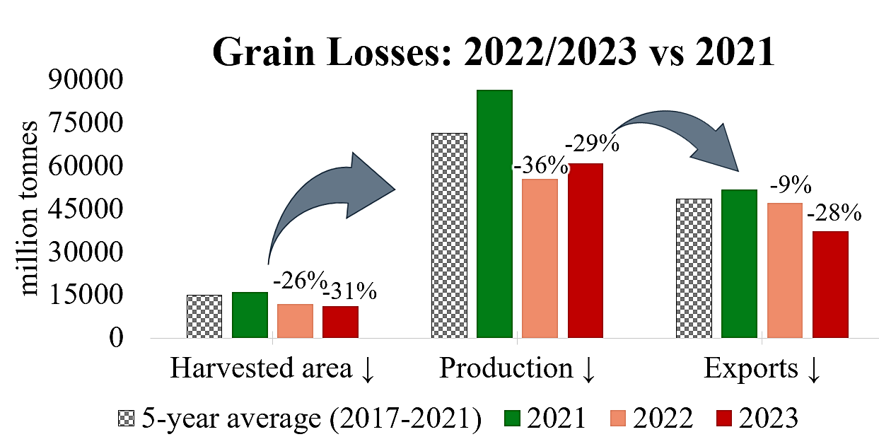
Motivation
War in Ukraine ̶ 1.5 mln ha of damaged croplands

Slide 3

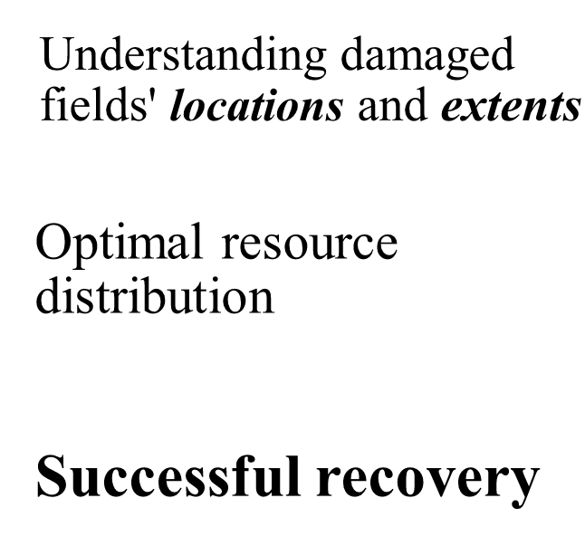



Motivation
International support
Restoring Agricultural Well-being

Slide 4
Problem statement
In Situ Field Inspections:
Time-consuming
Occupation Restrictions
Unexploded Ordnance Threat
People-intensive
Lack of Information Transparency
Remote sensing:
Quick observation of large areas
Access to occupied territories
Safety
Minimal personnel requirement
Data transparency

Slide 5
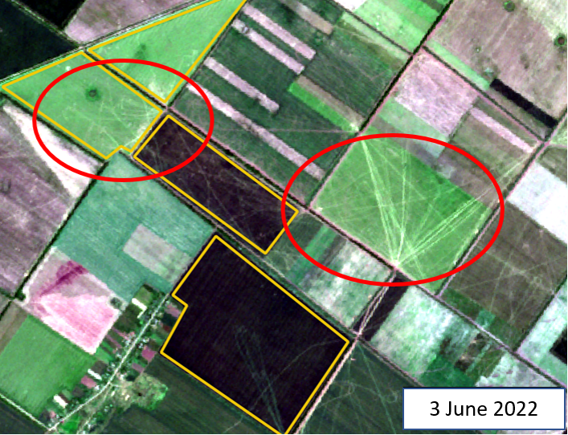
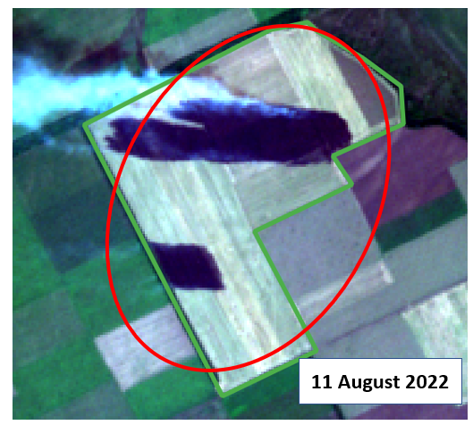
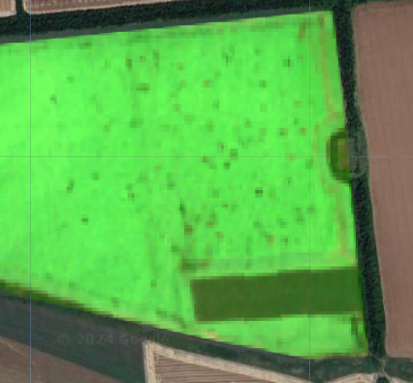
Potential of satellite data for damage detection
20 June 2022
Damage from military equipment,
Zaporizka region;
Burned crops,
Donetsk region
Craters,
Donetsk region

Slide 6



Data used and tools
Sentinel-2 images
Field delineation data (Sinergise)
https://acleddata.com/about-acled/

Slide 7
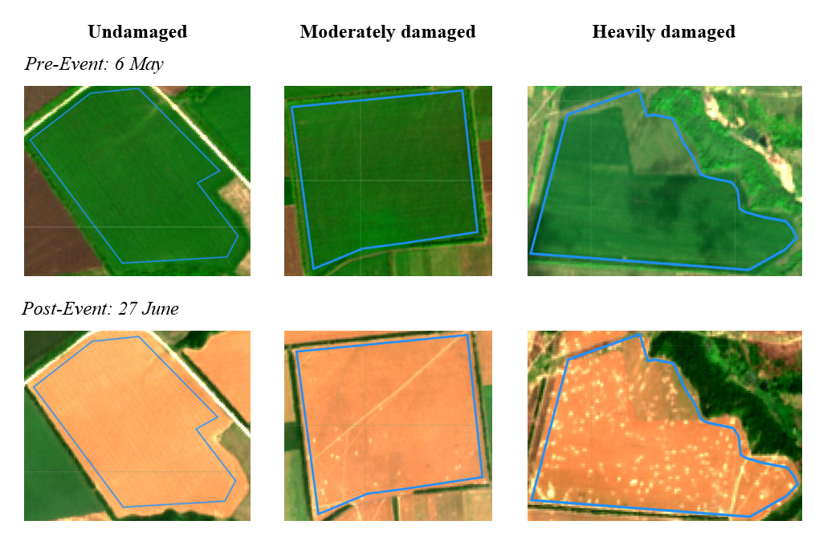
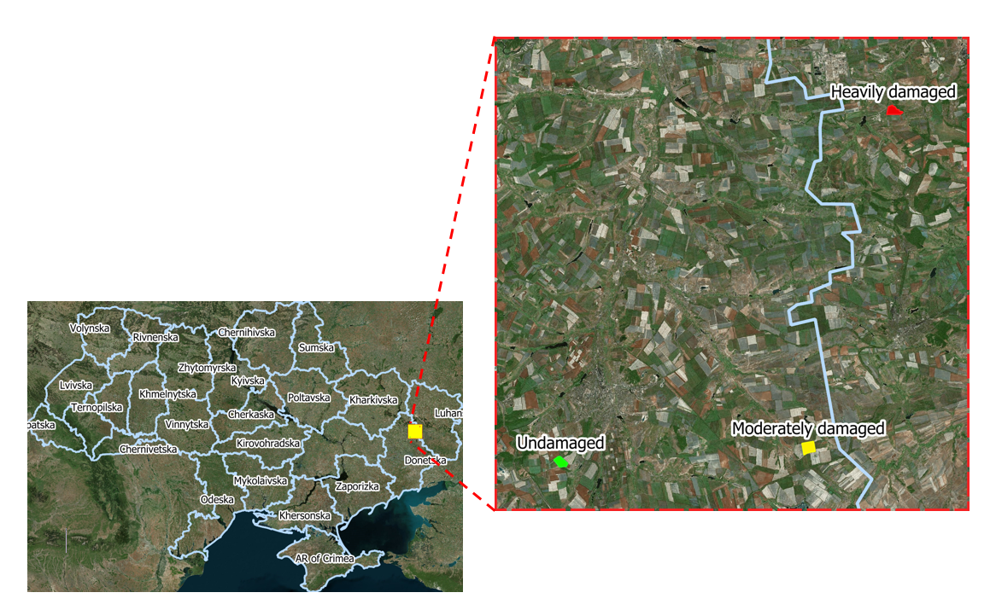
Determining the Most Informative Sentinel-2 Data for Damage Detection
3 test fields:
Same crop cover
Same vegetation level
Same region

Slide 8

Determination of the most informative bands

Slide 9
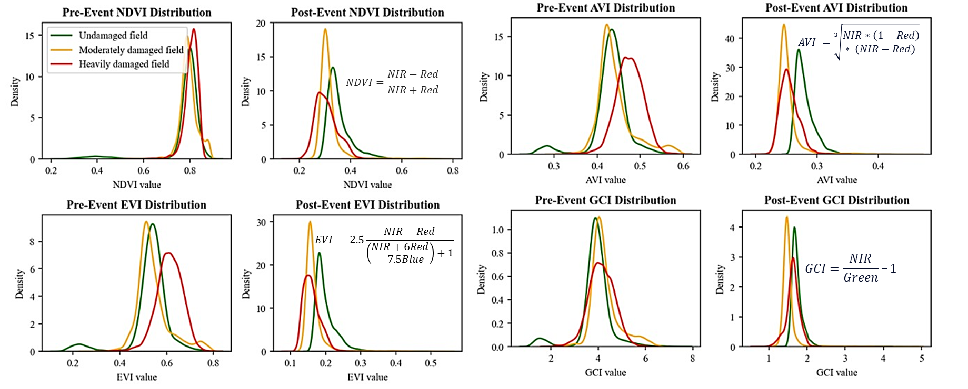
Determination of the most informative vegetation indices

Slide 10
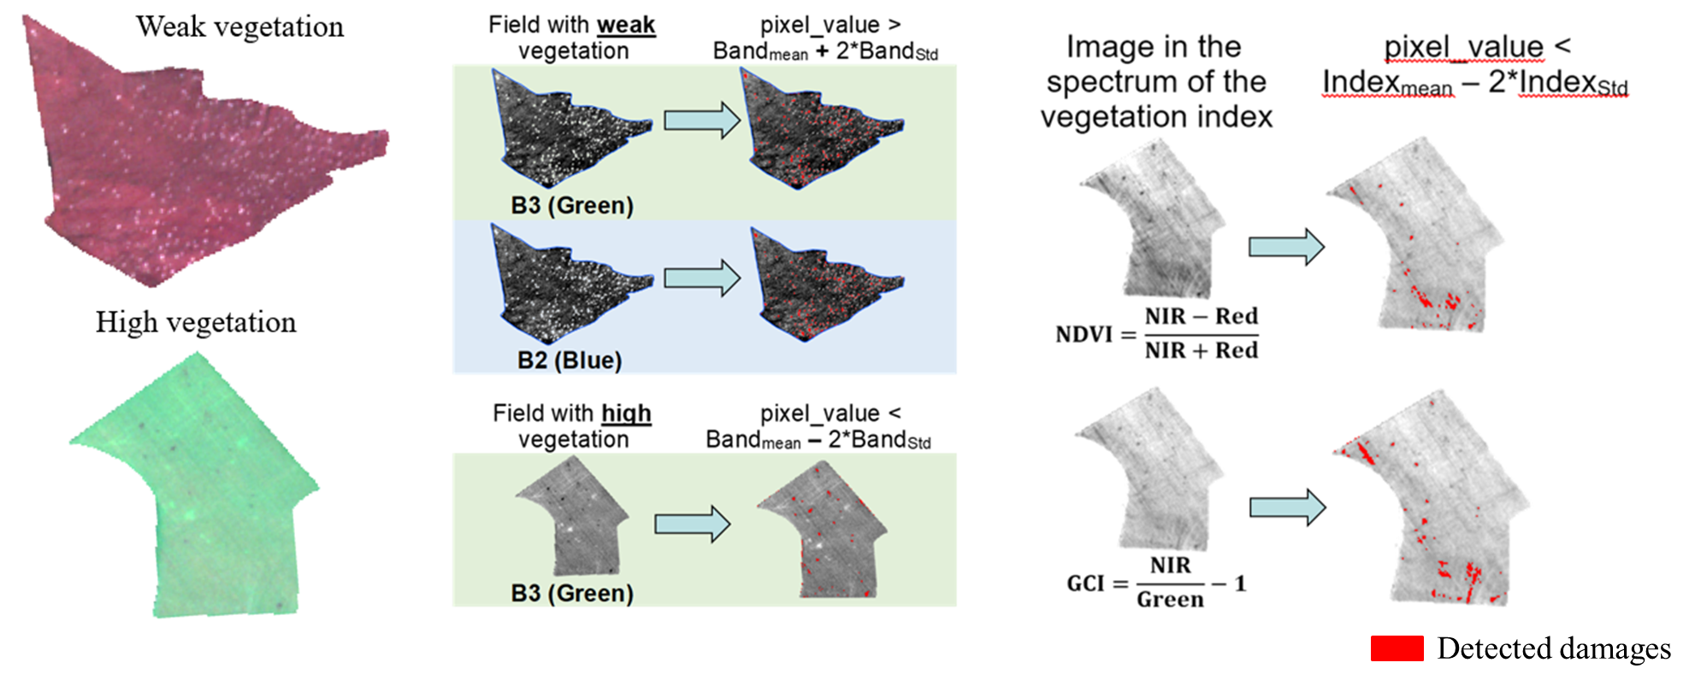
Damage detection the fields with different vegetation

Slide 11
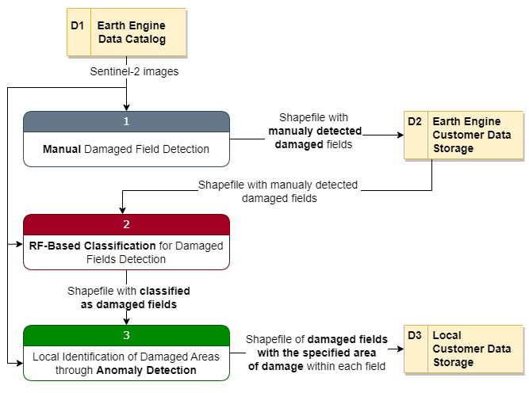
Proposed methodology
3 main steps:
Create train dataset of damaged fields with expert assistance.
Train and apply Random Forest classifier for binary classification (damaged vs. undamaged fields).
Detect local damage (craters, traces,…) using anomaly analysis.

Slide 12
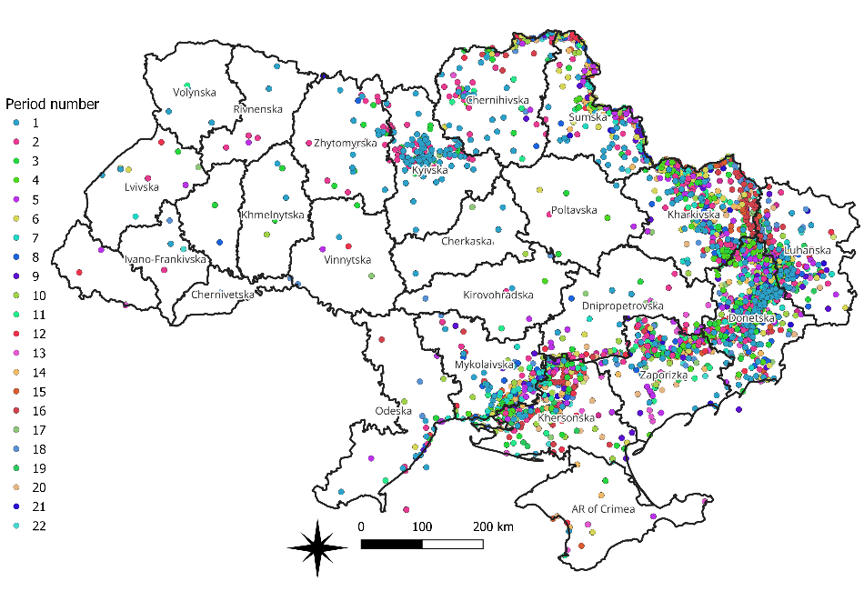
1. Creation of train dataset
3 experts:
monitoring the zone of active hostilities according to ACLED data every 2 weeks (period)
marking of damaged fields
agreement of the opinions of all 3 experts on each field

Slide 13
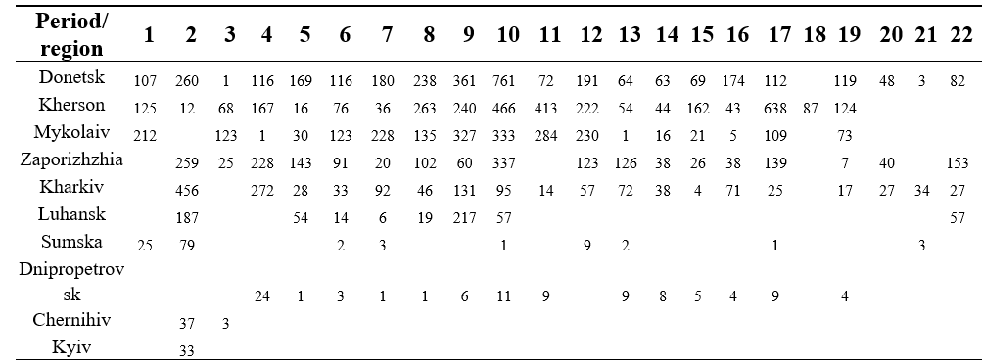
1. Creation of train dataset
Quantitative distribution of manually detected damaged fields by region and time period in Ukraine.

Slide 14
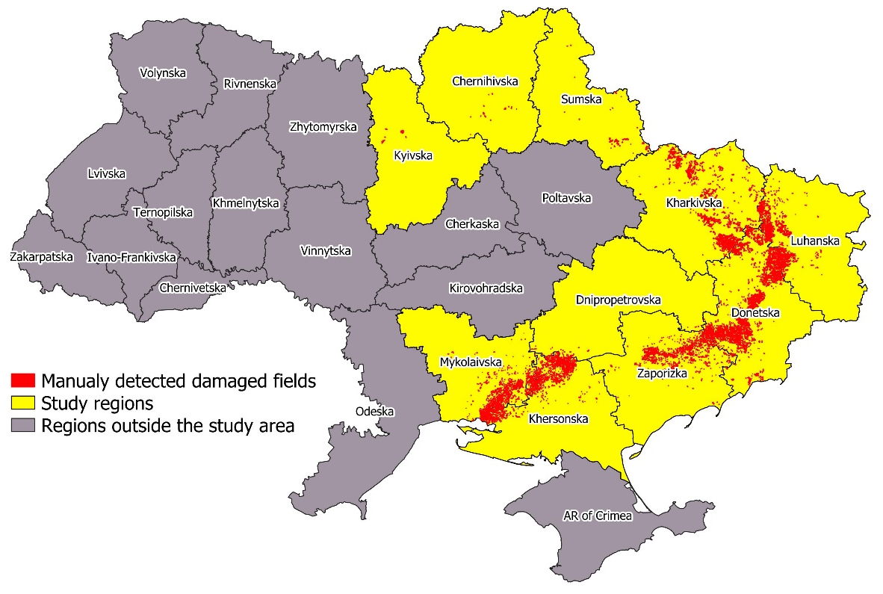
1. Creation of train dataset

Slide 15
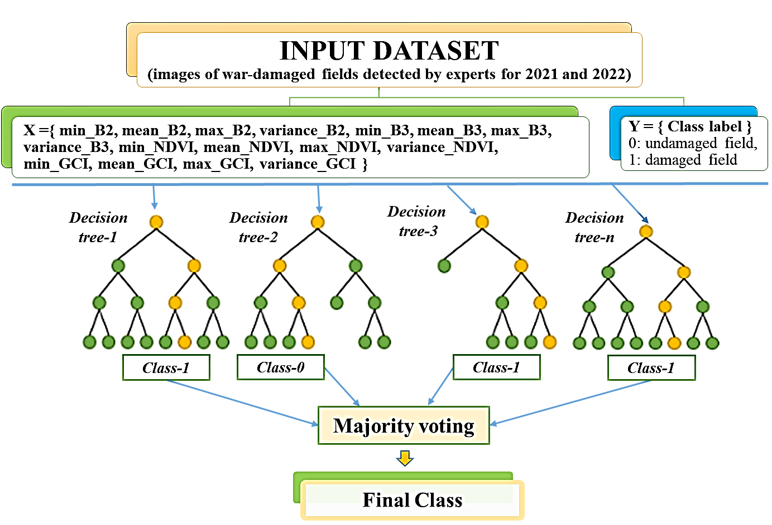
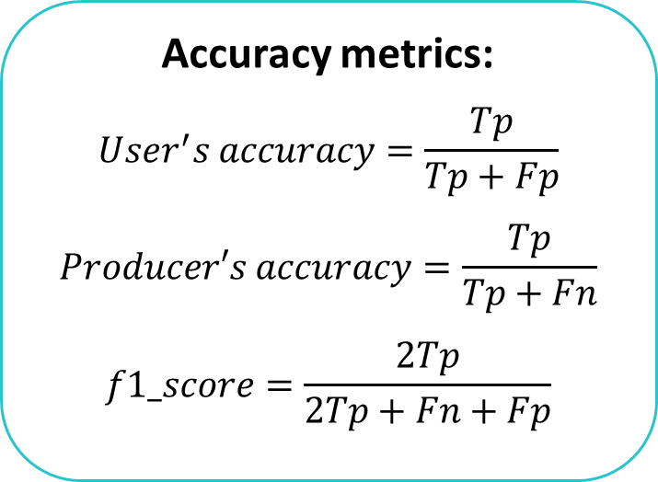
2. Classification
Random Forest Classifier Architecture
One model for each biweekly period
Accuracy metrics:
$${User}^{′}s accuracy=\frac{Tp}{Tp+Fp}$$
$$Producer′s accuracy=\frac{Tp}{Tp+Fn}$$
$$f1_score=\frac{2Tp}{2Tp+Fn+Fp}$$
5-fold cross validation

Slide 16
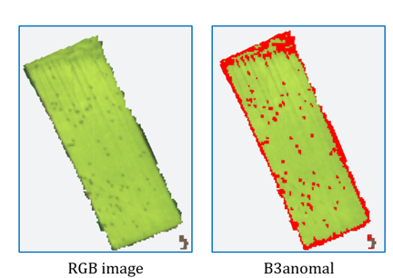
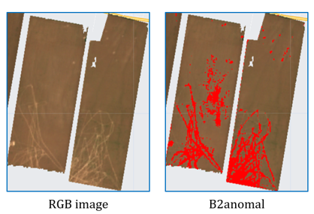
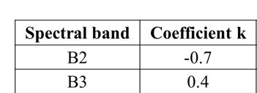
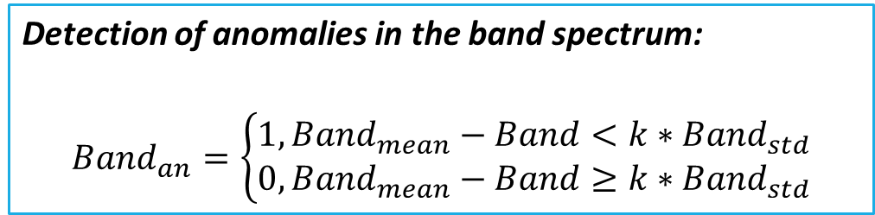
3. Local damage detection using spectral bands
Detection of anomalies in the band spectrum:
$$Band_{an}=\left\{\begin{aligned}1, Band_{mean}−Band<k∗Band_{std} \\ 0,Band_{mean}−Band≥k∗Band_{std}\end{aligned}\right.$$
Band– is the pixel values of specific band,
Band_{mean} – is the average value of all pixels of specific band within the field,
Band_{std} – represents the standard deviation of pixel values for a specific band within the field.
k – threshold coefficient (experimentally selected).

Slide 17
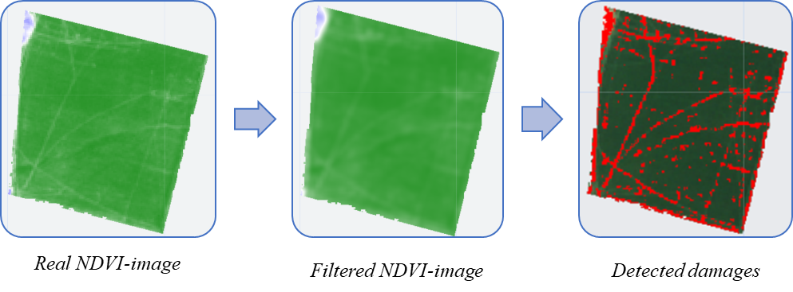
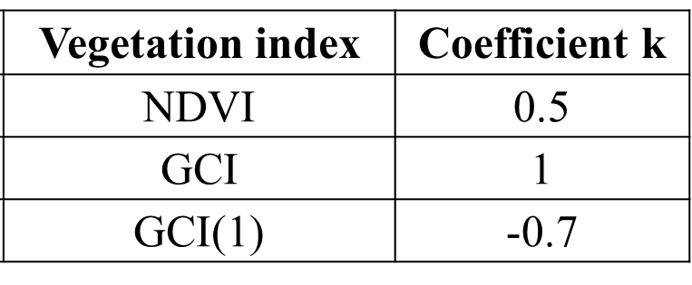
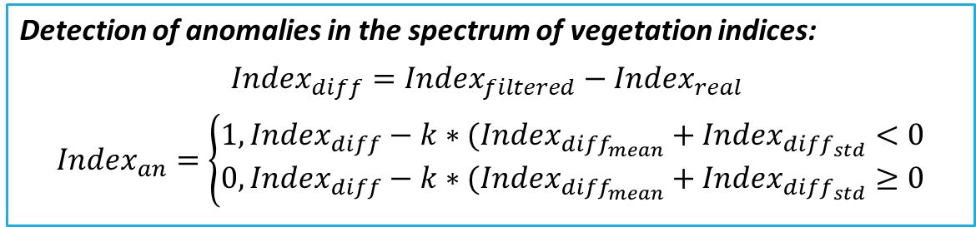
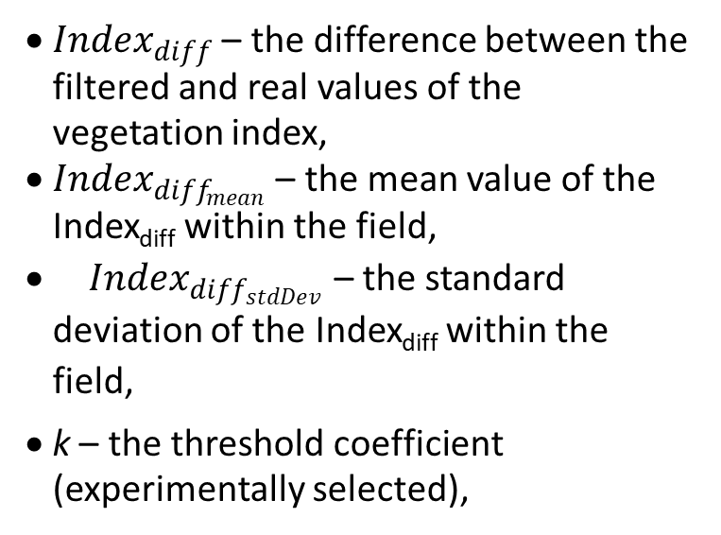
3. Local damage detection using vegetation indices
Detection of anomalies in the spectrum of vegetation indices:
$$Index_{diff}=Index_{filtered}−Index_{real}$$
$$Index_{an}=\left\{\begin{aligned}1, Index_{diff}−k∗(Index_{diff_{mean}}+Index_{diff_{std}}<0 \\ 0, Index_{diff}−k∗(Index_{diff_{mean}}+Index_{diff_{std}}≥0\end{aligned}\right.$$
${Index}_{diff}$ – the difference between the filtered and real values of the vegetation index,
${Index}_{diff_{mean}}$ – the mean value of the Index_{diff} within the field,
${Index}_{diff_{stdDev}}$ – the standard deviation of the Index_{diff} within the field,
k – the threshold coefficient (experimentally selected),
applying a 5x5 mean filter

Slide 18
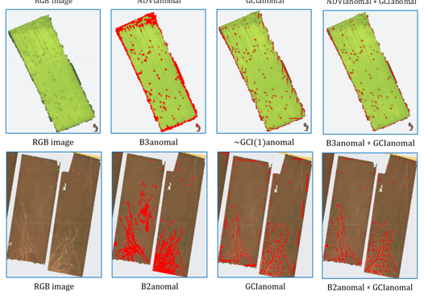
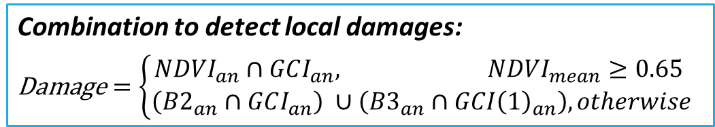
3. Local damage detection using combination of spectral bands and vegetation indices
Combination to detect local damages:
$$\text{Damage}=\left\{\begin{aligned}NDVI_{an}∩GCI_{an}, NDVI_{mean}≥0.65 \\ \left(B2_{an}∩GCI_{an}\right) ∪\left(B3_{an}∩GCI{\left(1\right)}_{an}\right), otherwise\end{aligned}\right.$$

Slide 19
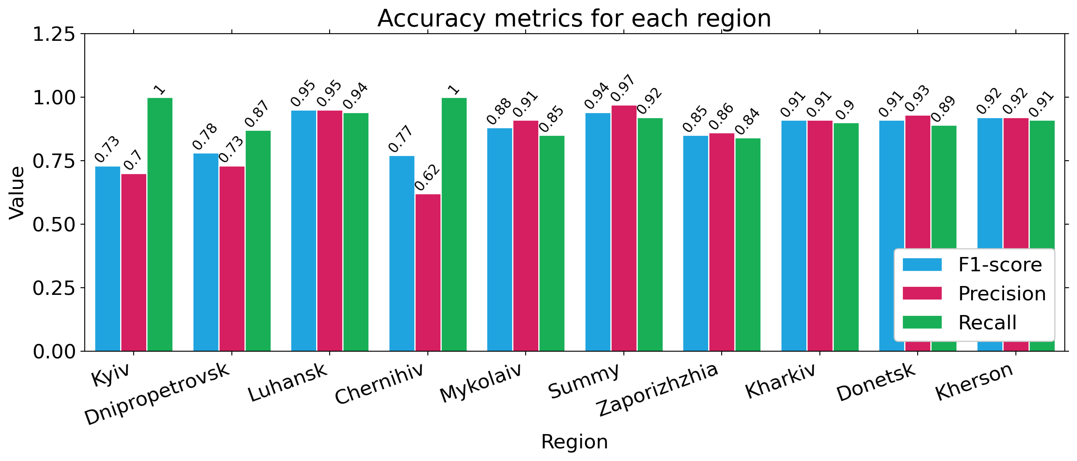
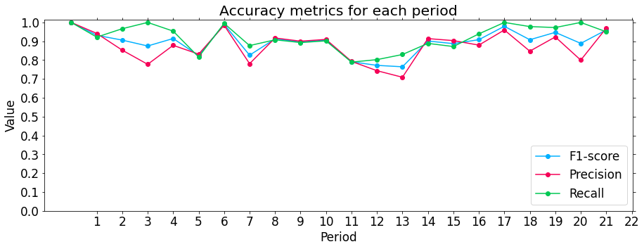
Results
Classification accuracy
___ Metric Class__ ___ | presicion | recall | f1-score | support
No damaged | 0.88 | 0.93 | 0.90 | 3812
Damaged | 0.92 | 0.87 | 0.90 | 3818
AVG/Total | 0.90 | 0.90 | 0.90 | 7630

Slide 20
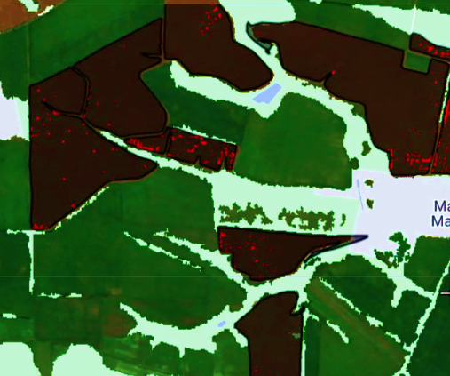
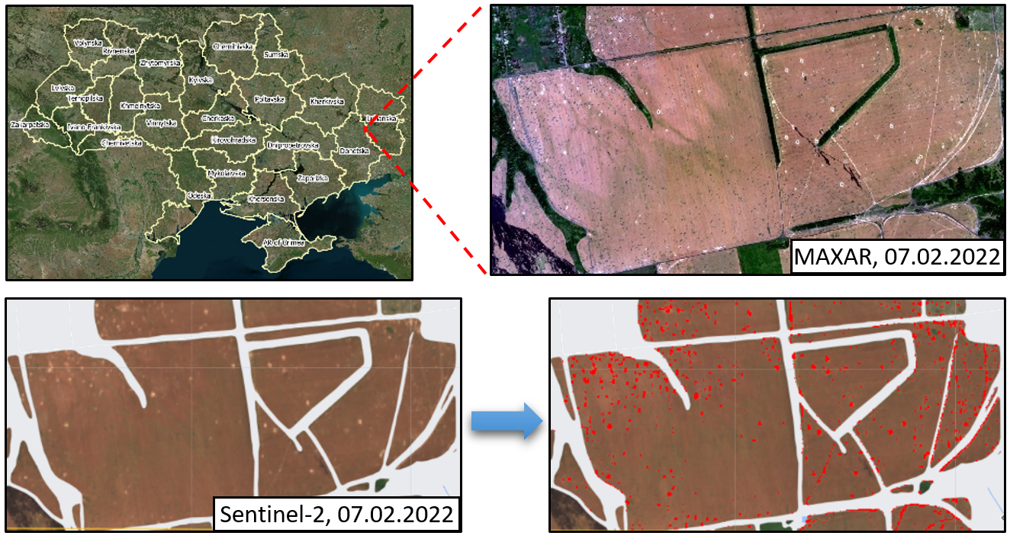
Results
Example of damage detection
Detected damaged fields
● Large craters are successfully detected
● Craters < 100m² (1 Sentinel-2 pixel) can be missed
Detected local damages

Slide 21
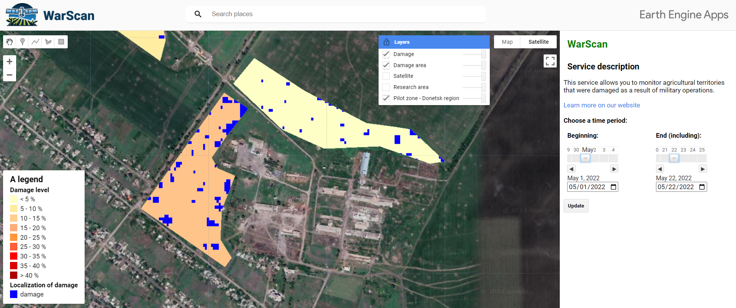

Google Earth Engine App to monitor damages
WarScan App:
Map of damaged fields
Map of local damages
Vector data: damaged areas and damage details
Link to App:
https://ee-warscan.projects.earthengine.app/view/warscan

Slide 22
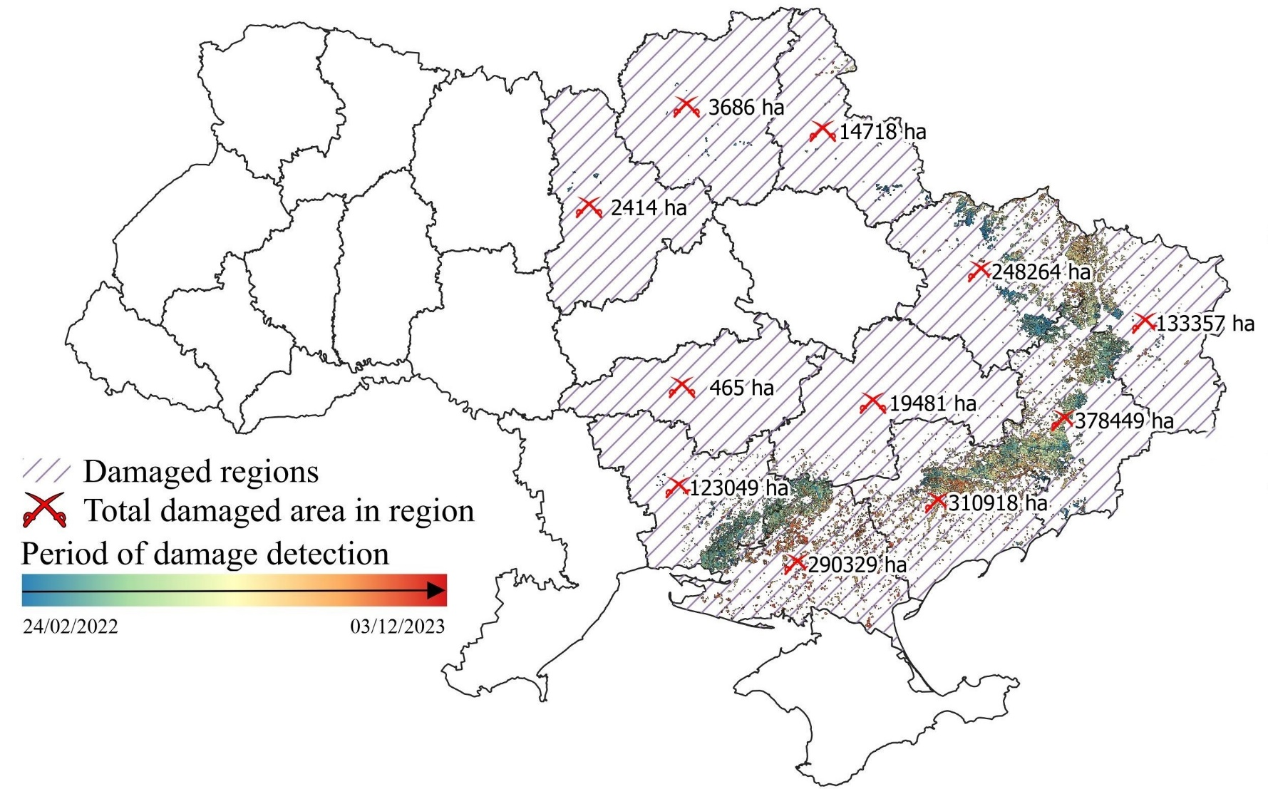
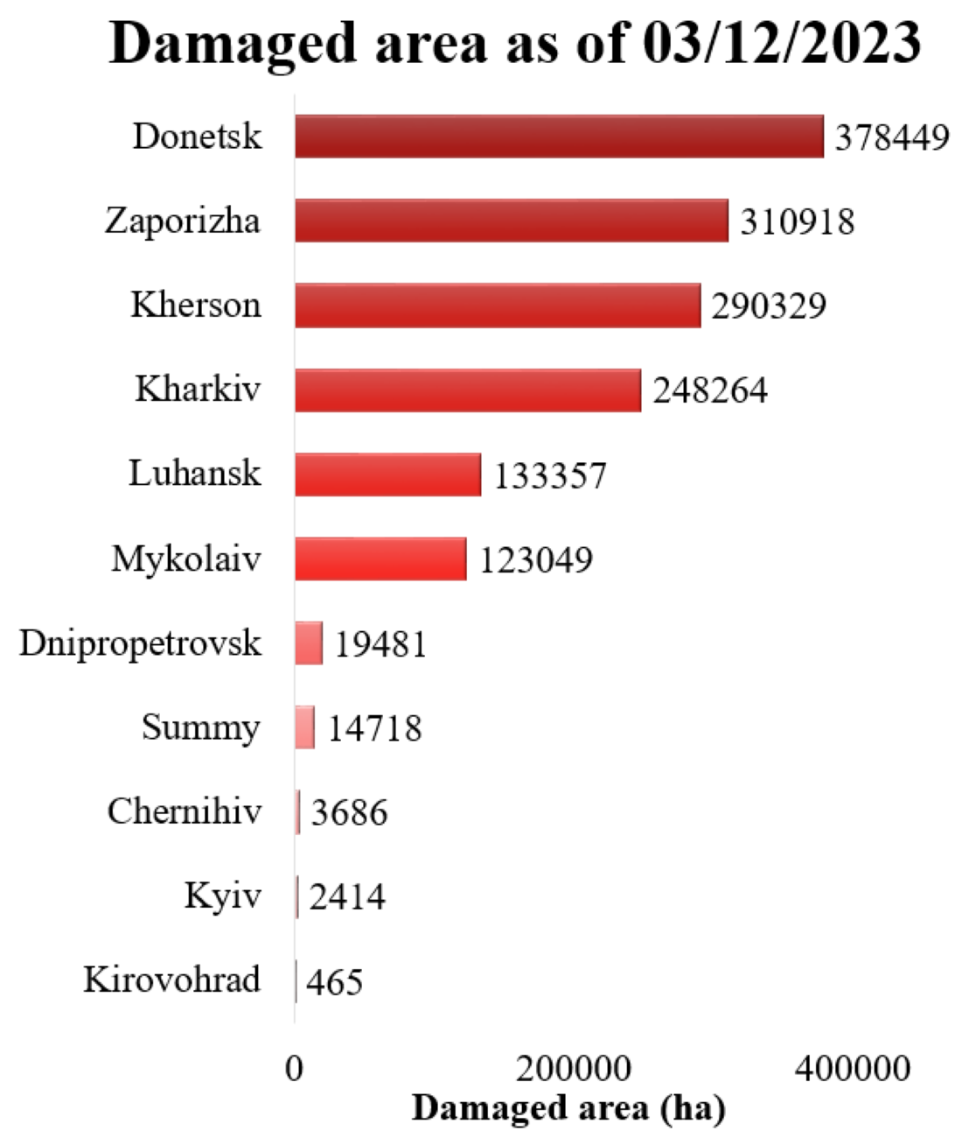
Results
Distribution of damaged areas by regions

Slide 23
To take home
Field damage assessment is feasible on Sentinel data (10 m)
Freely available data allow to monitor field damages on weekly/biweekly basis
There is room for method improvement (automatic adjustment of thresholds)

Slide 24
Thank you!
Nataliia Kussul
kussul@umd.edu

