Slide 1
Snow Cover Fraction Mapping from Optical Sensors
Carlo Marin, Eurac Research, Bolzano, Italy

Slide 2
Agenda
Introduction and Definition of Fractional Snow Cover Area
SoA methods for SCF detection
Spectral variability in real scenarios
Non-linear machine learning unmixing for complex mountains areas
Examples of real SCF detection in the Alps

Slide 3
Introduction: Snow Cover Fraction (SCF)
Snow cover area (SCA), snow cover (SC), and snow extent (SE) are interchangeable terms used to describe the total area covered by snow within a specific region. This measurement is expressed m².
Generally, when a specific area of interest is considered such as a hydrological catchment, it is more convenient to use the Snow Cover Fraction (SCF, FSC or fSCA) i.e., $SCF=\frac{A_{s}}{A_{S}+A_{SF}}$ [%].
SCF do not differentiate between the depth of snow cover.
Given the SCF it is not possible to reconstruct the correspondence snow map (except for trivial cases).
Image domain
Contour lines
Snow Area $A_{S}$
Catchment
Snow-free Area $A_{SF}$

Slide 4
Introduction: Snow Cover Fraction (SCF)
For digital images, $SCF={\# snow_pixels}/{\# total_pixels}$i.e., SCF depends on the spatial resolution.
The pixel resolution should adhere to the Nyquist-Shannon sampling theorem.
In general, a resolution of ~1m is enough to guarantee pure classes in the mountains*.
Freely available satellite missions often capture data at a spatial resolution >> 1 meter, leading to ambiguities (aliasing) in the computation of the SCF.
SCF should be estimated for each pixel.
Image domain
Image domain
Contour lines
Contour lines
Snow
Snow
Snow-free
Catchment
Snow-free
Catchment
*Selkowitz, D.J.; Forster, R.R.; Caldwell, M.K. Prevalence of Pure Versus Mixed Snow Cover Pixels across Spatial Resolutions in Alpine Environments. Remote Sens. 2014, 6, 12478-12508. https://doi.org/10.3390/rs61212478

Slide 5
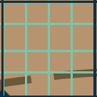
Introduction: Snow Cover Fraction (SCF)
$$SCF=100\%$$
REFERENCE
Image domain
reflectance
Contour lines
λ
$$SCF=50\%$$
reflectance
Catchment
SPECTRAL MIXING
λ
Snow-free
Snow
$$SCF=0\%$$
The observed spectral signature is the composition, or “mix”, of the individual “pure” spectra of snow and snow free.
There is a relationship between SCF and the observed radiance.
reflectance
λ
$SCF=\frac{A_{s}}{A_{S}+A_{SF}}$
$$SCF=\frac{\# snow_pixels}{\# total_pixels}$$
$SCF=f(R_{obs})$

Slide 6
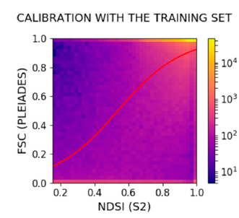
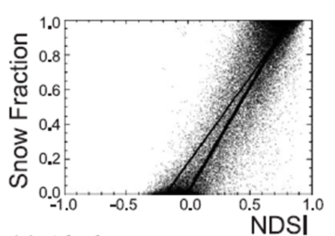
SoA: Unmixing methods for SCF detection
Regressions on the NDSI e.g., [1] [2]:
MODIS (500m):
$$SCF=a_{1}+b_{1}∙NDSI$$
“Final” approach: $SCF=1.45∙NDSI −0.01$
Sentinel-2 (20m):
$$SCF=0.5\tanh{(2.65∙NDSI−1.42)+0.5}$$
[1] Salomonson, Vincent V., and I. Appel. "Estimating fractional snow cover from MODIS using the normalized difference snow index." Remote sensing of environment 89.3 (2004): 351-360.
[2] Gascoin, S.; Barrou Dumont, Z.; Deschamps-Berger, C.; Marti, F.; Salgues, G.; López-Moreno, J.I.; Revuelto, J.; Michon, T.; Schattan, P.; Hagolle, O. Estimating Fractional Snow Cover in Open Terrain from Sentinel-2 Using the Normalized Difference Snow Index. Remote Sens. 2020, 12, 2904. https://doi.org/10.3390/rs12182904

Slide 7
SoA: Unmixing methods for SCF detection
Linear unmixing e.g., [1]
The hypothesis of linear mixture modeling is that:
The surface inside the cell is made up by a small number of distinct (independent) materials;
The different components inside the cell reflects the solar radiation in the same proportion of the area they cover.
We know all the “pure” components involved.
The “pure” and distinct components are called endmembers ($e$).
The fraction in which they appear in a mixed pixel is called abundance ($α$).
snow
Snow-free
$$e_{1}$$
$$e_{2}$$
$$α_{1}$$
reflectance
$$α_{2}$$
reflectance
reflectance
λ
λ
λ
[1] N. Keshava and J. F. Mustard, "Spectral unmixing," in IEEE Signal Processing Magazine, vol. 19, no. 1, pp. 44-57, Jan. 2002, doi: 10.1109/79.974727.

Slide 8
SoA: Unmixing methods for SCF detection
Observed reflectance [Mx1]
Number of endmembers
$$Y=\sum_{i=1}^{N}{α_{i}}e_{i}+n=Ea+n$$
Subject to:
$0{≤α}_{i}≤1$ and $\sum_{i=1}^{N}{α_{i}}=1$
When there are more bands M than endmembers N and $E$ is full rank the unconstrained solution can be computed by solving the normal equation i.e., (neglecting$n$):
$${\tilde{a}}^{U}={(E}^{T}{E)}^{−1}E^{T}Y$$
The solution of the unconstrained problem minimizes ${\left\|Y−E{\tilde{a}}^{U}\right\|}^{2}$ i.e., a least squares solution.
We can force that ${\tilde{a}}^{U}$fulfill the full additivity condition using the Lagrange multipliers method constrained to the condition $1^{T}a=1$ however, the non negativity is difficult to be addressed in closed form.
$\tilde{a}$is generally estimated solving the following quadratic optimization problem:
$\tilde{a}=\underset{a}{argmin}{\frac{1}{2}{\left\|Y−Ea\right\|}^{2}}$ subjected to: $1^{T}a=1, 0≤a≤1$
Additive noise [Mx1]
Abundance
Endmembers matrix [MxN]
$E^{+}:$(left) Pseudoinverse of $E$

Slide 9
Spectral Variability: Atmospheric effects
One of the main sources of spectral variability is atmospheric interference when measuring ground reflectance.
The light detected by the sensor can come from four sources:
solar radiation directly reflected off the ground;
light directly reflected off the atmosphere into the sensor;
light scattered by the atmosphere and reflected off the ground;
light reflected off surrounding regions on the ground and then scattered before reaching the sensor (adjacency effect).
These effects must be compensated to achieve an accurate characterization of surface reflectance.
Statistical or physical models are generally employed to perform the so-called atmospheric correction (e.g., L2A BoA products).
Bad specification of the model parameter, will produce large errors.
(2)
(3)
(4)
(1)
R. A. Borsoi et al., "Spectral Variability in Hyperspectral Data Unmixing: A comprehensive review," in IEEE Geoscience and Remote Sensing Magazine, vol. 9, no. 4, pp. 223-270, Dec. 2021, doi: 10.1109/MGRS.2021.3071158.

Slide 10
Spectral Variability: Illumination and Topography
Another main sources of spectral variability is the varying illumination conditions.
Illumination changes are mainly due to two effects:
varying terrain topography, which affects the angles of the incident radiation;
the occlusion of the light source by other objects (leading to shadow).
These effects must be compensated to achieve an accurate characterization of surface reflectance.
Statistical or physical models are generally employed to perform the so-called topographic correction (e.g., L2A BoA products).
Bad specification of the model parameter, will produce large errors.
N
terrain
R. A. Borsoi et al., "Spectral Variability in Hyperspectral Data Unmixing: A comprehensive review," in IEEE Geoscience and Remote Sensing Magazine, vol. 9, no. 4, pp. 223-270, Dec. 2021, doi: 10.1109/MGRS.2021.3071158.
Picard, G., Dumont, M., Lamare, M., Tuzet, F., Larue, F., Pirazzini, R., and Arnaud, L.: Spectral albedo measurements over snow-covered slopes: theory and slope effect corrections, The Cryosphere, 14, 1497–1517, https://doi.org/10.5194/tc-14-1497-2020, 2020.

Slide 11
Spectral Variability: Intrinsic Spectral Variability
Another important source of spectral variability is the intrinsic variation of the pure ground components.
From the previous lecture (Dr. Di Mauro) we know that sources of intrinsic spectral variations for snow may be:
Snow grain size variations;
Impurities such as algae, mineral dust, black/organic carbon;
Liquid water content variations;
The same is for the many possible different snow-free areas e.g., rock, soil, vegetation, etc.

Slide 12
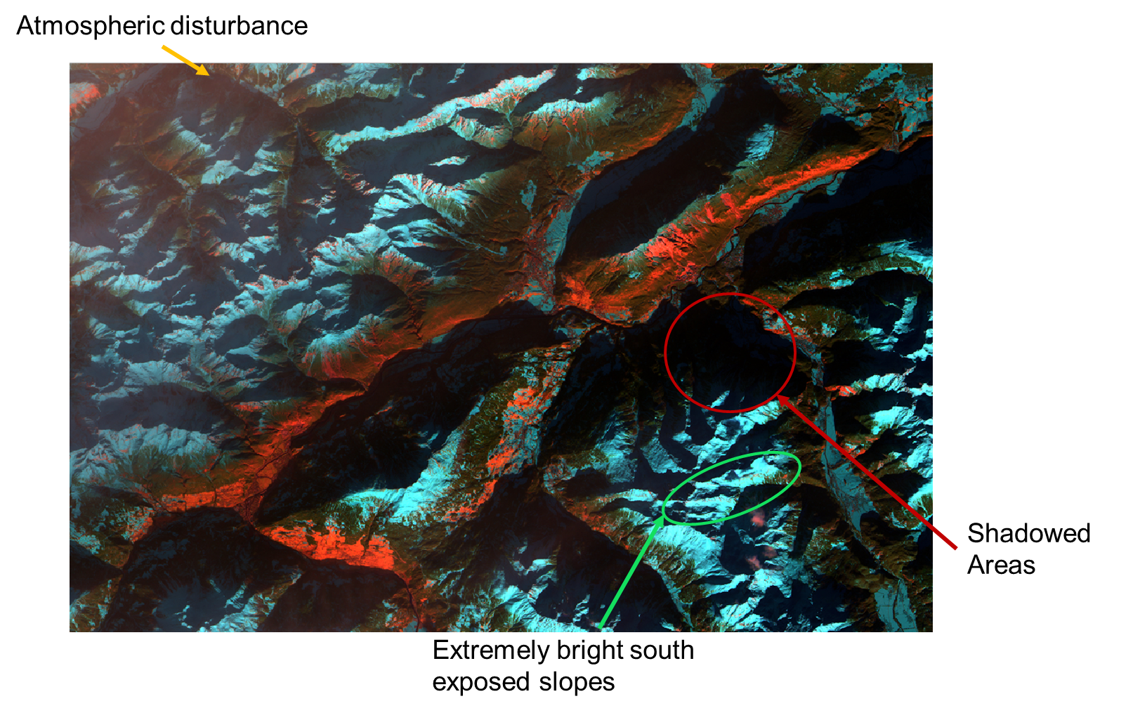
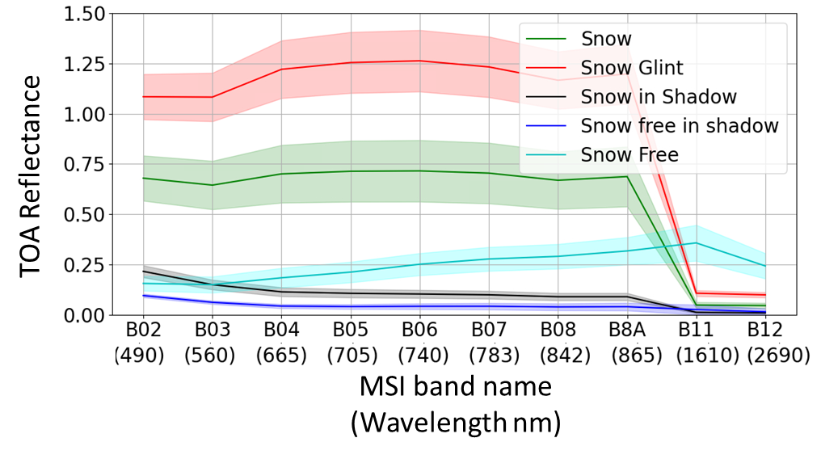
Spectral Variability
Sentinel-2 L1C 01/01/2021
Ambiguities on spectral signature (and NDSI)!
Atmospheric disturbance
Shadows
Snow glint on south exposed slopes

Slide 13
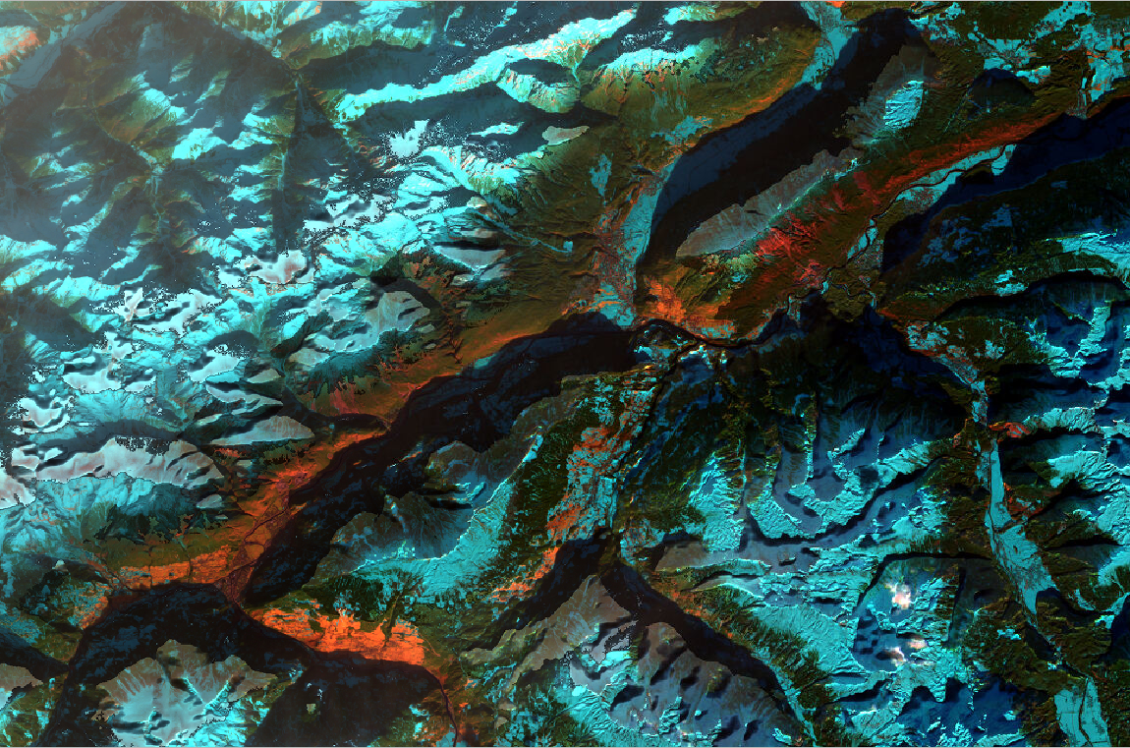
Spectral Variability
Sentinel-2 L1C 01/01/2021
Sentinel-2 L2A 01/01/2021
Atmospheric disturbance
Shadows
Snow glint on south exposed slopes
SoA method for SCF retrieval fail in challenging winter conditions of illumination and atmospheric disturbance

Slide 14
ML Unmixing – Problem Formulation
100% SNOW
Unknown
PROBLEM FORMULATION
Find the decision rule i.e., how to divide 100% snow samples (blue dots) from 100% snow free samples (red dots) using only straight lines.
0% SNOW
$$\overline{w}$$
Feature j
The straight lines define a “street” between the two classes;
We want to maximize the width of the street;
Let us define a vector $\overline{w}$ perpendicular to the “street” with unknow length.
Let call $\overline{u}$ the vector pointing to the unknown sample we want to classify.
100% SCF
$$\overline{u}$$
0% SCF
Decision rule: $\overline{w}∙\overline{u}>c$ then snow
Feature i

Slide 15
ML Unmixing – Pure and Mixed samples
Decision rule: $\overline{w}∙\overline{u}≥c$ then snow
100% SNOW
MIXED PIXEL
Without loss of generality let assume $c=−b$ then:
$\overline{w}∙\overline{u}+b≥0$ then snow (Eq. 1)
Let us fix that the samples of snow have values greater than +1 and the sample of snow free have value less than -1 i.e.,
$\overline{w}∙{\overline{x}}_{snow}+b≥+1$
$\overline{w}∙{\overline{x}}_{snowfree}+b≤−1$
Let us introduce the variable $y_{i}=+1$ if snow samples and $y_{i}=−1$ otherwise.
If we consider the i^{th} sample ${\overline{x}}_{i}$ we can rewrite a general expression of the decision rule as follows:
$$y_{i}\left(\overline{w}∙{\overline{x}}_{i}+b\right)≥+1$$
$⇒y_{i}\left(\overline{w}∙{\overline{x}}_{i}+b\right)−1=0$ on the edge (Eq. 2)
0% SNOW
$$\overline{w}$$
Feature j
$$\overline{u}$$
WIDTH
100% SCF
0% SCF
Feature i

Slide 16
ML Unmixing – Maximization of class distance
100% SNOW
MIXED PIXEL
WIDTH = $\left({\overline{x}}_{snow}−{\overline{x}}_{snowfree}\right)\frac{\overline{w}}{\left\|\overline{w}\right\|}$
By using eq (2):
WIDTH = $\frac{2}{\left\|\overline{w}\right\|}$
Our initial goal was to max the width i.e.,
$$\max_{}{\frac{2}{\left\|\overline{w}\right\|}}=\max_{}{\frac{1}{\left\|\overline{w}\right\|}=\min_{}\left\|\overline{w}\right\|=\min_{}{\frac{1}{2}{\left\|\overline{w}\right\|}^{2}}}$$
Constrained to
$$y_{i}\left(\overline{w}∙\overline{x_{i}}+b\right)−1=0$$
0% SNOW
Feature j
$${\overline{x}}_{snow}$$
$${\overline{x}}_{snow}−{\overline{x}}_{snowfree}$$
100% SCF
$${\overline{x}}_{snowfree}$$
0% SCF
Feature i
Lagrangian Multipliers

Slide 17
ML Unmixing – Maximization of class distance
We can solve this problem with Lagrangian Multipliers, minimizing this function:
$L={\frac{1}{2}|\left|\overline{w}\right||}^{2}−\sum_{i=1}^{n}{α_{i}\left[y_{i}\left(\overline{w}∙\overline{x_{i}}+b\right)−1\right]}$
100% SNOW
MIXED PIXEL
Lagrange multiplier
0% SNOW
$$\overline{w}$$
$\frac{∂L}{∂\overline{w}}=\overline{w}$- $\sum_{i=1}^{n}{α_{i}y_{i}\overline{x_{i}}=0 ⇔ \overline{w}= }\sum_{i=1}^{n}{α_{i}y_{i}\overline{x_{i}} }$ (Eq. 4)
$\frac{∂L}{∂b}=$ $−\sum_{i=1}^{n}{α_{i}y_{i}=0 }$
By plug into L
$$L=\sum_{1}^{n}{α_{i}}−\frac{1}{2}\sum_{i=1}^{n}{\sum_{j=1}^{n}{α_{i}α_{j}y_{i}y_{j}\overline{x_{i}}\overline{x_{j}}}}$$
By developing the solution (Eq 4 into Eq 1), we obtain that the decision function is:
$$SCF∝ \sum_{i=1}^{n}{y_{i}}α_{i}\overline{x_{i}}\overline{x_{u}}+b$$
Feature j
$$\overline{u}$$
100% SCF
To be solved with
numerical methods!
0% SCF
Feature i

Slide 18
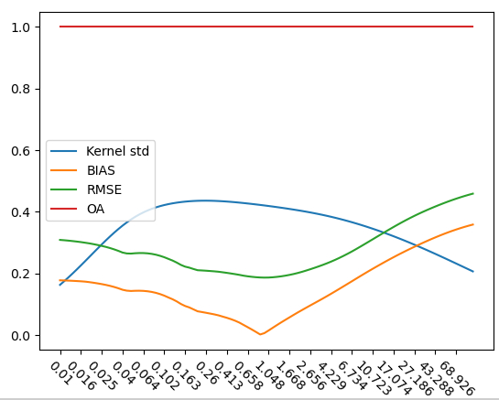
ML Unmixing procedure – Selection of 𝜸 and 𝜶𝒊
Snow
No Snow
RBF Kernel: $K\left(\overline{x_{i}},\overline{x_{j}}\right)=\exp\left(−γ{\left|\left|\overline{x_{i}}−\overline{x_{j}}\right|\right|}^{2}\right)$
KERNEL
TRICK
$$DF=\sum_{i=1}^{n}{y_{i}}α_{i}\exp\left(−γ{\left|\left|\overline{x_{i}}−\overline{x_{j}}\right|\right|}^{2}\right)+b$$
Model selection is performed in 2 steps:
Selection of the best $γ$ - The $γ$ associated to the maximum kernel standard deviation of the pure classes always falls close to the best $γ$ evaluated with the reference dataset
Estimation of b and 𝜶_{𝒊} - Solving the minimization problem
$L=$ ${\frac{1}{2}|\left|\overline{w}\right||}^{2}−\sum_{1}^{n}{α_{i}\left[y_{i}\left(\overline{w}∙\overline{x_{i}}+b\right)−1\right]}$
$$γ$$

Slide 19
ML Unmixing procedure – SCF estimation
SNOW
MIXED PIXEL
SNOW FREE
$$SCF=\left\{\begin{aligned}100 if DF≥1 \\ 50DF+50 if −1<DF<1 \\ 0 if DF≤−1\end{aligned}\right.$$
with
Feature j
100% SCF
$$\frac{2}{|\left|\overline{w}\right||}$$
$$DF=\sum_{i=1}^{n}{y_{i}}α_{i}\exp\left(−γ{\left|\left|\overline{x_{i}}−\overline{x_{u}}\right|\right|}^{2}\right)+b$$
0% SCF
Feature i

Slide 20
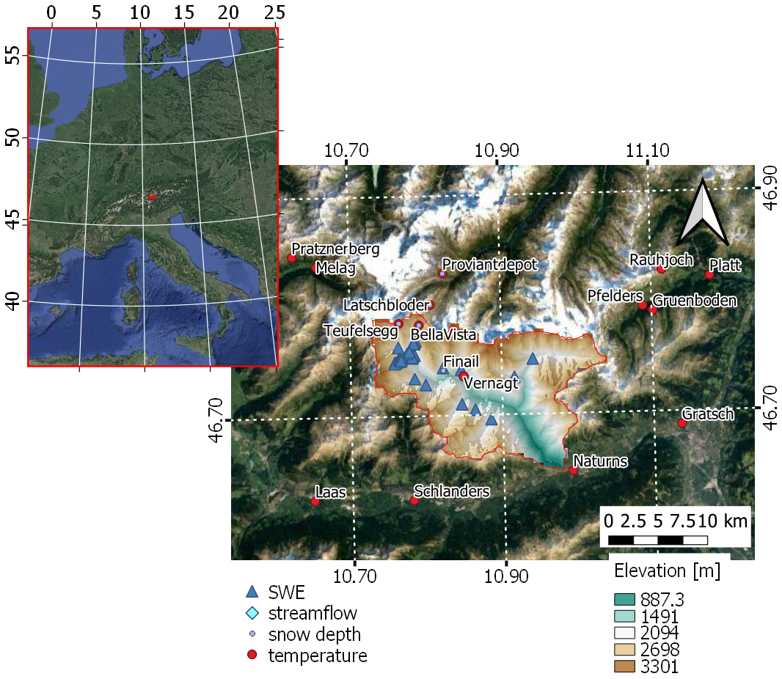
Results: Val Senales - Schnalstal

Slide 21
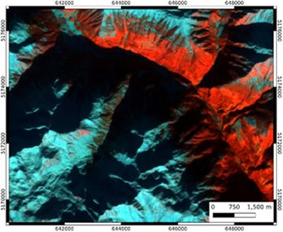
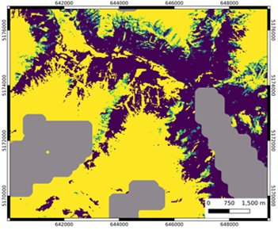
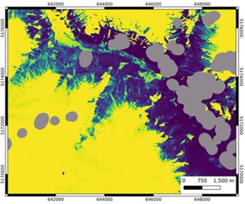
Results: Val Senales - Schnalstal
RGB FC
Copernicus snow product
SnowFLAKES

Slide 22
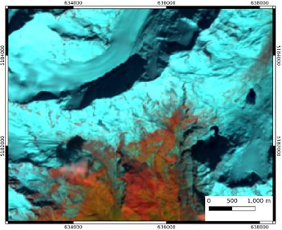
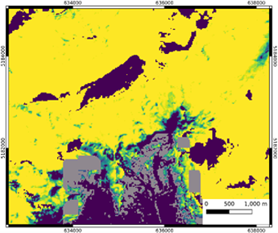
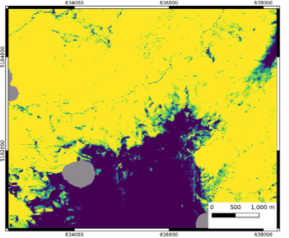
Results: Val Senales - Schnalstal
RGB FC
Copernicus snow product
SnowFLAKES

Slide 23
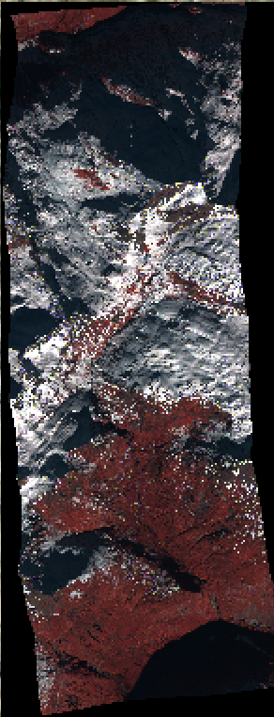
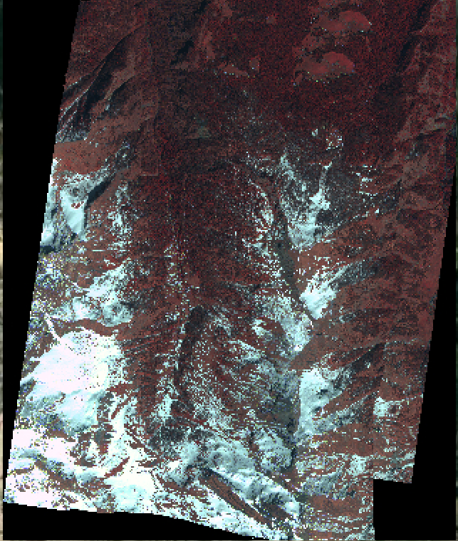
Results: Val Senales - Schnalstal
World View 3 – 1.2 m resolution
Davos, Swiss
11-01-2021
The VHR images were provided under the ESA TPM project: Validation of ESA Alpsnow snow cover fraction maps ID 69539.
Val d’Isère, France
25-11-2020
Valle d’Aosta, Italy
14-04-2021

Slide 24
Results: Isere (France)

