Slide 1
Glacier Motion
Synthetic Aperture Radar measurement techniques
John Peter Merryman Boncori
Technical University of Denmark

Slide 2
Activities
9:30-10:30: Lecture on SAR measurement techiniques
11:00-13:00: Glacier surface velocity exercise 1 (InSAR)
16:00-18:00: Glacier surface velocity exercise 2 (Offset tracking)

Slide 3
Spaceborne SAR sensitivity to ground motion
Notes:
Before focusing our attention on measurement techniques. Lets start with some general concepts related to SAR and ground motion.

Slide 4
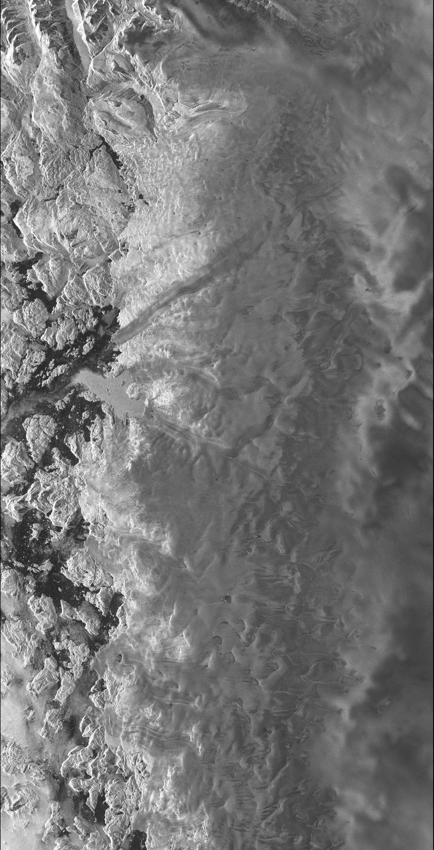
SAR sensitivity to motion: image amplitude
Upernavik Isstrøm, NW Greenland
ENVISAT ASAR, July 15th, 2010
Notes:
What elements of a SAR image provide sensitivity to motion? One of them is image amplitude. This is a SAR amplitude image of one of the Upernavik glaciers in north west Greenland, acquired by the ENVISAT ASAR sensor in July 2010. If we compare it to the image acquired on the next repeat cycle (35 days later) we might be able to see some areas moving.

Slide 5
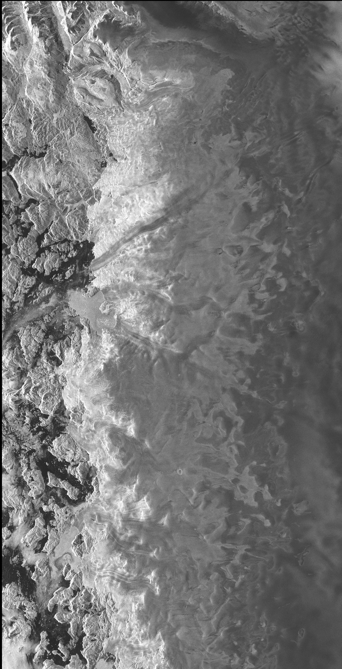
… 35 days later (ENVISAT repeat cycle)
ENVISAT ASAR, Aug. 19th, 2010
If you saw something moving, you have just carried out SAR ”feature tracking”!
Notes:
Did you see anything move? In which direction? Well if you have seen the main glacier tongue flow into the ocean towards the bottom-left, your brain has just carried out a processing algorithm called SAR feature tracking!

Slide 6
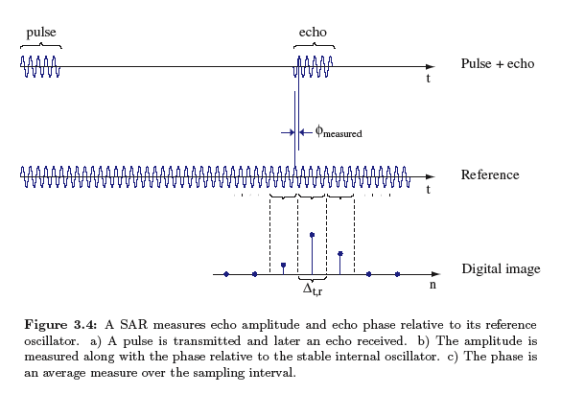
SAR sensitivity to motion: image phase
Flight path
pulse
echo
Slant-range delay
Satellite
τ
R₀
SAR wavelength (λ=c/f_{c})
Transmitted Pulse
Backscattered echo
Measured phase
f_{c}=carrier frequency
Azimuth
Stable oscillator reference
τ
Echo received from a target at slant-range R₀:
Beam footprint
Point on ground
Swath
Phase dependent on R₀:
Ground range
Notes:
However another measurement technique we will discuss today, SAR Interferometry, exploits image phase rather than image amplitude. Do do this, when the SAR transmits a pulse it maintains a phase reference which it compares with the phase of incoming echoes. The phase difference compared to the transmitted pulse is due its two-way propagation delay (from the radar to the ground and then back to the radar). Ideally this is just related to the one-way distance or slant-range R0 of the point on ground which was “hit” by the pulse. This provides a sensitivity to motion, since any change in the slant-range R0 between two acquisitions will also cause a change in the radar phase between the two images. This discussion is unfortunately oversimplified as we will see throughout the rest of the presentation. One simplification we can see already now, and concerns the fact that the phase we measure is only within the fundamental interval (0 and 360 degrees, or equivalently +/- pi radians).

Slide 7
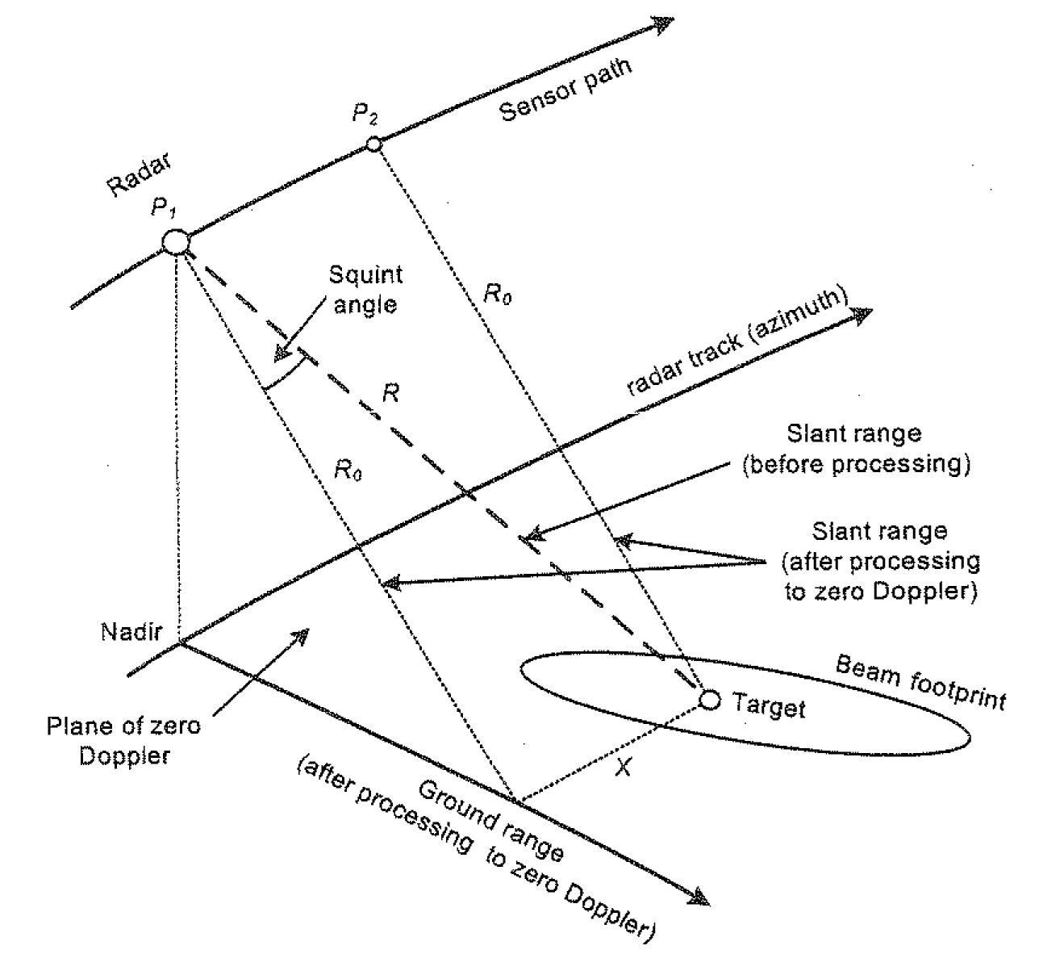
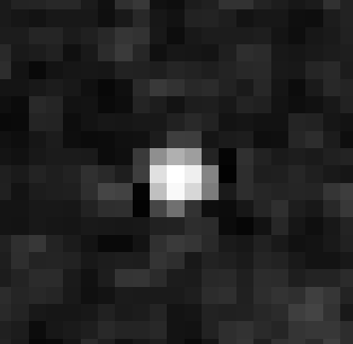
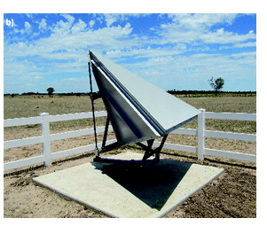



Zero-Doppler coordinates
In a SAR image focused “to zero-Doppler”, targets (objects/areas on ground) are located at their zero-Doppler coordinates (η₀,R₀)
zero-Doppler time
$$η_{0}$$
$$R_{0}$$
Range of closest approach
Azimuth
$$η_{0}$$
Slant-range
Notes:
Let’s start to get a little more quantitative. The focused images distributed by the European Space Agency, and by virtually all current SAR missions, are in so-called zero-Doppler geometry. This means that objects, such as the trihedral corner reflector shown in this slide, appear at their zero-Doppler coordinates eta0 and R0. R0 represents the range of closest approach between the radar (and more precisely the antenna phase centre of the radar) and a given point on ground. Eta0 represents the azimuth time at which the point on ground is located at the range of closest approach. Note that a range of closest approach always exists, even if the SAR antenna is not pointing perfectly orthogonally to its flight path, as in this slide, where it is slightly “squinted” forwards.

Slide 8
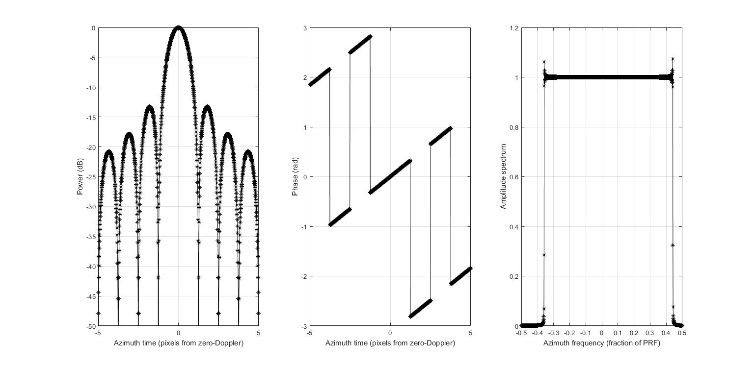
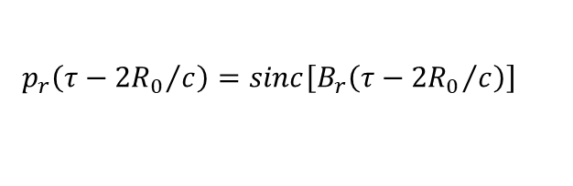



Point target amplitude and phase
In a focused SAR image a point target has the following signal:
In this course we neglect this term
$$s_{foc}^{}\left(τ,η\right)=p_{r}\left(τ−{{2R}_{0}}/c\right){∙p}_{a}\left(η−η_{0}\right)∙exp\left(−j\frac{4πR_{0}}{λ}\right)∙exp\left(j2πf_{η_{c}}\left(η−η_{0}\right)\right)$$
Slant-range and azimuth time variables
Amplitude
Phase
$$R_{0}$$
Azimuth IRF profile
$$p_{r}\left(τ−{{2R}_{0}}/c\right)=sinc\left[B_{r}\left(τ−{{2R}_{0}}/c\right)\right]$$
-3 dB
$$p_{a}\left(η−η_{0}\right)=sinc\left[B_{a}\left(η−η_{0}\right)\right]$$
Azimuth
$$η_{0}$$
Bandwidth
Slant-range
NOTE: the same applies for slant-range, replacing B_{a} with B_{r}
Resolution = 1/B_{a}
Notes:
If we now consider the signal of a point target in the focused image, its zero-Doppler coordinates appear both in the amplitude and in the phase terms. The two amplitude terms are sinc() functions, centred on the zero-Doppler coordinates in each image dimension. There are also two phase-terms, one dependent on R0 and one on eta0. In this course we will ignore the latter, whereas the one depending on R0 will be the one we will exploit in SAR interferometry.

Slide 9
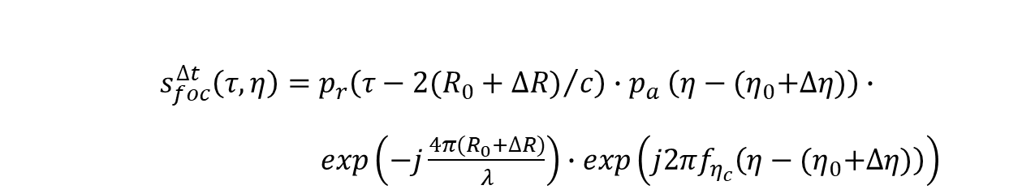
What SAR quantities are sensitive to motion?
$$s_{foc}^{}\left(τ,η\right)=p_{r}\left(τ−{{2R}_{0}}/c\right){∙p}_{a}\left(η−η_{0}\right)∙exp\left(−j\frac{4πR_{0}}{λ}\right)∙exp\left(j2πf_{η_{c}}\left(η−η_{0}\right)\right)$$
If we acquire two images of the same area after a given time interval (Δt), the changes in image amplitude and phase can be used to measure the slant-range and azimuth motion (ΔR, Δη) occurred in the meantime:
$$s_{foc}^{∆t}\left(τ,η\right)=p_{r}\left(τ−{{2(R}_{0}+∆R)}/c\right){∙p}_{a}\left(η−{(η}_{0}+∆η)\right)∙$$
$exp\left(−j\frac{4π{(R}_{0}+∆R)}{λ}\right)∙exp\left(j2πf_{η_{c}}\left(η−{(η}_{0}+∆η)\right)\right)$
Notes:
If we acquire a second image of the same point on ground after a certain time interval, we will notice changes in its amplitude and phase if this point has undergone motion in either slant-range or azimuth. You might already guess that the sensitivities with which we can measure such motion differ between the amplitude and the phase term. Amplitude-based methods will have a sensitivity which is a fraction of the spatial resolution (often several meters), whereas phase-based method will have sensitivities which are a fraction of the (centimetric) radar wavelength.

Slide 10
SAR-based motion measurement techniques
Method | Observable | Num. of images | Motion magnitude | Accuracy | Spatial resolution | Motion component
Differential SAR Interferometry (DInSAR) | Phase | 2 | > few cm | 1 cm | 10 - 50 m | slant-range
Split-bandwidth InSAR | Phase | 2 | > few tens of cm | 10 cm | 400 m - 2 km | azimuth
Offset-tracking
Feature-tracking | Amplitude | 2 | > few tens of cm | 10 cm | 400 m - 2 km | slant-range and azimuth
Speckle-tracking | Amplitude | 2 | > few tens of cm | 10 cm | 400 m - 2 km | slant-range and azimuth
Coherence-tracking | Coherence | 2 | > few tens of cm | 10 cm | 400 m - 2 km | slant-range and azimuth
Large displacements
Multi-temporal InSAR
Persistent scatterers, SBAS, SqueeSAR | Phase | tens | < 1-2 mm/day | few mm/year | single scatterers / 10 – 50 m | slant-range
Slow deformations
Notes:
To sum up these general concepts concerning ground motion measurements from SAR, here you find an overview of the main measurement techniques and their properties. Not all can be clear at this stage, but some things should. SAR-based motion-measurement techniques exploit either amplitude or phase. At least two images are required as we saw, which means that the motion which is measured is between the that which occurred between the two acquisitions. Interferometry is more sensitive and accurate than amplitude-based techniques (since smaller motion magnitudes can be measured with higher accuracies). This is due to the fact that the phase-distance relation involves the centimetric SAR wavelength, whereas you can imagine that the sensitivity of feature-tracking for instance is influenced by the SAR spatial resolution, which is in the order of meters. On the other hand interferometry can provide only one-dimensional motion measurements, namely in the slant-range direction (also called line-of-sight). Offset tracking measurements are two-dimensional instead (remember the glacier flowing into the ocean earlier). Techniques which use only two SAR images are typically sufficient for applications involving large displacements, such as ice and co-seismic motion. For slower deformations several tens of image pairs need to be jointly analyzed using so-called multitemporal InSAR techniques.

Slide 11
Differential SAR interferometry
A top-down introduction
Notes:
Let us know dive into differential SAR interferometry, or DInSAR as it is usually called.

Slide 12
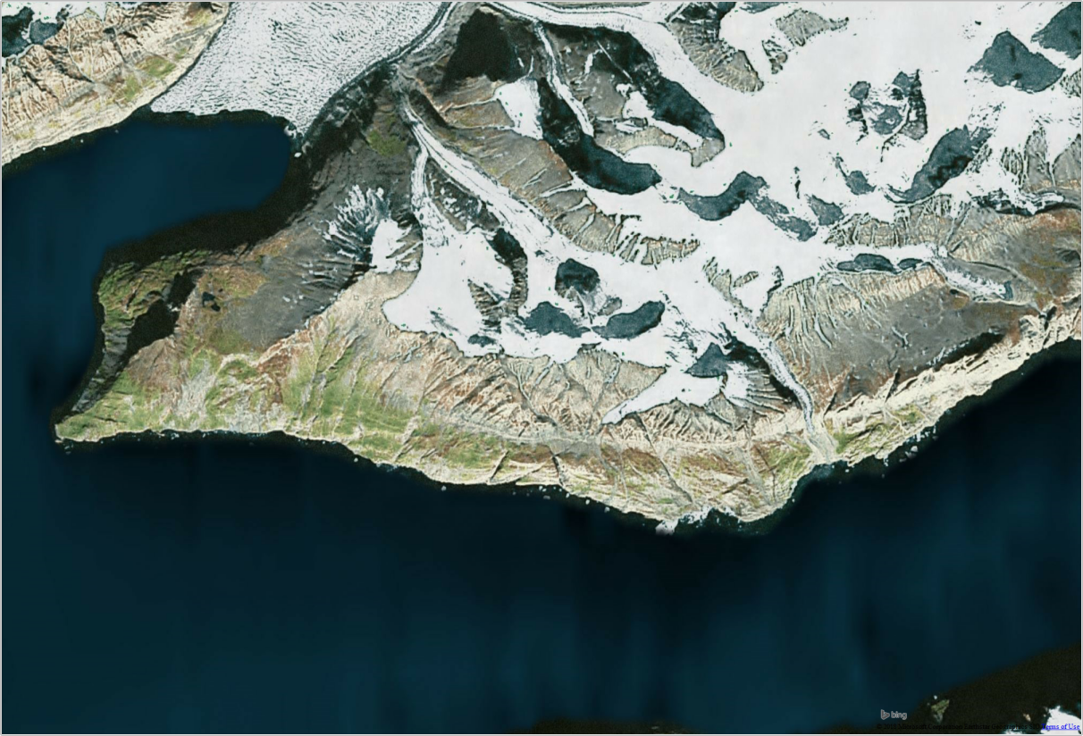

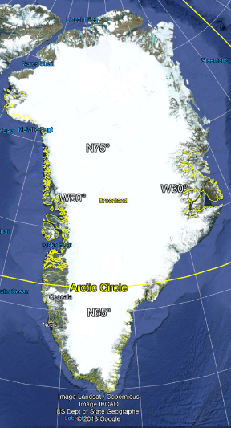
Optical image of Karrat fjord, West Greenland (Bing Aerial)
Notes:
We are going to do so in a top-down fashion, meaning that I will start by showing you some DInSAR results on a given area, which is the one you see in this image. The area is called Karrat fjord, it is in western Greenland, and several researchers worldwide including myself have been applying DInSAR to this area following a large landslide occurred on June 17th, 2017, which you might recall reading about in the press.

Slide 13
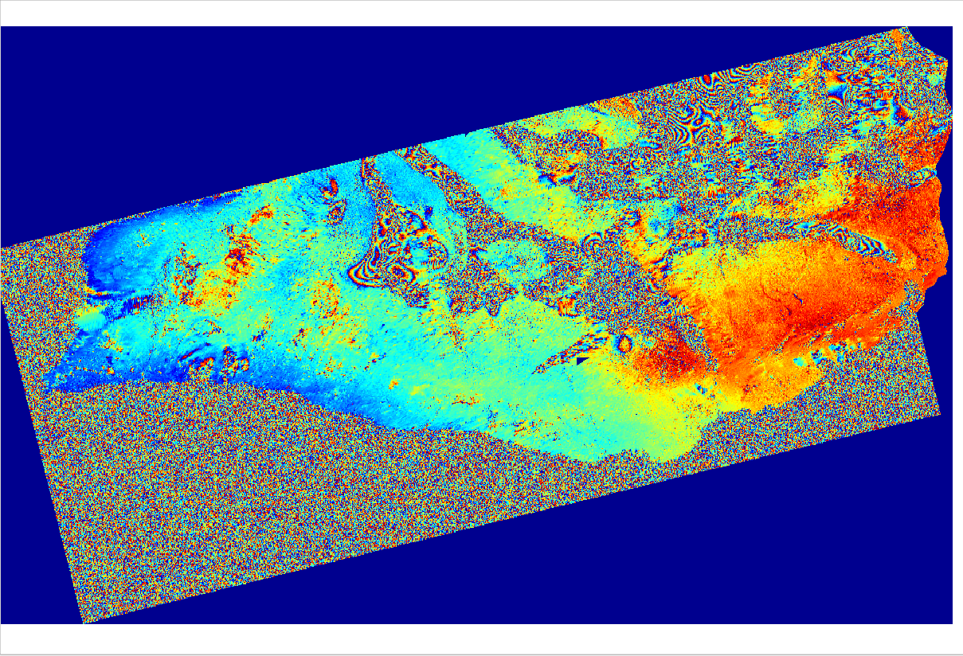
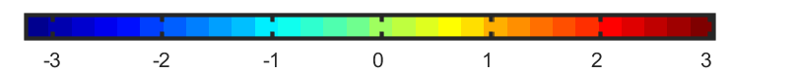
Differential Sentinel-1a interferogram (wrapped phase) 23 Oct. 2014 – 04 Nov. 2014, B_{n}=2 m, B_{temp}=12 days
rad
Notes:
This image shows a (geocoded) Sentinel-1a interferogram of this area, generated using two images acquired 12 days a part: on Oct. 23rd, 2014 and on Nov., 4th 2014. In differential sar interferometry a wrapped interferogram is the basic intermediate result we generate and analyze to measure ground deformation. It represents a phase difference in time (between two acquisitions) and in space (the color variations you see). Typically an interferogram is shown with a cyclic color scale between –pi and pi radians.

Slide 14
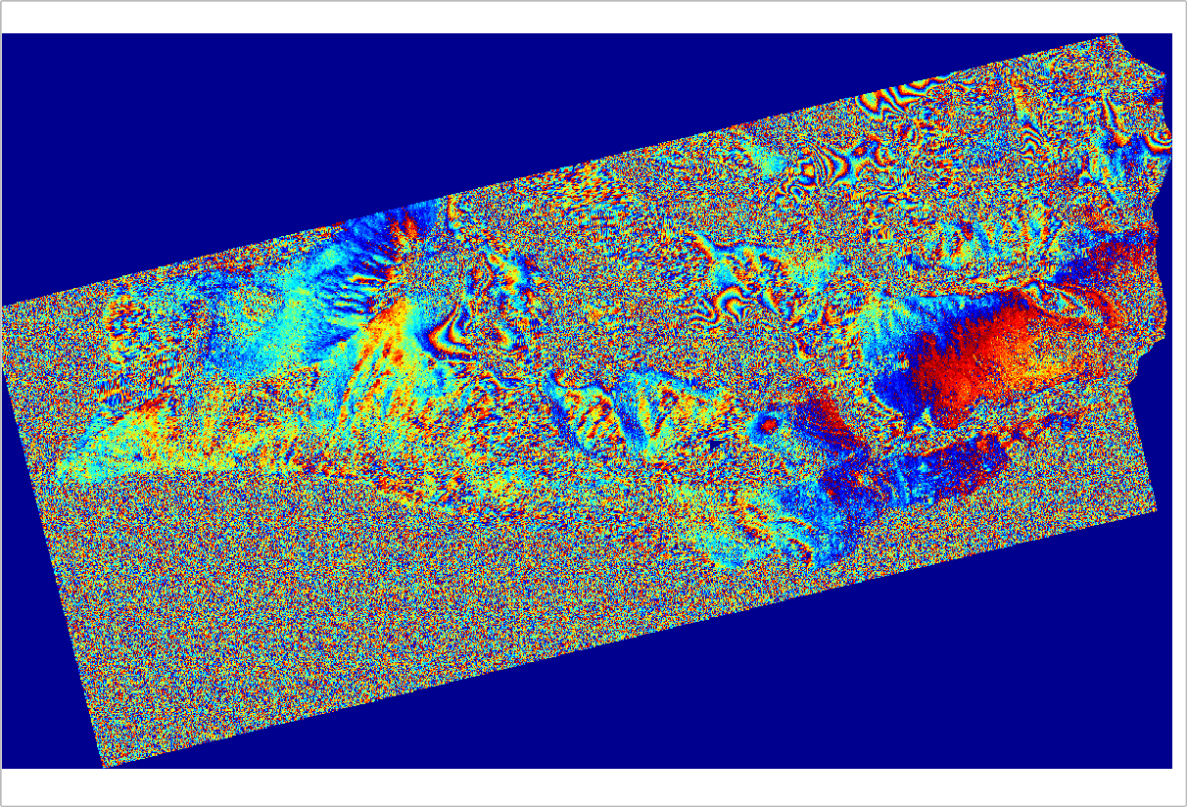
Differential Sentinel-1a/b interferogram (wrapped phase) 24 Oct. 2016 – 30 Oct. 2016, B_{n}=147 m, B_{temp}=6 days
rad
Notes:
This is another differential interferogram of the same area, generated using an image from Sentinel-1a and one from Sentinel-1b, acquired 6 days later. As you can see it looks quite different compared to the previous interferogram.

Slide 15
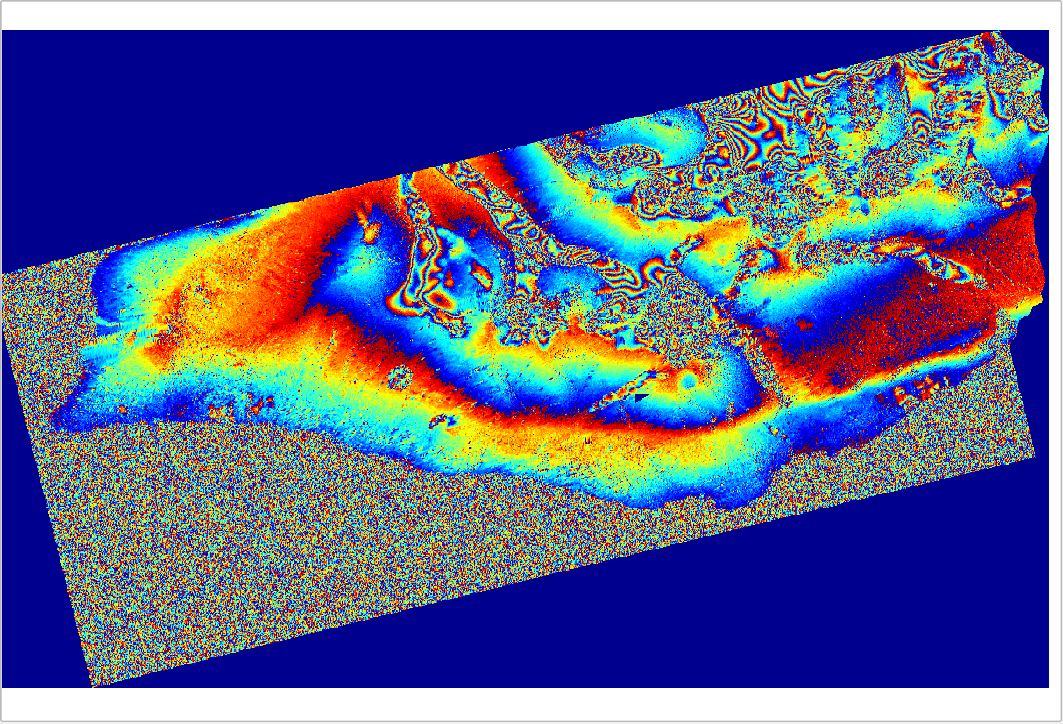
Differential Sentinel-1a/b interferogram (wrapped phase) 17 Dec. 2016 – 23 Dec. 2016, B_{n}= -6 m, B_{temp}=6 days
rad
Notes:
Not all 6-day interferograms look like that however. Take this other one for example.

Slide 16
Some legitimate questions
What do the colours represent?
What seems to influence the colour (phase) patterns?
What are the parameters which are mentioned?
…
Notes:
So now you probably have several legitimate questions. What do these colour variations acutally represent? How do we get from these coloured pictures to deformation maps like the ones we saw in the very beginning? What are the parameters I’ve shown, such as Bn, and what role do they play?

Slide 17
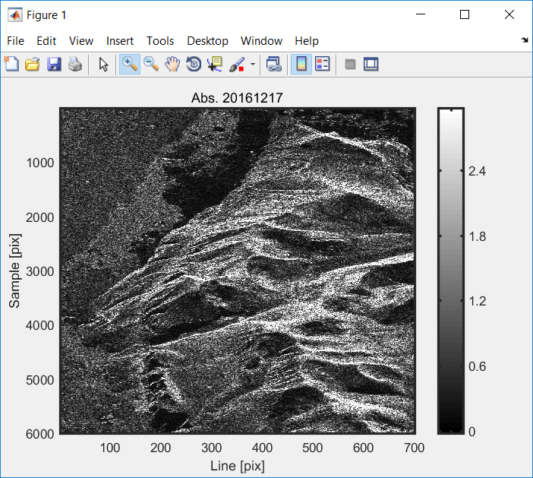
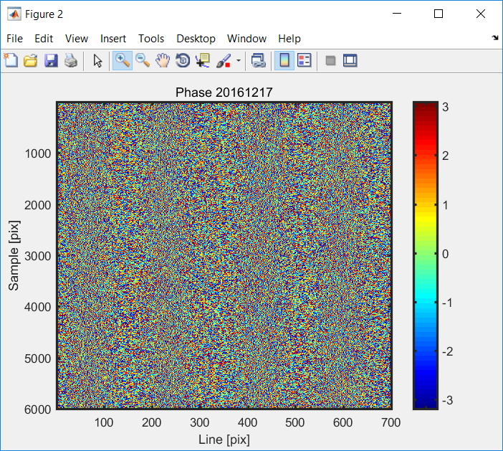
Single Look Complex (SLC) image
(i.e. a focused full-resolution SAR image)
Sentinel-1a, ascending image amplitude (Karrat fjord, Greenland)
Sentinel-1a, ascending image phase, (Karrat fjord, Greenland)
Slant-range
Slant-range
Azimuth
Azimuth
Phase of an SLC image looks random
Notes:
To find an answer to our questions, lets start by looking at the amplitude and phase of a focused SAR image (what the European Space Agency traditionally refers to as a Single Look Complex image). The ones shown in this slide are extracted from an ascending Sentinel-1a image of Karrat fjord (like the interferograms shown previously by the way). The two image dimensions, as you should know by now, are azimuth (i.e. parallel to the flight path) and slant-range (that is the direction from the satellite to the ground). While the amplitude looks like a microwave picture of the area, which looks similar to the optical image shown in slide 12, the phase looks mostly random.

Slide 18
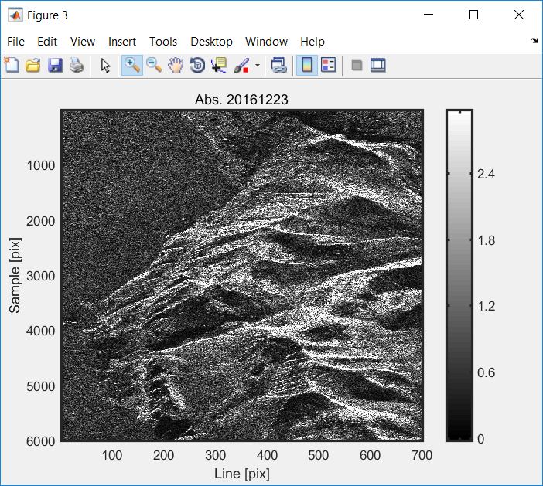
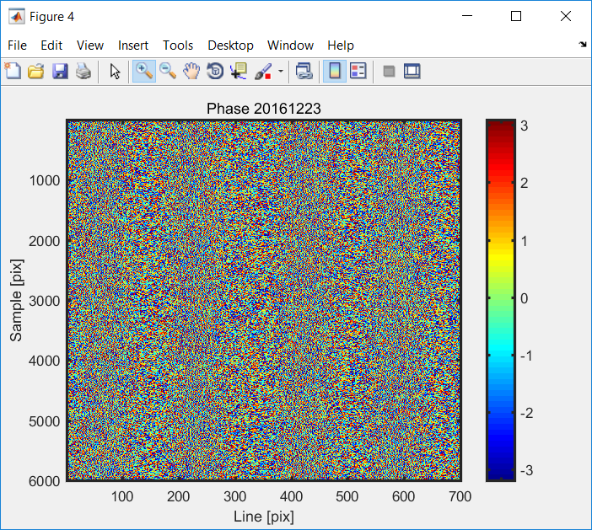
We try again 6 days later …
Sentinel-1b, image Amplitude (Karrat fjord, Greenland)
Sentinel-1b, image Phase, (Karrat fjord, Greenland)
Slant-range
Slant-range
Azimuth
Azimuth
Still random
Notes:
We have the same situation if we look at a second image, acquired 6 days later by Sentinel-1 b. The amplitude looks like a black and white picture, while the phase is random.

Slide 19
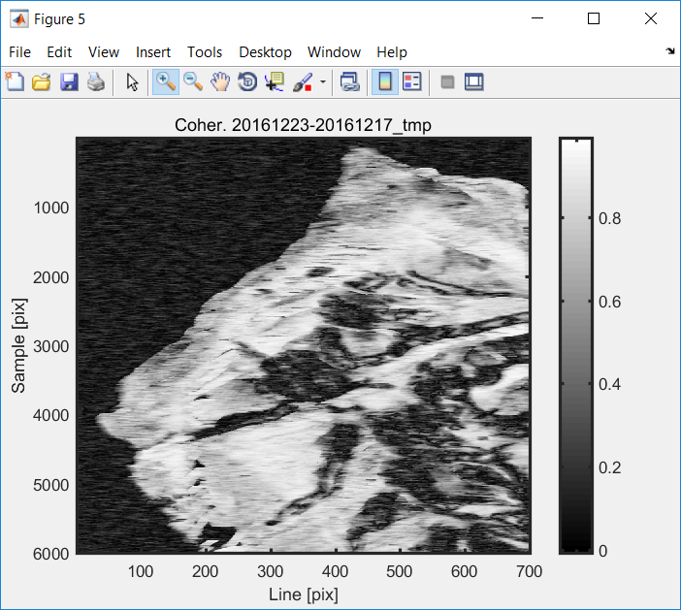
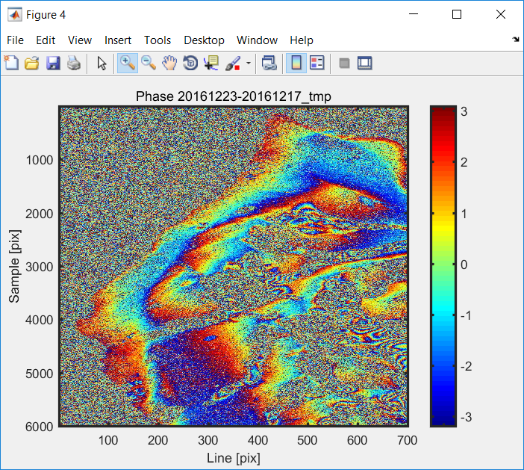
How about the phase difference?
Interferometric coherence
Differential interferogram
1
Slant-range
Slant-range
Azimuth
Azimuth
Luckily the phase difference is not random everywhere!
Notes:
However, the phase difference is not random everywhere luckily. It is not random or shows clear fringes as we say in SAR jargon where a parameter called interferometric coherence, shown to the left, is close to 1.

Slide 20
Interferometry working principle 1/2
SLC pixel phase terms:
Satellite flight path
Radar carrier frequency f_{c} = c / λ
SAR antenna phase centre
due to atmospheric propagation
Range of closest approach
Line-of-Sight (LoS)
R₀
Squint angle
Azimuth
due to geometric distance
due to coherent sum of contributions from resolution cell elements (speckle)
SAR antenna
Slant-range (LoS)
Antenna beam footprint
Ground range
SAR resolution cell
Notes:
Lets now describe these concepts using some equations. Each complex pixel value in a focused SAR image can be considered to have two phase terms: a more deterministic one related to propagation delay, and a random one due to speckle. Speckle is due to the coherent sum of backscattering contributions from all the objects within a radar resolution cell. Coherent sum means a sum of complex vectors where both amplitude and phase play a role. The propagation delay term in turn depends on the geometric distance of closest approach between the satellite and the phase-centre of the resolution cell (R0), but also on atmospheric propagation, as we will see later on. The fact that the phase of a single SLC image appears random, is due to the fact that the deterministic terms are covered by the random one due to speckle. This does not mean that the deterministic terms are not there however, just that they cannot be seen in a single image.

Slide 21
Interferometry working principle 2/2
Corresponding SLC pixels in images acquired from 2 different passes:
Repeat-pass interferometer
Flight path 2
SLC 1
SAR (pass 2)
Flight path 1
SLC 2
SAR (pass 1)
Interferogram
Point on ground (resolution cell)
Flat Earth + Topographic phase
Phase is wrapped in [-ϖ, ϖ]
The only welcome contribution for deformation/motion measurements
Notes:
If we now have a second image acquired from a slightly different satellite orbit, we form a complex interferogram by multiplying each pixel in image 1 by the complex conjugate of the corresponding pixel in image 2. This corresponds to subtracting the phase of image 2 from that of image 1. The phase of the resulting interferogram will have several contributions. One corresponding to the difference of the geometric terms, one to the difference of the atmospheric delays, and one to the difference between the speckle terms. Also, since the interferogram phase is the phase of a complex number (that is the complex interferogram pixel), its value can only be between 0 and 360 degrees or equivalently –pi and pi radians. In SAR jargon we say the phase is wrapped in this interval.

Slide 22
So what are the colours we see in an interferogram?
Spatially-uncorrelated (noisy) term
Spatially-correlated terms
Area where the random phase contributions prevail -> noisy phase
Areas where the spatially-correlated (more deterministic) phase contributions prevail -> clear phase fringes
Notes:
What we see in an interferogram represented with cyclic color scale are the spatial variations of the sum of all the phase contributions. If these phase contributions were the same for each image pixel we would see no color variations. We see color variations where the sum of these terms takes on different values for close-by image pixels. Smooth variations among pixels give rise to clear fringes and occur where the differences between the spatially-correlated and more deterministic terms prevail. Abrupt variations lead to phase noise and occur where the random terms to not cancel out. The only welcome term for ground motion measurements is that related to the slant-range distance difference R01-R02. However only part of this is due to deformation.

Slide 23
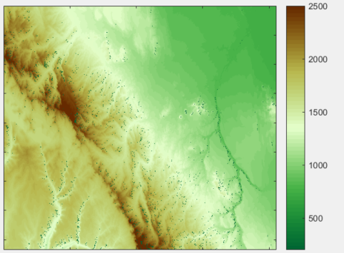
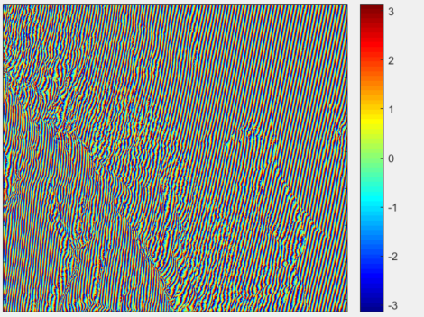
Differential interferograms
In a differential interferogram φ_{flat} and φ_{topo} are removed based on an Earth ellipsoid and a Digital Elevation Model
SAR (pass 2)
SRTM Digital Elevation Model, Rift Valley, Ethiopia
m
SAR (pass 1)
Sentinel-1a (wrapped flattening + topographic phase) 28 Mar. 2015 – 21 Apr. 2015, B_{n}=-36 m, B_{temp}=´24 days
rad
Earth ellipsoid
h
Topographic height
Notes:
In fact the value of the geometric term R01 – R02 can be different for two image pixels even if there is no relative deformation between them. If two image pixels have different positions of on the Earth ellipsoid, such as the blue and yellow points in the figure, or if they have different topographic heights such as the yellow and black points, R01 – R02 will take on different values and we will observe a color difference in the interferogram. Since we are interested in deformation, we can form a so-called differential interferogram by estimating these phase contributions based on an Earth ellipsoid model and on a Digital Elevation Model and subtracting them from the interferogram phase. These processing steps are called “phase flattening” and “topographic phase removal”. All the interferograms we have seen so far are differential interferograms, meaning that the phase contributions from flat Earth and topography have been estimated and subtracted in the processing. Therefore any variations in the geometric term R01 – R02 can in principle only be due to deformation. In practice however, if our Digital Elevation Model is not perfect, and if we don’t perfectly know the satellite positions (that is their orbits), there can still be residual contributions from the flattening and topographic phase terms.

Slide 24


Sensitivity to topography
The sensitivity of interferometric phase to height depends on the normal baseline (or perpendicular baseline) component:
SAR (pass 2)
SAR (pass 1)
Baseline
Normal baseline
Look angle
Low B_{n} -> low sensitivity to height variations and/or DEM uncertainties.
The height variation leading to a 2ϖ phase is called height of ambiguity:
$$∆θ_{inc}$$
Incidence angle
Earth ellipsoid
h
Topographic height
$$∆θ_{inc}≅\frac{B_{n}}{R_{0}^{1}}$$
Notes:
An important parameter of an interferometric system is the interferometric baseline. For a given pixel it represents the difference between the position vectors of the two satellites at the moment that pixel was imaged. In particular, the interferometer’s sensitivity to height (and also to DEM height errors), depends on the normal or perpendicular baseline component Bn, shown in this slide. You might recall that this parameter appeared in the very first interferograms I’ve showed you in slides 13 to 15 and in the previous one. Another parameter often used to describe sensitivity to height is the so called height of ambiguity, that is the height variation which would lead to a 2 pi phase variation.

Slide 25
Sensitivity to motion
We consider the zero baseline case for clarity, but all relations hold also for a non-zero baseline
Interferometric phase is sensitive to the projection of the 3D deformation onto the radar line-of-sight vector
SAR (pass 1)
= SAR (pass 2)
A deformation of λ/2 between the two SAR acquisitions = 1 phase fringe (2ϖ phase change)
In the presence of a steady deformation rate (v), phase changes are proportional to the temporal baseline T
Surface deformation between passes 1 and 2 (uplift)
Projection of deformation onto SAR line-of-sight (LoS)
λ = 5.6 cm for Sentinel-1a,b
Notes:
What about deformation? For clarity let us consider the case of a zero interferometric baseline. In this case the flattening and topographic phase terms are zero for each pixel. However, if now there is a local surface deformation between acquisitions 1 and 2, such as the exaggerated orange uplift shown in this picture, R02 will differ from R01 for all the pixels in the deforming area, causing a local change in the interferogram colour. This range difference can also be written as the projection of the 3D deformation vector onto the unit line-of-sight vector. Note that a line of sight deformation of half a radar wavelength is enough to cause a phase variation of 2 pi radians, that is a full phase fringe in the cyclic colour scale we use to represent interferograms. For Sentinel-1a,b, a deformation fringe corresponds to about 2.8 cm of deformation. Note that in the presence of a steady motion, such as a glacier flow with a constant velocity, the deformation and therefore the number of interferogram fringes will increase proportionally to time separation between the two SAR images. This time separation between two images forming an interferometric pair is also called “temporal baseline” in SAR jargon.

Slide 26
Can we explain a little more of what we see?
23 Oct. – 04 Nov. 2014, B_{n}=2 m, B_{temp}=12 days
17 Dec. – 23 Dec. 2016, B_{n}= -6 m, B_{temp}=6 days
rad
Why are there more fringes in the interferogram to the left?
Notes:
Lets see if we can now explain a little more of what we see in these differential interferograms. Where do the deterministic phase difference terms prevail and where to the random components prevail? On ice-covered areas such as the one pointed at by the arrows, why are there more fringes in the interferogram to the left? If you recall the optical image of Karrat fjord on slide 12, you will notice that areas with a noisy phase include mainly water bodies and areas covered in snow/ice. For the bare-rock areas, in these interferograms the deterministic phase difference terms prevail. If ice is moving at a steady rate, we will see twice as much motion in the interferogram to the left, which has a 12 day temporal baseline, compared to that to the right with a 6 day time separation.

Slide 27
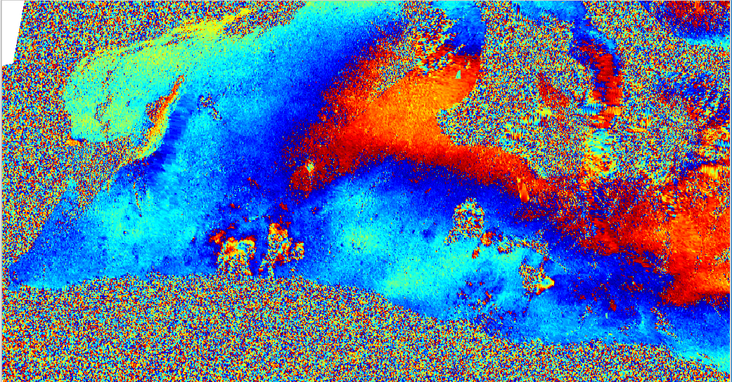
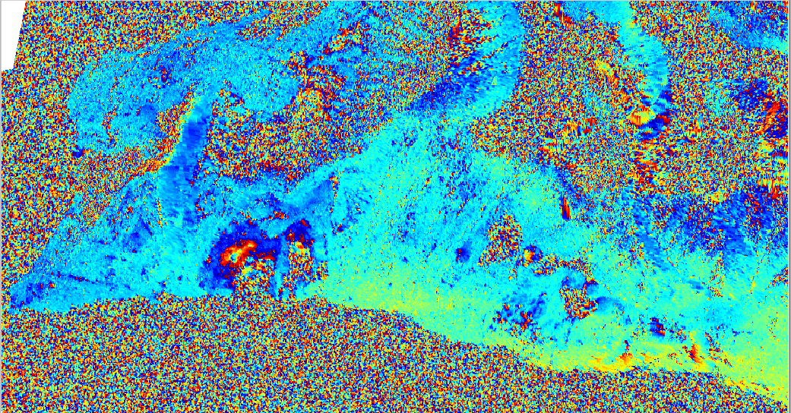
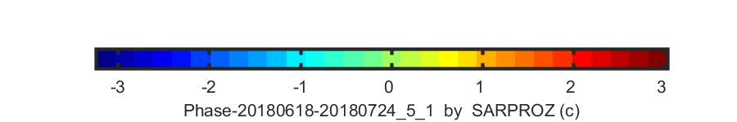
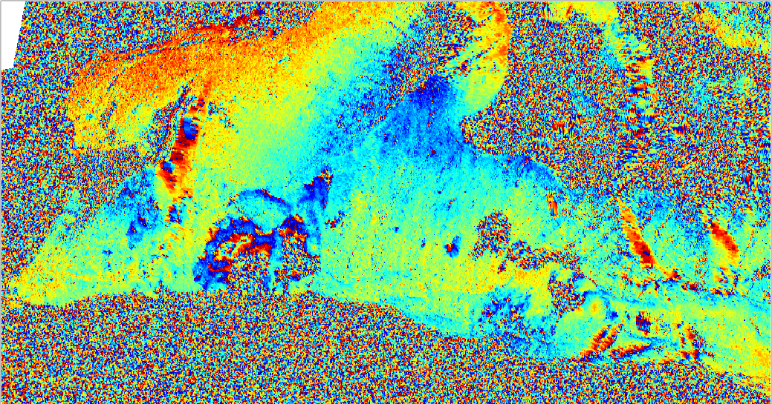
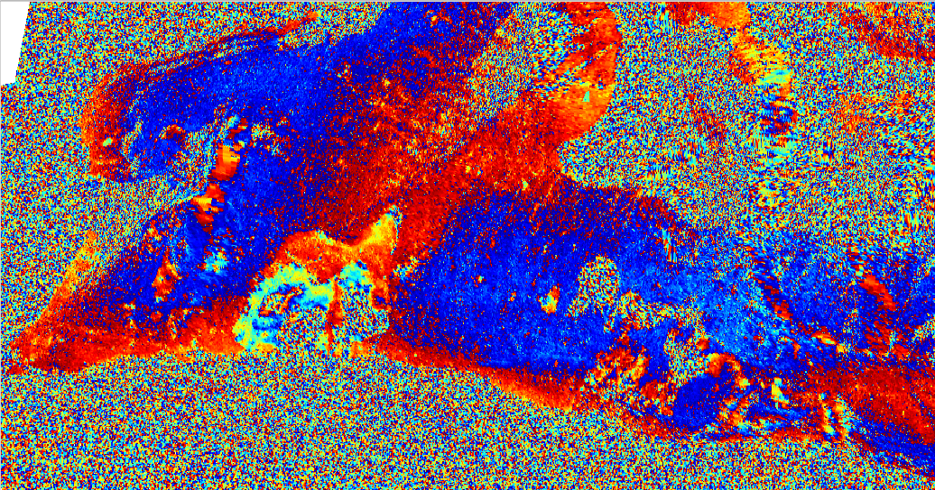
Sensitivity to motion (in more pictures)
24 – 30 Jul., 2018 (6 days, phase)
30 Jun. – 12 Jul., 2018 (12 days, phase)
rad
24 Jul. – 11 Aug., 2018 (18 days, phase)
24 Jul. – 17 Aug., 2018 (24 days, phase)
27
Notes:
As mentioned initially, the reason for generating so many differential interferograms of Karrat fjord was to study landslides and slope-instabilities. These differential interferograms are from a descending Sentinel-1 orbit. What areas are moving? What can the localized phase noise in certain areas be due to?

Slide 28
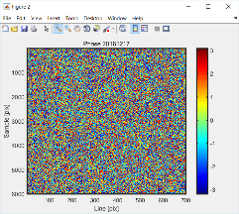
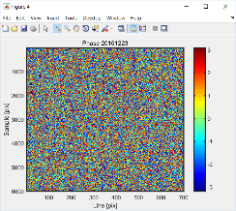
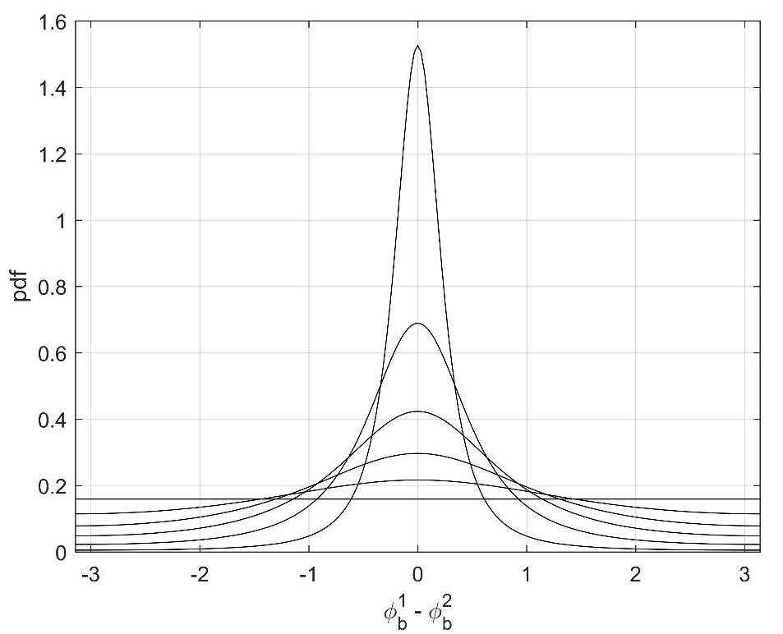
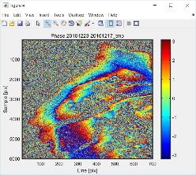
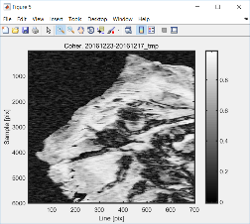
Interferometric coherence 1/2
Although are random
= 0.95
can be sharply peaked around a zero mean when the magnitude of the interferometric coherence (γ) is high
= 0.8
= 0.6
= 0
= 0.4
= 0.2
Coherence magnitude (|γ|) values :
Measure of statistical similarity in [0,1]
0: dissimilar (decorrelated)
1: identical (correlated)
Statistical expectations computed in practice as local spatial averages (ergodicity assumption)
28
Notes:
We mentioned earlier, on slide 19, that wherever interferometric coherence was high, the interferometric phase difference did not appear to be random. The complex interferometric coherence is defined as the complex cross-correlation coefficient between two SAR images. It’s magnitude, also known as interferometric coherence, is a local measure of statistical similarity between the radar returns at the times of the two acquisitions. Values close to 0 mean the pixel values are dissimilar. Values close to 1 mean that they are very similar. The curve in this slide shows that if coherence values are high, the difference between the random phase terms due to speckle, phi b 1 and phi b 2, have probability distributions which are sharply peaked around a zero mean. Therefore the probability of this difference being small is high when and where the coherence is high. In contrast, when the coherence is low, there is a high probability of the random phase difference values to be high and therefore cover the deterministic ones we are interested in to measure deformation.

Slide 29
Interferometric coherence 2/2
Coherence is influenced (decorrelation can be caused) by several factors:
Geometric decorrelation
Horizontal scatterer spreading + different viewing angles (look and squint angles)
Processing decorrelation
(e.g. image mis-registration)
Volume decorrelation
Vertical scattering spreading (e.g. penetration in ice or foliage) + different viewing angles
Thermal noise decorrelation
Radar electronics (the only signal in radar-dark areas)
Temporal decorrelation
Changes of surface properties in time (e.g. snow, irrigation, ploughing, rockfall, etc.)
29
Notes:
Several factors can influence interferometric coherence and in particular cause coherence to be lost, which is referred to as decorrelation. Geometric decorrelation arises from the horizontal spreading of scatterers within a resolution cell, viewed from different angles at the two acquisition times, due to a non-zero perpendicular baseline and/or squint angle. Volume decorrelation arises from the vertical spreading of scatterers within a resolution cell, due to penetration of the radar signal into a medium such as ice, snow or vegetation, and from viewing these returns from different angles due to a non-zero baseline. Temporal decorrelation arises from changes in time of electromagnetic properties of the surface, e.g. due to weather or surface changes such as rockfall, ploughing, irrligation. Thermal noise and processing decorrelation will be neglected in this presentation.

Slide 30

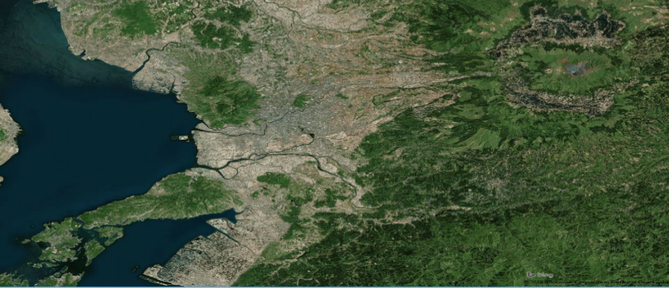
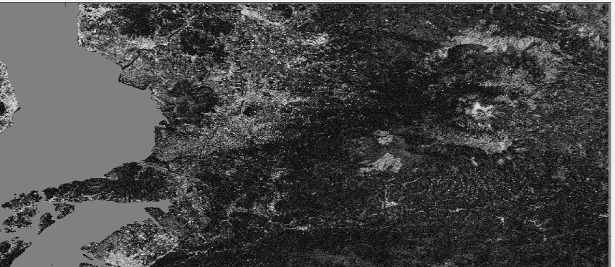
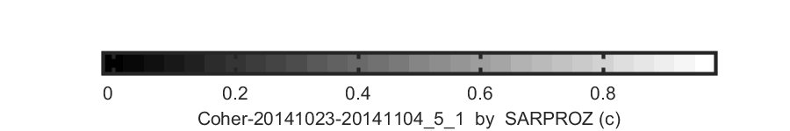
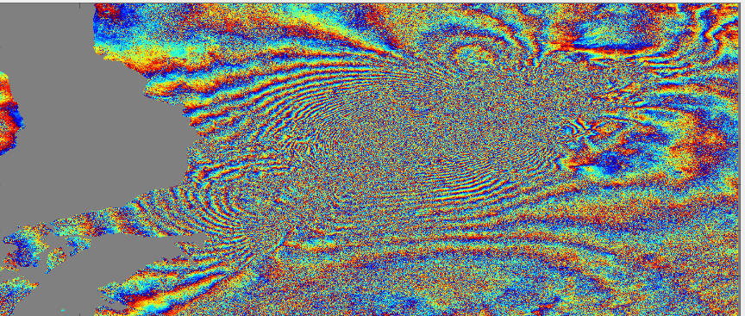
Decorrelation examples
Karrat fjord, Greenland (Bing Aerial)
Kumamoto, Japan (Bing Aerial)
Sentinel-1 23 Oct.–04 Nov. 2014
Sentinel-1 08 Apr.–20 Apr. 2016
Coherence magnitude
1
DInSAR phase
Earthquakes on Apr. 14-16, 2016
Notes:
What sources of decorrelation can you point out in these Sentinel-1 interferograms?

Slide 31
Still an unexplained phase pattern?
Differential Sentinel-1 interferogram (wrapped phase) 17 Dec. 2016 – 23 Dec. 2016, B_{n}= -6 m, B_{temp}=6 days
rad
31
Notes:
The concepts presented so far help us explain most but not all of the phase patterns we have observed in our differential interferograms. This interferogram for example shows some clear fringes to ice motion, some localized phase patterns due to slope instabilities, but also a large-scale phase pattern which roughly mimics the shape of the cliff (that is it is correlated with topography). The perpendicular baseline is very low, so it cannot be due to residual height errors, nor is there any geophysical phenomenon which could cause such a deformation pattern. In my experience these effects are due to stratified tropospheric delay.

Slide 32

Atmospheric propagation delay
z
SAR
Sentinel-1a,b (~700 km)
800 km
h_{top}
Top of atmosphere
600 km
100 km
Non-zero and spatially-variable refractivity N(x,y,z)
50 km
20 km
h(x,y)
Earth surface
Propagation delay
Troposphere
Stratosphere
Mesosphere
Ionosphere
Termosphere
Exosphere
Excess path (delay)
Refractivity
Notes:
Remote sensing satellites orbit the Earth at heights between 500 and 800 km. Therefore the radar waves transmitted and received by spaceborne SARs traverse several atmospheric layers. Microwaves propagating through these layers experience a delay, due to atmospheric refractivity, which depends on some key atmospheric parameters: pressure, temperature, water vapour and liquid water in the troposphere and free electron density or TEC in the ionosphere. The atmospheric refractivity introduces a delay by reducing the propagation speed of the radar waves. Equivalently one can still consider the radar waves to travel at the speed of light through the atmosphere, but besides the geometric distance it is as if they would also have to travel an excess path distance. This excess path is given by the integral of the refractivity along the radar line-of-sight.

Slide 33
DInSAR processing
Notes:
We have previously described the working principle of Differential SAR Interferometry (DInSAR). In practice, to actually use this technique to measure ground motion there is a little more to it.

Slide 34

From theory to processing chain
Known quantities, albeit for DEM errors which can lead to residual phase errors
Unknown noise source, which we can reduced by phase filtering due to its spatially uncorrelated nature.
Unknown noise source, which we cannot easily reduce due to its spatial correlation.
Our unknown
We cannot know the absolute phase of each pixel, but we can unwrap the phase differences among interferogram pixels
$$φ_{defo}=\frac{4π}{λ}\vec{D}∙\vec{LOS}$$
Notes:
This equation shows the phase terms, which appear in an interferogram. In a differential interferogram the flat-Earth and topographic contributions are removed, using an Earth ellipsoid model and topographic information derived from a Digital Elevation Model (DEM). Of course any errors in the DEM, will lead to residual phase errors, due to uncompensated height variations. Then there are two noise sources, namely the atmospheric and the decorrelation terms. The atmospheric phase is in general difficult to reduce, due to its spatial correlation. Phase noise related to speckle is spatially (much more) uncorrelated and can be reduced by phase filtering techniques, which we will discuss later on. Finally, the phase we observe is that of a complex number, which means that it is “wrapped” between –pi and pi. Although we cannot recover the absolute phase, we can recover the phase differences among interferogram pixels, through a procedure known as two-dimensional phase unwrapping.

Slide 35
High-level processing steps
Part 1: get our best estimate of the wrapped interferometric phase ϕ_{int} and of the coherence as a quality parameter.
Part 2: unwrap the interferometric phase and scale it to get the line-of-sight deformation.
Notes:
The processing steps can be grouped into two high-level tasks. The first is to generate our best estimate of the wrapped interferometric phase and of interferometric coherence. The second part requires two-dimensional phase unwrapping and scaling of the unwrapped phase to generate a line-of-sight deformation map.

Slide 36
Part 1: Wrapped interferogram formation and coherence estimation
Notes:
We have previously described the working principle of Differential SAR Interferometry (DInSAR). To actually use this technique to measure ground motion, we must go into more details.

Slide 37
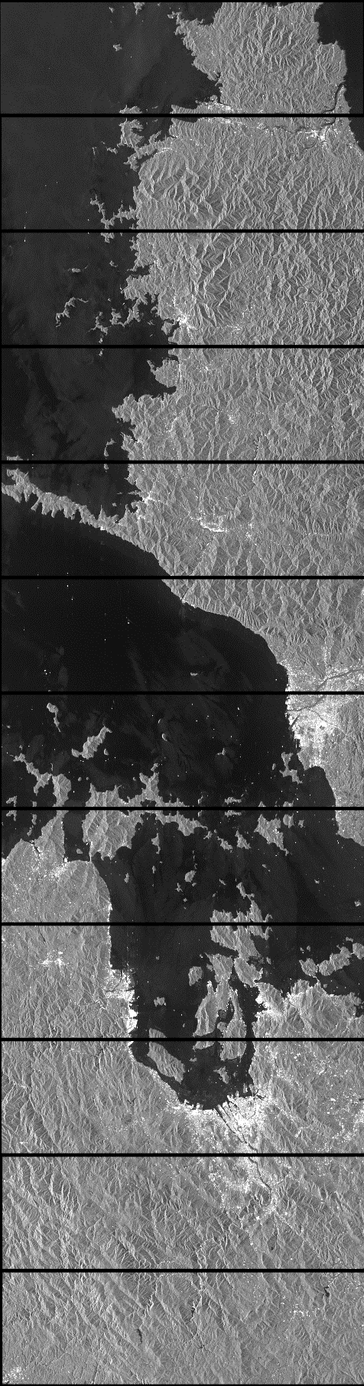
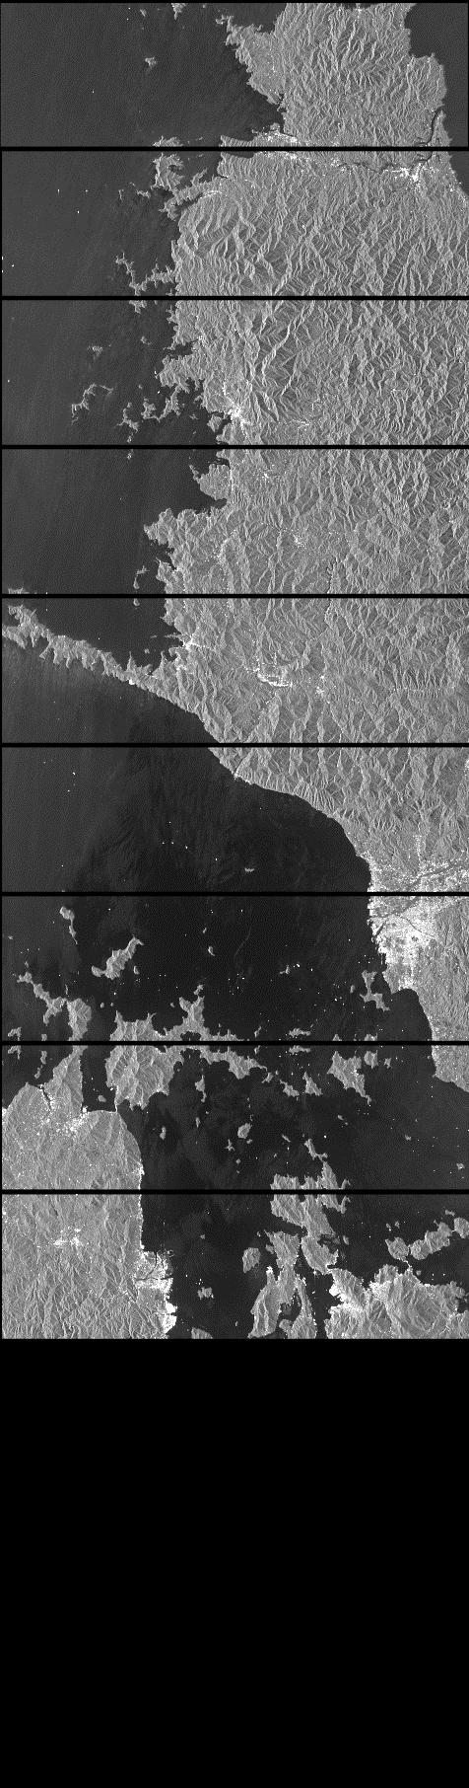

A prerequisite: image co-registration
Operational way of forming a complex interferogram
It requires the pixels in image 1 (master) to correspond (be coregistered) to those of image 2 (slave)
Co-registration is the first DInSAR processing step
$$z_{int}=z_{1}∙z_{2}^{∗}=\left|z_{1}∙z_{2}^{∗}\right|e^{jϕ_{int}}$$
Image 1
Aligned with image 1
Image 2
Co-registered image 2
Notes:
An operational way of forming an interferogram is to use its definition, which consists in the complex multiplication in the equation above. Each pixel in complex image 1 is multiplied by the complex conjugate of the corresponding pixel in image 2. The resulting phase represents the wrapped interferometric phase. However, this assumes that the two complex images are aligned, so that corresponding pixels in the two images also cover the same area on ground. This is not the case in general when you download two SAR acquisitions, and a processing step called “coregistration” is required to align the two images before a complex interferogram can be formed.

Slide 38
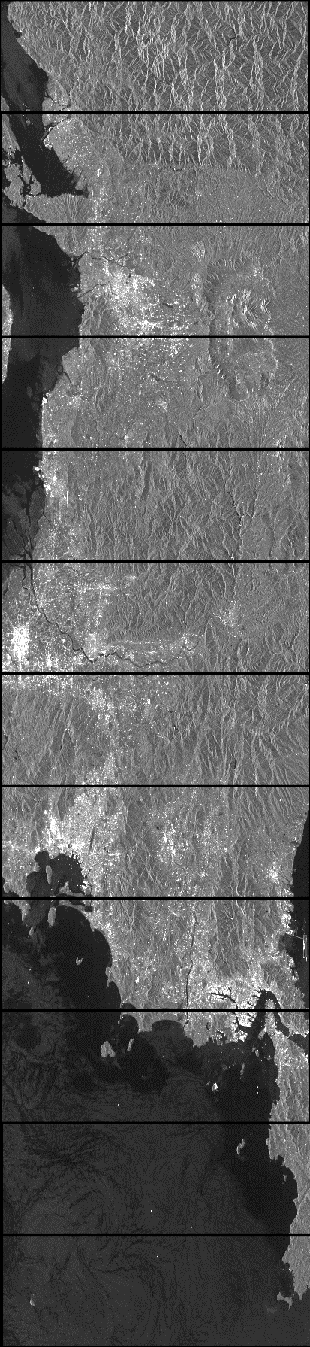
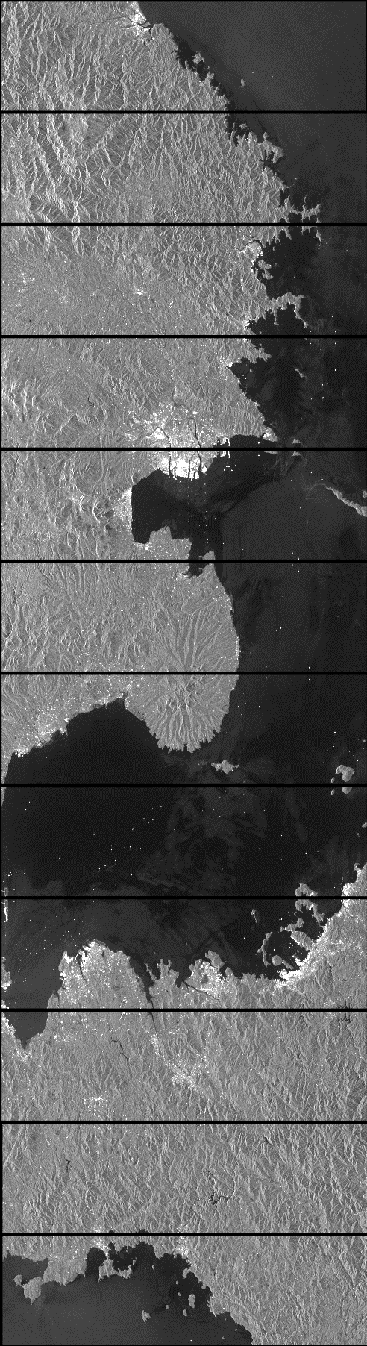
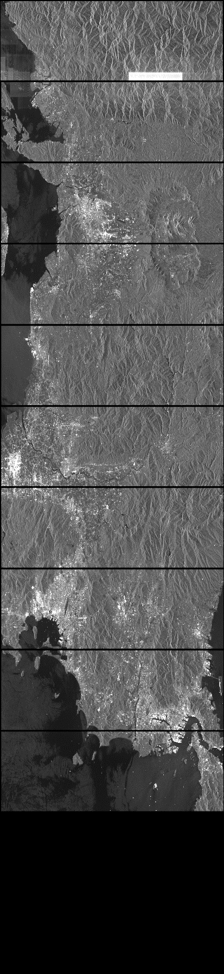
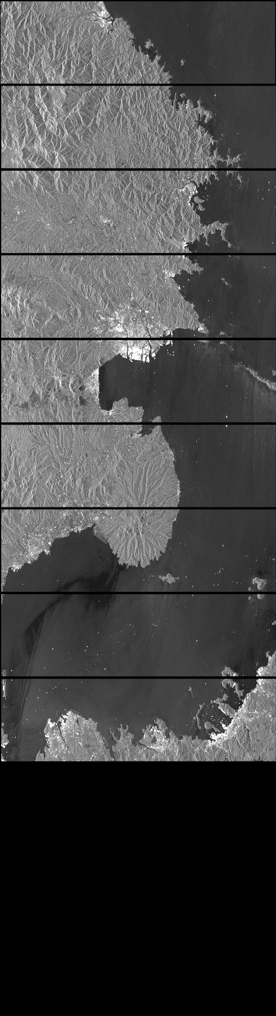
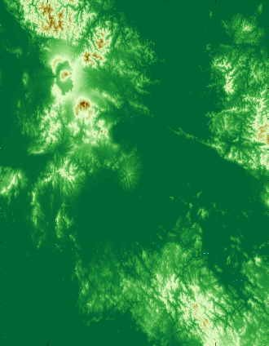
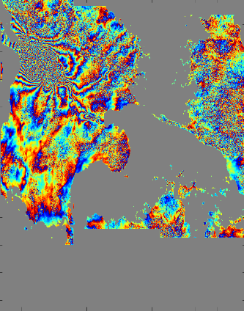
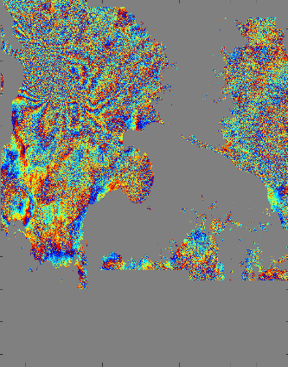
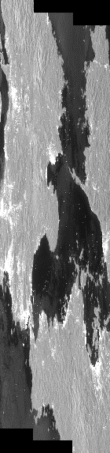
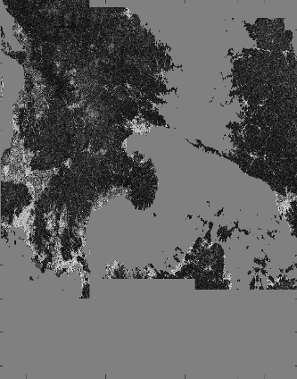
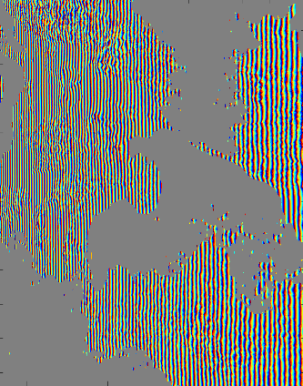

Forming a wrapped DInSAR interferogram
1. Input data
2. Co-registration
Aligned with master burst
Master image burst
Image 1 (master)
Image 2 (slave)
Digital Elevation Model
Slave image burst
Co-registered slave burst
5. Phase filtering and coherence estimation
4. Differential interferogram formation
3. Mosaicking (debursting)
Coherence
Flattening and topographic phase
Mosaicked slave
Filtered interferogram phase
DInSAR interferogram phase
Mosaicked master
This step is required only for wide-area acquisition modes, such as Sentinel-1 TOPS
Notes:
To summarize the concepts mentioned so far, given two images, which are called master and slave images in SAR jargon, these are first of all aligned in the coregistration processing step. In the case of wide-area acquisition modes, such as the Sentinel-1 TOPS images shown in this slide, coregistration must be carried out between corresponding image bursts in the two images to avoid geometric decorrelation. Once the bursts are aligned, we can form the differential interferogram by performing a pixelwise complex multiplication and remove the uninteresting flat Earth and topographic phases using a DEM. At this stage we can stitch together the bursts eliminating the overlap regions, an operation known as mosaicking or debursting. One can either mosaic the complex images and then form the interferogram, or form the interferograms burst-by-burst and mosaic them. Finally, we will need to reduce the phase noise of the interferogram, a step known as interferogram “filtering”. Typically it will also be useful also to estimate the interferometric coherence as a quality parameter.

Slide 39

Example: Mw7.1 Kumamoto earthquake, Japan
Earthquake on Apr. 16th, 2016 (foreshocks also on Apr. 14th and 15th).
SAR data: Apr. 8th and Apr. 20th:
S1A_IW_SLC__1SSV_20160408T091355_20160408T091430_010728_01001F_83EB.SAFE
S1A_IW_SLC__1SSV_20160420T091355_20160420T091423_010903_010569_F9CE.SAFE
Swath IW1, bursts 2-4 cover main ground deformation
Burst 4
Burst 3
DEM: 3 arcsec (~90 m) SRTM (http://dwtkns.com/srtm/)
Burst 2
IW3
IW2
Precise orbits
IW1
Notes:
Let’s look at an application example more in detail. We will consider a Sentinel-1a TOPS image pair spanning the 2016 Kumamoto earthquake, Japan. The swaths and bursts are shown by the red rectangles in the image. There is more than one type of Sentinel product which can be downloaded (SLC, GRD, etc.), but only the Single Look Complex (SLC) product is suitable for interferometry, since the phase information is retained. We will also need a Digital Elevation Model, both for the coregistration step and to remove the topographic phase, and finally we can use the most accurate Sentinel orbits, which are called Precise Orbit Ephemerides (POE) orbits, and are available 21 days after the data acquisition. Note that if we are in a hurry to process a very recent acquisition we can always use the Restituted Orbits (RES orbital product), available 3 hours after the acquisition.

Slide 40


Mosaicked interferogram (unfiltered)
Azimuth
rad
Slant-range
Notes:
Lets consider only 3 bursts from the first swath, and for each burst we form a differential interferogram, by coregistering the images, and by estimating and removing the flattening and topographic phase. The result is the interferogram you see in this slide. The dense fringes we see are due to the ground deformation caused by the earthquake. Do you remember how much deformation one fringe represents? Each fringe represents half a wavelength of deformation, which corresponds to 2.8 cm for Sentinel-1. As you see the phase is quite noisy. We try to reduce this noise by averaging and subsampling the complex interferogram, a processing step which is called “multi-looking” in SAR jargon.

Slide 41

Mosaicked interferogram (multi-looked)
Azimuth
rad
Result of 3 x 12 pixels (azimuth x slant-range) multi-looking (40 m x 40 m interferogram spatial resolution)
Slant-range
Notes:
After multi-looking the fringes are much more visible. Note also that the number of pixels on each axis is less than in the original unfiltered interferogram.

Slide 42

Adaptive (Goldstein) filtering
Azimuth
rad
Result of Goldstein filtering (alpha=0.8, win=64 x 64 pixels)
Slant-range
Notes:
Multi-looking is simple, but the larger the filter windows, the lower the resulting spatial resolution. Furthermore, multi-looking applies the same amount of filtering to all areas of the image, even though the noise levels are not the same. An adaptive filtering method which is very often used after the multi-looking step is known as Goldstein filtering. The results of applying this method to the multi-looked complex interferogram is shown here. The fringes now stand out much more clearly.

Slide 43

Multi-looking rationale
Multilooking consists in applying a local spatial filter to the complex (flattened) interferogram
Square area on ground -> rectangular interferogram area. Typically 1:4 ratio (azimuth:slant-range) for Sentinel-1.
After filtering interferogram pixels would be very correlated -> interferogram size can be reduced (decimation)
Summation is over neighbour pixels within the rectangle
$$φ_{multi}=angle\left(\frac{1}{L}\sum_{i=1}^{L}{z_{1i}^{}z_{2i}^{∗}}e^{−j\left(ϕ_{flat}+ϕ_{topo}\right)}⁡\right)$$
Notes:
Multi-looking consists in spatially filtering the complex interferogram values. The simplest filter is a box-filter, in which case multi-looking reduces to a moving average. Typically, when using an interferometric processing software, the user will be asked to specify the size of the multi-looking window, meaning the size of the spatial filter in both slant-range and azimuth. We choose this so that the resulting area on ground is a square, and since the pixel spacing for Sentinel-1 is about 14 m in azimuth and 2.33 m in slant-range, which corresponds to 3.8 m in ground-range at the center of the IW2 swath, the window size in slant-range is typically chosen to be 4 times larger than the one in azimuth. In the example we see here, a box-filter window size of 3 pixels in azimuth and 12 pixels in slant-range has been used. Finally, after filtering we can also reduce decimate the data, which is why the number of image pixels in each dimension is reduced after the multi-looking step in the interferograms you see. In this case decimation was carried out selecting every 3rd pixel in azimuth and every 12th pixel in slant-range, even though this is an oversimplified procedure compared to what would be done by a real InSAR processor.

Slide 44
Goldstein filtering rationale
Applied to multilooked (averaged and decimated) interferogram
Two parameters: window size (W), and filter strength (alpha).
Within a W x W window, dominant fringes are enhanced.
How much depends on alpha (0=do nothing; 1 = a strong filter)
The filter is adaptive, because it adapts to spatial variations of the phase pattern by estimating the local dominant fringes
Reference paper:
Goldstein and Werner, (1998), “Radar interferogram filtering for geophysical applications”.
Notes:
Goldstein filtering boosts the dominant local fringes. Very much like our eye, this method enhances fringes which are barely visible under the noise. The method is adaptive, meaning that it behaves differently depending on the local properties of the image. In a region with a dominant frequency, this frequency is enhanced, whereas in a region with only noise, where no dominant fringe is present, the filter doesn’t do much. There are two parameters a user should specify when running a software implementing this method: the first parameter is the window size within which the dominant spatial frequencies are estimated (typically between 16 and 64 pixels in both slant-range and azimuth); secondly, a parameter referred to as “alpha” in the reference paper describing this method, which determines the strength of the filter. Reasonable values of alpha lie between 0, which means no filtering, and 1, which is a strong filter.

Slide 45



Interferometric coherence
|γ|
Azimuth
Slant-range
Notes:
Typically the interferometric coherence is also computed as a quality parameter. Care must be taken though if interferogram filtering steps such as the Goldstein filtering are used, since these will change the properties of the phase, in ways which are not represented by the coherence. This is how the coherence map looks for the Kumamoto area. Can you guess/remember which sources of decorrelation there might be, looking at the optical image in the inset in the bottom-right corner?

Slide 46



Coherence estimation
$$γ=\frac{E\left(z_{1}^{}z_{2}^{∗}\right)}{\sqrt{E\left({\left|z_{1}\right|}^{2}\right)}\sqrt{E\left({\left|z_{2}\right|}^{2}\right)}}$$
The coherence definition contains expected values, which cannot be evaluated in practice
$$\hat{γ}=\frac{\sum_{i=1}^{L}{z_{1i}^{}z_{2i}^{∗}}}{\sqrt{\sum_{i=1}^{L}{{\left|z_{1i}\right|}^{2}}}\sqrt{\sum_{i=1}^{L}{{\left|z_{2i}\right|}^{2}}}}$$
An operational way of estimating coherence is to compute the “sample coherence”:
In practice we also need to remove all known phase trends in the estimation window:
$$\hat{γ}=\frac{\sum_{i=1}^{L}{z_{1i}^{}z_{2i}^{∗}}e^{−j\left(ϕ_{flat}+ϕ_{topo}\right)}⁡}{\sqrt{\sum_{i=1}^{L}{{\left|z_{1i}\right|}^{2}}}\sqrt{\sum_{i=1}^{L}{{\left|z_{2i}\right|}^{2}}}}$$
Notes:
Computing the coherence is also an estimation problem, rather than a deterministic calculation. This is because the coherence definition cannot be applied directly, since this would require a large number of speckle realizations to compute the expected values E() . A practical way to estimate coherence is to replace the expected values with spatial averages, computing the magnitude of the so called “sample coherence”. The underlying assumption is that the speckle affecting neighbouring pixels belongs to the same random distribution, so averaging close-by pixels is the same as averaging different speckle realizations. As for multi-looking, all known deterministic phase contributions (flat Earth and DEM topography) must be removed before averaging the complex pixel values. Not doing this will result in an underestimation of the coherence.

Slide 47
Part 2: Phase unwrapping and line-of-sight deformation map generation
Notes:
We have now gone through the steps which allow us to derive good estimates of the wrapped interferometric phase and of the interferometric coherence. There are still two processing steps left to measure the line-of-sight deformation.

Slide 48

Phase unwrapping
Here the unwrapping algorithm gave up
5 fringes
31.4 rad
Wrapped and filtered interferometric phase
Unwrapped interferometric phase
Phase gradients are unwrapped with respect to a starting pixel (seed)
Phase differences between neighbouring pixels are integrated assuming differences are < +/-ϖ. Errors can result from violations of this assumption (e.g. due to decorrelation and/or large motion gradients).
Notes:
The first one is to unwrap the interferometric phase. The end result of phase unwrapping is that the phase variations between any two image pixels can be computed. These variations span almost 200 radians in this case. Between the ends of the double arrow for example, 5 fringes are seen in the wrapped interferogram, and a variation of 31.4 radians, which corresponds to 5 times 2 pi radians, is seen in the unwrapped phase map. In the grey areas we don’t have any unwrapped phase value. This is because the phase unwrapping algorithm “gave up”, meaning that those are all areas where phase gradients are likely to be >pi and therefore unwrapping cannot be carried out.

Slide 49


Generating a LoS deformation map
meters
The unwrapped phase needs to be converted to LoS displacement (d_{LOS})
(-) Away from the radar
(+) Towards the radar
$$d_{LOS}=−\frac{λ}{4π}φ_{defo}$$
Line-of-sight deformation (relative to the star)
The sign convention of the scaling factor is arbitrary! With the choice above, positive values in the LoS deformation map will indicate motion towards the radar, and negative values motion away from the radar
Notes:
The unwrapped phase can then be scaled to deformation in meters. The sign of the resulting deformation map is a convention. By using a negative scaling factor (-lambda/4/pi), negative values will represent deformation away from the radar (for which R02 is greater than R01). Viceversa, positive values indicate deformation towards the radar (R02 is smaller than R01). Be aware that there is not a universal consensus in the scientific community concerning the sign convention. So if you use a processing software you must be aware of the convention it follows.

Slide 50


Geocoding
Away from the radar
Towards the radar
Azimuth
m
Ground-range
Geocoded ascending line-of-sight deformation
  Given the precise orbit state vectors and a Digital Elevation Model, a grid of geographic coordinates (lat/lon/height) can be converted to SAR coordinates (azimuth/slant-range) and the existing measurements in SAR geometry can be resampled to this grid.
Notes:
The result we obtained is a LoS deformation map in SAR coordinates (range and azimuth). We would like to associate our deformation measurements to a point on a map. This procedure is called geocoding and consists in interpolating the deformation map (or any other data matrix) we have in SAR geometry to a grid of geographic coordinates or on a map projection. In this case I used a so called backward geocoding procedure, by computing the SAR coordinates of a latitude/longitude grid, with heights known from a DEM, and interpolating the deformation map in SAR geometry to such coordinates.

Slide 51


But wasn’t ground deformation 3D?
East/North/Up deformation from ALOS-2 offset-tracking
Himematsu Y, Furuya M (2016) Fault source model for the 2016 Kumamoto earthquake sequence based on ALOS-2/PALSAR-2 pixel-offset data: evidence for dynamic slip partitioning. Earth Planets Space 68:169.
Away from the radar
Primarily due to Eastward deformation component
Towards the radar
Primarily due to Westward deformation component
m
Notes:
We have now measured a 1 dimensional deformation along the radar line of sight. Ground deformation however is 3 dimensional. Is our line of sight deformation pattern consistent with this 3 dimensional deformation? Usually we don’t have the answer to this, which is why we do interferometry in the first place. In this case we cheat a little for educational purposes only, and use the 3 dimensional deformation measured with SAR offset-tracking applied to ALOS-2 stripmap data to understand if our result is reasonable. Since the line-of-sight component is mostly sensitive to the vertical and east-west motion components, due to the near-polar orbit of the satellites, we see that the line-of-sight deformation pattern we obtain is primarily explained by the east-west deformation, which is this dominant one for this fault mechanism (right-lateral strike-slip). The eastward motion gives a contribution away from the radar, which is flying in an ascending orbit and looking right. The westward motion is instead towards the radar.

Slide 52





In equations
LoS motion
ENU (Cartesian) motion components
3D view
$$d_{los}=cosφ∙cosθ{∙d}_{e}+ sinφ∙cosθ{∙d}_{n}+ sinθ{∙d}_{u}$$
Up
$$d_{azi}=sinφ{∙d}_{e}−cosφ{∙d}_{n}$$
Azimuth
SAR
line-of-sight
North
2D views
$$θ$$
SAR
Up
North
$$φ(<0)$$
East
Azimuth
line-of-sight
Ground-projection of the line-of-sight
Ground-projection of the line-of-sight
East
$$θ$$
$$φ(<0)$$
Ground-projection of the line-of-sight
Notes:
These same concepts can be quantified using the equation shown in this slide, which illustrates how the 3D motion components, in a local Cartesian system, project onto the SAR line-of-sight (and azimuth direction). The two angles, phi and theta, can be computed from the acquisition geometry parameters (precise orbits and radar data annotations).

Slide 53
Offset-tracking
Notes:
Let’s now look at another technique, which is the dominant technique used to map large ground motions, e.g. related to ice-sheets, glaciers and large earthquakes.

Slide 54
Our starting point in this lecture
In a focused SAR image a point target has the following signal:
$$s_{foc}^{}\left(τ,η\right)=p_{r}\left(τ−{{2R}_{0}}/c\right){∙p}_{a}\left(η−η_{0}\right)∙exp\left(−j\frac{4πR_{0}}{λ}\right)∙exp\left(j2πf_{η_{c}}\left(η−η_{0}\right)\right)$$
Slant-range and azimuth time variables
Amplitude
Phase
Phase terms: exploited by DInSAR.
Amplitude terms: exploited by amplitude or intensity offset tracking.
But why bother, aren’t we already happy with what the phase-based methods can provide? Which limitations/drawbacks would we like to overcome?
Notes:
The amplitude terms in the equation above, provide less sensitivity to motion compared to the phase terms. However, relying on these for motion measurements has also several important advantages: coherence is not a must (although it can be exploited, as we will see); phase unwrapping is not required; motion measurements are two-dimensional (also in azimuth).

Slide 55


Intensity tracking concept
Rink Isbræ, West Greenland
ALOS PALSAR, Nov 20th, 2009
Notes:
In this example, the motion of the Rink Isbræ glacier in NW Greenland is clearly visible by comparing two images taken 46 days apart.

Slide 56

Intensity tracking concept
… same place 46 days later
ALOS PALSAR, Jan 5th, 2010

Slide 57

Interferometric coherence
20091120 - 20100105
Notes:
The level of interferometric coherence however is close to zero everywhere on the glacier, meaning that this motion, which is apparent when looking at the amplitude images, is instead impossible to measure with DInSAR.

Slide 58




What we can (hope to) track: features and speckle
Glacier tongue
SAR
Optical
Ice sheet
SAR
Optical
Notes:
The motion is apparent to us, because our eyes lock onto some features on the glaciers, such as crevasses, and track their motion. A particularity of SAR is that not only features can be tracked, but also correlated “speckle” patterns, which are present even in areas where there are no prominent features, such as in the interior of polar ice-sheets.

Slide 59


Radar speckle
Due to the coherent sum of contributions from resolution cell elements
Causes “salt and pepper” amplitude even for areas of homogeneous backscatter
Causes phase of distributed scatterers to be random
ERS-1, Storstrømmen, Greenland (full resolution focused image)
Notes:
Speckle is due to the constructive and destructive interference of elementary scatterers within a radar resolution cell.

Slide 60

Implications for motion measurements
A nuisance (noise source) for the estimation of phase differences related to motion and for the “tracking” of amplitude features
A blessing for some applications (e.g. ice motion), since correlated speckle can be tracked, enabling motion measurements also in featureless areas (such as ice sheet interior)
ERS-1, Storstrømmen, Greenland (averaged amplitude->reduced speckle)
Notes:
Although it is a nuisance for the detection and tracking of features, it is what enables radar surface-velocity measurements of the ice-sheet interior in both Greenland and Antarctica for example.

Slide 61


Normalized Cross Correlation (NCC)
$$NCC\left(i,j\right)=\frac{\sum_{m,n}{\left(t\left(m,n\right)−\overline{t}\right)∙\left(s\left(m+i,n+j\right)−\overline{s_{ij}}\right)}}{\sqrt{\sum_{m,n}{{\left(t\left(m,n\right)−\overline{t}\right)}^{2}}∙\sum_{m,n}{{\left(s\left(m+i,n+j\right)−\overline{s_{ij}}\right)}^{2}}}}$$
template window average
t = template window
i
search window average in the region under the template window at location (i,j)
j
s = search window
NCC values between +1 (t = s) and -1 (t=-s)
Notes:
Offset-tracking can be implemented in several ways. Conceptually, a data patch in one image (template window) is searched within a larger data patch in the second image (search window). One widely used method to perform this search is Normalized Cross Correlation, which is illustrated in this slide.

Slide 62
Motion measurement based on NCC
Template window (image 1)
NCC surface
Search window (image 2)
NCC peak
Peak can be due to:
Common features (feature tracking)
Coherent speckle (speckle tracking)
Motion in the range and in the azimuth dimensions causes a 2D shift of the NCC peak with respect to the centre of the search window.
Notes:
The position of the normalized cross-correlation peak, due to features and/or speckle, can be related to the 2D motion of the data patch.

Slide 63




Quality parameter: cross-correlation SNR
NCC peak
NCC surface
Peak value
$$SNR=\frac{NCCpeak}{\left\langle \left|NCCbackground\right|\right\rangle }$$
Spatial average of background (excluding peak and its immediate surroundings)
Increasingly low (poor) SNR
Notes:
Different quality parameters can be used, to describe the strength of the cross-correlation peak. One of these is the so called SNR, which quantifies the prominence of a cross-correlation peak w.r.t. its background.

Slide 64
Motion mapping
Template window centered on image1(i,j)
Search window centred on image2(i’,j’)
j
j’
i
i’
Corresponding coordinates in image2
Measurement spacing
(in general there can be overlap between adjacent template windows)
Measurement spacing
Image 1
Image 2
Notes:
To generate a motion map for a given area, NCC needs to be carried out on a regular grid in the master image, yielding two-dimensional (slant-range and azimuth) peak offsets for each point in the grid.

Slide 65
Processing algorithm
SLC 1
Co-registration
Offset calculation (NCC)
SLC 2
Outlier culling and filtering
Convert offsets to displacement
Co-registration not strictly required. Intensity tracking can however be applied also to co-registered images (e.g. if co-registration is done to apply phase-based techniques).
No unwrapping required (offsets are unambiguous)
65
Notes:
Summarizing, an intensity offset-tracking processing chain is shown in this block diagram. The co-registration step is optional, but can in practice improve the results, since a smaller search area is required.

Slide 66
Maximum measureable motion
The search window size should be large enough to accommodate the largest expected motion
j
j’
Template window
i
i’
Max. trackable azimuth motion (in each direction)
searchWindowSize / 2
Max. trackable slant-range motion (in each direction)
Image 1
Image 2
Notes:
The search area must be deisgned to accommodate the maximum expected motion in each direction.

Slide 67
Spatial resolution
Spacing between two adjacent measurements
Template window size
Prominent feature (or area of correlated speckle) causing NCC peak
Best case: resolution = measurement spacing
Worst case: resolution = template window size
Notes:
The measurement spacing and the template window size, determine the lower and upper bounds for the achievable spatial resolution.

Slide 68

Measurement accuracy: feature tracking
  Error standard deviation
  Single point-target in incoherent clutter
Accuracy depends on:
  Spatial resolution
  Prominence of the feature compared to its surroundings
In practice the features we track are not simple point targets and the background is not random noise -> accuracies cannot be predicted
  Resolution cells
  Signal to clutter ratio
Notes:
It is not straightforward to derkive reliable accuracy figures for feature tracking, since this depends on the prominence of the feature being tracked, and we don’t know beforehand, which features are contributing to the cross-correlation peak.

Slide 69

Measurement accuracy: speckle tracking
  Error standard deviation
Intensity speckle tracking
  Resolution cells
MAI (split-bandwidth InSAR)
  Number of independent averaged pixels
  Coherence
Complex cross-correlation
Notes:
In case the NCC peak is due to correlated speckle, the accuracy depends on the interferometric coherence, and on the template window size. Again, these relations are useful to have lower and upper bounds for the achievable accuracies, but they are difficult to use in practice for error estimation, since, when offset tracking is applied, it is not known beforehand, what is giving rise to a correlation peak at a given location (if it is speckle, a feature, and in this case which feature).

Slide 70



DInSAR vs Offset tracking: application to the Northeast Greenland Ice Stream
+ Good coverage of outlet glaciers
Resolution > 250 m
High noise level
- Poor coverage of outlet glaciers
+ Resolution 50 m
+ Low noise level
Offset tracking alone
DInSAR alone
Offset tracking + DInSAR
Notes:
InSAR and offset-tracking complement eachother in terms of coverage and accuracy., as shown in this example of Sentinel-1 based measurements of the Northeast Greenland Ice Stream (NEGIS).

Slide 71
Extras
Notes:
The concepts presented so far help us explain most but not all of the phase patterns we have observed in our differential interferograms.

Slide 72





Geometric decorrelation
$$∆θ=\frac{λ}{{∆ρ}_{l}}$$
A critical normal baseline value exists which yields complete decorrelation
$$∆ρ=\frac{c}{2B_{r}}$$
$B_{n,crit}=\frac{λ}{{2∆}_{ρ}}R_{0}∙tan\left(θ_{look}−S\right)$=$\frac{λ}{{2∆}_{ρ}}R_{0}∙tan\left(θ_{inc}\right)$
Slant range resolution
$$γ_{geom}=1−\frac{B_{n}}{B_{n,crit}}$$
Rosen et al., 2000. Synthetic Aperture Radar Interferometry.
Radar
Local incidence angle
For slopes close to the SAR look angle, even a small B_{n} can lead to complete decorrelation
For B_{n} < B_{n,crit} geometric decorrelation can be avoided (at the expense of resolution) during InSAR processing (using “range spectral shift” and “azimuth common-band” filtering).
Terrain slope towards radar
Notes:
Although it is out of the scope of this presentation to go into the details of each decorrelation source, it is useful to understand in a little more depth the factors that influence geometric and volume decorrelation. In particular if we consider geometric decorrelation in the slant-range direction, its extent depends on the size of the projected ground resolution element (delta rho l). The larger this is, the more “directive” will the backscattering from a resolution cell be. If the backscattering is very directive, even a small change in viewing geometry (i.e. even a small perpendicular baseline), will lead to a decorrelated return. The perpendicular baseline for which complete decorrelation is achieved is called the “critical baseline”. In particular, we should be aware that if the terrain slope approaches the SAR look angle values, which are typically between 20 and 50 degrees, the ground resolution element becomes extremely large. In this situation even a very small normal baseline can cause a strong decorrelation. In other words in this condition it is enough to view the surface from slightly different angles to have statistically dissimilar radar returns.

Slide 73



Volume decorrelation
Increase in the size of the projected range resolution cell
Volume decorrelation increases with penetration depth and B_{n}
Closed-form expressions depend on backscattering models for the scattering medium
Rosen et al., 2000. Synthetic Aperture Radar Interferometry.
Hoen and Zebker, 2000.
ERS-1/2, B_{temp}= 6 days (left) and 3 days (right)
73
Notes:
Also volume decorrelation depends on the size of the projected ground resolution element. This decorrelation source accounts for the increase in the projected range resolution cell due to the vertical spreading of scatterers. In turn this spreading is due to penetration within a scattering medium, such as vegetation or ice/snow. Volume decorrelation increases with perpendicular baseline and penetration depth, and descreases with the radar wavelength.

Slide 74




Stratified tropospheric delay
TerraSAR-X differential interferogram (wrapped phase) 10 Oct. 2011 – 21 Oct. 2011, B_{n}= 58 m, B_{temp}=´11 days
Due to changes in refractivity profile N(z) between two SAR acquisitions
Results in DInSAR phase patterns (errors) strongly correlated with topography
Refractivity vertical profile depends on Pressure, Temperature and humidity
(λ=3.1 cm)
1540
rad
m
Interferometric phase
Digital Elevation model
0
Cong, X.; Balss, U.; Rodriguez Gonzalez, F.; Eineder, M. Mitigation of Tropospheric Delay in SAR and InSAR Using NWP Data: Its Validation and Application Examples. Remote Sens. 2018, 10, 1515.
Pressure
Specific humidity
Temperature
Notes:
Stratified tropospheric delay is due to changes in time of the vertical profile of the refractivity. This causes delays which are correlated with topographic height, but do not depend on the interferometric baseline. For some locations and times it is actually possible to estimate this kind of delay using numerical weather models. The example shown in this slide is a TerraSAR-X differential interferogram from El Hierro, one of the Canary Islands. If these fringes were to be interpreted as deformation, they would amount to more than 10 cm of motion. Instead they are highly correlated with topography and due to changes in tropospheric stratification.

Slide 75

Turbulent tropospheric delay
Caused by horizontal variations of water vapour and liquid water content in both acquisitions
Observed under a variety of weather conditions (from thunderstroms to clear sky)
TerraSAR-X differential interferogram (wrapped phase) 04 Dec. 2011 – 15 Dec. 2011, B_{n}= 80 m, B_{temp}=´11 days
1540
rad
m
ENVISAT ASAR differential interferogram (wrapped phase) 06 Nov. 2008 – 15 Jan. 2009
Interferometric phase
Digital Elevation model
0
Cong, X.; Balss, U.; Rodriguez Gonzalez, F.; Eineder, M. Mitigation of Tropospheric Delay in SAR and InSAR Using NWP Data: Its Validation and Application Examples. Remote Sens. 2018, 10, 1515.
Spatial statistics (variograms) often follow power-law models expected from turbulence theory
Experimental variogram
Notes:
Horizontal variations of atmospheric refractivity also occur under a variety of meteorological conditions, ranging from thunderstorms to clear weather. They may be caused by spatial variations in pressure, temperature and particularly humidity as well as by rainfall. We are not able to model these effects in a deterministic way, and typically describe them as a spatially correlated error source, whose spatial statistics often follow those expected from turbulence theory. In this slide two examples are shown. One is another interferogram from El Hierro, where the phase pattern is not correlated with topography, and is due to turbulent water vapour mixing. Another example is an ENVISAT ASAR (apparent) deformation map from Denmark, in which atmospheric delays in the order of 1 cm are observed, and the spatial statistics of the delay follow different turbulence regimes.

Slide 76

Ionospheric propagation delay
Due to spatio-temporal variations of Total Electron Content (TEC)
Frequency dependent: effects are more severe at lower frequencies (L-band)
Effects are more noticeable in large-scales differential interferograms
More severe effects
Less severe effects
TEC difference between the two acquisitions
80 km
ALOS-1 PALSAR (λ=23.6 cm)
Mw6.9 Yushu, China, earthquake
Wu Zhu, Wen-Ting Zhang, Yu-Fang He, and Wei Qu, “Performance Evaluation of Azimuth Offset Method for Mitigating the Ionospheric Effect on SAR Interferometry,” Journal of Sensors, vol. 2017, Article ID 4587475, 10 pages, 2017. https://doi.org/10.1155/2017/4587475.
Notes:
For L-band SAR systems, or even at C-band when very large spatial scales are considered, also ionospheric propagation effects can be noticed in differential interferograms. These two examples show two differential interferograms from the L-band ALOS-1 sensor, spanning a large earthquake in China. The star indicates the epicenter of the earthquake, and fringes due to the coseismic displacement are seen along the fault trace. However, away from the fault the fringe patterns in the two interferograms differ significantly and are due to different ionospheric conditions. Notice that in this case the L-band sensor has a 23.6 cm wavelength, so each phase fringe represents about 12 cm of deformation or atmospheric excess path delay.

Slide 77



Multilooking seen as an estimation problem
$$φ_{multi}={\hat{φ}}_{MLE}$$
Cramer Rao bound (lower bound on the standard deviation):
$$σ_{φ}^{}=\frac{1}{\sqrt{2L}}\frac{\sqrt{1−{\left|γ\right|}^{2}}}{γ}$$
(good approximation for large L):
Bamler and Hartl, 1998. Symthetic Aperture Radar Interferometry.
Notes:
Multi-looking can also be seen as an estimation problem. If we want to estimate the phase from L independent complex interferogram samples, it can be shown that the maximum likelihood estimator (MLE) is the phase of the sum of the complex interferogram samples. This is the same as the multi-looked phase (the 1/L scale-factor does not change the phase). A lower bound (Cramer Rao bound) for the variance of this estimator is given by the equation in this slide. This expression is a good approximation for the true phase variance for large L (greater than 10) and can be used to estimate the phase “noise” associated with a given level of coherence and a given selection of multi-looking parameters.

Slide 78


Coherence estimation bias and variance example
Courtesy of E.Y.H. Lippert, DTU
Interferometric coherence for a Sentinel-1 data patch comprising only water (Karrat fjord, Greenland). Averaging factors: 2 azimuth x 8 slant-range pixels.
Complication: “sample coherence” is a biased estimator. The smaller the number of averaged pixels L and the coherence magnitude, the larger the bias and variance of the estimator.
Notes:
However, there is a complication, since the sample coherence turns out to be a biased estimator. This means that for instance an area of 0 coherence, like this patch of water (Karrat fjord, Greenland), has a non-zero average sample coherence, as you see from the coherence histogram shown to the right. The estimator also has a variance about its mean, biased, value.

Slide 79



Coherence estimation bias and variance in equations
Bamler and Hartl, 1998. Symthetic Aperture Radar Interferometry.
Cramer Rao bound:
$$σ_{γ}=\frac{\left(1−{\left|γ\right|}^{2}\right)}{\sqrt{2L}}$$
Notes:
The mean and variance of the sample coherence estimator can be computed numerically, and expressed in terms of special functions (Gamma and Hypergeometric functions). These curves show some values for different numbers of looks (i.e. independent number of samples averaged) and different coherence levels. A lower bound for the standard deviation of the sample coherence estimator is provided by the Cramer Rao bound, shown in this equation.

